Slide 1
TASK-ORIENTED CONVERSATIONAL MODEL
Presented By: Krutarth K. (CB.EN.P2AID19018)
Lanka Naga Sai Deep. (CB.EN.P2AID19019)
Akshaya A (CB.EN.U4CSE17401)
Nivedha W B (CB.EN.U4CSE17444)
Prashanth S (CB.EN.U4CSE17140)
Dhanvanth S (CB.EN.U4CSE18416)
Faculty mentor : Dr. S. Padmavathi.

Slide 2
Outline
Introduction
Objective
Previous works
Datasets
Methodology
Output
Improvements
Overall Learning

Slide 3
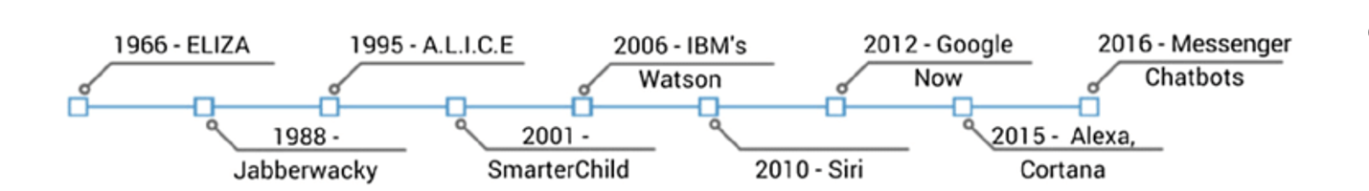
Introduction
Rule-Based Chatbots
Generative

Slide 4
Objective
Build A task oriented conversational model using seq2seq approaches :
without-Attention,
with-Attention,
with-Transfer Learning.
Hello
Hello !! What can I help you with today ?

Slide 5

Previous work
The most successful goal-oriented dialog systems model conversation as partially observable Markov decision processes (POMDP) (Young et al., 2013).
Learning End-to-End Goal-Oriented Dialog(ICLR 2017) by By Antoine Bordes, Y-Lan Boureau, Jason Weston.

Slide 6
Datasets
The bAbI project
The (6) dialog bAbI tasks
dialog-babi-task1-API-calls
dialog-babi-task2-API-refine
dialog-babi-task3-options
dialog-babi-task4-phone-address
dialog-babi-task5-full-dialogs
dialog-babi-task6-dstc2

Slide 7
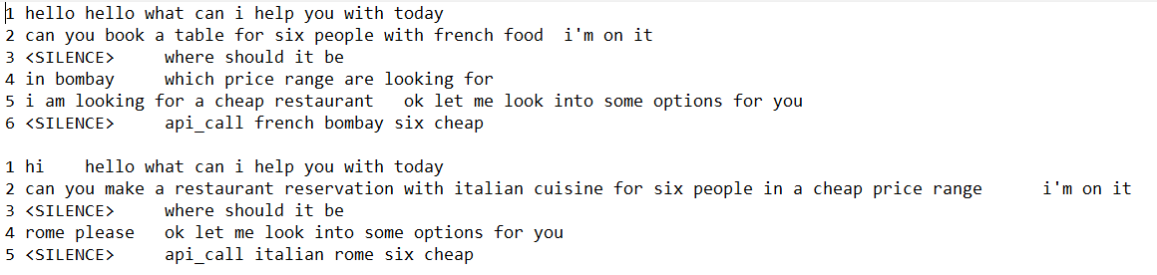

Slide 8
Why NO One-Hot Encoding?
Doesn’t take word order into account.
Fixed sized input/output .
Dummy Variable Trap.
high cardinality, the feature space can really blow up quickly

Slide 9
So Word Embedding
Word embeddings are a type of word representation that allows words with similar meaning to have a similar representation.
Preserves the semantic relationship between words
Efficient size of input/output vectors.
It uses SVD at its core, which produces more accurate word vector representations

Slide 10
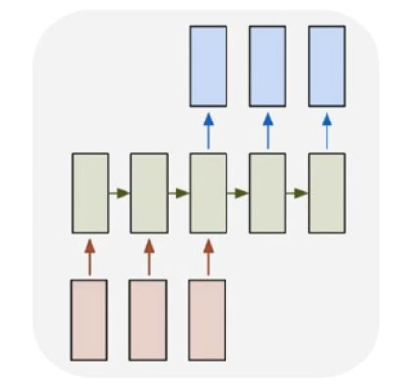
RNN’s
Recurrent Neural Networks(RNN) are a type of
Neural Network where the output from the
previous step is fed as input to the current step.
RNN's are mainly used for, Sequence Classification
i.e., Sequence matters.
RNNs can use their internal state (memory) to
process variable length sequences of inputs
RNNs process variable sized input and output(Architectures).

Slide 11
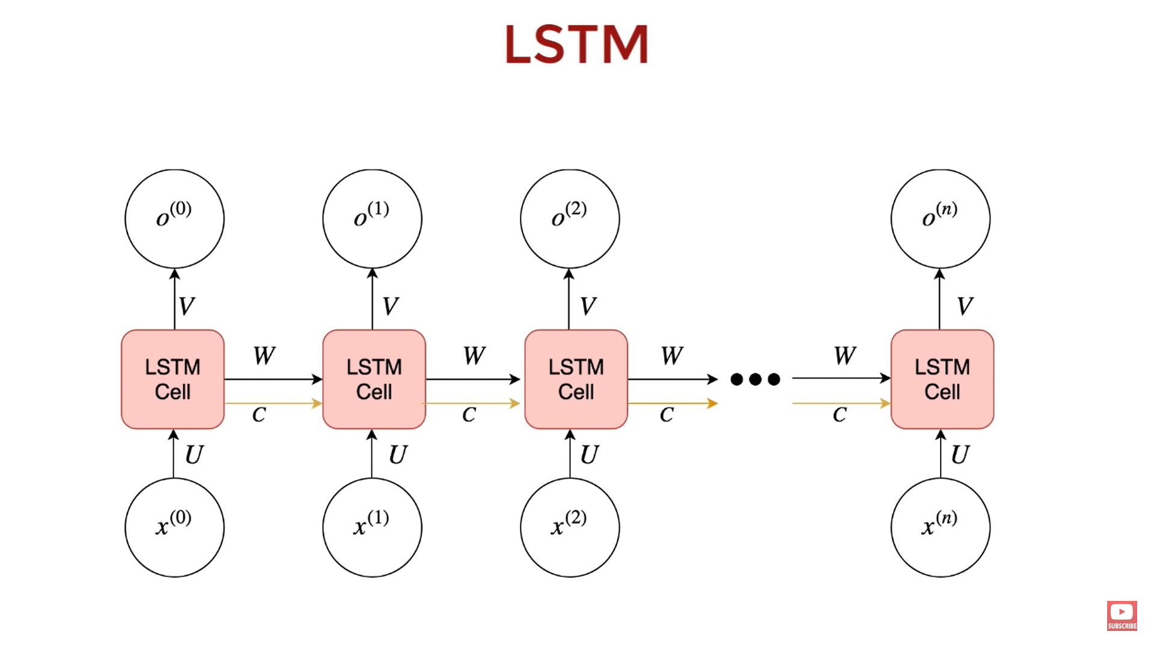
LSTM
A special kind of RNN’s
capable of learning
long-term dependencies.
It can not only process
single data points, but
also entire sequences of
data.LSTM has feedback
connections.

Slide 12
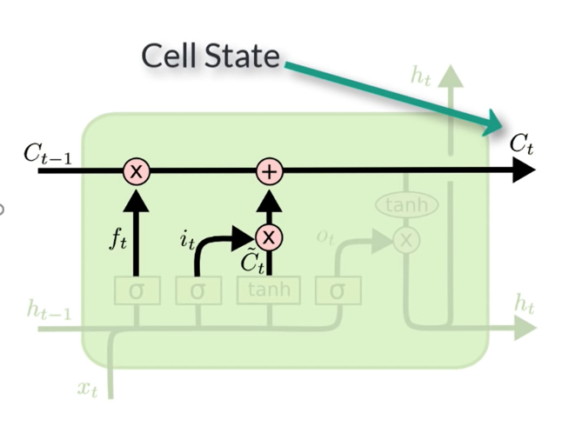
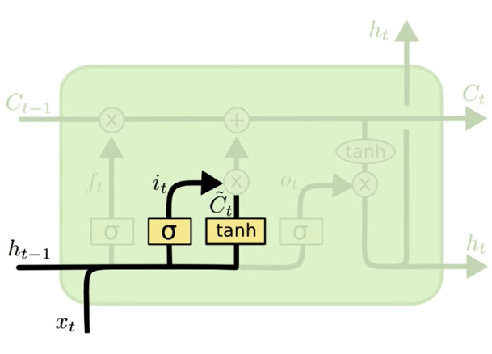
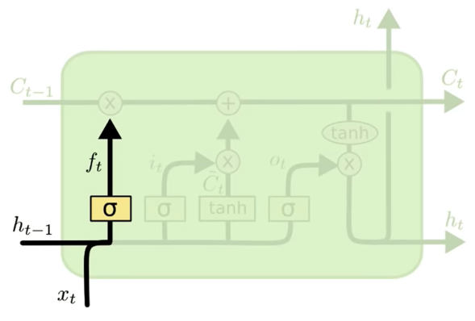
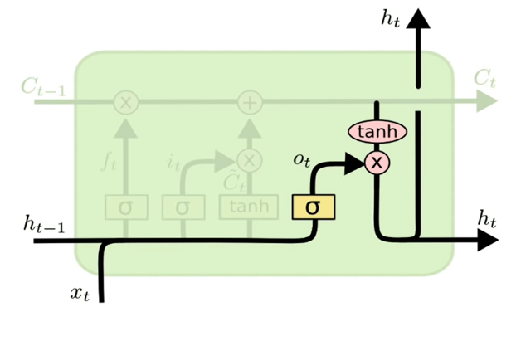

Slide 13
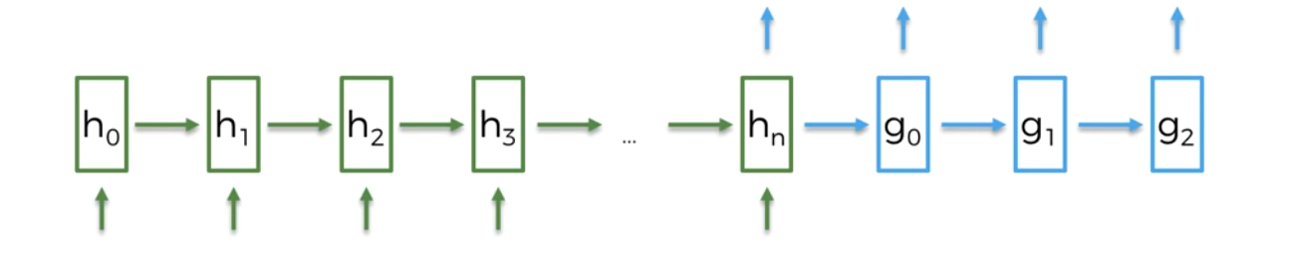
Seq2Seq
seq2seq is a general-purpose encoder-decoder framework for Tensorflow
This can be used for free-from question answering (generating a natural language answer given a natural language question) .
Encoder
Decoder

Slide 14
PRE PROCESSING
STEPS
Splitting Questions , Answers and removing <SILENCE>
Removing Unwanted Symbols like ? , ! And adding <start> and <end> to the end of each sentence
Tokenize
index to word mapping

Slide 15
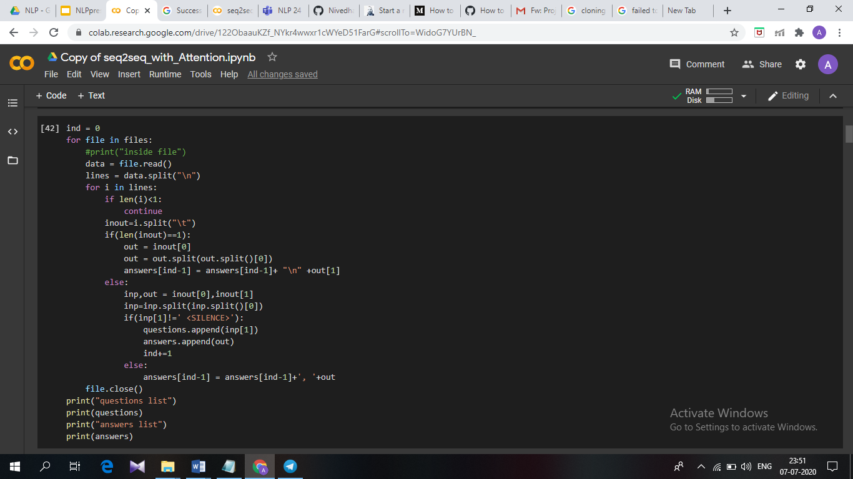
Splitting Questions , Answers
code snippet:

Slide 16
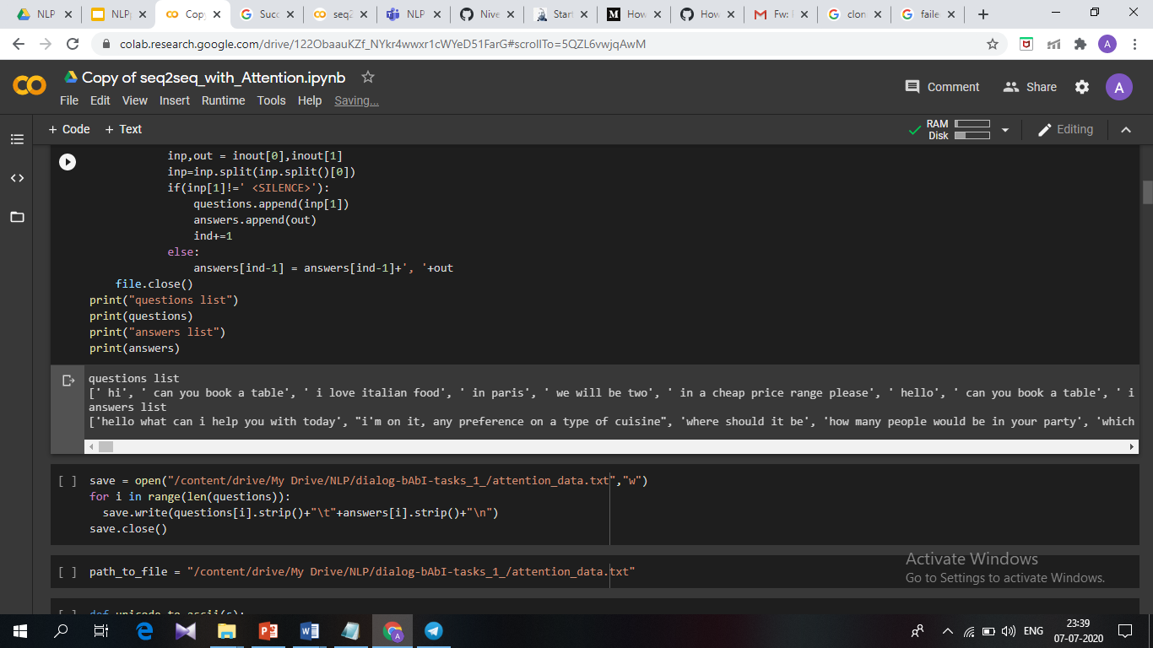
Splitting Questions , Answers
Output:

Slide 17
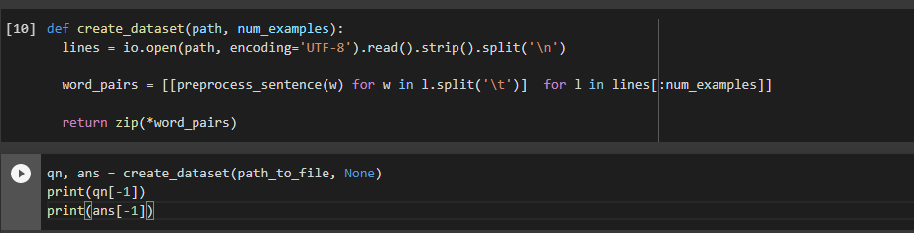
Removing Unwanted Symbols
code snippet: 1.remove the accents
2.clean the sentence
3.return the word-pairs in the format : [questions, answers]

Slide 18
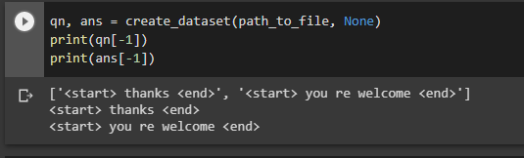
Removing Unwanted Symbols
Output:

Slide 19
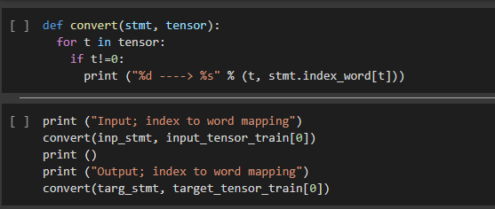
index to word mapping
Code snippet:

Slide 20
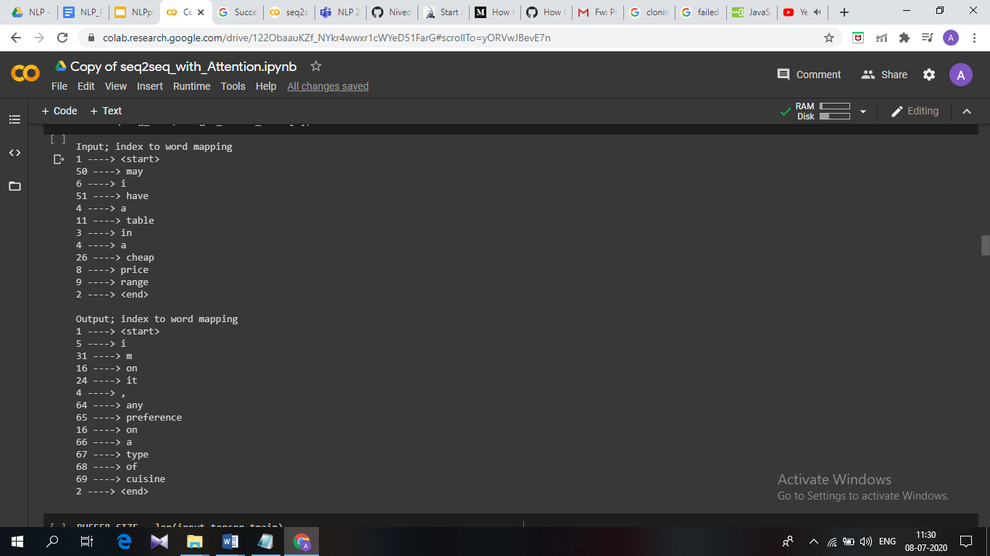
index to word mapping
Output:

Slide 21
Without-Attention
A typical sequence to sequence model has two parts – an encoder and a decoder.
Both the parts are practically two different neural network models combined into one giant network.
Broadly, the task of an encoder network is to understand the input sequence, and create a smaller dimensional representation of it.
This representation is then forwarded to a decoder network which generates a sequence of its own that represents the output.

Slide 22
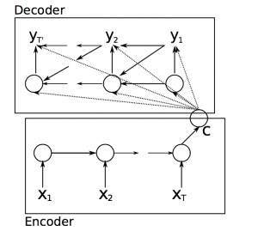

Slide 23
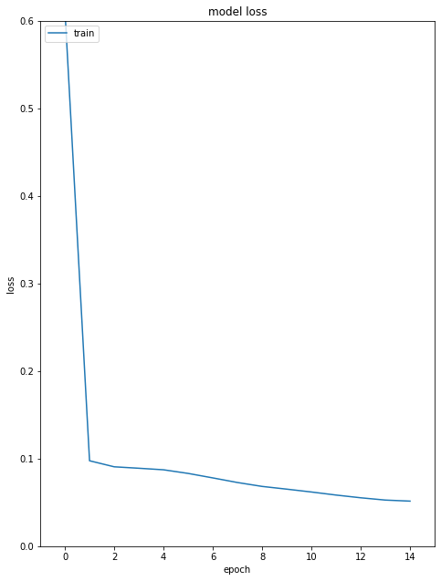

Slide 24
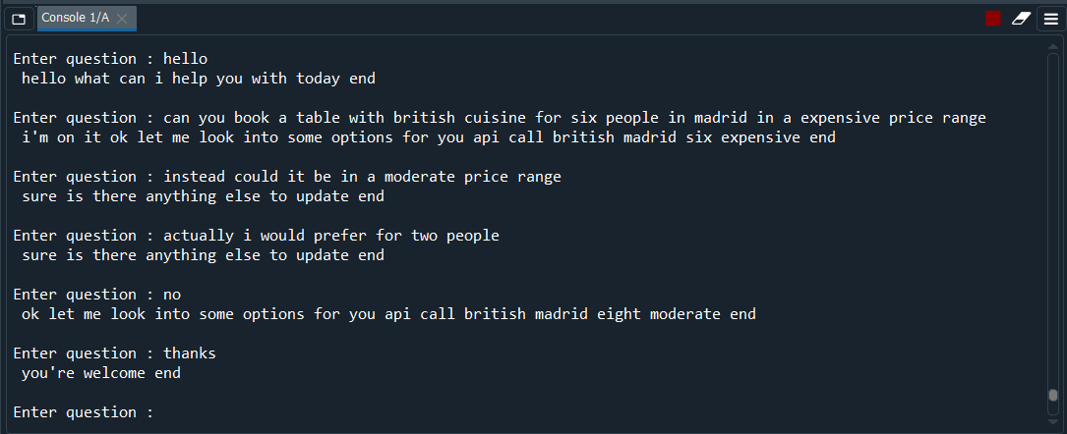
Results of previous work

Slide 25
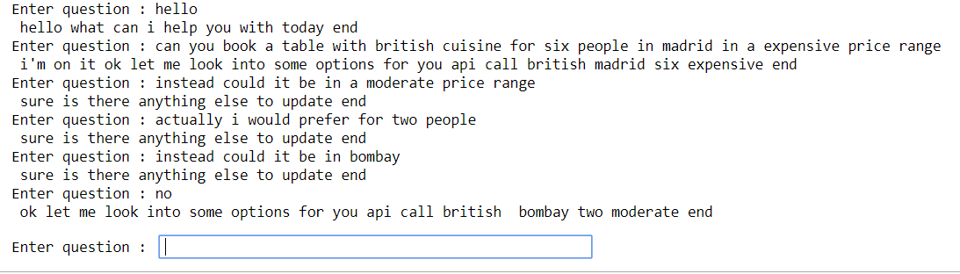
Best Case Results

Slide 26
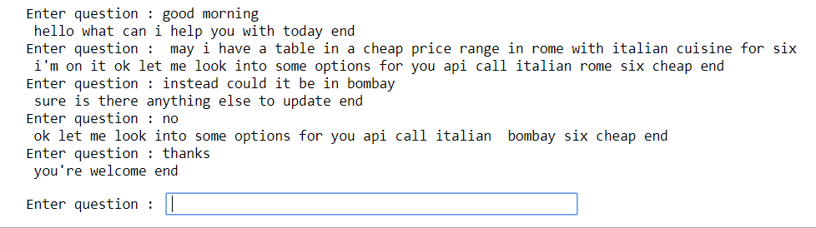
Worst Case Results

Slide 27
Reference
https://research.fb.com/publications/learning-end-to-end-goal-oriented-dialog/
https://arxiv.org/abs/1409.0473

Slide 28
With Attention
The basic idea of Attention mechanism is to avoid attempting to learn a single vector representation for each sentence, instead, it pays attention to specific input vectors of the input sequence based on the attention weights.
At every decoding step, the decoder will be informed how much “attention” needs to be paid to each input word using a set of attention weights.
To implement attention mechanism, we take input from each time step of the encoder – but give weightage to the timesteps. The weightage depends on the importance of that time step for the decoder to optimally generate the next word in the sequence

Slide 29
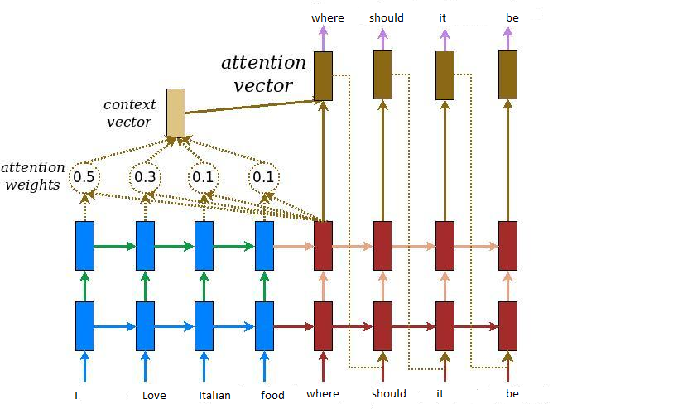
Attention Mechanism Architecture:

Slide 30
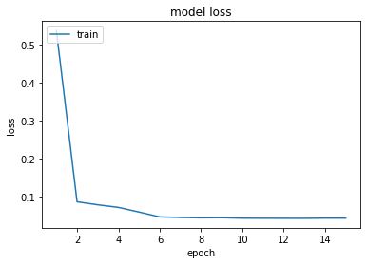

Slide 31
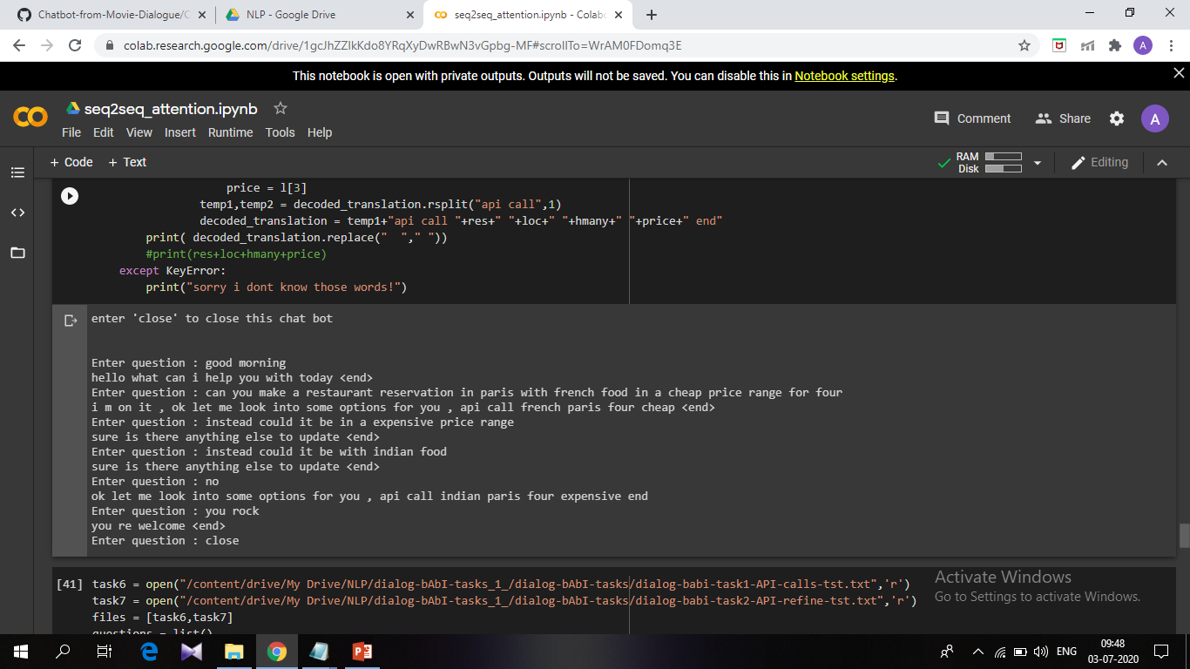
Best Case Results:

Slide 32
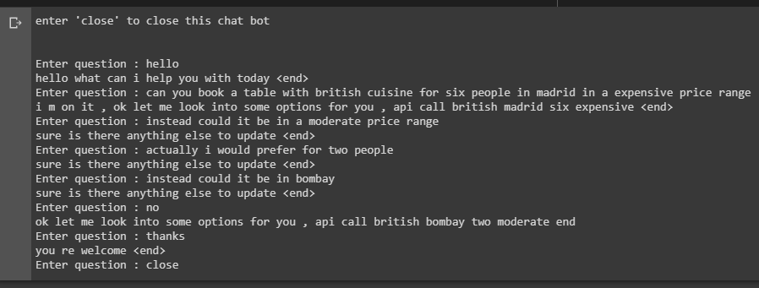
Worst Case Results

Slide 33
References:
https://research.fb.com/publications/learning-end-to-end-goal-oriented-dialog
https://www.tensorflow.org/tutorials/text/nmt_with_attention
https://arxiv.org/pdf/1409.0473.pdf

Slide 34
Overall learning
learned how to develop the encoder decoder model with seq2seq
learnt few nlp techniques to pre-process the data

Slide 35
Accuracy comparison
Accuracy for without Attention - 95.105%
Accuracy for with Attention - 95.115%

Slide 36
Thank You

