Slide 1
CAPSTONE PROJECT
KEY LOGGER AND SECURITY
Presented By:
1. Nivedha – College of Engineering, Guindy – Computer science and Engineering

Slide 2
OUTLINE
Problem Statement
Proposed System/Solution
System Development Approach
Algorithm & Deployment
Result
Conclusion
Future Scope
References

Slide 3
Problem Statement
In today's digital age, where cybersecurity threats loom large, one of the significant concerns is the proliferation of keyloggers, stealthy software tools designed to monitor and record keystrokes on a user's computer without their knowledge. Keyloggers pose a severe threat to individuals and organizations as they can capture sensitive information such as passwords, credit card details, and other personal data, leading to identity theft, financial loss, and privacy breaches.

Slide 4
Proposed Solution
Keystroke Capture:
It listens for keyboard events using pynput.
Stores each keystroke in a list (keys_used).
Distinguishes between pressed, held, and released keys for potential further analysis (though the current code doesn't utilize this distinction).
Data Storage:
Creates two output files:
key_log.txt: Contains a simple text log of all keys pressed in their order.
key_log.json: Stores a JSON-formatted list of keys with additional information about their press/release states (if the key was held down for a while).
Graphical User Interface (GUI):
Employs the tkinter library to build a basic GUI with:
A label displaying status messages.
"Start" and "Stop" buttons to control keylogging functionality.

Slide 5
System Approach
System Requirements
Functional Requirements:
Capture keystroke events (presses and releases) using a library like pynput.
Store captured keystrokes in a designated file format (text or JSON in this case).
Provide a user interface (GUI) for controlling the keylogging process.
The GUI should offer functions to:
Start keylogging.
Stop keylogging.
Non-Functional Requirements:
User-friendly interface with clear labels and functionality.
Reliable keystroke capture with minimal errors.

Slide 6
Libraries and Tools
Keystroke Capture:
The code utilizes the pynput library to listen for keyboard events.
Data Storage:
The code currently stores keystrokes in two files: key_log.txt (plain text) and key_log.json (JSON format). Secure storage methods like encryption are not implemented (important for future enhancements).
User Interface:
The code employs the tkinter library to create a simple GUI with "Start" and "Stop" buttons for controlling keylogging.

Slide 7
Algorithm & Deployment
1. Library Import:
The code starts by importing the necessary library: pynput. This library provides functions to listen for keyboard events on the user's computer.
2. Keystroke Capture Function:
A function named on_press is defined. This function gets called whenever a key is pressed on the keyboard.
Inside the on_press function:
The pressed_key variable stores the information about the pressed key using key.char (for printable characters) or key.name (for non-printable keys like function keys).
The captured key information (potentially including press/release state) is appended to a list named keys_used.
3. Data Storage:
The code defines two functions for storing the captured keystrokes:
write_keys_to_file(keys_used):
This function takes the list of captured keys (keys_used) and writes them to a plain text file named key_log.txt. Each key is written on a separate line.

Slide 8
write_keys_to_json(keys_used):
This function also takes the keys_used list, but it converts it into JSON format and writes it to a file named key_log.json. This JSON file potentially allows for storing additional information about the keystrokes .
4. User Interface (GUI):
The code utilizes the tkinter library to create a simple graphical user interface (GUI).
The GUI consists of a label displaying a message ("Log Started" or "Log Stopped") and two buttons:
"Start": clicking this button starts the keylogging process by calling the on_press function whenever a key is pressed.
"Stop": Clicking this button stops the keylogging process by presumably preventing the on_press function from being called.
5. Main Execution:
The code includes a main function that creates the GUI window and starts the event loop, waiting for user interaction with the buttons.

Slide 9
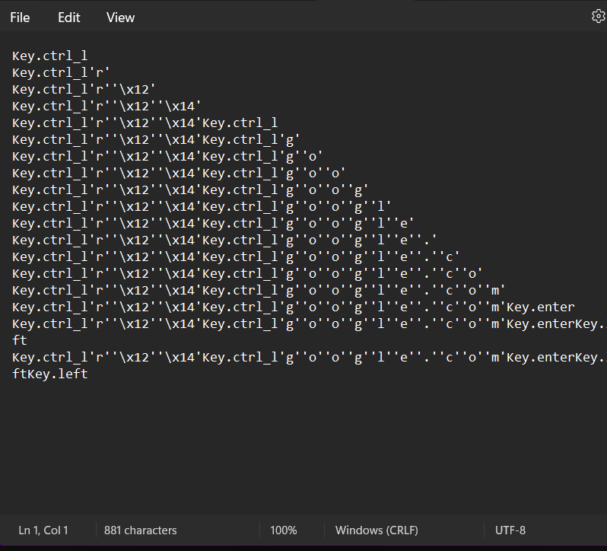
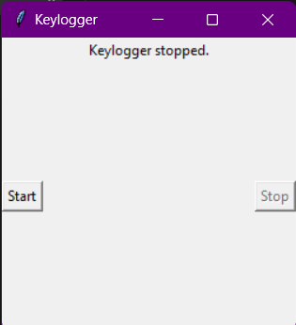
Result

Slide 10
Conclusion
Our project focuses on implementing a basic keylogger using Python and the pynput library.
The keylogger captures key presses, holds, and releases, logging them in both text and JSON formats.
A simple GUI built with Tkinter allows users to start and stop the keylogging process easily.
Key findings include successful implementation of keylogging functionality, user-friendly interface design, and effective file handling for logging keystrokes.
Challenges encountered include potential detection by antivirus software and limited error handling.
Potential improvements include enhanced logging features, better error handling, and considerations for security and cross-platform compatibility.
Overall, our project provides insights into keylogging techniques, their applications, and ethical considerations surrounding their use.

Slide 11
Future scope
Focus on Ethical Enhancements:
Prioritize user consent, data security (encryption, access controls), and transparency.
Improve Core Functionality:
Implement secure storage for captured keystrokes.
Integrate user management and logging control options (if ethically justifiable).
Data Analysis :
Explore feature engineering, data preprocessing, and anonymized machine learning for specific analysis goals.
Emerging Technologies:
Investigate edge computing for privacy-preserving analysis (if applicable).
Explore advanced machine learning techniques cautiously, prioritizing user consent and privacy-preserving methods.

Slide 12
References
Rai, S., Choubey, V., & Garg, P. (2022, July). A Systematic Review of Encryption and Keylogging for Computer System Security. In 2022 Fifth International Conference on Computational Intelligence and Communication Technologies (CCICT) (pp. 157-163). IEEE
Joy, J., Rajaram, V., Aditya, A. R., & Pandimurugan, V. (2023, December). Developing Advanced Software Keylogger using Python and Creating Awareness of their Functionalities. In 2023 2nd International Conference on Automation, Computing and Renewable Systems (ICACRS) (pp. 1551-1557). IEEE
Shirke, A., Pawar, R., Bivalkar, M., Waghela, H., & Shah, Z. (2023, December). Advance Keylogger–Capturing Keystrokes. In 2023 6th International Conference on Advances in Science and Technology (ICAST) (pp. 250-255). IEEE.
Bejo, S. P., Kumar, B., Banerjee, P., Jha, P., Singh, A. N., & Dehury, M. K. (2023, March). Design, Analysis and Implementation of an Advanced Keylogger to Defend Cyber Threats. In 2023 9th International Conference on Advanced Computing and Communication Systems (ICACCS) (Vol. 1, pp. 2269-2274). IEEE.
Ahmed, M. B., Shoikot, M., Hossain, J., & Rahman, A. (2019). Key logger detection using memory forensic and network monitoring. International Journal of Computer Applications, 975, 8887.
Parekh, D. H., Adhvaryu, N., & Dahiy, V. (2020). Keystroke Logging: Integrating Natural Language Processing Technique to Analyze Log Data. International Journal of Innovative Technology and Exploring Engineering (IJITEE), 9(3), 2028-2033.

Slide 13
THANK YOU

