Slide 1
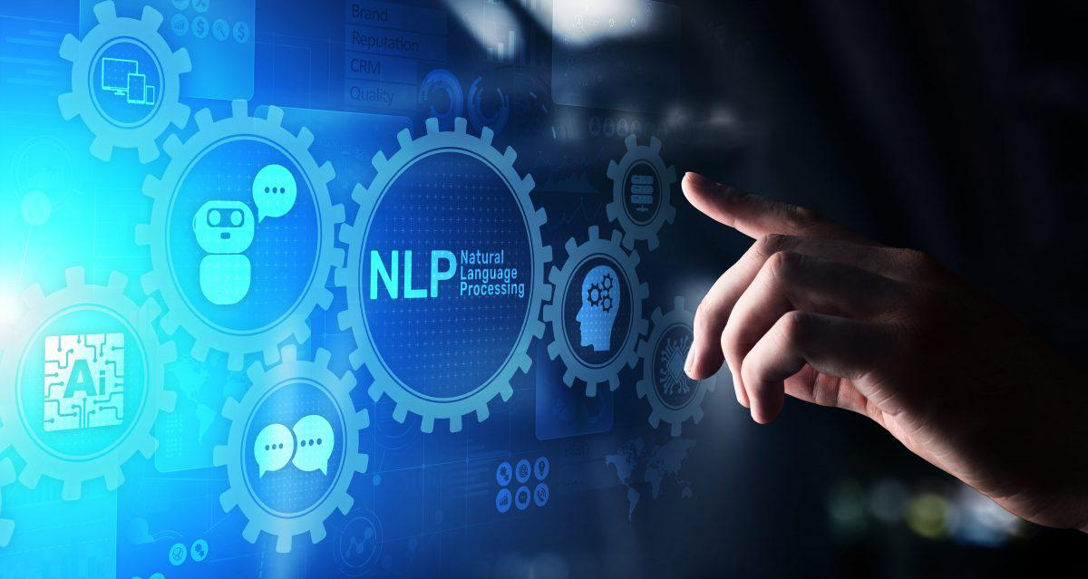
Monoclonal Antibody Treatment
Nivedha Radhakrishnan
NLP Text mining and Sentimental Analysis

Slide 2
Problem Statement
Monoclonal antibodies (mAbs) are highly effective in treating mild to moderate COVID-19 among non-hospitalized patients. We are asked to perform the following tasks:
1. Scrape data related to monoclonal antibody treatment from any of the social media platform like facebook, twitter or reddid
2. Perform sentiment analysis and label positive and negative comments
3. Fetch the key words that are most used across platform
4. Fetch the influencers and their geography
5. Provide insights obtained using visualization

Slide 3

Table of contents
Approach
Fetch Tweets and Sentiments
Pre-Processing
Key Words
Key Phrase
Visualization
Feature Extraction
Model Building

Slide 4
Approach
The problem will be approached with the following steps:
1. Web Scraping from Twitter
2. Use Wordcloud to display the key topics of discussion
3. Determine the sentiments associated to monoclonal antibody treatment for covid patients using textblob.
4. Label the sentiments as positive and negative using a Naive Bayes Classifier
5. Visualization plot of the Influencers,Organizations,Groups and Geography

Slide 5
Fetch tweets and sentiments
Tweets
Using tweepy library I scraped data from twitter. To authenticate my credentials I used the customer key , customer secret, access key and access secret generated from twitter dev platform. I stored the fetched data in a Dataframe
Sentiments
I used the textblob library to fetch the sentiments using the Dataframe created.

Slide 6
Pre-processing
Key words
Pre-processing step | Description
Removing names | The names that are tagged with an @ and the string ‘RT’ (retweet) are removed
Removing links | The links with tag ‘http’ and ‘https’ are removed
Removing spaces | Empty spaces in the text are removed
Removing punctuations, special characters and numbers | Punctuation, numbers and Special characters are removed
Removing stop words | Stop words are words that have lesser correlation to the context. They are removed
Tokenisation | Tokenisation breaks the text into small chunks
Lemmatization | Lemmatization replaces the word to with its root word or a similar word
Joining the tokens | The tokens are joined into a sentence
Dropping rows | The duplicate texts are dropped
Resetting the index | Index should be reset as we drop rows

Slide 7
Pre-processing
Key phrase
Pre-processing step | Description
Lemmatization | Lemmatization replaces the word to with its root word or a similar word
Stemming | Same as Lemmatization but does not use vocabulary or morphological analysis while deriving the root word
Case normalisation | Convert all the text to either lower or upper case
Length Optimization | Check if the length of the phrase is within the given limit
Define the grammar | Provide the constraints that the phrase should have

Slide 8
Visualisation
I used Wordcloud library to display the positive and negative key words and used sns library to plot the histogram of hastages and influencers.

Slide 9
Feature Extraction
Feature Extraction is done using two methods namely the following,
1. Bag of words (simple vectorisation)
2. TF-IDF (Term Frequency - Inverse Document Frequency)

Slide 10
Model Building
To perform the sentiment analysis I built a model using Naive bayes algorithm using the features extracted from the Bag of words and the TF_IDF methods and based on key words and key features. The accuracy score obtained using the confusion matrix infers that the Bag of words model based in key words gives the best accuracy. Hence the same can be used for model building

Slide 11


