Slide 1
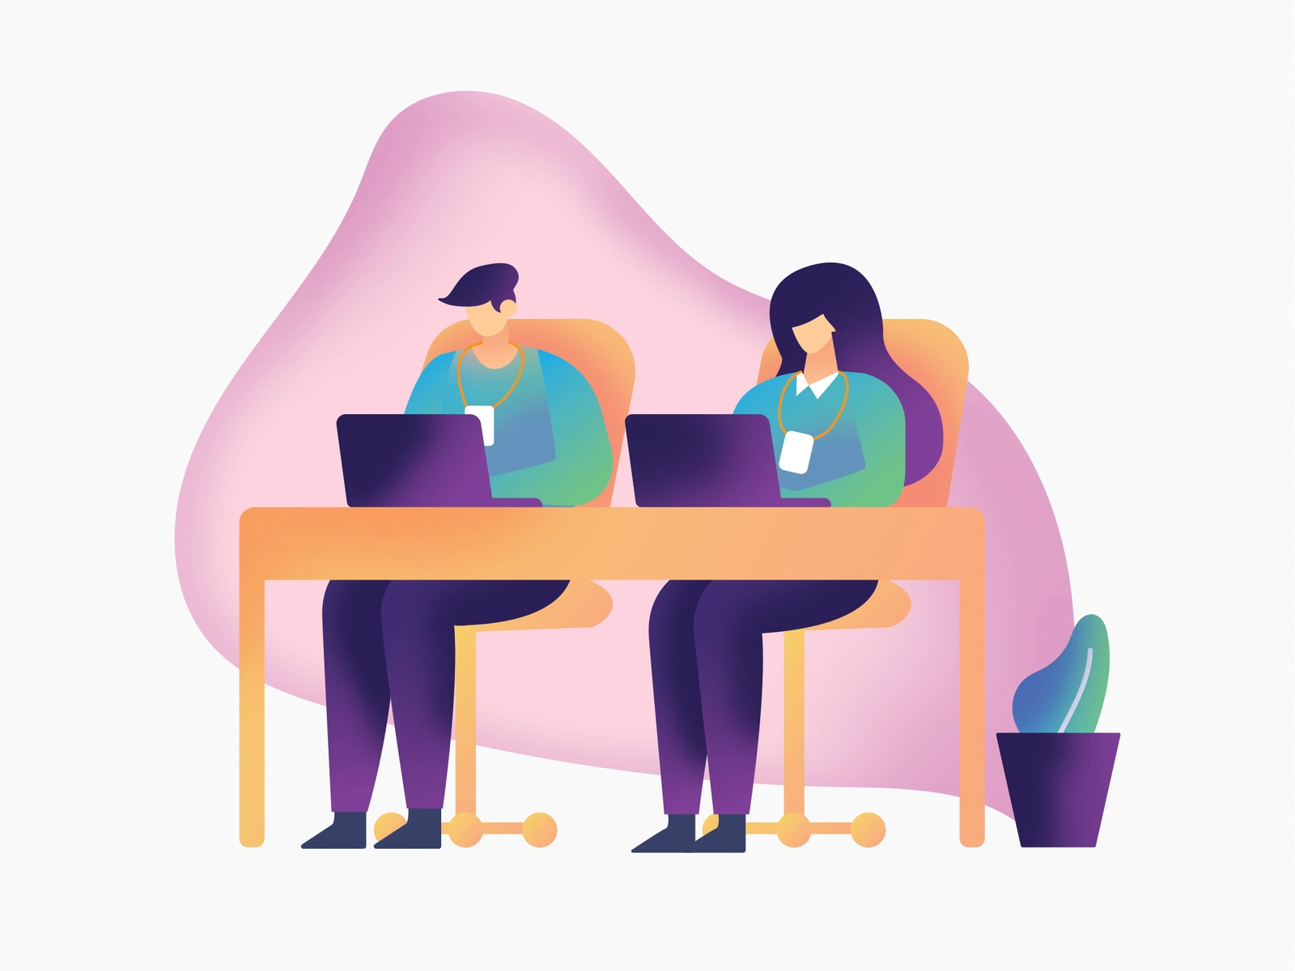
Study buddy
Joel Bellapurla
Nivedha Kuzhandai Velu
Ashwin Korra
Sriniketh Sowmithri

Slide 2
Objective
The main objective of the project is to bridge the students On-campus.
This web application is designed using JavaScript, HTML, CSS and Firebase.
Using this application, students can find a study partner inside the campus with the available time.

Slide 3
Requirements
User account
Any user can search a study buddy for one subject at a time.
The user is able to see the contact details of the study buddy and also their available timings.
The results are displayed through a effective search .
Also able to see the results which are relevant.

Slide 4
Working Model - Homepage
The user should be able to create a account
Credentials : user name, email id, password.
The user should be able to log in into the application using valid credentials.
Credentials : email and password

Slide 5
Need a Buddy
As a valid user, the user should be able to search their buddy with valid course name, available day and timings.
Every fields in the Need a Buddy page is validated using certain conditions .
If the buddy is not available in the timings requested, the suer should be able to see the Buddies list in the relevant or closest timings.

Slide 6
I am a Buddy
Every valid user can register himself as a Buddy using a valid username, course, available day and timings, also the contact details.
Every field is validated using certain conditions based on a criteria.

Slide 7
Database - Firebase
When a user registers, every user has their own user id , which will be stored in the authentication page.
When a user enters , the valid data in Need a Buddy or I am a Buddy page, will be stored in our realtime database, “Firebase”.

Slide 8
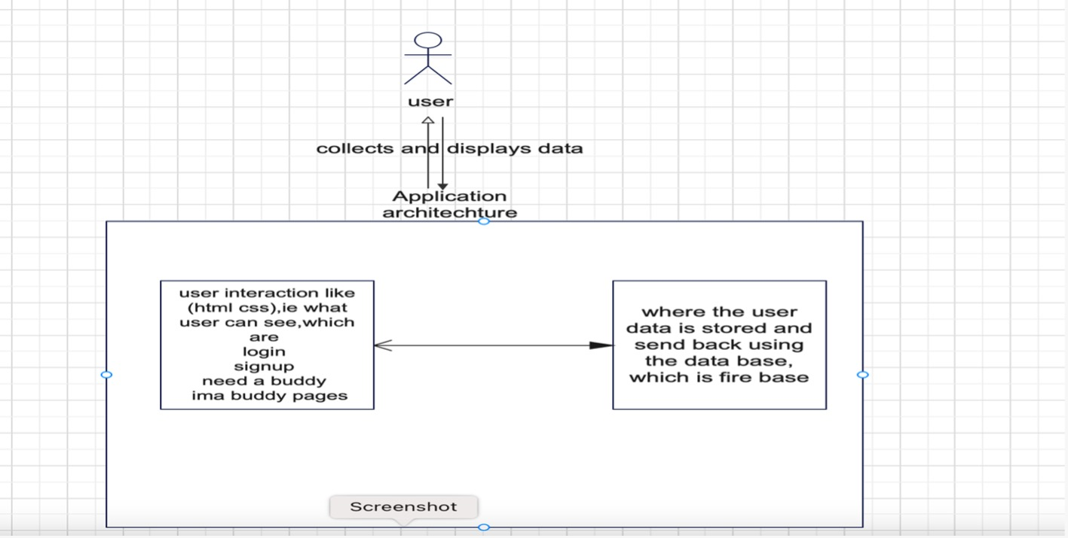
Use case Diagram

Slide 9
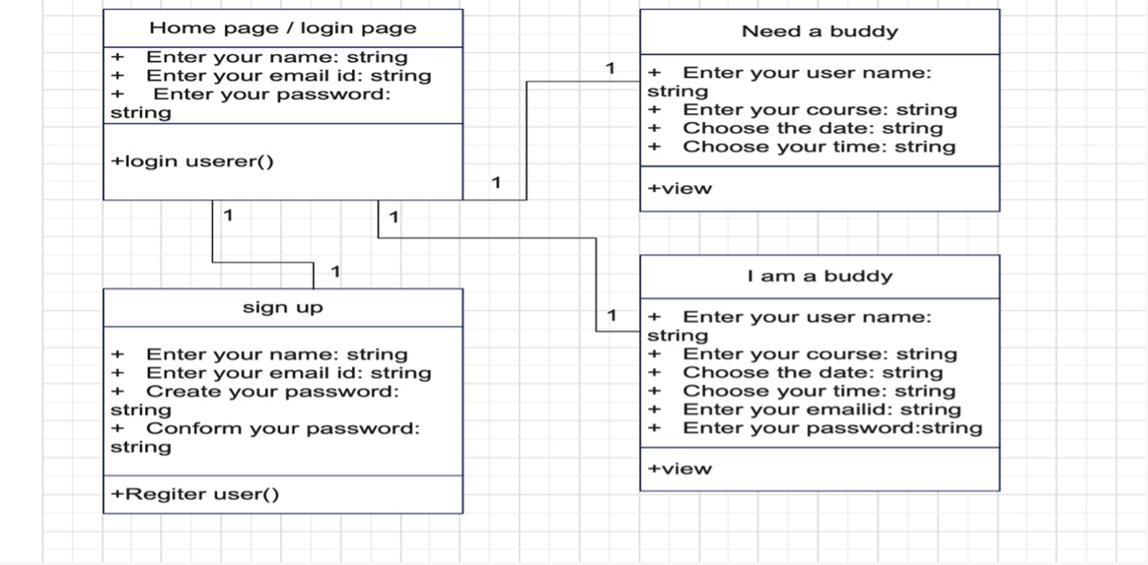
Class Diagram

Slide 10
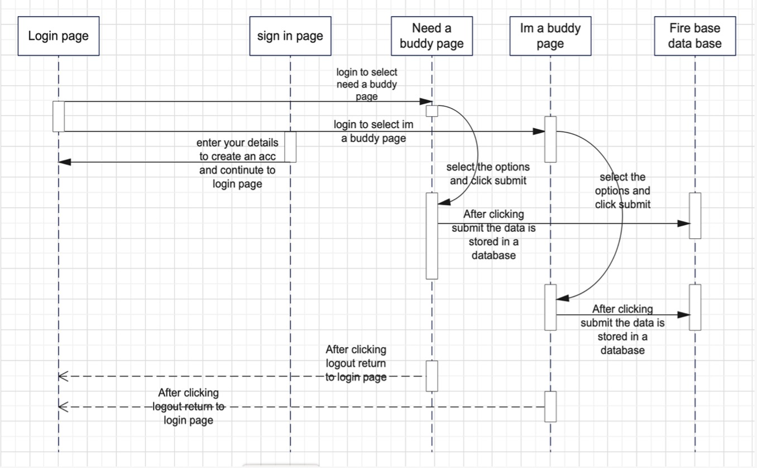
Sequence Diagram

Slide 11
Testing
The testing methods , we used here is Manual and Functional Testing.
Through manual Testing, we have tested whether every field is working and the UI corrections.
Through Functional testing, we have tested whether our functionalities in “Need a Buddy” and “I am a Buddy page” are working fine.
And the functionality of “Submit” Button is working fine, in such a way that it retrieves output from the database.

Slide 12
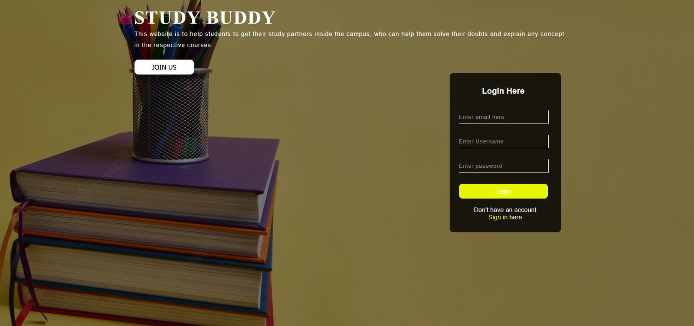

Slide 13
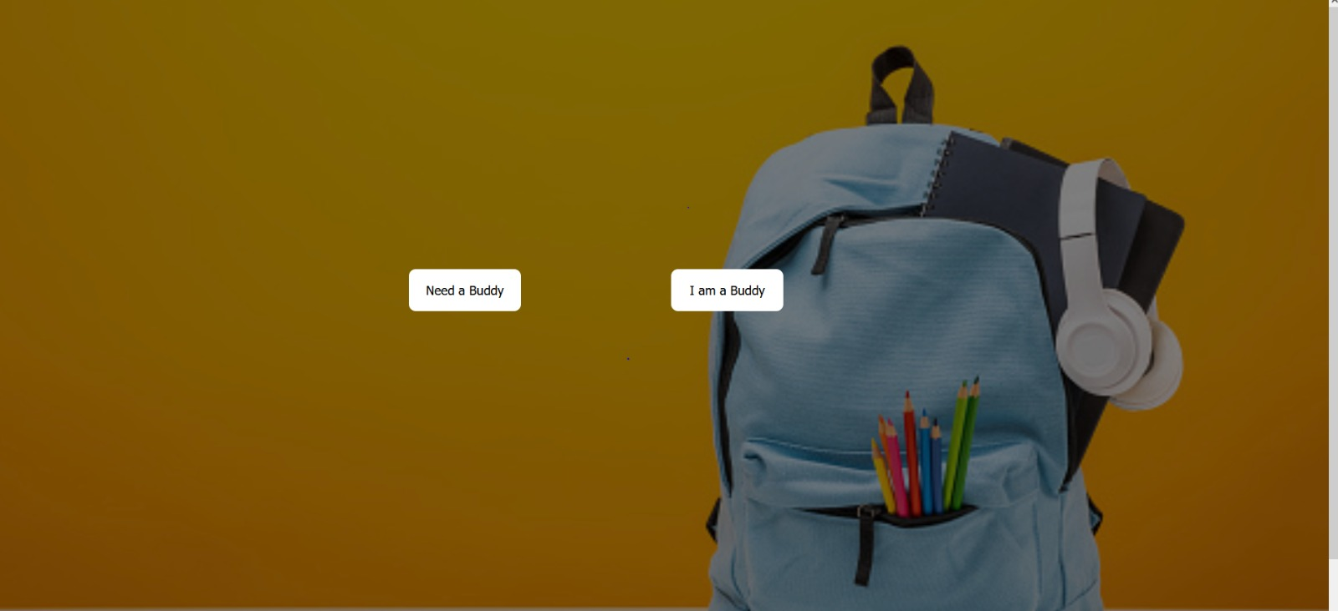

Slide 14
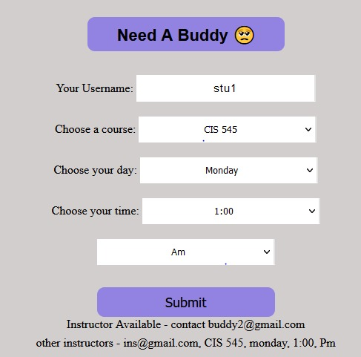

Slide 15
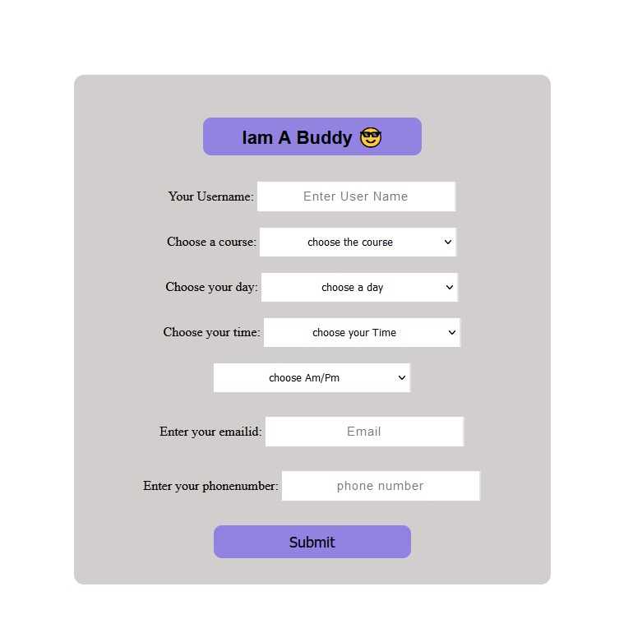

Slide 16
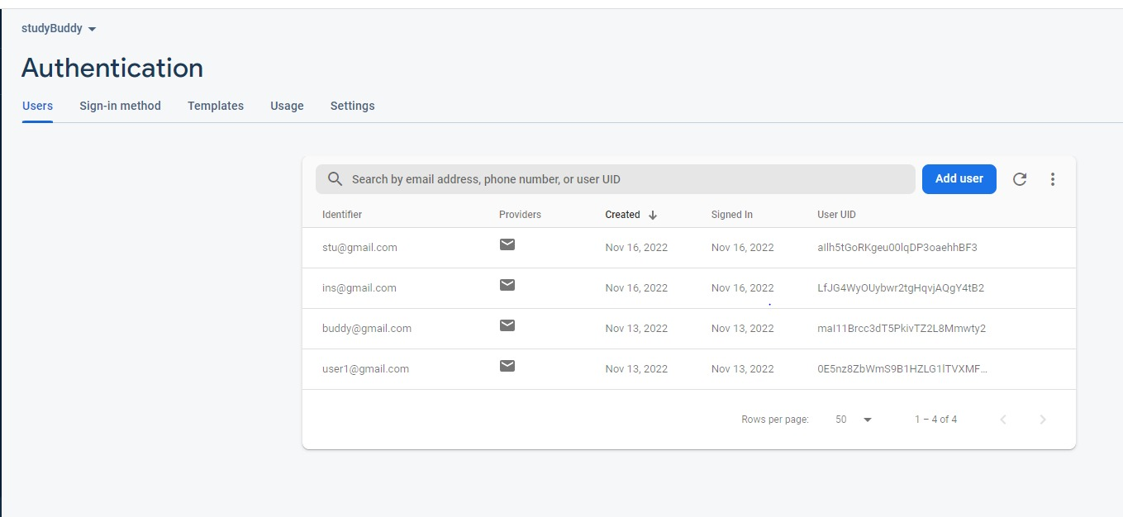

Slide 17
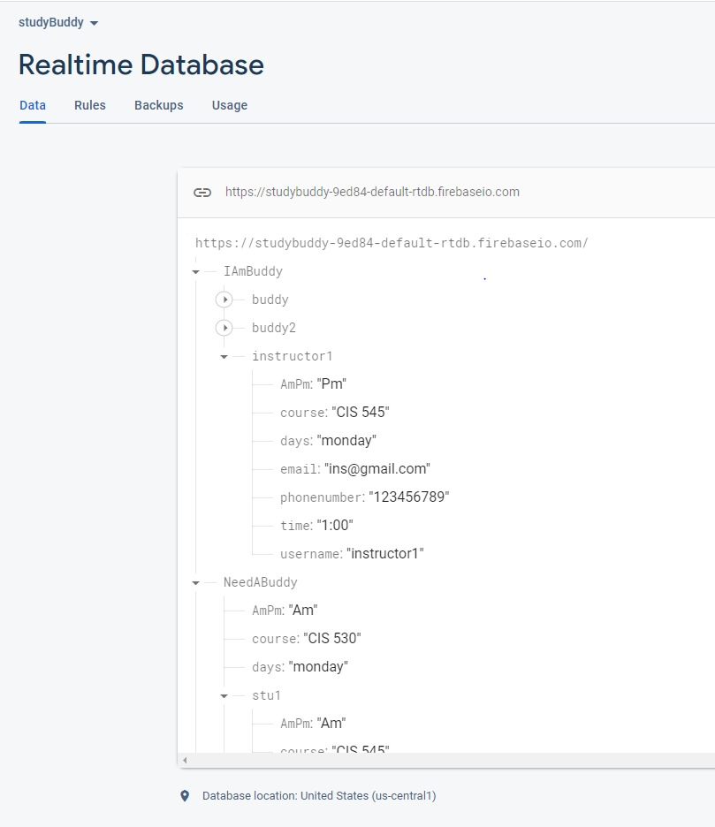

Slide 18
FUTURE WORK

Slide 19
Thank you !!

