Slide 1
AlphaZero
The Effects of a Deep Reinforcement Learning Model on the Chess World

Slide 2
Background
1996: IBM Deep Blue loses to world champion Garry Kasparov 2-4
1997: IBM Deep Blue defeats Kasparov 3.5-2.5
2002: Deep Fritz draws world champion Vladimir Kramnik 4-4
2006: Deep Fritz defeats Kramnik 4-2
Around this point, chess engines become insurmountable for human masters
2017: AlphaZero plays a match against top chess engine Stockfish 8

Slide 3
Pre-AlphaZero chess engines
Brute force search
Evaluate all possible positions and score them for advantage
Make the move that is most advantageous
Opening / endgame tables
Some optimizations possible to improve search

Slide 4
Why is AlphaZero different?
Uses deep reinforcement learning
Agent in an environment reinforces positive behavior with rewards and eventually
Trained against itself for 24 hours
“Training proceeded for 700,000 steps (mini-batches of size 4,096) starting from randomly initialised parameters, using 5,000 first-generation TPUs (15) to generate self-play games and 64 second-generation TPUs to train the neural networks.”

Slide 5
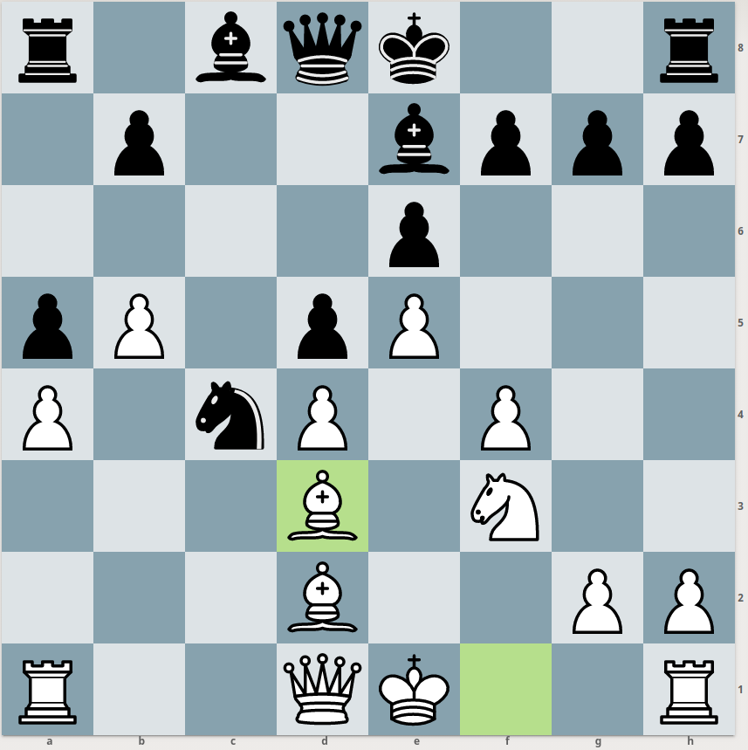
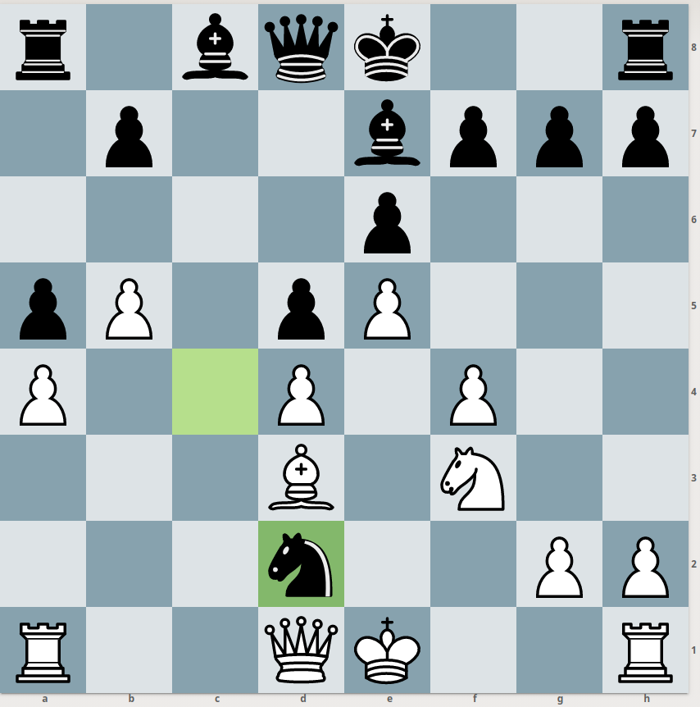
How to recapture?

Slide 6
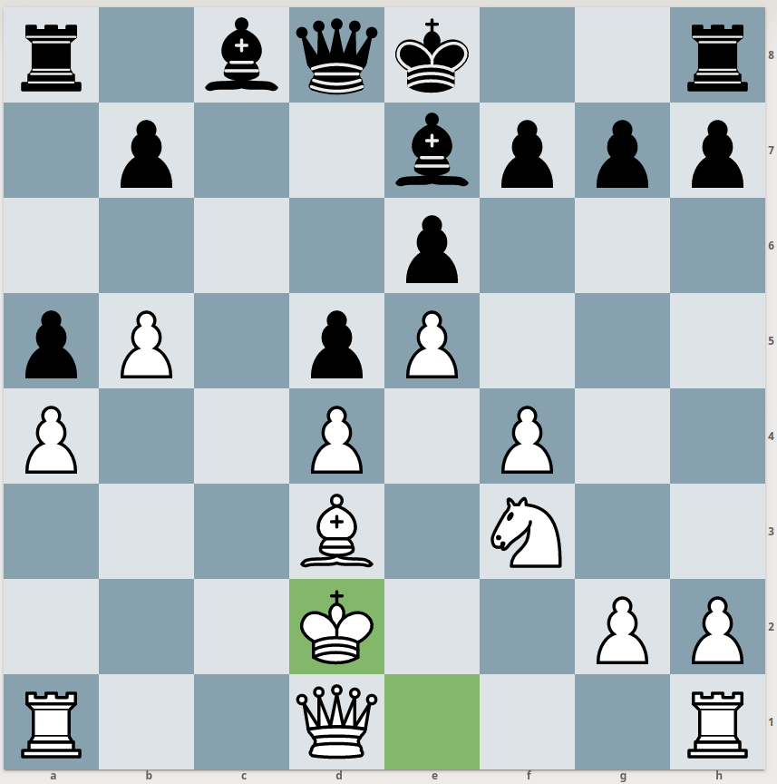
Neglecting principle of king safety for center control

Slide 7
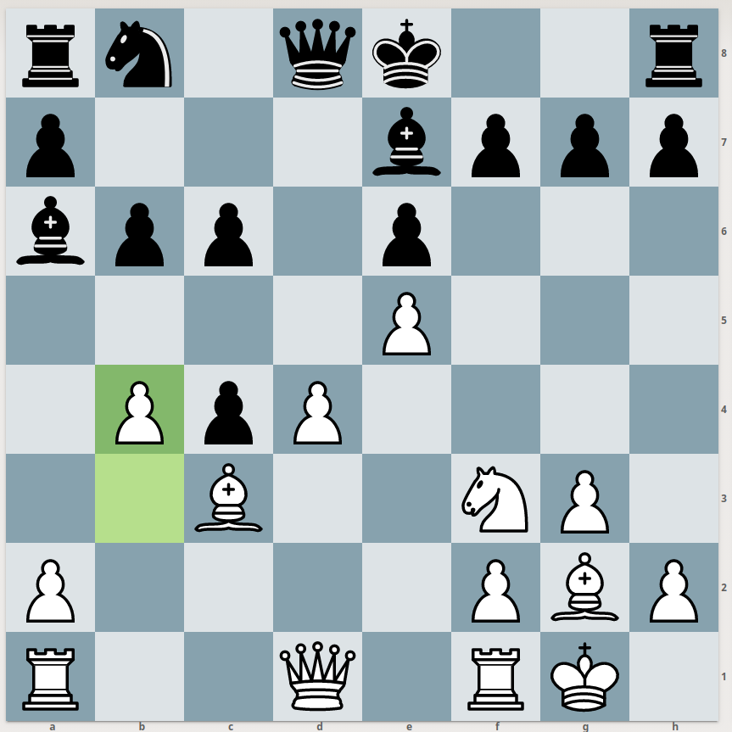
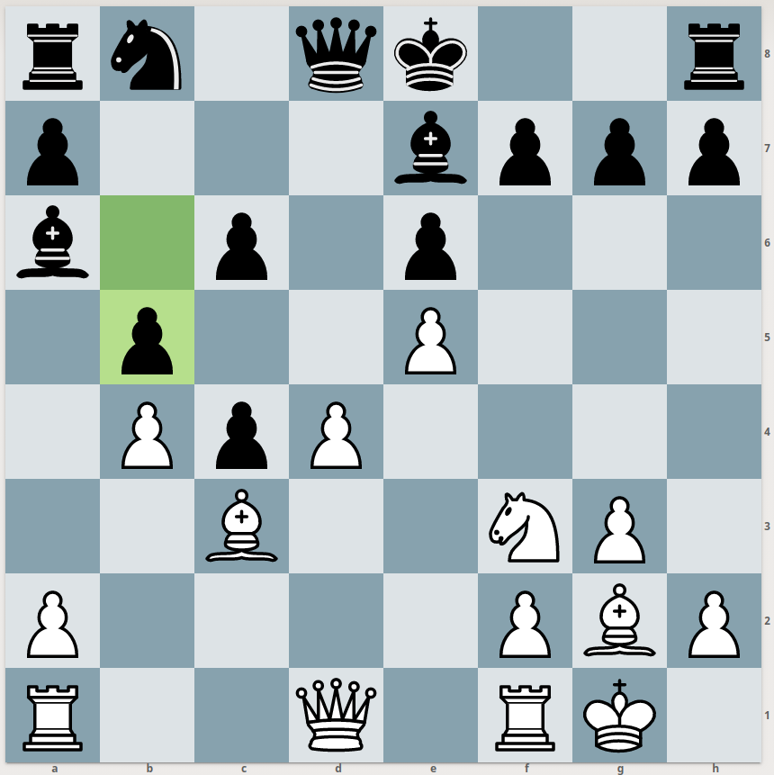
Restricting enemy pieces’ movement

Slide 8
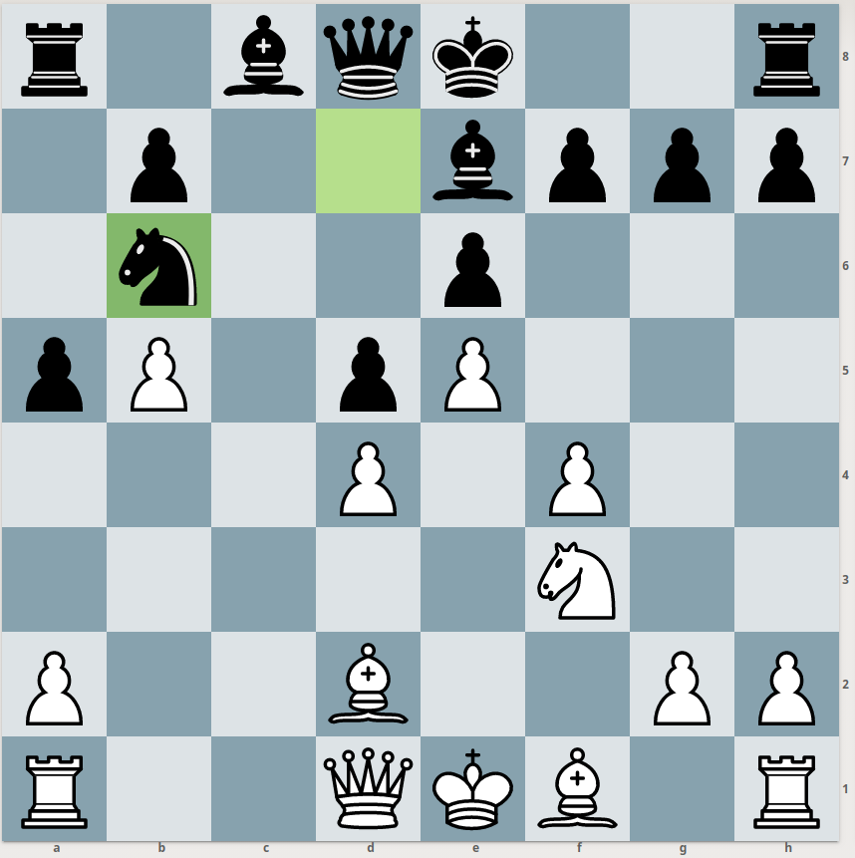
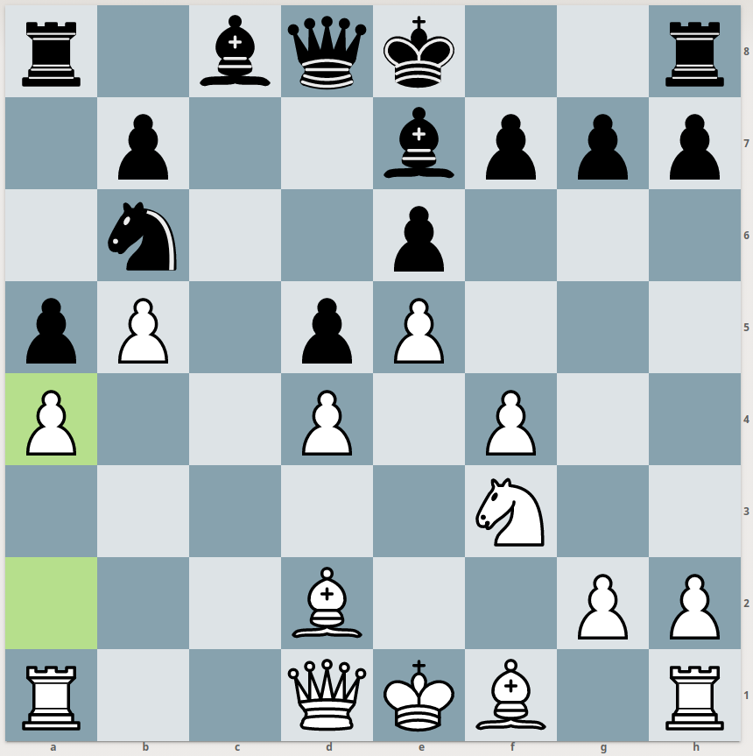
Restricting enemy pieces’ movement

Slide 9
Results:
Stockfish 8 looks at 70,000,000 positions per second
AlphaZero: 80,000 positions per second
Yet AlphaZero won the match
28 wins, 72 draws, 0 losses
The result was disputed by some in the chess community
Rematch one year later: 155 wins, 839 draws, 6 losses

Slide 10
Most recent paper: variant evaluation
AlphaZero playing itself in chess, but with new rules
Determine how balanced those rules are
“An analytic comparison show that pieces are valued differently between variants, and that some variants are more decisive than classical chess.”
Would be much harder to evaluate without intelligent system

Slide 11
Questions to prompt some discussion:
What would be a possible “non-gamification” of AlphaZero? i.e. an application that is beneficial somewhere in society / industry
Training AlphaZero required extremely large amounts of compute, which researchers only had access to because they worked for Google. What would have to happen for these kinds of models to become usable to smaller organizations?
Does a deep RL model like AlphaZero threaten the “worth” of games such as chess, go, and checkers?

