Slide 1
Reinforcement Learning for COVID-19 Optimization Problems
October 13, 2020
Reading Group
Presenter(s): Nikhil Devraj

Slide 2
Huh?

Slide 3
Quick RL Overview

Slide 4
What is RL?
We want a control agent to interact with a system using trial and error in order to control some attribute of the system
Agent outputs a policy function: mapping from system state to action
Policy function is optimal with respect to a given reward function

Slide 5
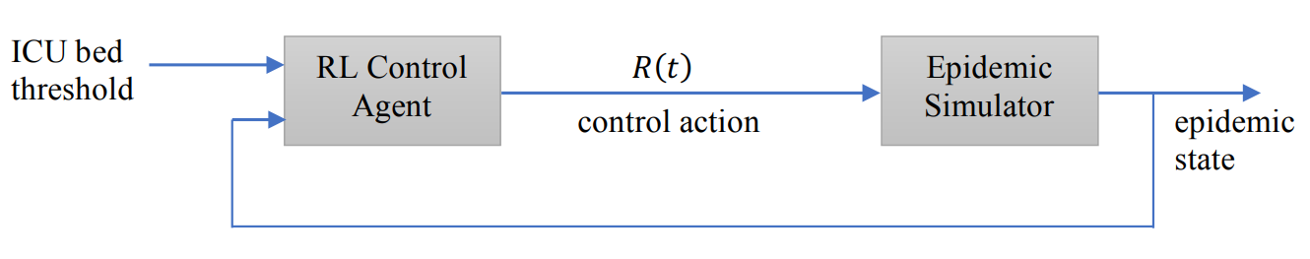
Example
System variable: Number of ICU beds in use
Actions: Enforce lockdown, lift lockdown

Slide 6
COVID-19 Optimization Problems

Slide 7
Cyclic Lockdown
[1]: COVID-19 Pandemic Cyclic Lockdown Optimization Using Reinforcement Learning

Slide 8
Cyclic Lockdown Motivation
Governments may need to enforce and lift lockdown in cycles, because they can't sustain prolonged lockdown
Want to figure out how long we can lock down or keep things open

Slide 9
Problem Formulation

Slide 10
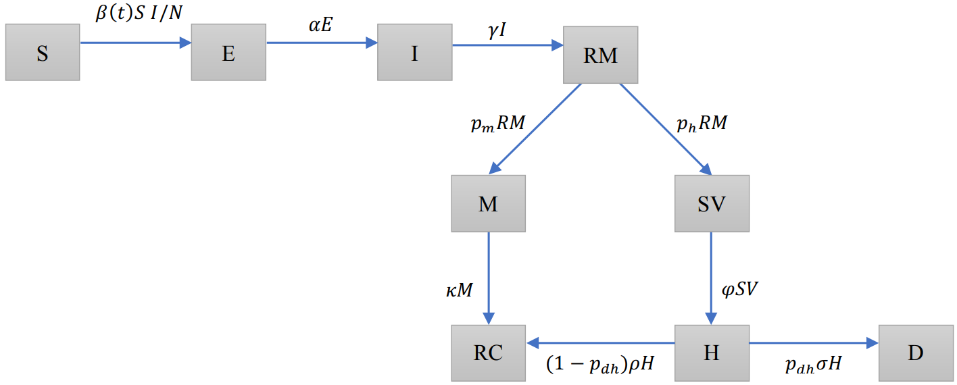
Epidemic Simulator
SEIR Model ((S)usceptible, (E)xposed, (I)nfected, (R)ecovered)

Slide 11

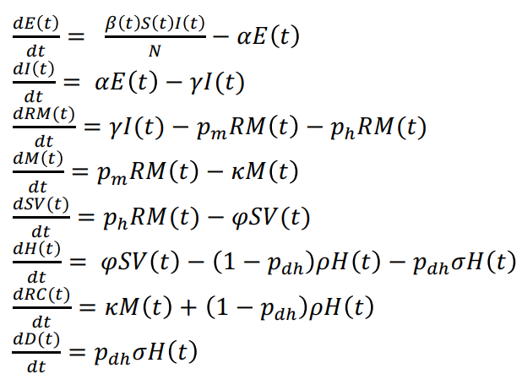
Epidemic Model Definition
Patients divided into groups and transition
Modeled as a system of differential equations
Don't worry about these too much
B(t) is time-dependent transmission-rate: this begets dynamics!

Slide 12
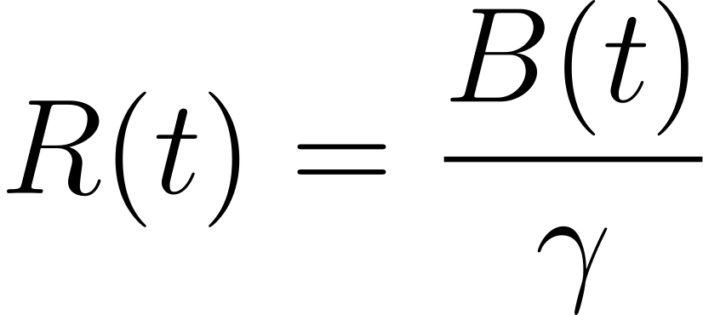
Effective Reproduction Number as Action
R(t): average number of people an infected individual infects (called the effective reproduction number)
R(t) > 1: epidemic expanding
R(t) < 1: epidemic declining

Slide 13
Reinforcement Learning Agent
Online RL setting: agent starts with random policy, observes state, acts on system, gets feedback, updates, and continues
Observed state: number of people infected I(t)
R(t) possibilities
open: non-lockdown interventions such as mandatory masks
closed: stay-at-home, school closures, etc.

Slide 14

DDQN (Double Deep Q-Network)
Neural network approximation of Double Q-Learning (Hasselt, 2010)
Idea: Agent updates some representation of (state, action) pairs with values that maximize "reward"
SEARCH IT UP
Bellman equation
Q-update (regular Q-learning)

Slide 15
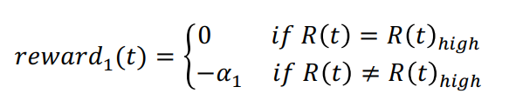
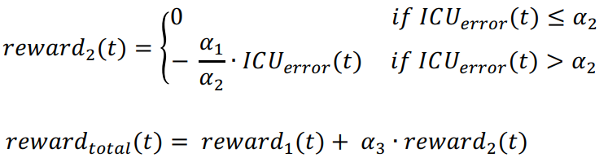
Reward Function
Want number of ICU beds in use to be as close to the threshold as possible

Slide 16
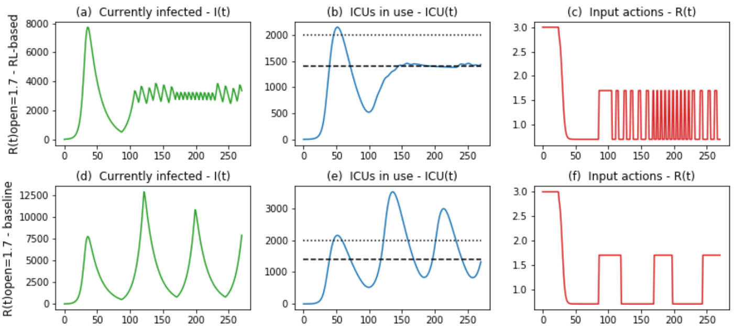
Some results

Slide 17
Recommendations for applying RL control
Measure current R(t) and call it R(t)_{open}. R(t)_{closed} is the lowest average R(t) measured during initial lockdown

Slide 18
Recommendations for applying RL control
Measure current R(t) and call it R(t)_{open}. R(t)_{closed} is the lowest average R(t) measured during initial lockdown
Select ICU limit

Slide 19
Recommendations for applying RL control
Measure current R(t) and call it R(t)_{open}. R(t)_{closed} is the lowest average R(t) measured during initial lockdown
Select ICU limit
Train a model and get a policy

Slide 20
Recommendations for applying RL control
Measure current R(t) and call it R(t)_{open}. R(t)_{closed} is the lowest average R(t) measured during initial lockdown
Select ICU limit
Train a model and get a policy
Run it on simulations for multiple days (time steps t) during which multiple lockdown cycles occur

Slide 21
Recommendations for applying RL control
Measure current R(t) and call it R(t)_{open}. R(t)_{closed} is the lowest average R(t) measured during initial lockdown
Select ICU limit
Train a model and get a policy
Run it on simulations for multiple days (time steps t) during which multiple lockdown cycles occur
The R(t) produced by the agent during these simulations is used to determine length of openings and closures during a lockdown cycle

Slide 22
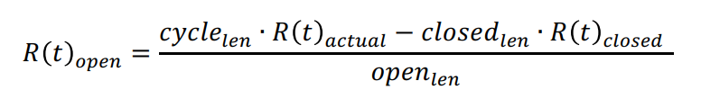
Recommendations for applying RL control
Measure current R(t) and call it R(t)_{open}. R(t)_{closed} is the lowest average R(t) measured during initial lockdown
Select ICU limit
Train a model and get a policy
Run it on simulations for multiple days (time steps t) during which multiple lockdown cycles occur
The R(t) produced by the agent during these simulations is used to determine length of openings and closures during a lockdown cycle
Adjust R(t) as necessary:

Slide 23
Overall for cyclic lockdowns:
Approach with recommendations for RL-based control system, optimizing:
ICU beds (helps achieve maximum utility of resources without overshooting)
Time spent under lockdown (socioeconomic)
Should be used as a temporary alternative to extended lockdowns

Slide 24
Vaccine Distribution
[2]: VacSIM

Slide 25
Vaccine Distribution Motivation
Estimated that 462 million doses will need to be given to achieve herd immunity
Factors to consider when distributing:
Scarce supplies
Equitable distribution
Measurable and effective policy

Slide 26
Can you think of a way to formulate this as a control problem?

Slide 27
Let's look at the paper...

Slide 28
Discussion

Slide 29
Interesting questions:
Realistic usage vs assumptions being made?
Other COVID-19 problems we can approach with RL?
Better approaches than RL?
"Broader impacts"?

Slide 30
Questions?

