Slide 1

AI INFRASTRUCTURE AND ARCHITECTURE
ASSIGNMENT – 4 NIVEDHITHA MURUGESAN - 200539512
SANJAY VARGHESE KURIAN - 200543654

Slide 2
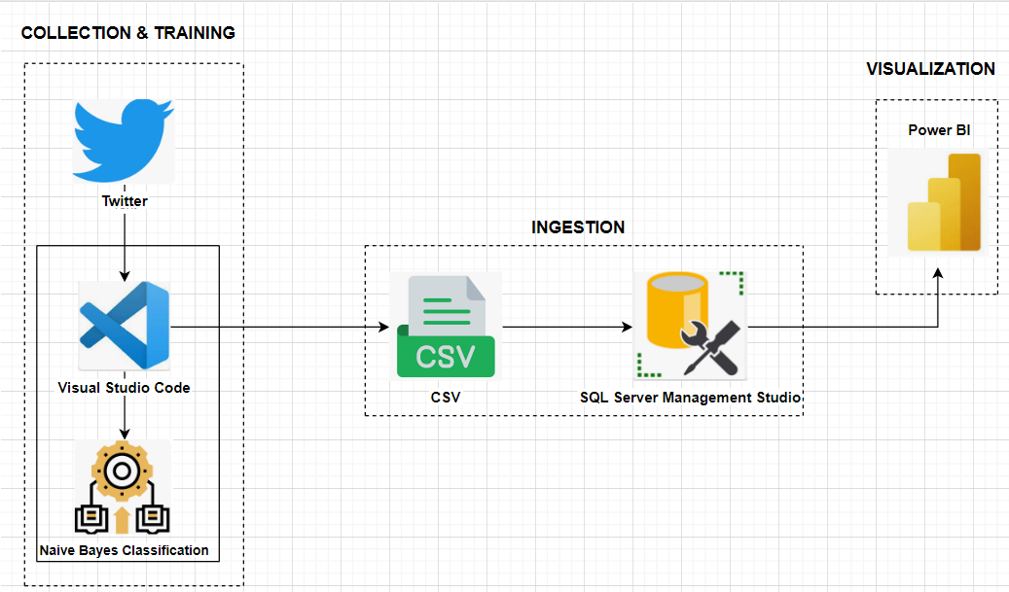
ARCHITECTURE

Slide 3
LIBRARY USED
import os
import numpy as np
import pandas as pd
import matplotlib.pyplot as plt
import seaborn as sns
from nltk.corpus import stopwords
from string import punctuation
from nltk.tokenize import word_tokenize
from nltk.stem import LancasterStemmer
from string import punctuation
from nltk.corpus import stopwords
from nltk.tokenize import word_tokenize
from nltk.stem import LancasterStemmer
from nltk.stem.wordnet import WordNetLemmatizer
import re
import warnings
warnings.filterwarnings('ignore')
import matplotlib.pyplot as plt
from sklearn.utils import resample

Slide 4
LIBRARY USED
from wordcloud import WordCloud
import seaborn as sns
from nltk import classify
from nltk import NaiveBayesClassifier
from sklearn.feature_extraction.text import TfidfVectorizer
from sklearn.model_selection import train_test_split
from sklearn.naive_bayes import MultinomialNB
from sklearn.svm import LinearSVC
from sklearn.metrics import ConfusionMatrixDisplay
from sklearn.discriminant_analysis import LinearDiscriminantAnalysis
from sklearn.metrics import accuracy_score,confusion_matrix,classification_report
from sklearn.linear_model import LogisticRegression

Slide 5
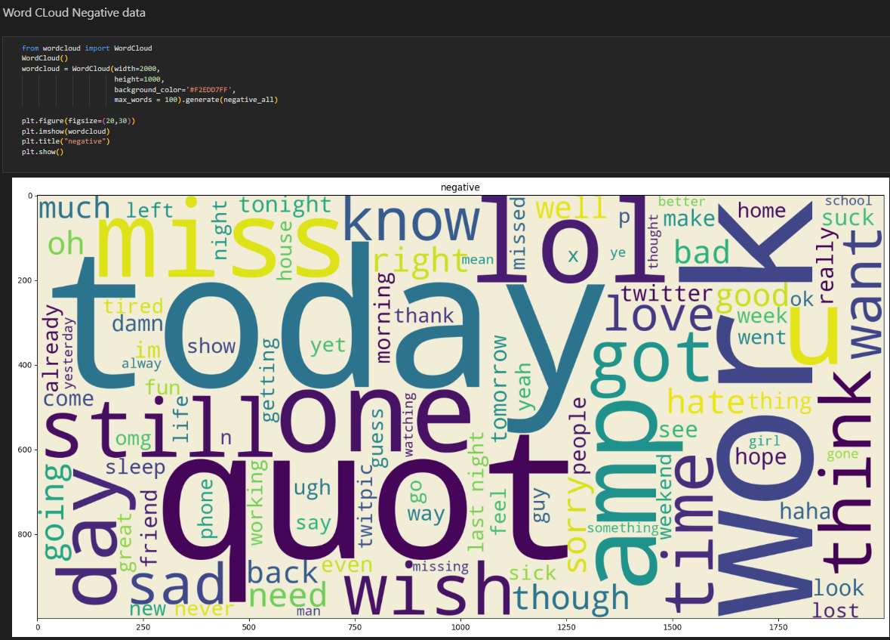
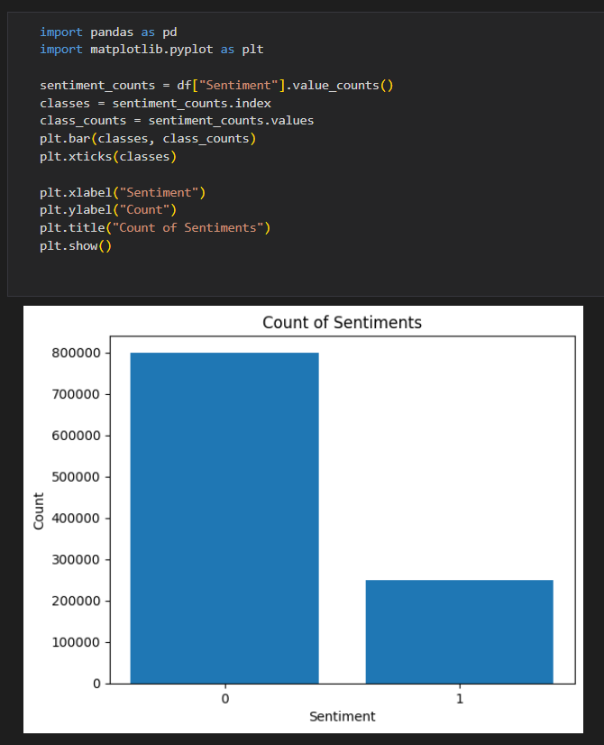
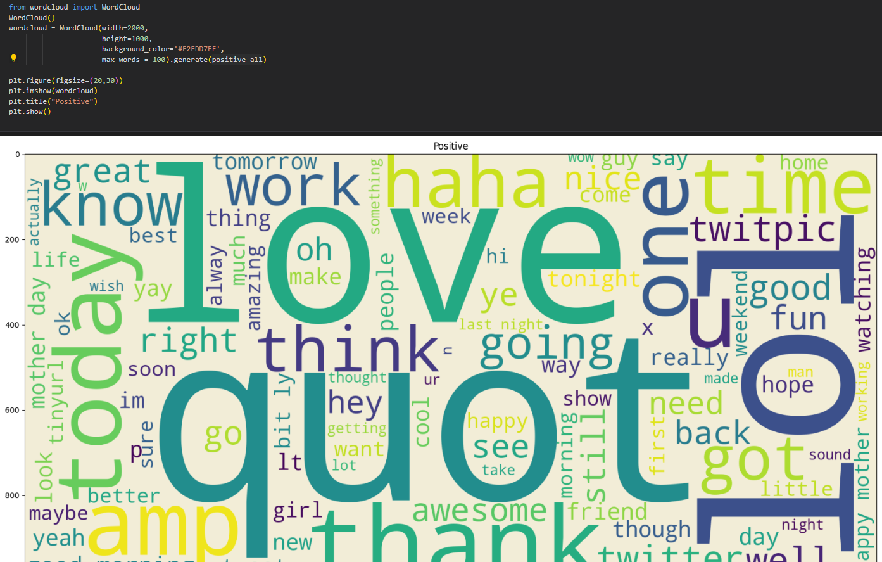
Project screenshots
Negative Word Cloud
EDA
Positive Word Cloud

Slide 6
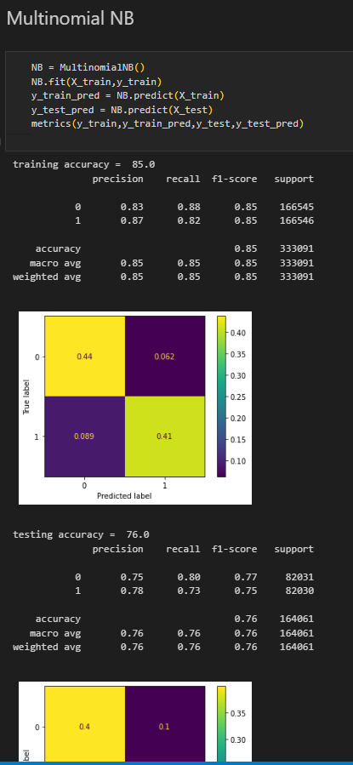
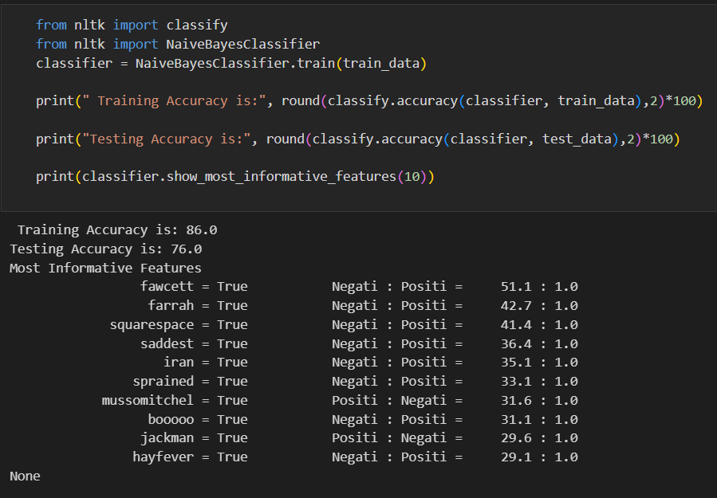
Project screenshots
Multinomial NB
Training the accuracy of Naïve Bayes Classifier

Slide 7
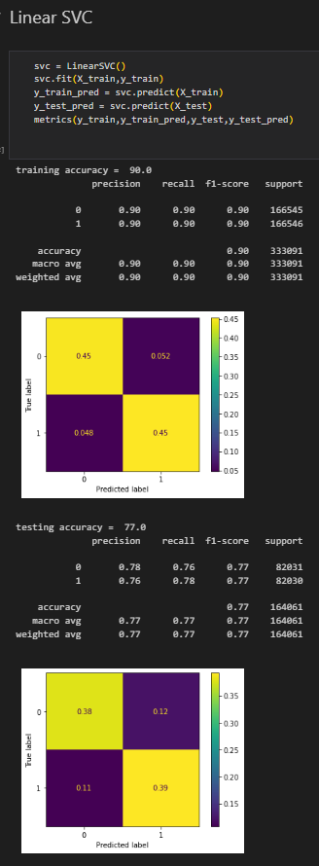
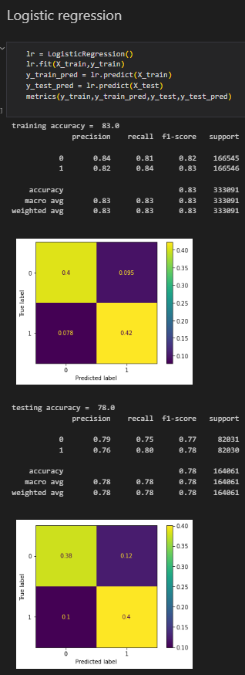
Project screenshots
Linear SVC
Logistic Regression

Slide 8
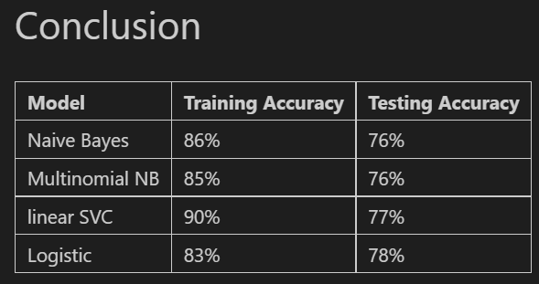
CONCLUSION

Slide 9
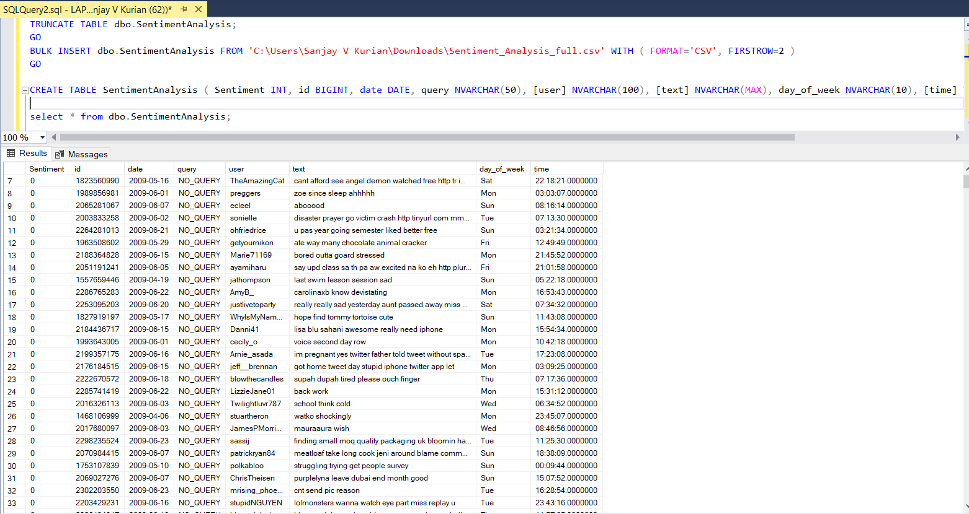
SQL SERVER

Slide 10
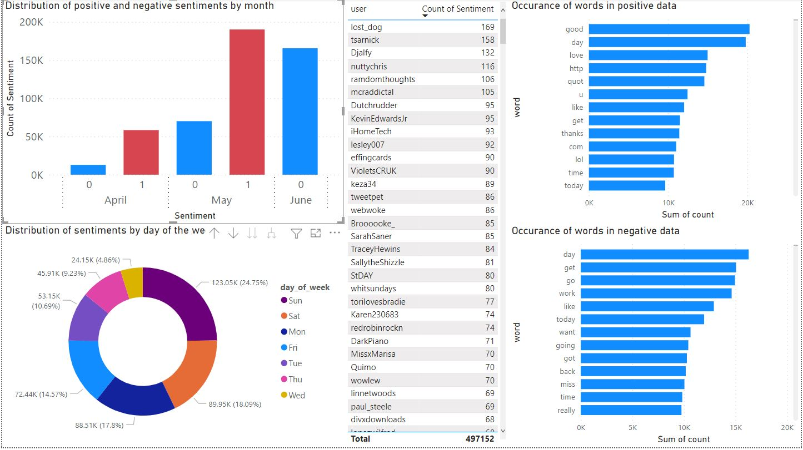
POWER BI DASHBOARD VISUALIZATION

Slide 11
GITHUB LINK
https://github.com/NivedhithaM10/aiarch

Slide 12
REFERENCES
https://www.datacamp.com/tutorial/text-analytics-beginners-nltk
https://www.digitalocean.com/community/tutorials/how-to-perform-sentiment-analysis-in-python-3-using-the-natural-language-toolkit-nltk
https://www.nltk.org/api/nltk.stem.lancaster.html
https://towardsdatascience.com/sentiment-analysis-of-tweets-using-multinomial-naive-bayes-1009ed24276b
https://medium.com/analytics-vidhya/sentiment-analysis-on-amazon-reviews-using-tf-idf-approach-c5ab4c36e7a1

Slide 13

THANK YOU

