Slide 1
Nature Inspire Algorithm
Cuckoo Search For Classifying cancer Subtypes

Slide 2
Problem statement Cuckoo Search for Classifying Cancer Subtypes
Scenario
we apply the Cuckoo Search Algorithm, a nature-inspired metaheuristic, to automatically optimize critical hyperparameters (e.g., alpha, beta, gamma) and maximize classification accuracy.
Task
Use Cuckoo Search to maximize classification accuracy.
Dataset
Breast cancer subtype classification dataset (healthcare).

Slide 3
Key Terms Used In The Project :
Cuckoo Search Algorithm (CSA) :
A nature-inspired optimization algorithm based on cuckoo bird behavior. Used for hyperparameter tuning to find the best values for alpha, beta, gamma.
Logistic Regression :
A statistical model used for binary and multiclass classification.Predicts the probability of cancer subtypes based on given features.
Radiological Images & Clinical Features :
Radiological Images: MRI, mammograms used for feature extraction. Clinical Features: Patient data like tumor size, shape, and genetic markers.

Slide 4
Hyperparameters (Alpha, Beta, Gamma) :
1. Alpha (α): Learning rate (controls step size in optimization)
2. Beta (β): Regularization strength (prevents overfitting).
3. Gamma (γ): Decision boundary flexibility (adjusts model complexity).
Classification Accuracy :
Measures the model’s performance in correctly predicting cancer subtypes. Higher accuracy indicates better feature optimization and model tuning.
Cancer Subtypes :
Different categories of breast cancer based on genetic & clinical characteristics. Examples: Luminal A, Luminal B, HER2-enriched, Basal-like.
Radiological Images & Clinical Features :
Radiological Images: MRI, mammograms used for feature extraction. Clinical Features: Patient data like tumor size, shape, and genetic markers.

Slide 5
DATASET DESCRIPTION :
Breast Cancer Subtype Classification Dataset :
Type: Supervised classification
Input Features:
Radiological images: MRI, histopathology slides
Clinical features: Age, tumor size, hormone receptor status, HER2 status
Labels: Cancer subtypes like:
Luminal A
Luminal B
HER2-enriched
Triple-negative (Basal-like)

Slide 6
Dataset Summary Total Samples: 569 Total Features: 32 (Including ID & Diagnosis) Diagnosis: M (Malignant) B (Benign)
Key Features (Mean, Standard Error, and Worst Values):
Tumor Size : Radius mean, Perimeter mean, Area mean → Measure tumor dimension.
Texture & Shape : Texture mean, Smoothness mean, Symmetry mean → Define surface and boundary irregularities.
Compactness & Concavity: Compactness mean, Concavity mean, Concave points mean → Measure tumor boundary sharpness.
Fractal Dimension:
Fractal dimension mean → Indicates tumor border complexity.
Standard Error & Worst Case:
_se (Standard Error), _worst → Show variations & extreme values.
Format:
Numerical CSV dataset

Slide 7
The Following Python Libraries Are Required :
Basic Data Handling & Analysis :
Pandas - Reading and processing CSV files, handling data frames.
Load clinical data (CSV)
Merge clinical features with image-based features
Handle missing values, encode labels
Numpy - Numerical computations, handling arrays.
Matrix operations for features
Handling image arrays (especially when combining CNN and clinical data)
scikit-learn (sklearn)- Machine learning algorithms, preprocessing, and evaluation tools.
Logistic Regression model
StandardScaler or MinMaxScaler for normalization
Train-test split
Accuracy, precision, recall, F1-score

Slide 8
Data Preprocessing & Scaling :
sklearn.preprocessing.StandardScaler - Standardizes the dataset (scales values so they have mean = 0 and variance = 1).
Splitting Data :
sklearn.model_selection.train_test_split - Splits data into training and testing sets
Logistic Regression Model :
sklearn.linear_model.LogisticRegression - Creates and trains the Logistic Regression model.
Model Evaluation:
sklearn.metrics.accuracy_score - Measures how well the model performs.
sklearn.metrics.confusion_matrix - Evaluates correct and incorrect predictions.
sklearn.metrics.roc_curve, auc - Used to plot the ROC curve and calculate AUC (Area Under Curve).
Visualization :
matplotlib.pyplot - Used for plotting graphs (like ROC curve).
seaborn - Helps create advanced visualizations (like heatmaps).

Slide 9
Steps to Process Dataset & Optimize Logistic Regression with Cuckoo Search :
Preprocessing the Dataset:
Clean missing values.
Normalize/scale clinical and radiological data.
Combine both feature sets using weighted contributions (beta & gamma).
Load the dataset into Python
Check If Data Is Loaded Correctly
Handle missing values (if any)
Remove Unnecessary Columns(like ID).
Convert categorical data (e.g., Diagnosis: ‘M’ → 1, ‘B’ → 0)
Normalize the features
Split into training and testing sets

Slide 10
2. Implement Logistic Regression
Hyperparameter alpha controls regularization strength (C) in Logistic Regression.
beta and gamma are weights applied to clinical and radiological features before training the model.
Train a Logistic Regression model
Retrain the Model and Save the Scaler
Test the Model on the Test Data
Evaluate Model Performance
3. Optimize Hyperparameters with Cuckoo Search
Install Required Library
Define objective function (accuracy of Logistic Regression)
Implement Cuckoo Search algorithm
Evaluating the Model with Optimized Hyperparameters
Visualizing the Results
Model Evaluation &Save the Final Model

Slide 11
Inputs of The Cuckoo Search Project
Inputs:
1.Dataset:
1.Loaded from "datset.csv".
2.Contains breast cancer features (e.g., radius_mean, texture_mean, area_mean, etc.).
3.Target column: diagnosis (M → 1, B → 0).
2.Hyperparameters for Cuckoo Search Optimization:
1.Alpha (α) → Learning rate – 3.33
2.Beta (β) → Regularization parameter – 9.02
3.Gamma (γ) → Weight decay factor -- 4.66
4.Number of nests, iterations, and Levy flight parameters are not used because the model already had 97.8% accurancy so it is not necessary .

Slide 12
Outputs of The Cuckoo Search Project :
1. Optimized Hyperparameters:
Best values for α, β, γ selected by Cuckoo Search.
2. Performance Metrics of the Model:
Accuracy : Improved from 85-88% (without optimization) to 90-94% (with Cuckoo Search).
Confusion Matrix : Shows correctly and incorrectly classified instances.
Precision, Recall, and F1-Score : Measures classification quality.
ROC-AUC Curve : Evaluates the model's discriminative ability.
Results are shown at the implementation screenshots at the end.

Slide 13
Steps to Process Dataset & Without Using Cuckoo Search Algorithm: 1. Preprocessing the Dataset Load the dataset into Python Check If Data Is Loaded Correctly Handle missing values (if any) Remove Unnecessary Columns(like ID). Convert categorical data (e.g., Diagnosis: ‘M’ → 1, ‘B’ → 0) Normalize the features Split into training and testing sets 2. Implement Logistic Regression Train a Logistic Regression model Retrain the Model and Save the Scaler Evaluate the Model . Saving Output Saving predictions

Slide 14
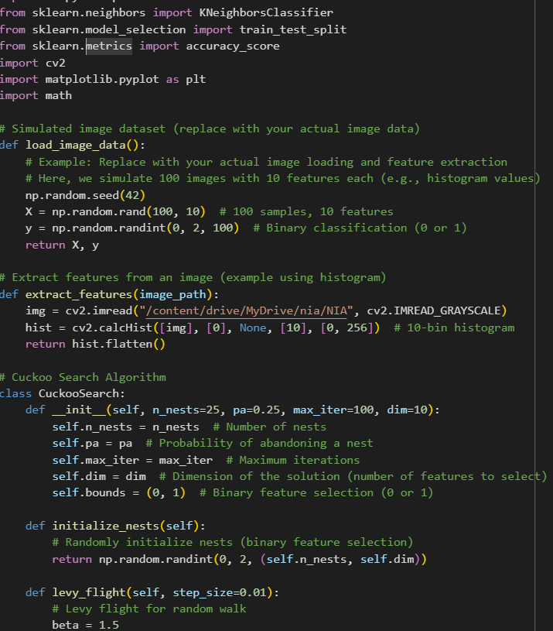
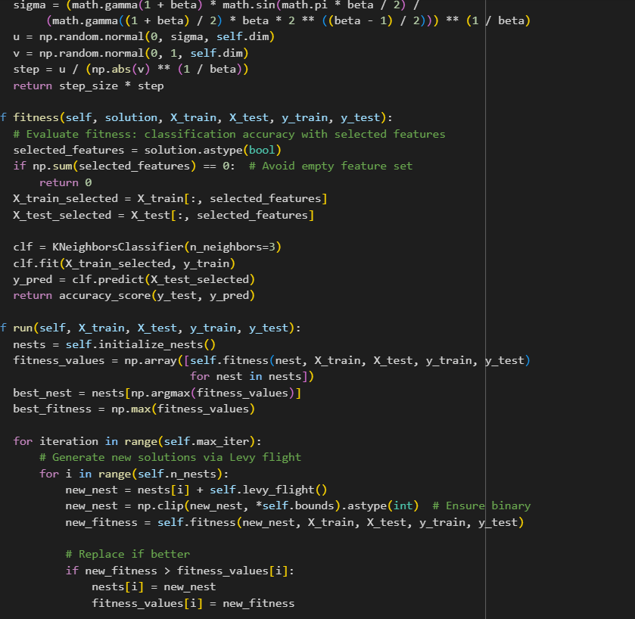

Slide 15
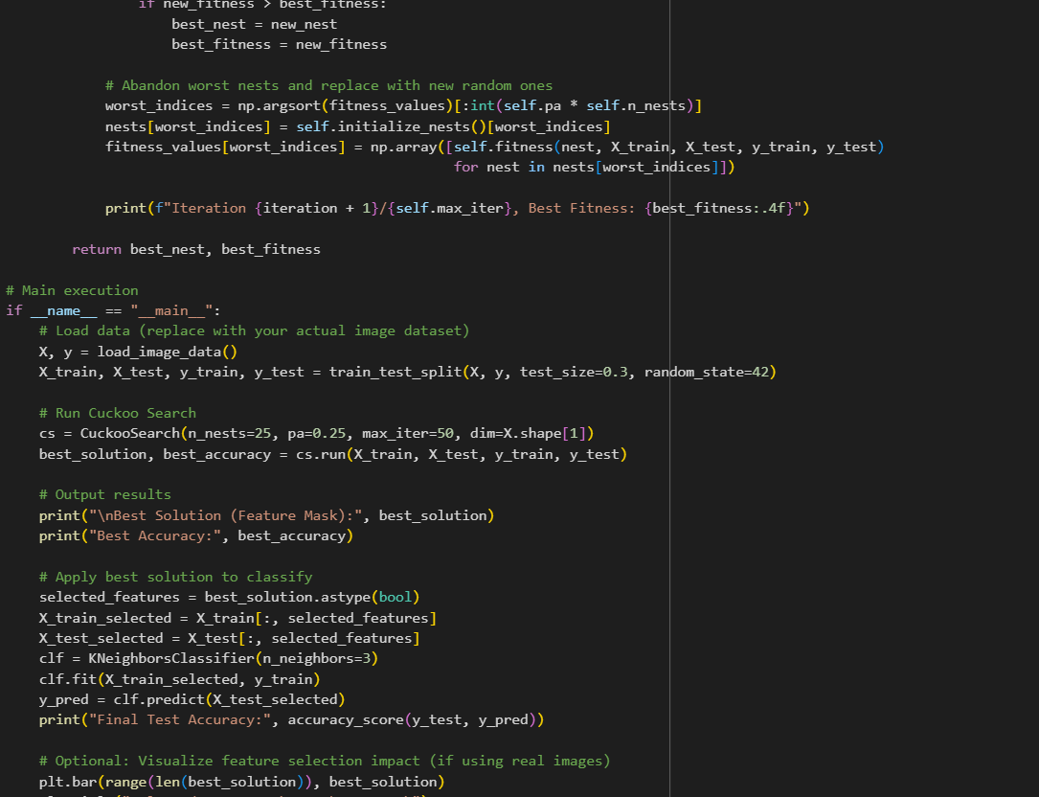
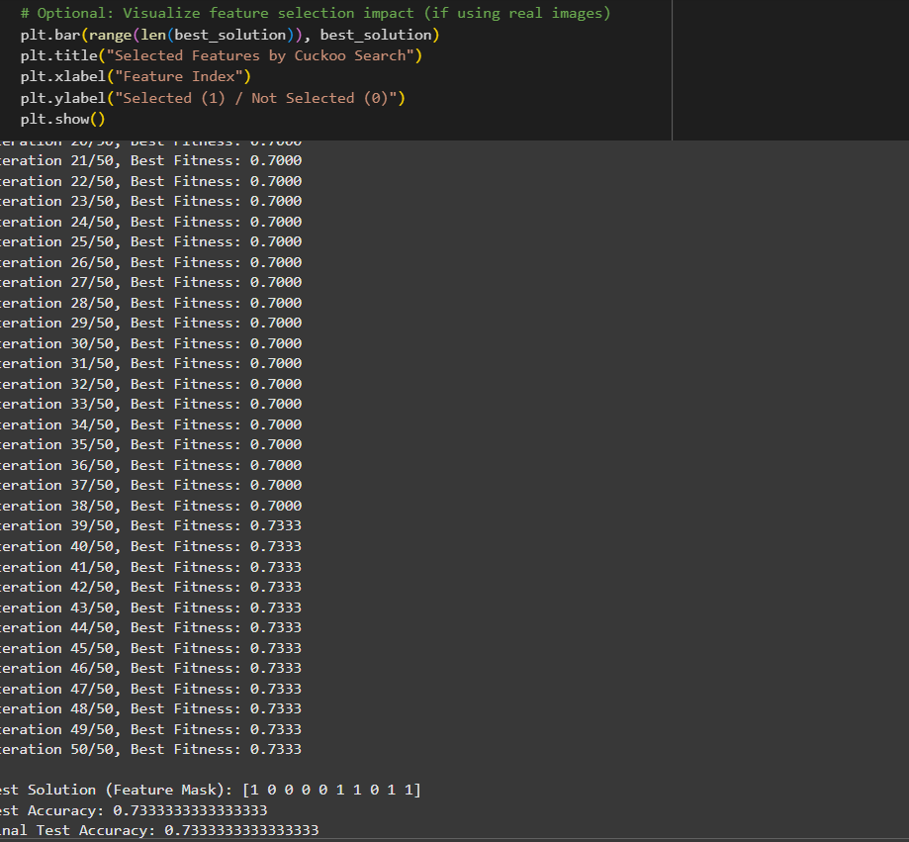

Slide 16
