Slide 1


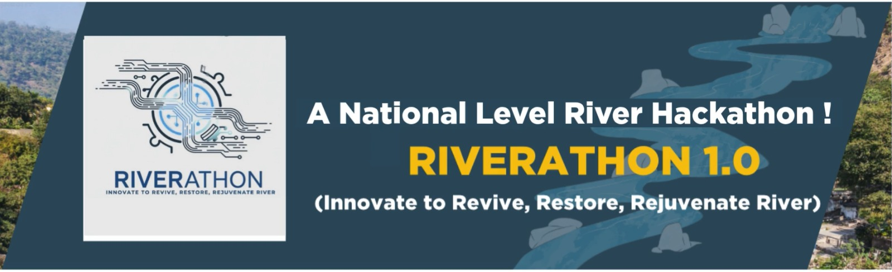
1
IDEA SUBMISSION

Slide 2
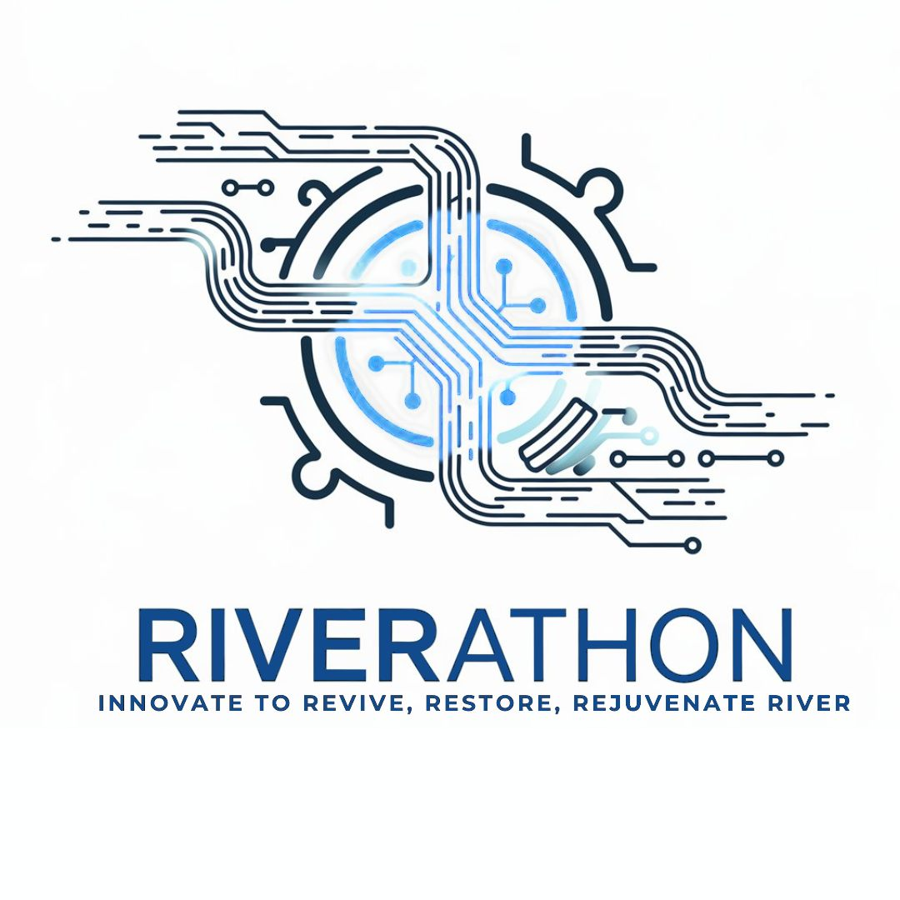
INTRODUCTION
(Team & Idea Overview)
Team Name: Kodikzee
Team Details:
Idea Title: Jalaj
Theme: Disaster Management
Name | Email ID | Contact Number | Institution | Team Leader (Yes/No)
Pankhi Gupta | guptapankhi3@gmail.com | 9897206417 | SRMSCET | YES
Nivedika Sharma | nivedika9719sharma@gmail.com | 7533825520 | SRMSCET | NO
Gautam Dua | duagautam2004@gmail.com | 8791438023 | SRMSCET | NO
Yash Gupta | gyash6328@gmail.com | 9520102418 | SRMSCET | NO
2
A National Level River Hackathon – RIVERATHON 1.0

Slide 3
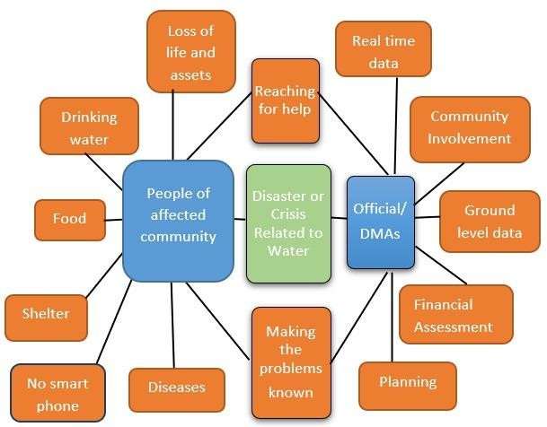
PROBLEM STATEMENT
A mobile app that crowdsources water-related issues, integrates open data, and maps them for proactive river management.
Description:
Rivers face pollution, encroachment, and flood risks, but issues are underreported and scattered across agencies. A unified platform combining citizen reports with environmental data can bridge this gap.
Why it matters:
Faster reporting and response reduce pollution impact, protect floodplains, and save lives and property.
Relevant data:
350+ polluted river stretches in India; floodplain loss exceeding 30% in many cities.
LiDAR’s role:
Enables precise mapping of riverbanks, erosion, and flood zones, enhancing the accuracy and impact of reported issues and enable safe route planning.
3
A National Level River Hackathon – RIVERATHON 1.0

Slide 4
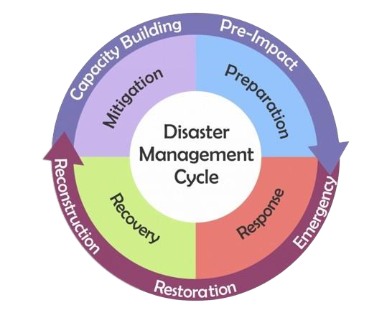
PROPOSED SOLUTION
Incident reporting end documentation system with a centralized information panel with choice of language.
Visualization on dot and choropleth map to identify patterns and grasp situation with access to 3D map and embedded pop notification.
Dedicated emergency and SOS button.
A platform for crisis managers to draft unique and well-informed plans by use of accurate and updated data.
Analysis of historical data to make predictions and ensure safety.
A tool for optimization of response and efforts.
Offline access to downloaded maps and basic guidelines like CPR.
Overlay high-resolution Digital Elevation Models (DEM) for accurate flood-prone zone detection.
Identify sediment buildup and riverbank erosion using time-series LiDAR scans.
Enable safe route planning for evacuation during floods.
4
A National Level River Hackathon – RIVERATHON 1.0

Slide 5
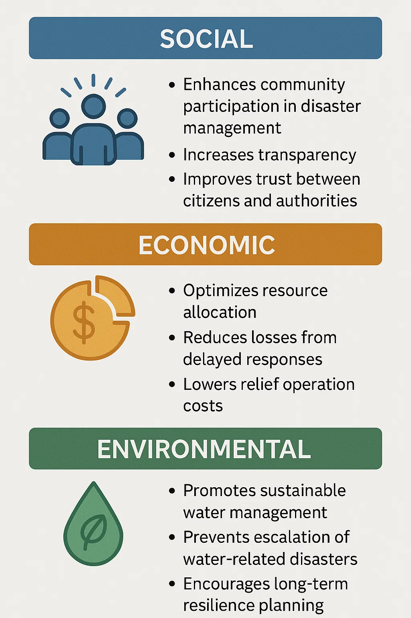
TARGET USERS & IMPACT
(Who will benefit?)
IMPACTS
How the Solution Helps Them
Communities: Easily report issues via text, images, or videos; access localized problem data; stay informed about relief activities and safety guidelines.
Authorities: Visualize crowdsourced and satellite data on dot, choropleth, and 3D maps for better situational awareness; plan and execute relief operations effectively.
Relief Workers: Quickly identify high-priority areas; coordinate resources using real-time, accurate information.
Government: Access categorized, location-based problem data for policy planning and preventive measures.
Local communities
TARGET USERS
Relief workers
NGOs
Disaster Management authorities
5
A National Level River Hackathon – RIVERATHON 1.0

Slide 6
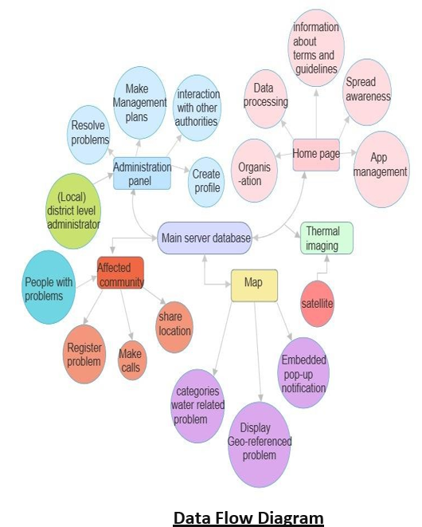
TOOLS & TECHNOLOGY STACK
Tools & Platforms:
ArcGIS, QGIS, CloudCompare, PDAL, GeoServer, MapLibre GL, HEC-RAS 2D, TensorFlow/PyTorch, OpenCV.
Programming Languages:
Python, JavaScript, Dart (Flutter), SQL.
Technology Stack:
Frontend: Flutter (mobile), React/MapLibre GL (web).
Backend: Python (FastAPI), Node.js.
Database: Postgres/PostGIS (spatial), TimescaleDB (sensor time-series).
Middle Layer: GeoServer for map services, Celery for processing.
LiDAR’s Role:
  Data Sources: ISRO Bhuvan DEM, Copernicus DEM, USGS LiDAR datasets.Tools: QGIS, Google Earth Engine (GEE), Leaflet.js / Mapbox for visualization.Integration: LiDAR elevation data processed into map layers for overlay in the app.
6
A National Level River Hackathon – RIVERATHON 1.0

Slide 7
IMPLEMENTATION PLAN
Home page:
View problem count.
Get basic information about water related problem.
Learn about disaster, disaster management and community participation.
Understand the steps to upload a problem .
Maps:
Point or dot map: Problems are shown by reference of latitude and longitude. The
area of each dot is representative of number of people affected and color for the
severity.
Choropleth map: Cities of state and regions of a city are shown discretely with boundaries. They are colored based on the level of relief attention required and provided. It can also be set to display the number of problems solved .
3D map: User can view in 3D the affected areas near them.
Enhanced Risk Mapping using LiDAR
Overlay high-resolution Digital Elevation Models (DEM) for accurate flood-prone zone detection.
Identify sediment buildup and riverbank erosion using time-series LiDAR scans.
Enable safe route planning for evacuation during floods.
User:
Provide them the option to register problems they face.
Problem can be reported as text, images or video.
They can access information particular to their area and problem.
They can view information shared by the management authorities.
Admin:
For the official authorities responsible for management and relief work.
They can view details information about area and community .
They can view the problems and upload problems.
They can use available data to draft their own plans.
They can share their plans etc. by creating a profile.
Call:
To make emergency call to community helpline.
To send SOS call and messages to emergency contact.
Provide a helpline for keypad users. The calls made on this line shall get stored in the database and directly impact the severity status .
Keypad user may report a problem through a computerized call.
7
A National Level River Hackathon – RIVERATHON 1.0

Slide 8
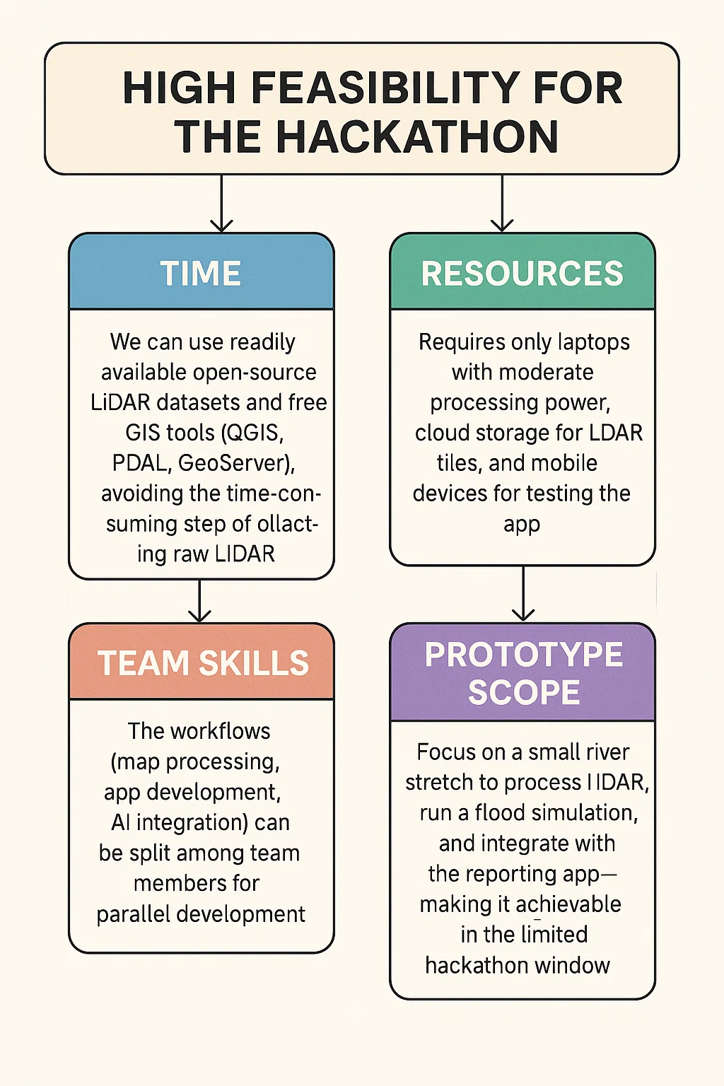
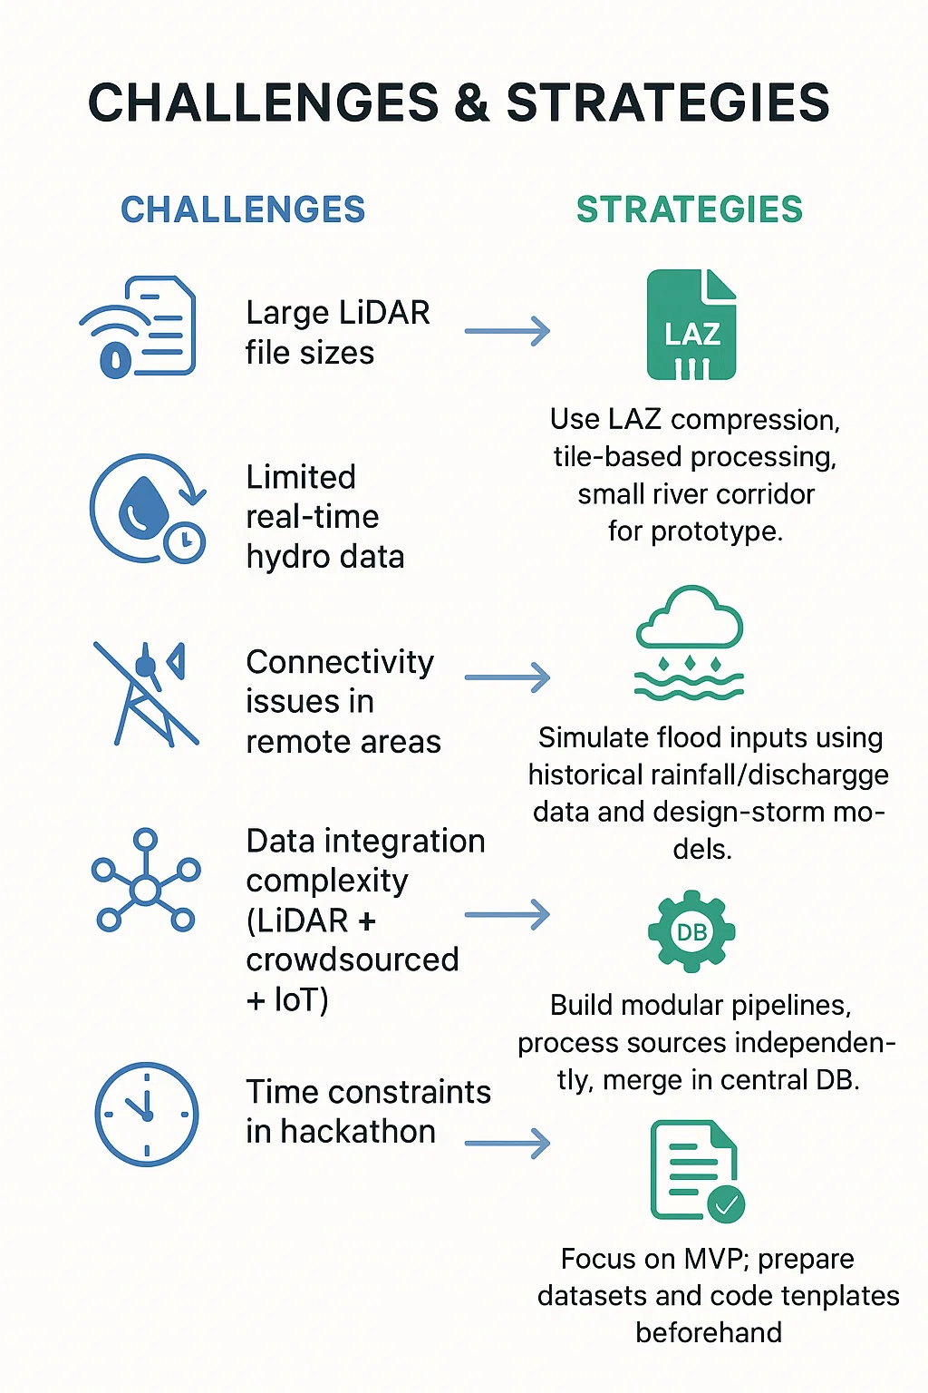
FEASIBILITY & CHALLENGES
What Makes it Innovative
LiDAR-powered, high-accuracy river mapping.
Fusion of crowdsourced reports, IoT sensor data, and LiDAR.
Interactive 3D maps and AR-based field navigation.
AI-driven flood prediction and pollution hotspot detection.
Single integrated platform for reporting, mapping, alerts, and simulations.
8
A National Level River Hackathon – RIVERATHON 1.0

Slide 9
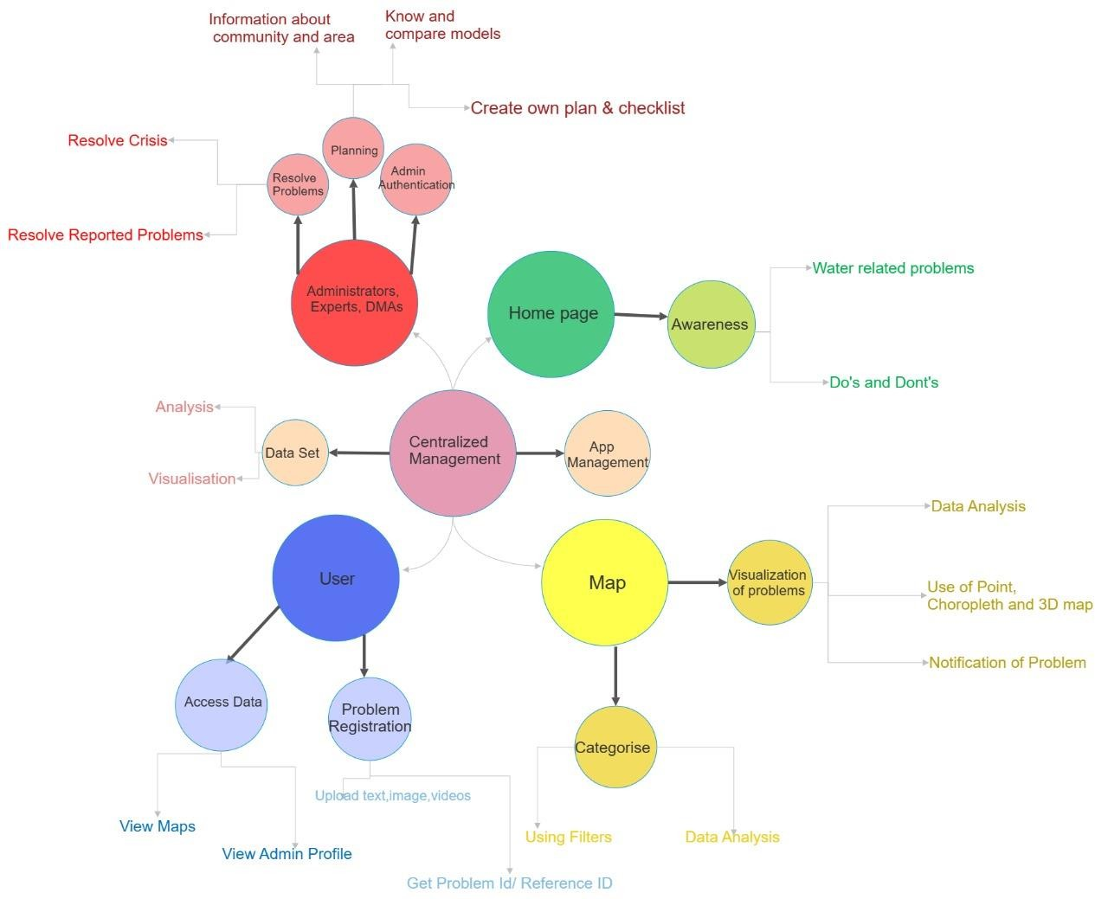
EXPECTED OUTCOME
(What will be delivered?)
Final Output:
Working prototype including mobile app, web dashboard, and LiDAR-powered 3D river map.
Integrated features: crowdsourced reporting, real-time alerts, flood simulation, and pollution hotspot mapping.
Demonstration:
Live walkthrough of app reporting & alert system.
3D LiDAR terrain view showing risk zones.
Simulation of flood scenario with impact analytics.
Scalability:
Extend to multiple rivers and larger basins using cloud-based processing and scalable map tile servers.
Handle high-computation tasks via distributed cloud processing.
Future Scope:
Drone-based LiDAR surveys for real-time morphology updates.
AI for biodiversity and habitat monitoring.
USE CASES
9
A National Level River Hackathon – RIVERATHON 1.0

Slide 10
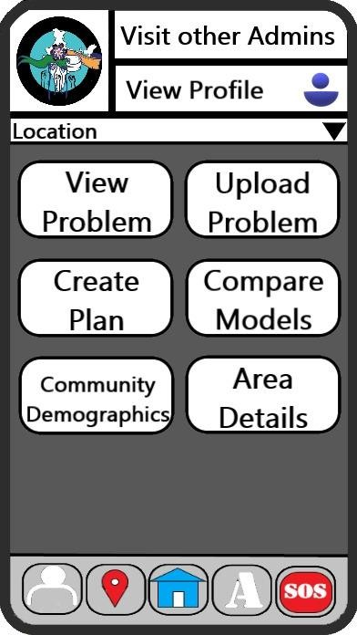
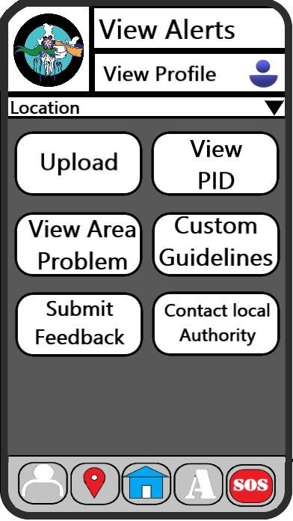
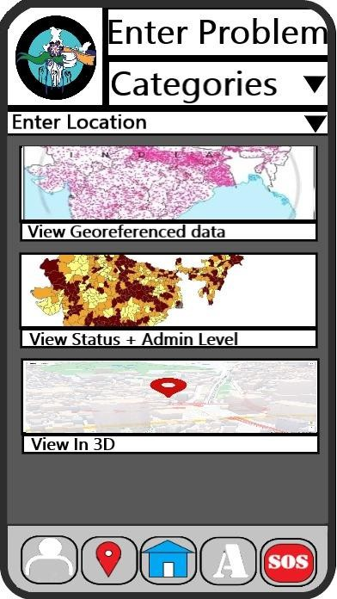
ADDITIONAL INFO & DECLARATION
Reference:
https://www.worldbank.org/en/topic/waterresourcesmanagement
https://www.researchgate.net/publication/277327554_Introduction_to_Disaster_Management
https://play.google.com/store/apps/details?id=disasterAlert.
YOUTUBE LINK: https://youtu.be/wWdfJDjzVu
Github Link: https://github.com/Yashgupta683/Jalaj
“We declare this idea is original and created by our team.”
10
A National Level River Hackathon – RIVERATHON 1.0

Slide 11
IMPORTANT INSTRUCTIONS
Prepare your idea submission in the form of a presentation (maximum 12 slides) following the structure provided in this template.
Upload the final file as a PDF or PPT (max size: 10 MB). Filename format: TeamName_Theme.pdf
Ensure originality, clarity, and relevance to the hackathon theme. Avoid too much of text material. Use points/infographics to explain the concept.
Please ensure that your team has submitted ONLY ONE idea under a THEME.
SAME idea cannot be submitted across different THEMES.
A team can submit only one idea under a theme. However, the team can submit other idea under different themes.
Prepare the ppt with Font size of 14 (Times new Roman).
11
A National Level River Hackathon – RIVERATHON 1.0

