Slide 1

Shri Ram Murti Smarak College of Engineering & Technology, Bareilly
Department of Computer Science & Engineering
Major Project Title:
Design and Development of an Document Intelligence & Routing System
Presented by: Group 08
Pankhi Gupta (2200140100073)
Nivedika Sharma (2200140100072)
Sanmita Biswas (2200140100093)
Saumya Gupta (2200140100096)
Project Guide:
Dr. Shahjahan Ali
Project Incharge :
Dr. Jyoti Agarwal

Slide 2
Content
Introduction
Motivation
Literature review
Problem statement
Objectives
Proposed solution
Methodology
Progress
Hardware and Software Requirements
Conclusion
References

Slide 3
1.cIntroduction
The proposed Document Management System (DMS) will organize and manage all documents at a big oganization, enabling easy storage, quick retrieval, and secure access. It will reduce manual work, improve efficiency, and support timely decision-making across departments.

Slide 4
2. Motivation
We are motivated to build this solution because:
1. Increase in the document overload is slowing decisions, creating compliance risks, and causing loss of valuable knowledge.
2. A smart, centralized system will save time, reduce risks, and ensure smooth and efficient metro operations.

Slide 5
3. Literature Review
Madhavi et al. (2025): This paper proposed the development of an OCR-driven pipeline integrating text extraction, abstractive summarization, translation, and classification for low-resource Indian languages. The system achieved strong results across OCR, summarization, and multilingual translation tasks.
Godbole et al. (2024): This paper drives contrasts between LLM based and the traditional ways of summarizing documents. It proposes a workflow from model selection to optimization; and uses case studies in legal, medical, and business domains to show how these models significantly improve efficiency and accuracy over traditional methods.

Slide 6
Majid et al.(2019): This paper proposes a strategic model for the railway industry, arguing that traditional, internal-only Knowledge Management is insufficient for innovation. It suggests integrating "Open Innovation" by using online communities as a bridge to connect with external knowledge bases
Sunitha et al. (2019): The authors proposed an abstractive summarization system for Malayalam using clause identification and semantic triples (subject–object–predicate). The work addressed challenges of agglutinative morphology and showed promising results compared to extractive methods

Slide 7
Liu & Chen (2017): The authors in this paper developed the DAM_AM model for big data, which normalizes multi-source data and applies object/association mapping and a "walk" mechanism. The model enables efficient, scalable, and intuitive multidimensional data analysis and visualization
Ho & Kim (2014): This paper proposed a fingerprinting-based method using sim-hash and trie-tree structures to detect near-duplicate documents and spam in social networks. Their approach achieved ~98% accuracy, effectively addressing redundancy and malicious data detection in online platforms

Slide 8
Fan & Huang (2012): This paper introduced a fusion of shingling, I-Match, and Simhash algorithms for near-duplicate document detection. Their multi-fingerprint Simhash method improved precision–recall balance and enhanced digital library search efficiency
Fesehaye, Malik, & Nahrstedt (2010): Thi paper proposed a scalable distributed file system for cloud computing that improves upon HDFS by using multiple name nodes and a lightweight front-end server. Their protocol enhances bandwidth utilization, reduces transfer latency, and removes single points of failure

Slide 9
Author(s) | Summary | Advantage | Disadvantage
Madhavi et al. (2025) | OCR + summarization + translation pipeline. | Supports low-resource languages. | High computation, less generalizable.
Ho & Kim (2014) | Simhash + trie-tree for near-duplicates. | ~98% accurate, good spam detection. | Storage + scaling issues.
Liu & Chen (2017) | DAM_AM model for big data mapping. | Scalable, efficient analysis. | Complex integration.
Fesehaye et al. (2010) | Improved HDFS with multi-namenodes. | Better bandwidth, no single failure. | Sync overhead.
Sunitha et al. (2019) | Abstractive Malayalam summarizer. | Handles morphology well. | Language-specific.
Fan & Huang (2012) | Hybrid Simhash for duplicates. | Balanced precision–recall. | More computation.
Godbole et al. (2024) | LLM vs. traditional summarization. | More accurate, efficient. | Costly, risk of bias.
Majid et al. (2019) | Open innovation in railway KM. | Boosts external collaboration. | Security/trust issues.

Slide 10
4. Problem Statement
Big organizations face the following problems due to document overload:
High document load → Thousands of files daily from email, SharePoint, WhatsApp, Maximo, scans.
Information latency → Managers waste hours skimming long docs for a few critical lines.
Siloed awareness → Departments act without knowing updates from others.
Compliance risk → Regulatory circulars often buried in inboxes, risking penalties.
Knowledge attrition → Insights lost when employees transfer or retire.
Duplicated effort → Multiple teams summarizing the same docs repeatedly.
Scalability issue → With expansion (new depots, UNS, IoT), document burden will increase further.
Without a centralized mechanism, KMRL risks slower decisions, higher costs, weaker compliance, and reduced service reliability.

Slide 11
5. Objective
The objective is to build a centralized Document Intelligence Platform for KMRL that can ingest documents from multiple sources, generate bilingual and role-specific summaries, and route critical updates to the right teams. The system will preserve institutional knowledge in a secure, searchable hub while maintaining full traceability to original documents. It will also be scalable to support future expansion with UNS and IoT integrations.

Slide 12
6. Proposed Solution
To address those problems, we propose the following solutions:
One platform to collect all kinds of documents in one place.​
Auto-extracts and highlights only the key points that matter.​
Shares role-specific digests → right info to right people.​
Links every summary back to the original document for trust.​
Searchable knowledge hub for old and new documents.​
Alerts for urgent or compliance-related updates.

Slide 13
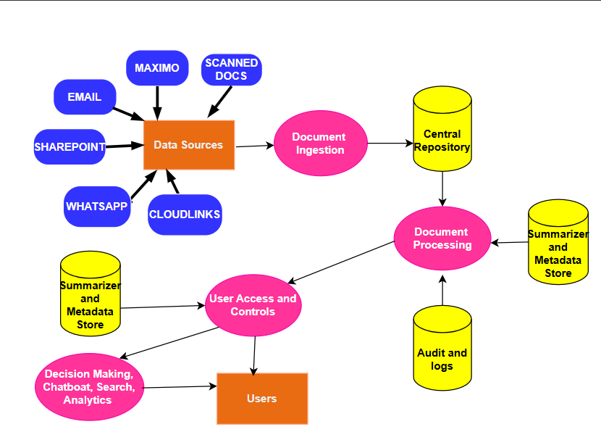
Process Flow

Slide 14
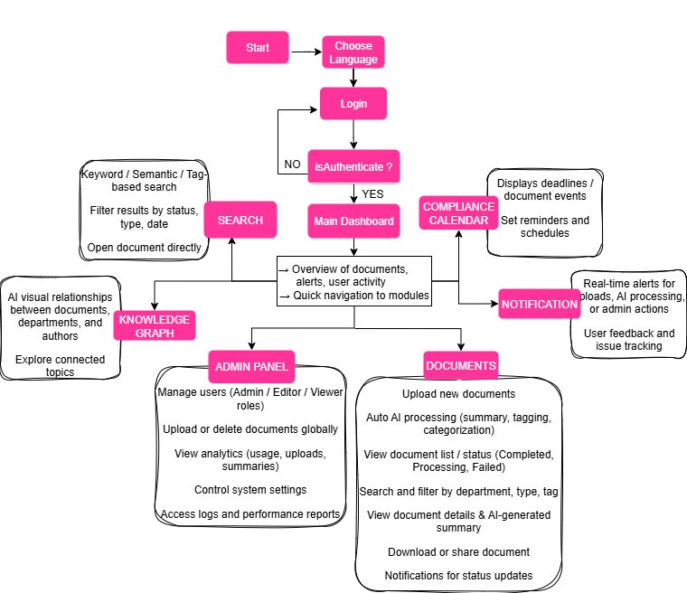
General Functional Flow

Slide 15
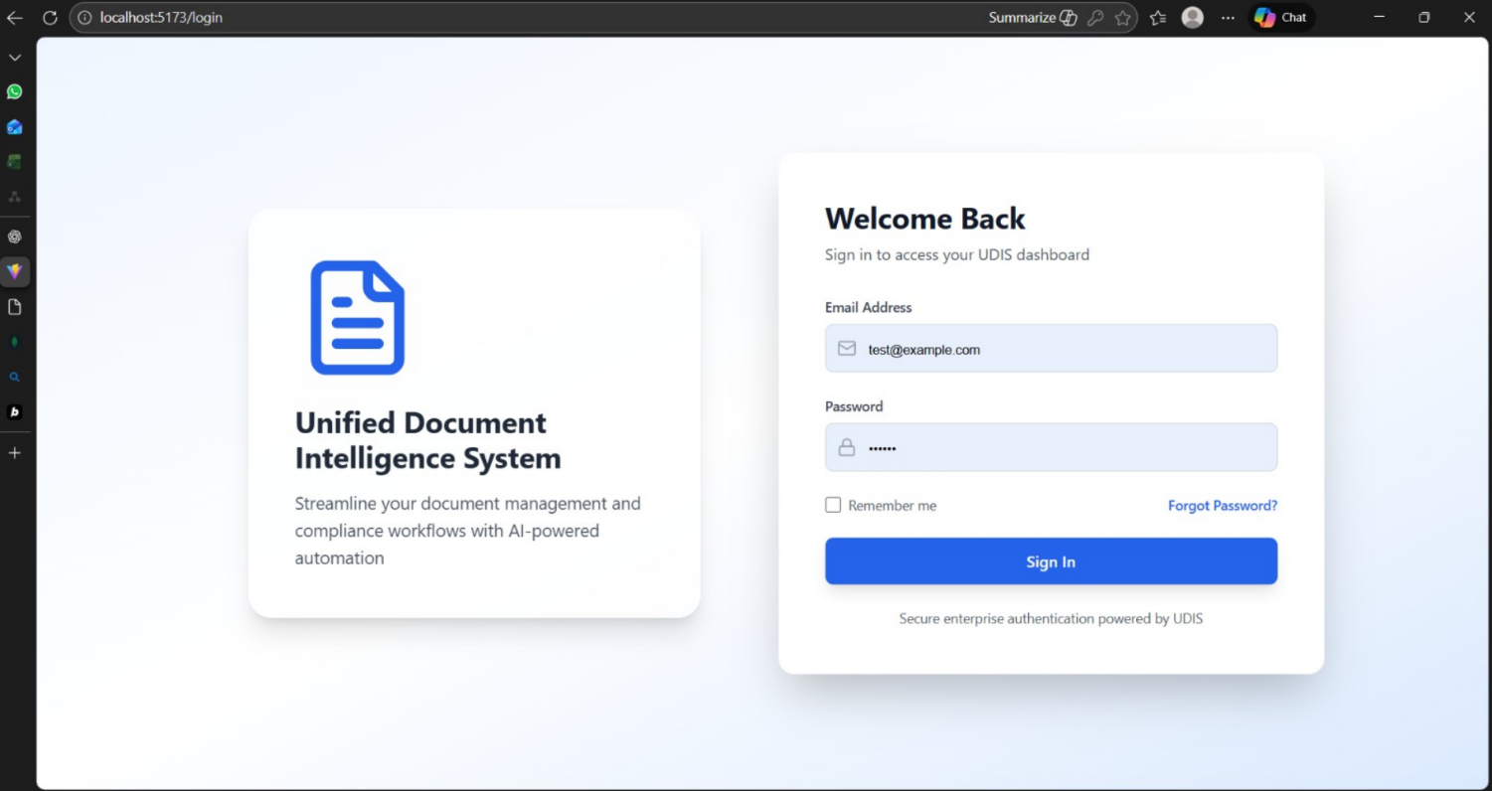
7.Progress

Slide 16
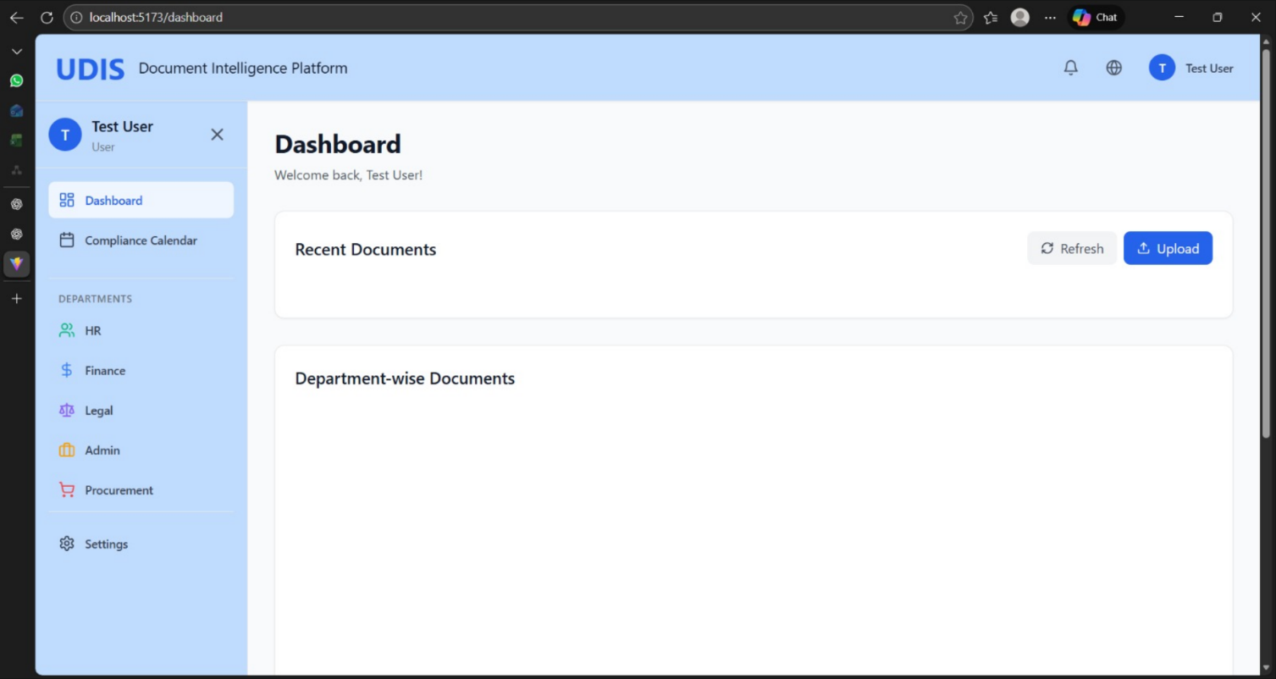

Slide 17
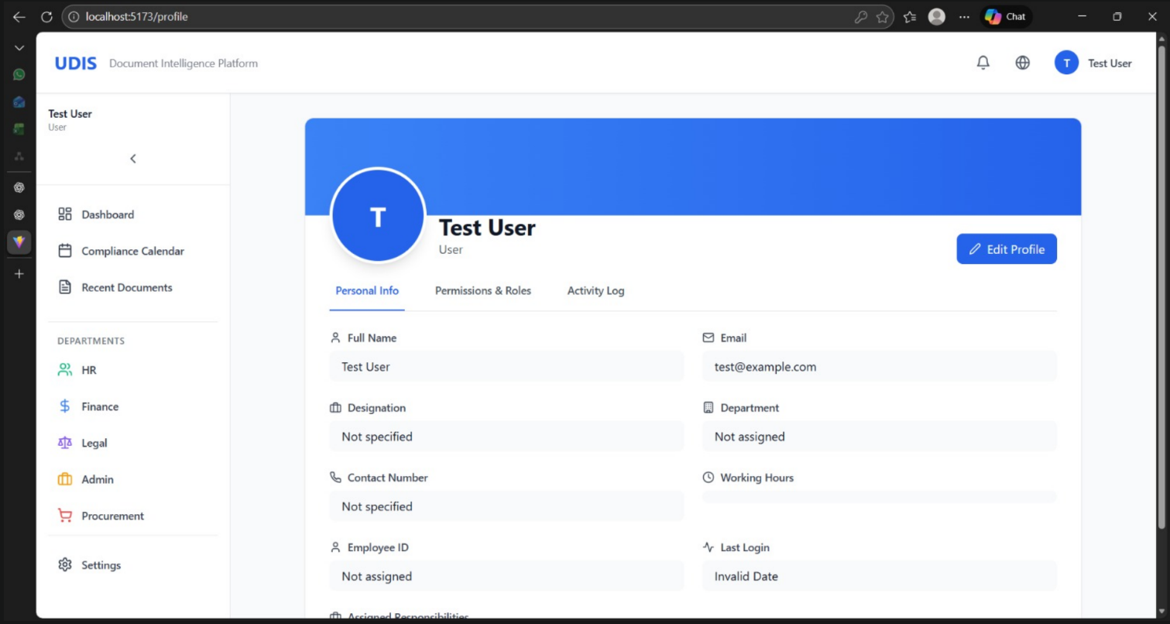

Slide 18
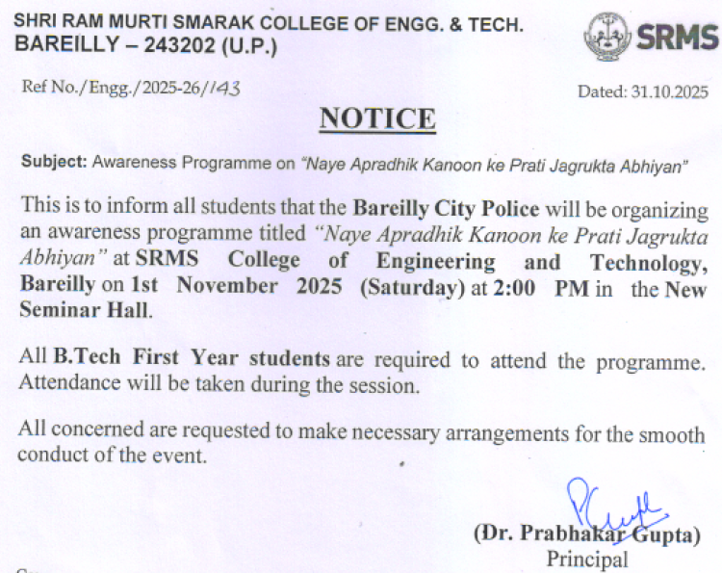
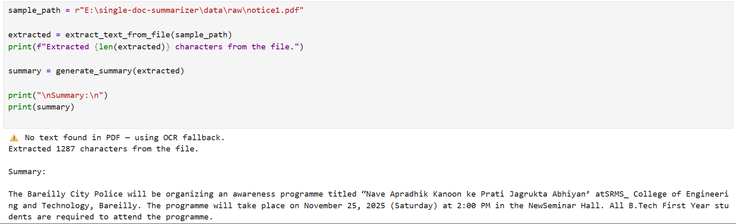
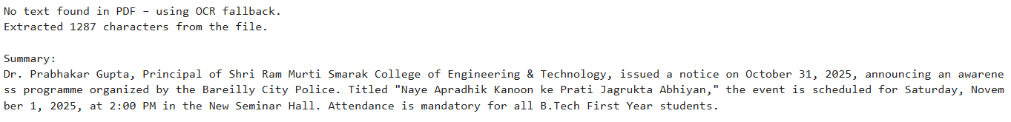
Single Doc Summarizer module (for Scanned Document)
Code snippet:
Output:

Slide 19
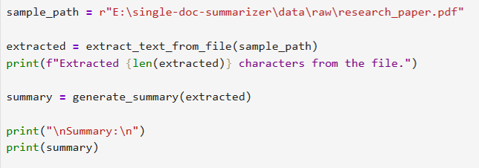
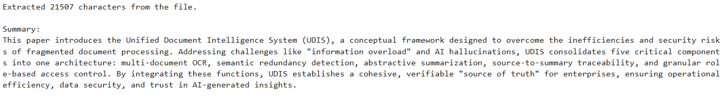
(for long pdf/word files)
Code snippet:
Output:

Slide 20
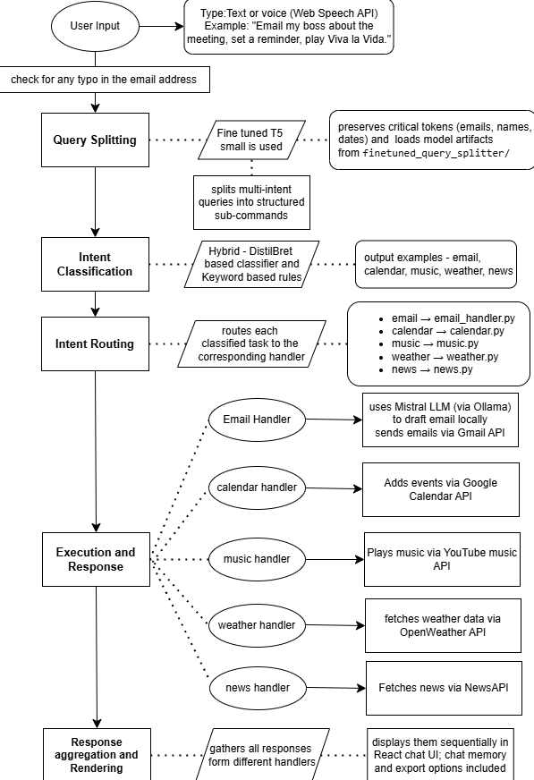
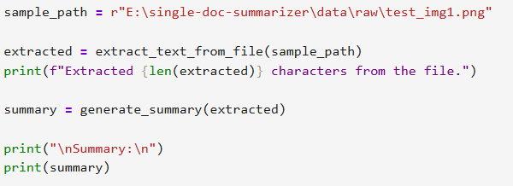
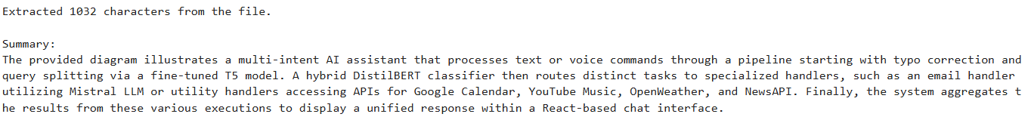
(for images/diagrams)
Code snippet:
Output:

Slide 21
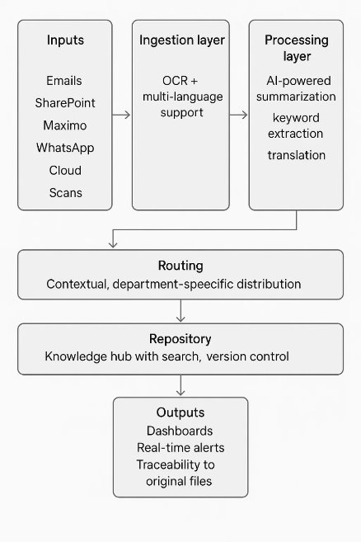
8. Methodology
Technology Used:
OCR: Tesseract
NLP: Hugging Face Transformers
  Summarization: Pegasus, GPT models
  Search: Elasticsearch
  Frontend: React, Power BI
  Notifications: Firebase, Twilio
  APIs: WhatsApp Business Api, Microsoft Graph Api, Google Translate Api.
Safety circular arrives in email (PDF in Malayalam).
OCR + NLP → extract text → auto-translate → generate 2-line summary.
Classifier tags it as safety-critical → routes to HR, Ops, Station Managers.
Stored in Database → searchable later (“Find all safety circulars of 2024”).
Alert sent: “New Safety Directive (Deadline Sept 15) – Action Required.”

Slide 22
9. Hardware & Software Requirements
Hardware Requirements
Server: 4-core CPU, 16 GB RAM, 1 TB storage
Client PCs: i3/i5 CPU, 8 GB RAM, 256 GB storage
Backup: External HDD or cloud storage
Optional: Scanners and printers
Software Requirements
Server OS: Windows Server
Database: MySQL
Web Server: Apache
Client OS: Windows
Web Browser: Chrome
Security: Antivirus, SSL/TLS, backup software

Slide 23
10. Conclusion
Our solution makes it easy for everyone in the KMRL organization to quickly find, understand, and act on important documents and tasks that matter to their job. It keeps information organized by roles, helps staff remember critical rules and deadlines, prevents mistakes, and allows smooth teamwork, making daily work safer and more efficient for all.

Slide 24
11. References
Madhavi, H., Cherian, J., Khamkar, Y., & Bhagat, D. (2025, May 4). Low-resource language processing: An OCR-driven summarization and translation pipeline. Dr. Vishwanath Karad MIT World Peace University. DOI: https://doi.org/10.48550/arXiv.2505.1117
Ho, P.-T., & Kim, S.-R. (2014). Fingerprint-based near-duplicate document detection with applications to SNS spam detection. International Journal of Distributed Sensor Networks, 2014, Article ID 612970. DOI: http://dx.doi.org/10.1155/2014/612970
Liu, P., & Chen, L. (2017). A multi-source data aggregation and multidimensional analysis model for big data. ITM Web of Conferences, 12, 05009. DOI: 10.1051/ itmconf/201 5009
Fesehaye, D., Malik, R., & Nahrstedt, K. (2010). A scalable distributed file system for cloud computing. Proceedings of the International Conference on Cloud Computing. Retrieved from https://www.researchgate.net/publication/228946298_A_Scalable_Distributed_File_System_for_Cloud_Computing
Sunitha, C., Jaya, A., & Ganesh, A. (2019). Automatic summarization of Malayalam documents using clause identification method. International Journal of Electrical and Computer Engineering (IJECE), 9(6), 4929–4938. DOI: 10.11591/ijece.v9i6.pp4929-4938
Fan, J., & Huang, T. (2012). A fusion of algorithms in near duplicate document detection. In L. Cao et al. (Eds.), PAKDD 2011 Workshops: Advances in Knowledge Discovery and Data Mining (pp. 234–242). Springer. DOI: 10.1007/978-3-642-28320-8_20
Babaei, M., Radfar, R., & Eshlaghy, A. (2019). Knowledge Management in Railway Industry: A Conceptual Model Based on Open Innovation and online Communities. Islamic Azad University, Tehran, Iran. DOI:10.22068/IJRARE.6.1.63
Godbole, A. , George, J., & Shandilya, S. (2024). Leveraging Long-Context Large Language Models for Multi-Document Understanding and Summarization in Enterprise Applications. DOI: 10.48550/arXiv.2409.18454

Slide 25
THANK YOU

