Slide 1

DAB 201 DATA VISUALIZATION AND REPORTING FALL 2024 002 TABLEAU PROJECT VISUALIZATION AND REPORT ON CAR ACCIDENT DATA GROUP NO 10
Submitted By Nivedita W0826550 Manish W0836754 Nandeep W0836669 Neha W0836775 Sahil W0837719

Slide 2

Project Objective and Questions to address:
The primary objective of our project is to conduct a comprehensive analysis of road traffic accidents using the provided dataset.
By exploring the relationships and patterns within the data, we aim to
Identify factors associated with the frequency and severity of accidents, as well as their spatial and temporal distribution.
What are the most common contributing factors to road accidents, such as weather conditions, road types, vehicle types, and driver behavior?
Are there any patterns or trends in the occurrence of road accidents, such as variations by time of day, day of the week, or month of the year?
How do the characteristics of road accidents, such as severity and number of casualties, differ across different regions or jurisdictions?

Slide 3

Dataset Overview:
Dataset No 1 (The reason we selected it)
Website Link: Search | Kaggle Data collected in Respect to Public Domain, Funded by Government of Royal Borough of Kensington, and Chelsea, which is in England, United Kingdom.
Accident Index, Accident Date ▪ Months, Year, Day of the Week ▪ Junction Control, Junction Detail ▪ Accident Severity ▪ Latitude, Longitude ▪ Light Conditions ▪ Local Authority (District) ▪ Carriageway Hazards ▪ Number of Casualties, Number of Vehicles ▪ Police Force ▪ Road Surface Conditions, Road Type ▪ Speed Limit ▪ Time ▪ Weather Conditions ▪ Vehicle Type
Dataset No 2 (The reason we rejected it)
Website Link: Motor Vehicle Collisions - Crashes (kaggle.com)
The dataset lacked comprehensive information, containing incomplete and missing data across various parameters essential for meaningful analysis.

Slide 4

Contribution of Team Members All Team Members have equally Contributed into this project.
Data Search | Nivedita, Manish
Data-Cleaning | Nivedita
Visualization Charts, Dashboard | Nivedita, Manish, Nandeep, Neha, Sahil
Presentation | Nandeep, Nivedita
Reporting | Chapter 1 - Introduction - Manish Chapter 2 - Methodology – Nivedita, Manish Chapter 3 - Conclusion – Manish and Nandeep

Slide 5
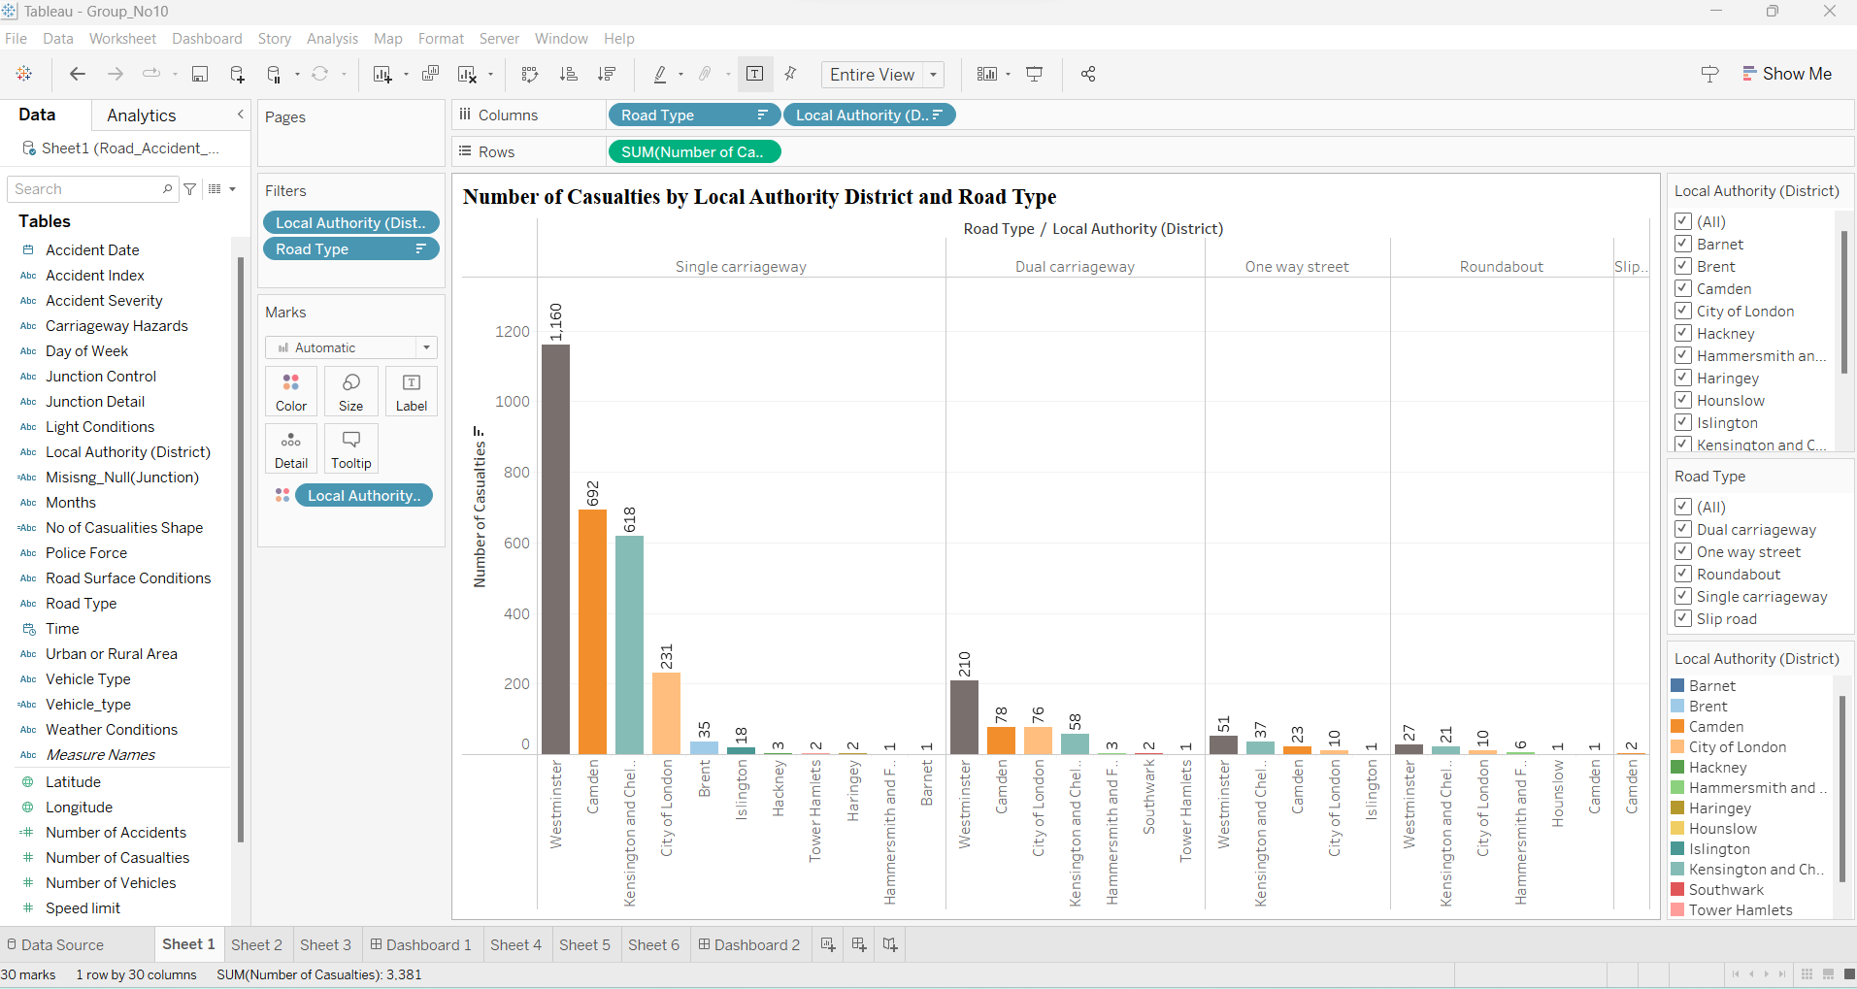
Bar Chart Number of Casualties by Local Authority District and Road Type
Each bar in the chart represents a local authority district, with multiple segments within each bar corresponding to different road types.
The height of each segment represents the total number of casualties recorded for that specific road type within the respective local authority District.
Where the highest no of causalities showed by the west minister in each road type.

Slide 6
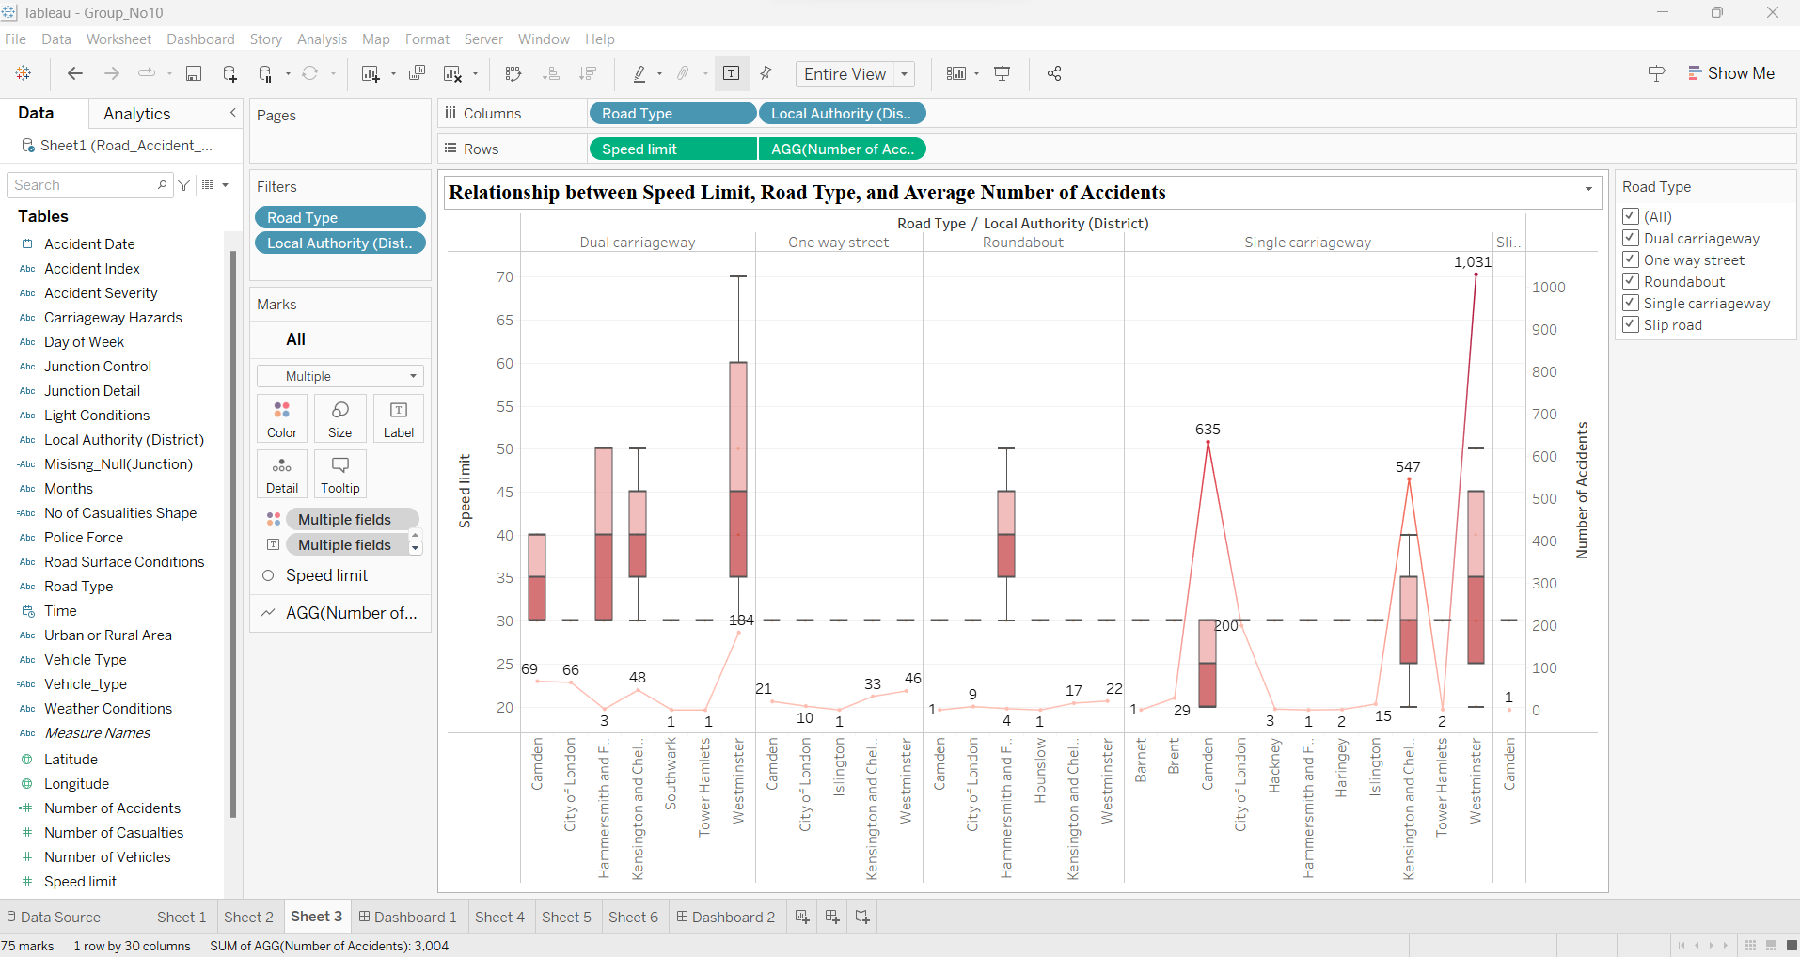
Dual-Axis Chart Relationship between Speed Limit, Road Type, and Average Number of Accidents
Each point on the line plot represents the average number of accidents for a specific combination of road type and local authority district.
Each box in the box plot represents the distribution of speed limits for the same combinations.
This plot shows the relationship between speed limits, road types, and accident rates, identifying any correlations or patterns that may exist.

Slide 7
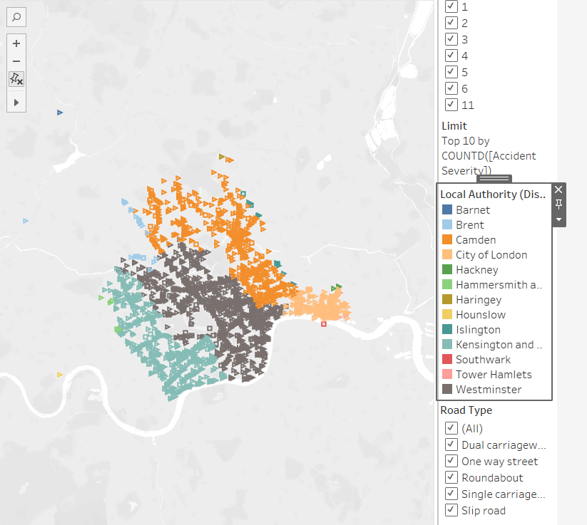
geographical map the distribution of road accident casualties across different local authority boundaries
Each point on the map represents a specific accident location, with the color of the point indicating the local authority responsible for that area.
Additionally, the shape of each point reflects the severity of the incident, with different shapes used to represent varying numbers of casualties.

Slide 8
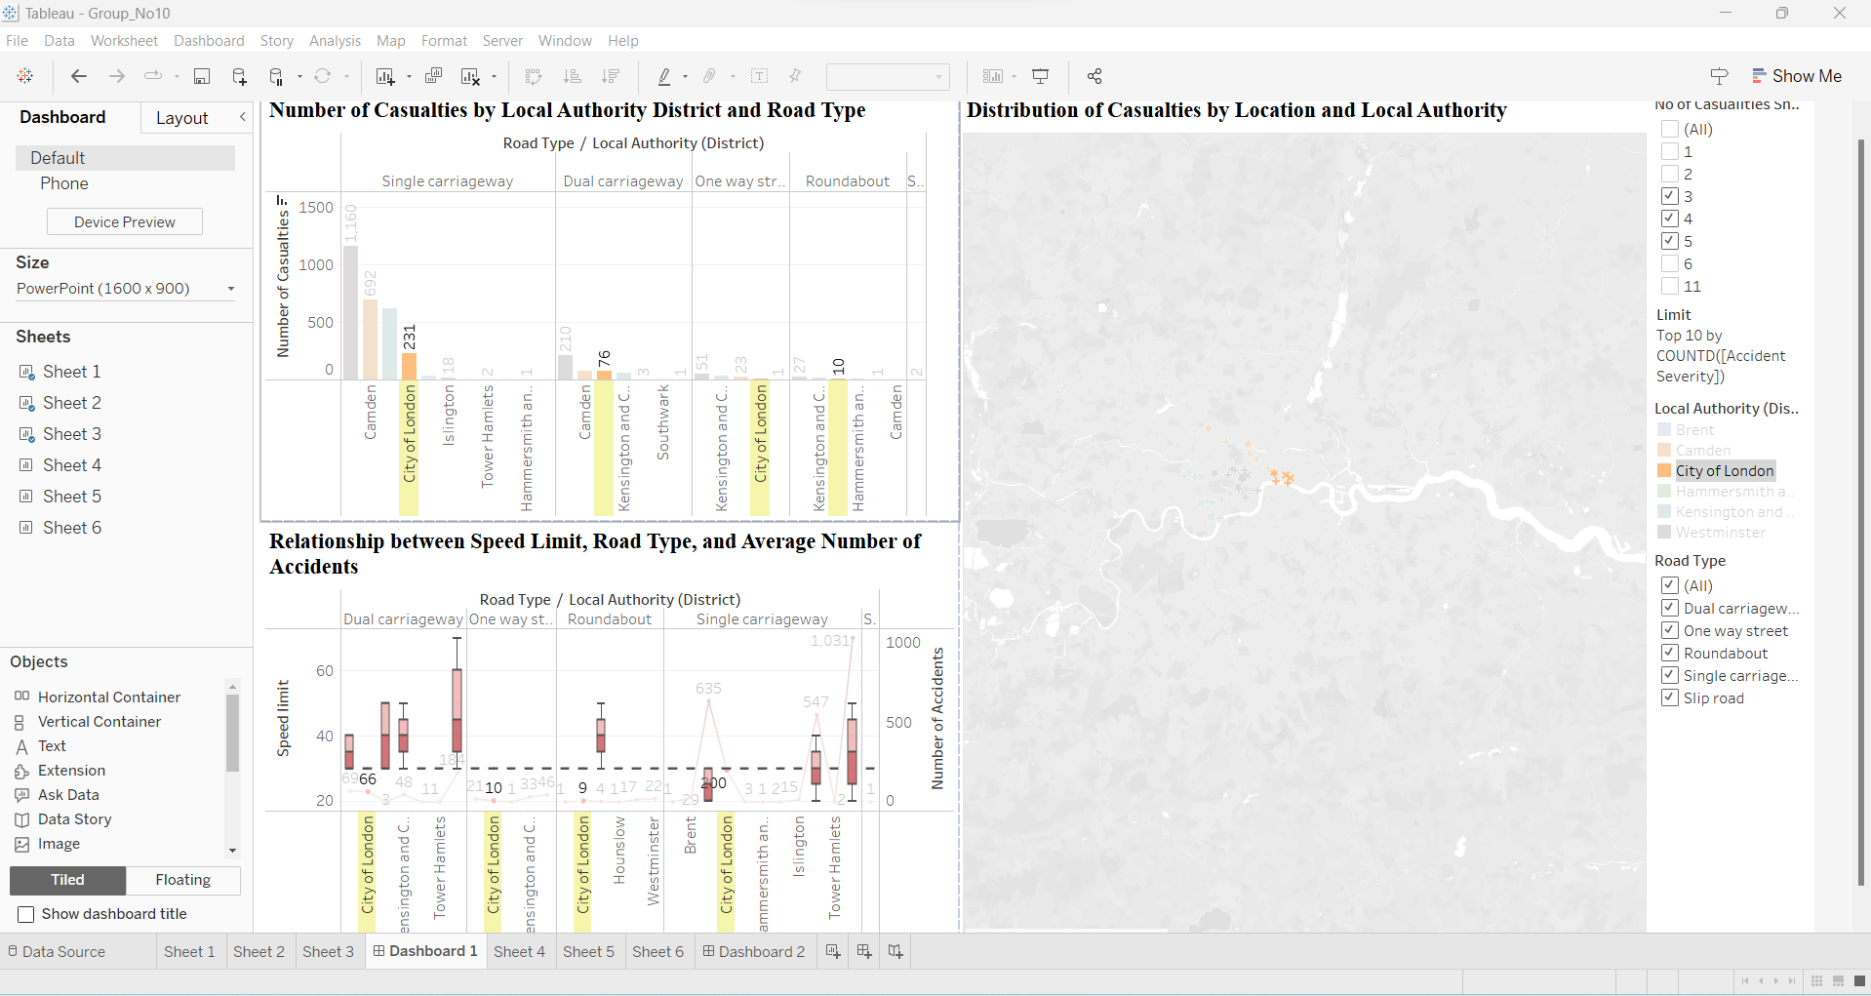
DASHBOARD 1
Interactivity: Users can filter the data by Local Authority District in the bar chart and dual-axis chart, allowing for focused analysis on specific road types
Insights: Through this dashboard, stakeholders can gain valuable insights into road traffic accidents, including spatial distribution, casualty rates, and factors influencing accident frequencies.

Slide 9
Limitations of Dashboard 1:
While Dashboard One provides valuable insights into road traffic accidents, it has several limitations to consider.
Firstly, the analysis relies heavily on reported accident data, which may not capture all incidents due to underreporting or data inaccuracies. This could lead to a skewed representation of accident frequencies and patterns, potentially overlooking less severe but still significant incidents.
Secondly, the dashboard primarily focuses on visualizing aggregate data at a macro level, which may obscure nuanced variations in accident characteristics at a more granular level

Slide 10
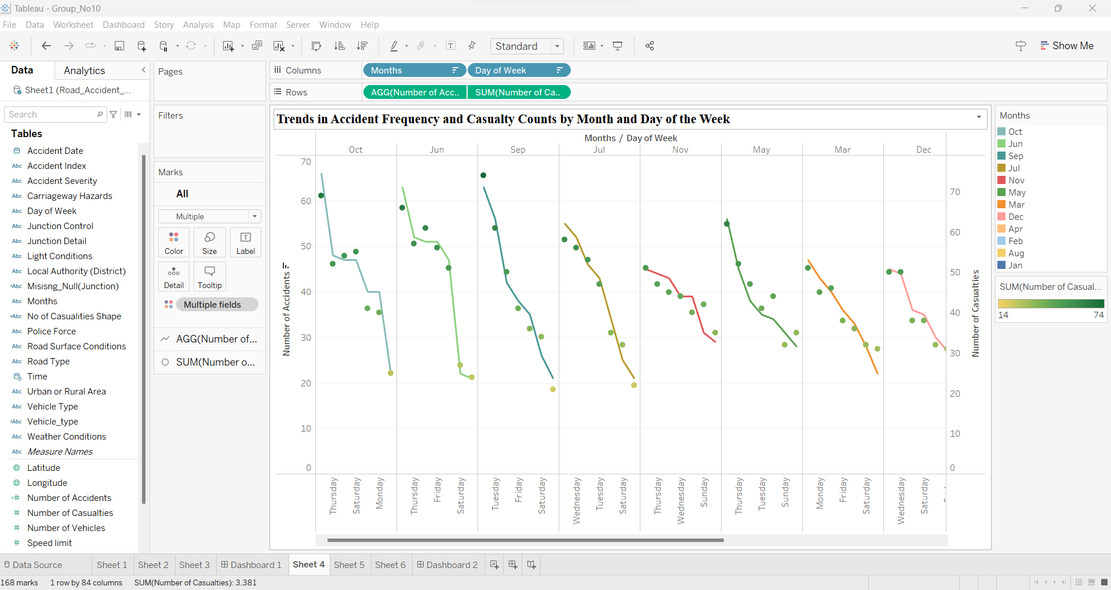
Line and Dot Chart Trends in Accident Frequency and Casualty Counts by Month and Day of the Week
Each point on the line plot represents the average number of accidents for a specific month, while each dot represents the total number of casualties for a specific day of the week.
By overlaying these plots and using color encoding for months and weekdays, We can analyze temporal patterns in accident occurrence and casualty counts, identifying any recurring trends or fluctuations.

Slide 11
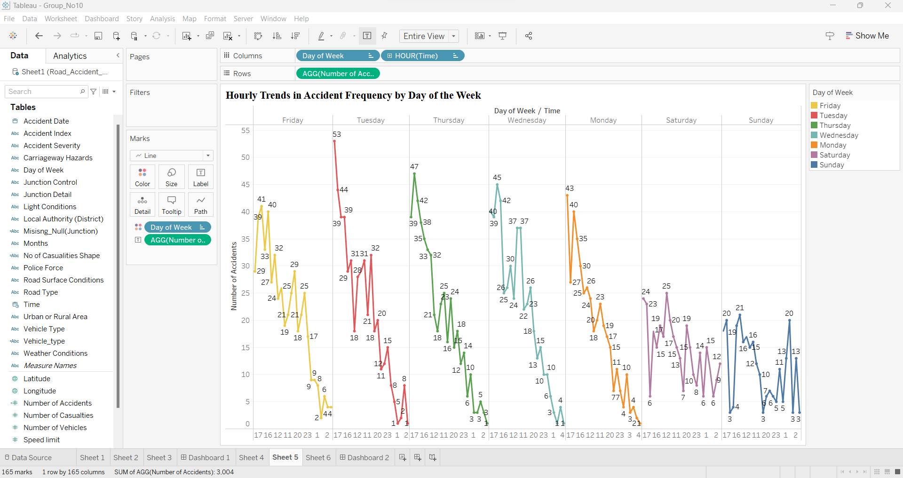
Line Chart Hourly Trends in Accident Frequency by Day of the Week
Each line on the chart represents a specific day of the week, with the x-axis indicating the hour of the day and the y-axis representing the average number of accidents.
Color encoding is used to differentiate between different days of the week, allowing stakeholders to compare trends across weekdays and weekends.

Slide 12
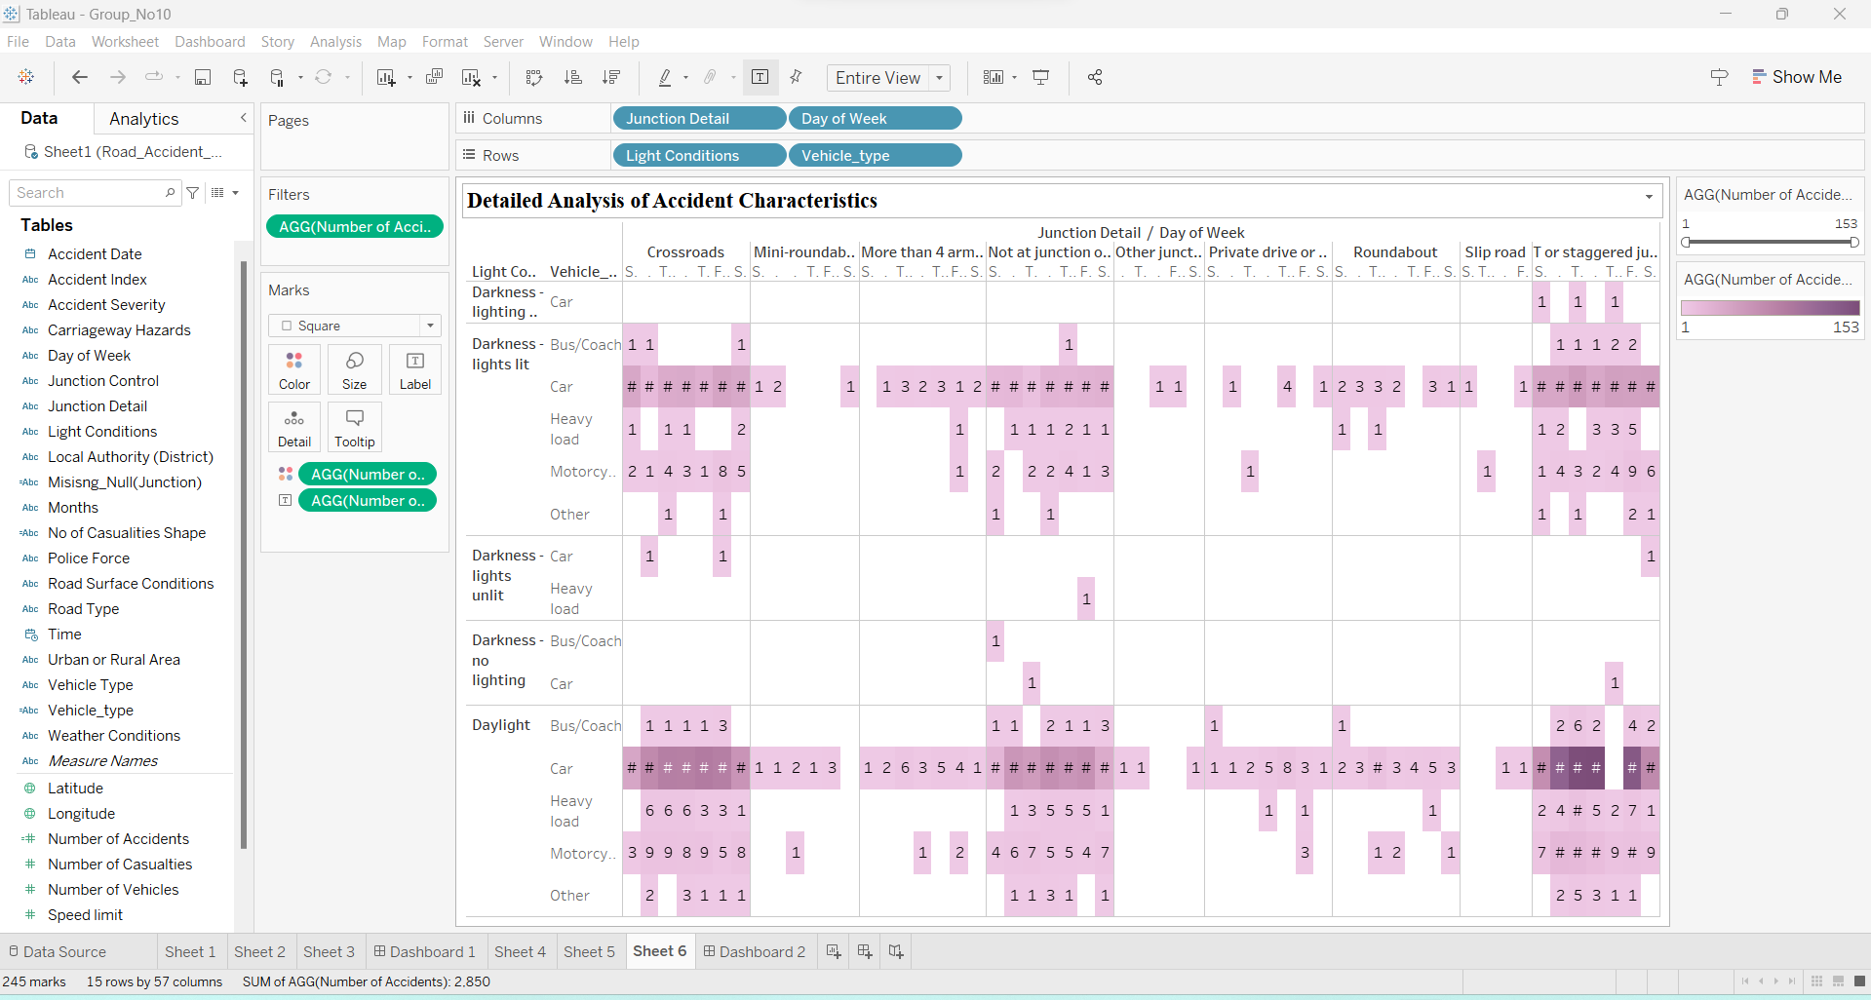
Highlighted Table Detailed Analysis of Accident Characteristics
Each cell in the table represents a unique combination of parameters, with the color indicating the number of accidents recorded under that specific condition.
By filtering the table to show the highest number of accidents, stakeholders can identify the most prevalent accident scenarios and explore additional factors contributing to these incidents.

Slide 13
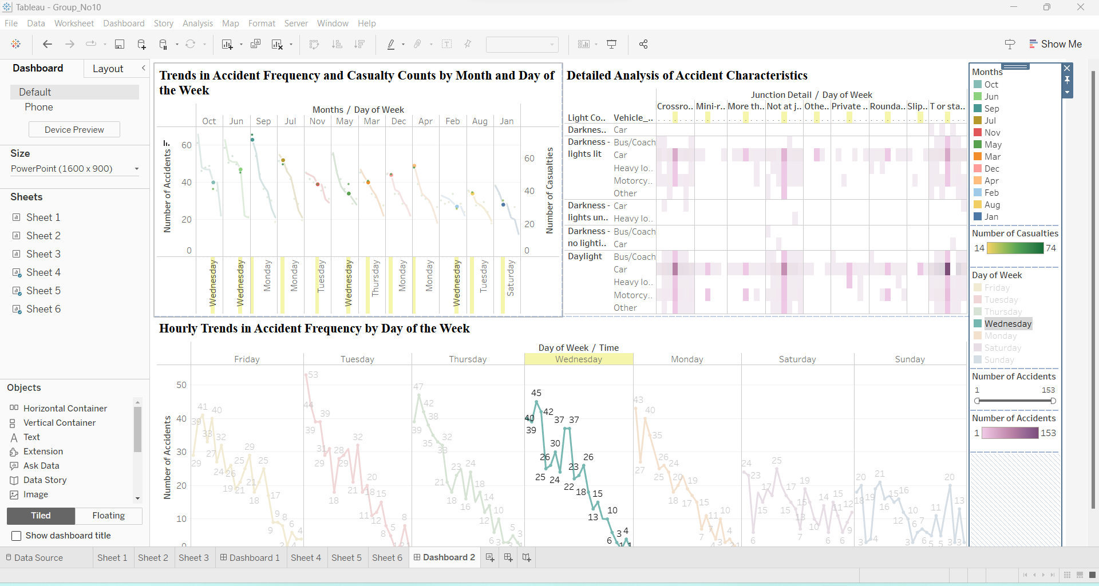
DASHBOARD 2
Overview: It allowing users to explore specific combinations of junction detail, day of the week, lighting condition, and vehicle type. The table facilitates granular exploration of accident scenarios, aiding in the identification of common patterns and risk factors.
Insights from Highlighted Table: The highlighted table enables stakeholders to identify prevalent accident scenarios, such as junction types associated with high accident rates on specific days of the week or under lighting conditions.

Slide 14
Limitations of Dashboard 2:
Dashboard Two offers valuable insights into temporal patterns and spatial distributions of road traffic accidents, yet it has its limitations.
Firstly, the analysis is constrained by the availability and quality of data, particularly regarding accident location accuracy and completeness.
Inaccurate or incomplete location data could compromise the reliability of spatial analyses and hotspot identification.
Secondly, the dashboard primarily focuses on visualizing temporal trends and spatial distributions, overlooking other potential factors contributing to accidents, such as road conditions, driver behavior, or vehicle characteristics.

Slide 15
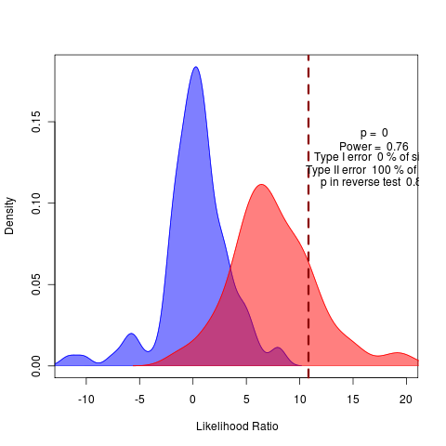

Conclusion
From the dashboard 1,
It is evident that Westminster local authority experiences the highest number of accidents, totaling 1031, with casualties numbering at 1160.
These incidents predominantly occur on single carriageways with a speed limit of 20 mph.
Additionally, the data highlights the need for targeted interventions in Westminster to address road safety concerns and reduce accident rates.
From the dashboard 2,
The highest number of accidents occurs on Tuesday, Wednesday, and Thursday evenings, particularly between 5 to 6 pm.
These incidents predominantly happen in daylight conditions involving cars, and the road junctions involved are primarily observed as T or staggered junctions.
This insight underscores the importance of targeted safety measures during peak traffic hours hours.

Slide 16
References
How To Create Data Reports That Will Skyrocket Your Business Performance, By Bernardita Calzon in Reporting, Mar 22nd 2024 (25 Dashboard Design Principles, Best Practices & How To's (datapine.com))
Dashboard examples: The good, the bad and the ugly (Dashboard examples: The good, the bad and the ugly (matillion.com))
Best Practices for Designing Dashboards (Best Practices for Designing Dashboards | DataCamp)
Batt, S., Grealis, T., Harmon, O., & Tomolonis, P. (2020). Learning Tableau: A data visualization tool. The Journal of Economic Education, 51(3–4), 317–328. (https://doi.org/10.1080/00220485.2020.1804503)
Analyzing Traffic Accident and Casualty Trend Using Data Visualization, By Abdullah Sakib, Saiful Adli Ismail, Haslina Sarkan, Azri Azmi & Othman Mohd Yusop (Analyzing Traffic Accident and Casualty Trend Using Data Visualization | SpringerLink)
Chai, C. P. (2020). The Importance of Data Cleaning: Three Visualization Examples. CHANCE, 33(1), 4–9. (https://doi.org/10.1080/09332480.2020.1726112

Slide 17

Thank you
GROUP NO 10

