Slide 1


Consumer Spending Trends and Patterns: A Time History Analysis
Nivedita Thorat
SEC-B W0826550

Slide 2
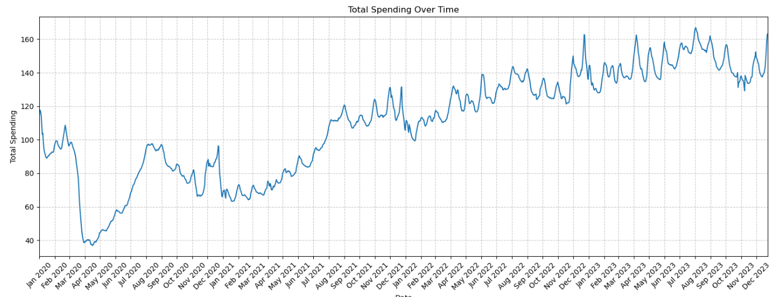
Total Spending over Time
Insights:
Upward Trend: Overall, there's a consistent increase in spending over time, suggesting growing customer base or increased spending per customer.
Seasonal Patterns: Spending fluctuates throughout the year, with peaks and troughs likely influenced by seasonal factors like holidays and weather.
Monthly Variations: Specific months consistently show higher or lower spending, indicating potential opportunities for targeted marketing and promotions.
Recommendations:
Capitalize on Peak Seasons: Identify high-spending months and implement strategies to maximize sales during these periods.
Address Low-Spending Periods: Develop strategies to stimulate demand during slower months, such as discounts or special offers.
Monitor and Adapt: Continuously track spending trends and adjust strategies to respond to changing customer behavior.

Slide 3
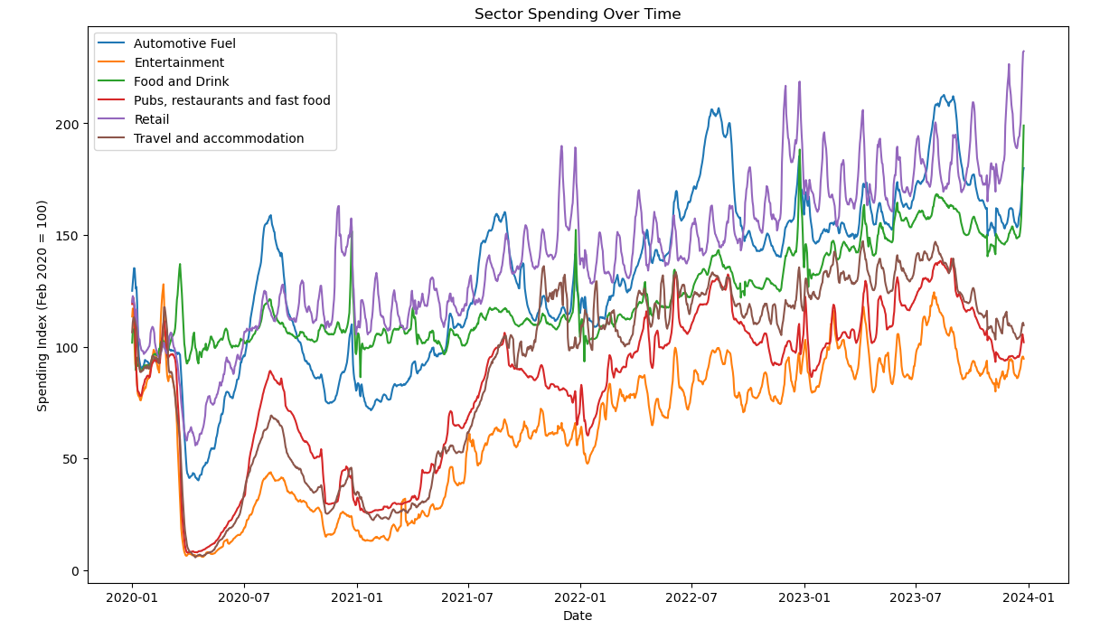
Spending in Different Sector over Time
Insights:
The plot likely shows a significant drop in spending, particularly in sectors like "Travel and Accommodation," "Entertainment," and "Pubs, restaurants and fast food" during the peak of the COVID-19 pandemic.
Despite the pandemic, many sectors have shown an overall upward trend, indicating resilience and potential for future growth.
There are distinct seasonal patterns in spending, with peaks and troughs throughout the year. This could be influenced by factors like holidays, weather, and social events.

Slide 4
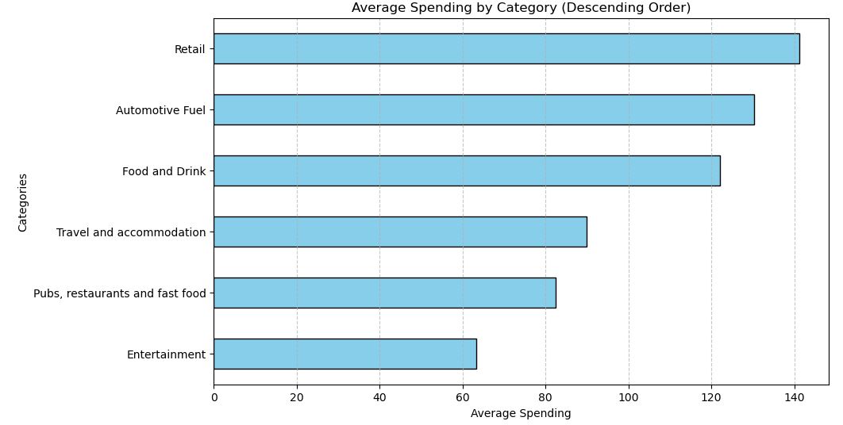
Average Spending by Category
Insights
1. Retail Dominance: Retail spending is significantly higher than other categories, indicating a strong preference for in-store purchases.
2. Essential Spending: Categories like "Automotive Fuel," "Food and Drink," show consistent spending, suggesting these are essential expenses.
Recommendations
1. Prioritize Retail Partnerships:
Focus on forging strategic partnerships with major retailers to offer exclusive deals and cashback rewards to Revolute customers.
2. Stimulate Discretionary Spending:
Introduce travel and entertainment packages in collaboration with travel agencies and event organizers to encourage spending in these categories.

Slide 5
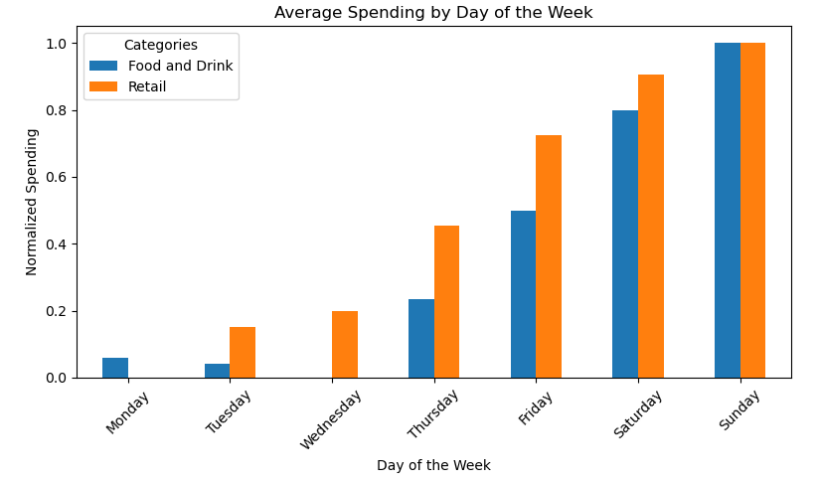
Weekly Trends on Food and Retail
Insights:
Weekend Spending: There's a significant spike in spending on Saturdays and Sundays, particularly in the "Food and Drink" category. This suggests increased social activity and dining out on weekends.
Weekday Patterns: Spending tends to be lower on weekdays, with a slight increase towards the end of the week. This could be attributed to people spending more on leisure activities and dining out as the weekend approaches.
Retail Spending: Retail spending shows a more consistent pattern throughout the week, indicating regular shopping behavior.
Recommendations:
Weekday Incentives: Consider implementing mid-week promotions or loyalty programs to stimulate spending during weekdays.

Slide 6
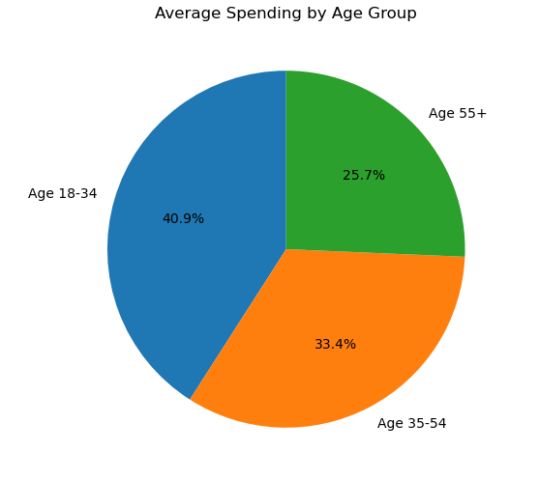
Demographic Analysis
Insights:
Dominance of Younger Age Groups: The 18-34 and 35-54 age groups dominate the user base, accounting for a significant portion of the total.
Digital Native Market: The strong presence of younger age groups suggests a significant market for digital products and services.
Recommendations:
Leverage digital marketing channels to reach and engage with younger audiences and Implement loyalty programs and personalized offers to retain existing customers, especially in the 18-34 age group.
Stay ahead of emerging trends and technologies to cater to the evolving needs of younger generations.

Slide 7
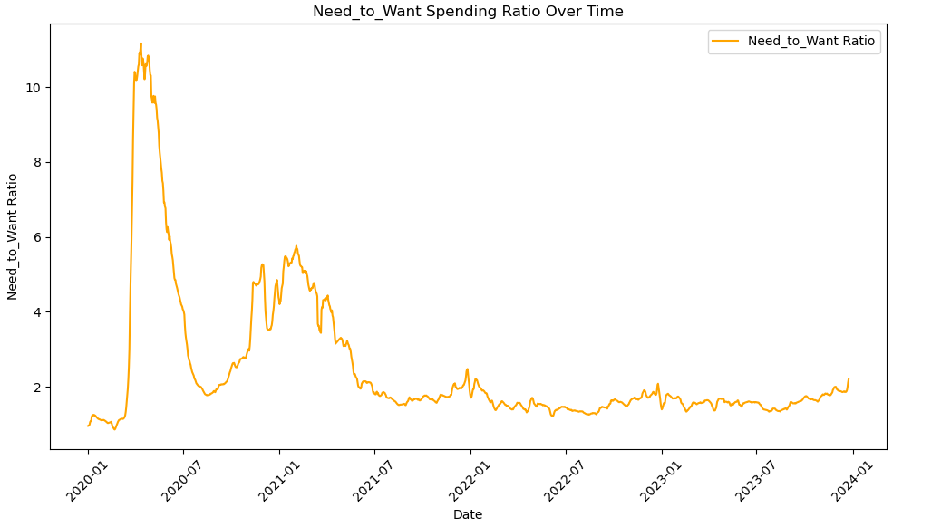
Need to want spending Ratio over Time
Insights:
Stabilization: The Need-to-Want ratio has stabilized post-pandemic, indicating a return to a more balanced spending pattern.
Emerging Trends: There might be new trends emerging, such as increased spending on experiences, health and wellness, and sustainable products.
Recommendations:
Regional Differences: Different regions may exhibit varying trends due to factors like economic conditions, cultural preferences, and government policies.
data['Need'] = data['Food and Drink'] + data['Retail’]
data['Want'] = data['Entertainment']+data['Pubs, restaurants and fast food’]
data['Need_to_Want_ratio'] =data['Need'] / data['Want’]

Slide 8
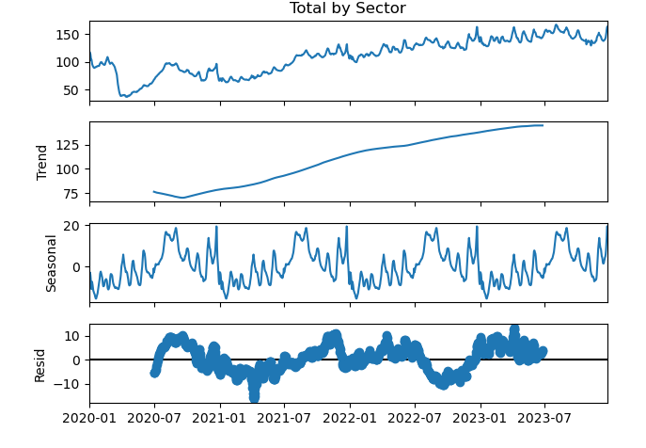
Time Series Decomposition Plot
Insight:
Upward Trend: The overall trend in total spending is upward, indicating a general increase over time.
Seasonal Patterns: There are clear seasonal patterns in the data, with peaks and troughs recurring annually. This suggests that factors like holidays, weather, and economic cycles influence spending behavior.
Residual Noise: The residual component shows random fluctuations, indicating that there might be some unexplained noise or random variation in the data.
Recommendations:
Leverage Seasonal Patterns: Identify peak seasons and plan marketing strategies to capitalize on increased demand.
Monitor Trends: Continuously track the trend component to identify potential shifts in consumer behavior and adjust business strategies accordingly.

Slide 9
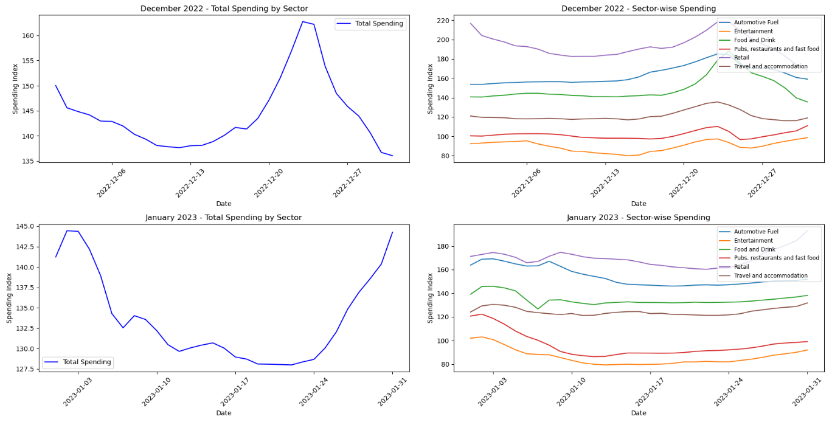
Identify peak seasons
Insights:
Spending fluctuates across sectors, with Automotive Fuel and Entertainment showing the most significant changes.
Total spending increased in the end of December 2022 and in the beginning of January 2023.
Recommendation:
Analyze the reasons behind the fluctuations, as well as the overall increase in total spending in December, January. This will help inform targeted marketing and promotional strategies.

Slide 10
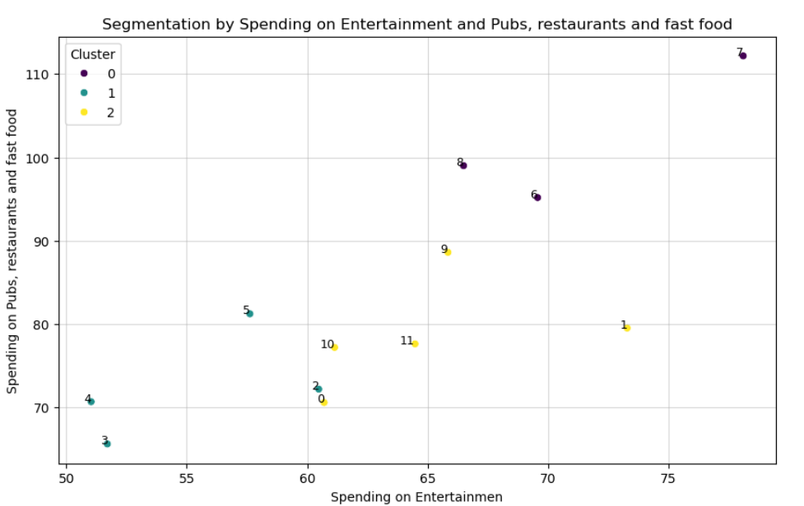
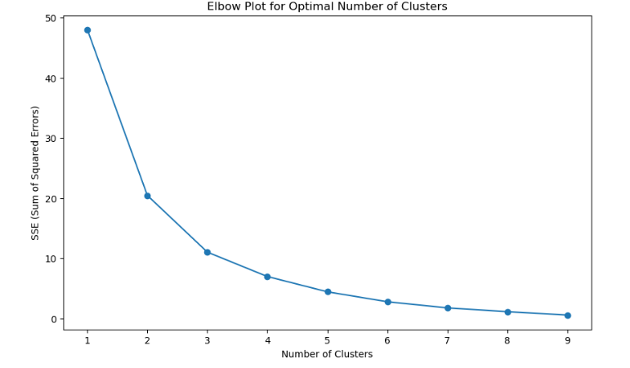
Cluster the Months basis of Spending Patterns
Insights:
June July August are the months in which highest spending on the entertainment and pub, restaurants is observed.
Recommendations: Revolute can make strategy providing discounts on certain merchants to increase spending in months of Feb, March, April.

Slide 11

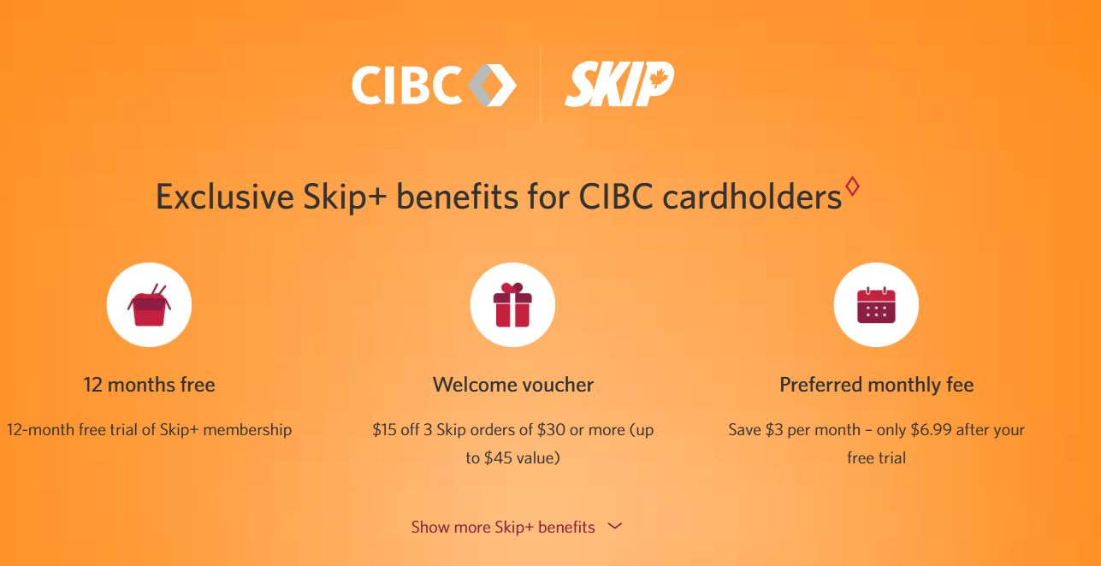
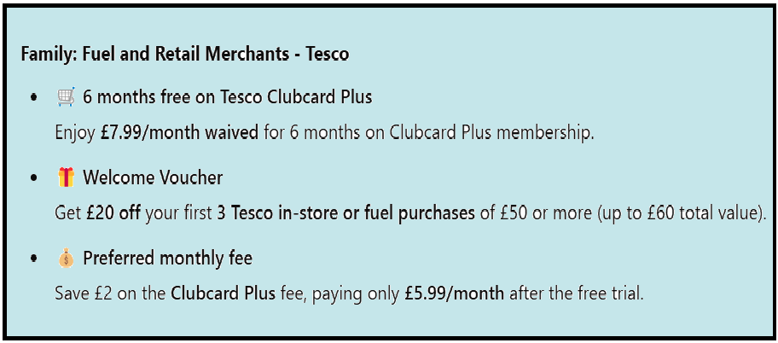
Summary
Capitalize on Seasonal Peaks: Launch targeted promotions during high-spending months like December and January to maximize revenue, as these months show consistent increases in total spending​
Boost Low-Activity Periods: Stimulate demand during slower months such as February, March, and April with strategic discounts or offers, focusing on discretionary categories like entertainment and dining​
Target Younger Audiences: Engage the dominant 18-34 age group with personalized loyalty programs and digital campaigns to drive retention and spending growth​
Leverage Retail Dominance: Strengthen partnerships with retail merchants and provide exclusive deals to benefit from the consistent preference for retail spending​
Adapt to Emerging Trends: Monitor the stabilization in the "Need-to-Want" ratio and invest in growing categories such as health, wellness, and sustainable products to stay ahead of consumer priorities​

Slide 12
THANK YOU!

