Slide 1

Experiential Learning Project Assessment-I on
“File Encryption/Decryption Tool”
under the course
Python Programming Language (N-PCCCM304P)
Presented By : Nivedita Nandurkar
(CM25037)
Under the Guidance of
Mrs. Mayuri Getme
Session:2026-27 (ODD )
Department of CSE(AI&ML)
S. B. JAIN INSTITUTE OF TECHNOLOGY MANAGEMENT AND
RESEARCH,NAGPUR
An Autonomous Institute, Affiliated to RTMNU, Nagpur
)

Slide 2
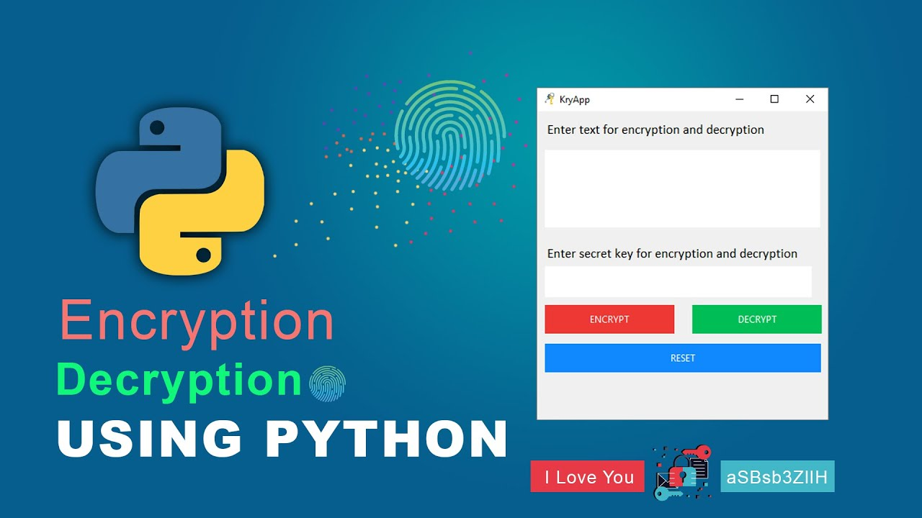
Contents
Problem statement :
Encrypt and Decrypt files. The application should protect sensitive information by converting the contents of a file into an unreadable format (encryption) using a secret key. Only users with the correct key should be able to restore the original content through decryption.
S. B. Jain Institute of Technology Management and research

Slide 3
Objectives :
The main objective of this project is to develop a File Encryption/Decryption Tool using Python to secure important and sensitive files. The tool will convert readable files into an unreadable encrypted format using a secret key. It will allow authorized users to decrypt the files using the correct key and restore the original content. The project aims to prevent unauthorized access and protect data privacy. It also demonstrates the practical use of cryptography and data security techniques.
Secure sensitive files from unauthorized access.
Encrypt files using a secret key.
Decrypt files using the correct key.
Maintain data privacy and security.
Preserve the original file content after decryption.
Provide a simple and easy-to-use application for users.
To secure sensitive files from unauthorized access using encryption.
To encrypt and decrypt files using a secret key while maintaining the original data.
To demonstrate the practical use of Python and cryptography for data security.
S. B. Jain Institute of Technology Management and research

Slide 4
Algorithm :
Start the program and display the main menu.
Allow the user to select Encryption or Decryption.
Ask the user to select the input file and enter/provide the secret key.
For encryption, read the file data, apply the encryption algorithm using the key, and save the encrypted data as a new file.
For decryption, read the encrypted file and use the correct key to restore the original data.
Display a success or error message and end the program.
S. B. Jain Institute of Technology Management and

Slide 5
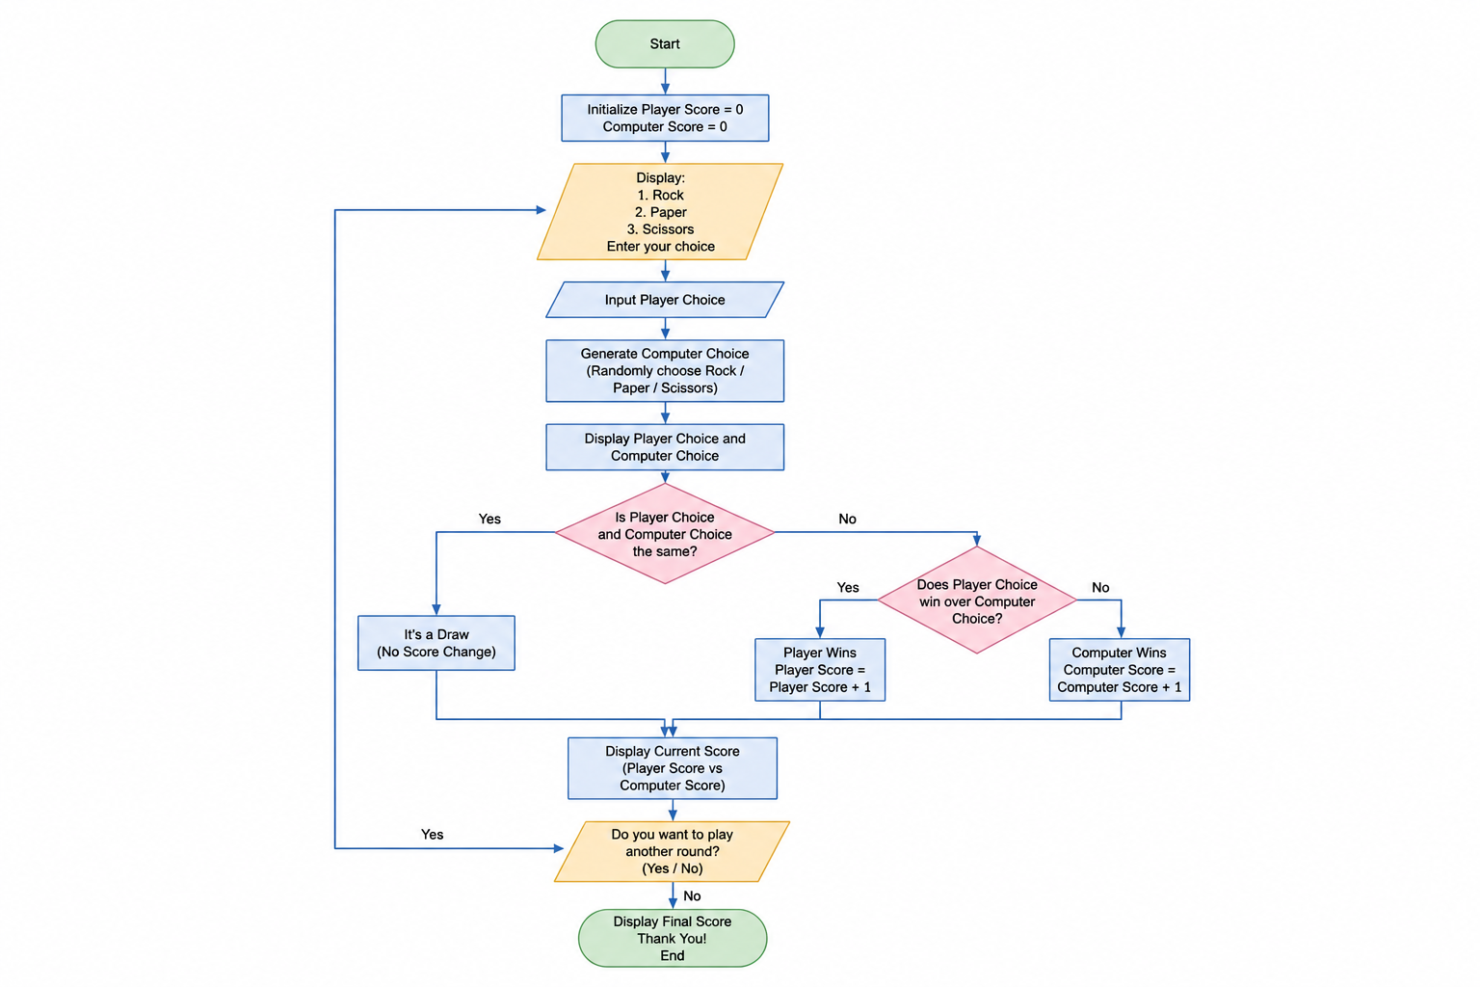
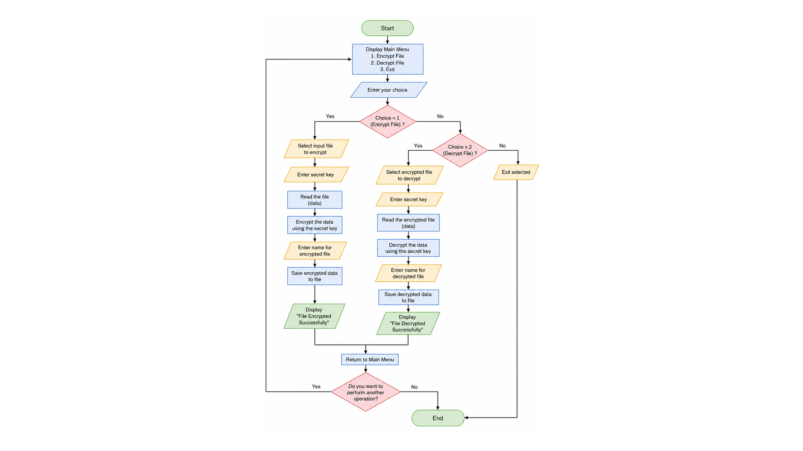
:
Flowchart/pseudocode :
S. B. Jain Institute of Technology Management and

Slide 6
Understanding of Python logic :
Python Logic Used in This Problem
The following Python programming logic is used in the File Encryption/Decryption Tool:
Conditional Statements (if-elif-else) – To select encryption, decryption, or exit based on the user's choice.
File Handling – To open, read, write, and save files using Python.
Functions – To create separate functions for encryption and decryption operations.
Loops (while) – To allow the user to perform multiple encryption/decryption operations.
User Input – To take the file name/path, operation choice, and secret key from the user.
Exception Handling (try-except) – To handle errors such as an incorrect key or missing file.
Cryptography Logic – To convert readable data into encrypted/unreadable data and restore it using the correct key.
S. B. Jain Institute of Technology Management and

Slide 7
GitHub account, repository creation, uploading code, meaningful commits, collaboration, individual contribution
Create a GitHub account and set up a new reposiory for the project.
Upload the project code, along with a README explaining setup and usage.
Make meaningful, incremental commits that describe each change (e.g., "Add encryption function", "Add error handling").
Collaborate using branches and pull requests when working with a team.
Track individual contribution through commit history so each member's work is visible.
S. B. Jain Institute of Technology Management and

Slide 8



