Slide 1
“Smart Gloves For Deaf and Dumb ”
Mini Project – III
Neetha Nataraj 1NH18EC077
Nivedita Salimath 1NH18EC080
Shivani Yadav 1NH18EC103
Sowmya L 1NH18EC108
Guided By
Mr. B. V. Santhosh Krishna
Senior Assistant Professor
Dept. of ECE
New Horizon College of Engineering, Bengaluru

Slide 2
Contents
Introduction
Literature Review
Existing System
Problem Statement & Objectives
Proposed System
Block Diagram
Hardware & Software Specification
Circuit Diagram & Working
Algorithm / Flow Chart
Results & Discussion
Advantages
Conclusion & Future Scope
References
Progress Work
Milestones/Schedule

Slide 3
Introduction
Communication is the only way by which we are able to express our thoughts among the peoples. Normal people can convey their thoughts effectively by establishing the conversation between them.
Generally, disabled people use the sign language for communication but they find problems in communication with those that are not able to understand sign language. Also, many disabled people do not know sign language themselves. Thus, a communication barrier is created between disabled people and the others around them.
The main objective of this system is to reduce the communication gap between two communities. The proposal of our project is to develop a system where disabled people can communicate with other people by using this hand glove.
We have developed a system which senses the bending movement of a finger using flex sensor, processes the input and displays the corresponding predefined statement.

Slide 4
Literature Review
Title of the paper | Author & Year of Publication | Outcome | Limitation
On design and implementation of a sign-to-speech/text system | Anwar Jamdal Ahmed Al-Maflehi Year-2017 | Implemention of sign to speech/text translator. | Only limited signs are allowed .
Smart glove for Sign Language communications | Abhinandan Das, Lavish Yadav, Mayank Singhal Year-2016 | Creating a device hearing or speech impaired persons to communicate with others | Heavier and expensive.
Development of Sign Language using Flex Sensors | Ajay Suri, Sanjay Kumar Singh, Rashi Sharma, Pragati Sharma Year-2020 | To reduce the communication barrier between a normal individual and a deaf/dumb individual. | Facial expressions are not considered .
Sign language interpreter using a smart glove | Nikhita Praveen,Naveen Karanth, M S Megha Year-2014 | Upon reception, the letter corresponding to the received ASCII code is displayed on the computer and the corresponding audio is played. | Not all the words and letters are recognised.

Slide 5
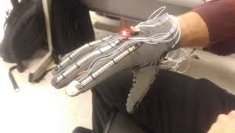
Existing System
Sign Language Recognition –These systems convert signs into text and speech.
Glove Sensor -Various sensors are used along with gloves to capture physical data like bending ,stretching ,movements.
Gesture and Pattern Recognition -Glove along with flex sensors and IMU(Inertial Measurement Unit) recognize gestures along with patterns.
Man-machine interface(MMI) - Acts as main bridge in this project by displaying text after processing sensor input.

Slide 6
Problem Statement & Objectives
Problem Statement:
In day to day life disabled persons will face many challenges like communication problem, degraded status etc, so we require a system which addresses this issue.
Objectives:
To study existing commercially available products / technologies.
To arrive at specific sensors and technical parameters necessary to come up with a solution to this problem.
To process data from all the sensors to get proper text .

Slide 7
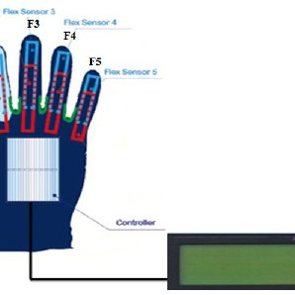
Proposed System
To overcome the problems faced by disabled people we developed a hand glove which consists of 3 flex sensors that detects the changes in resistance indicating when a finger is bent.
On back of the hand lies a Arduino UNO circuit , which acts as the heart of the system that analyses all these incoming signals and transmits them to LCD in order to display the resulting text.

Slide 8
Block Diagram
User Gesture
Flex
Sensor
Arduino
UNO
LCD
Power Supply

Slide 9
Hardware & Software Specification
Hardware Specification
1)Arduino UNO
The Arduino Uno is an open-source microcontroller board based on the Microchip ATmega328P microcontroller and developed by Arduino.cc. The board is equipped with sets of digital and analog input/output pins that may be interfaced to various expansion boards and other circuits.
Operating Voltage – 5V
Digital input pins -14
Analog input pins – 6
2) Flex Sensor
A flex sensor or bend sensor is a sensor that measures the amount of deflection or bending. Usually, the sensor is stuck to the surface, and resistance of sensor element is varied by bending the surface.
3) LCD(16*2 )
4) 10 kΩ fixed and 10 kΩ variable resisters

Slide 10
Software Specification
Arduino IDE (Integrated Development Environment)
The Arduino Integrated Development Environment (IDE) is a cross-platform application, It is used to write and upload programs to Arduino compatible boards
Written in – C , C++
Operating System – Windows

Slide 11
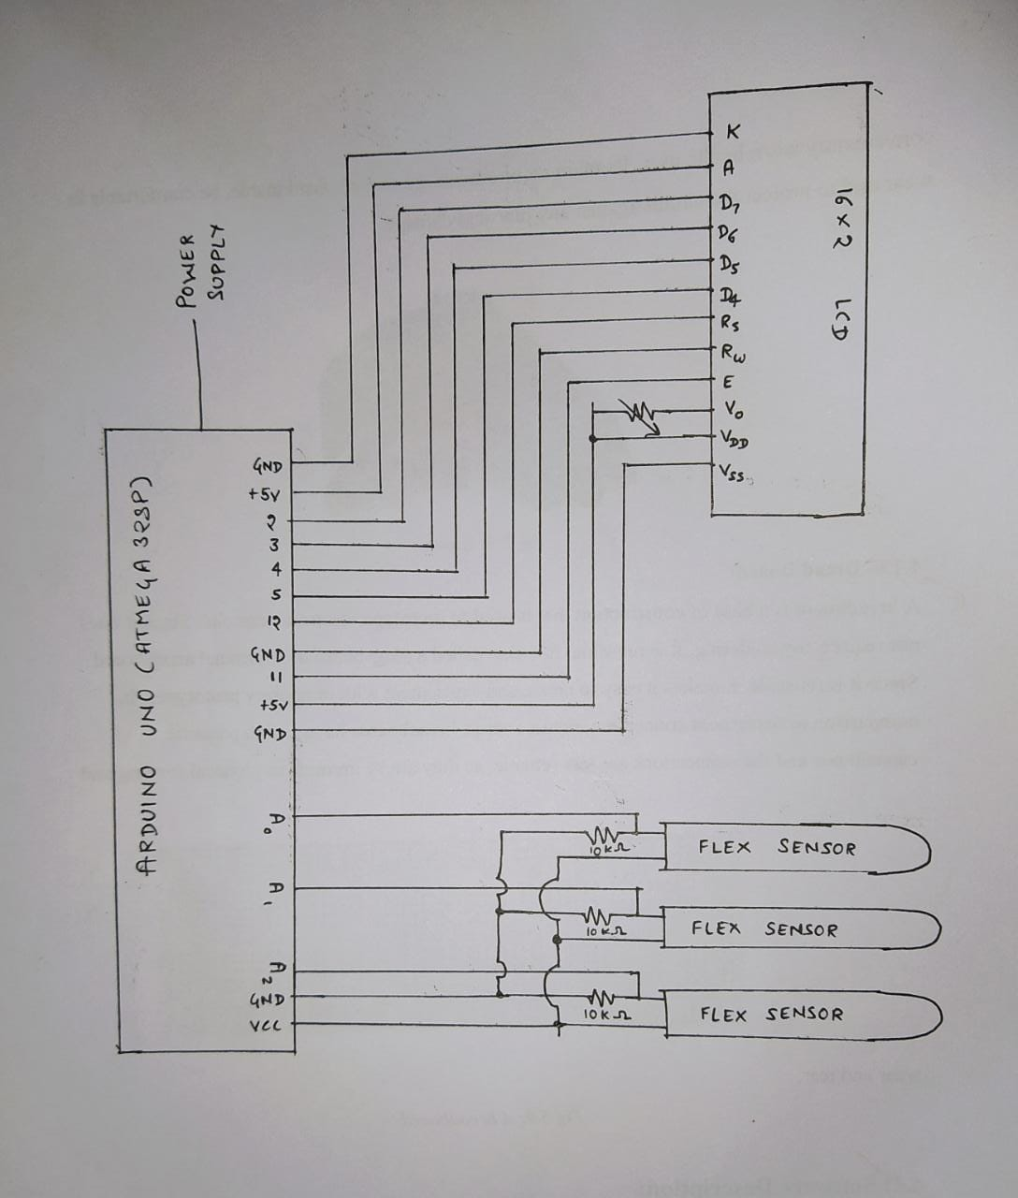
Circuit Diagram & Working

Slide 12
Working
The working of this project starts from movement of hand gloves where the flex sensors are attached, and the value of sensor changes when its experiences the bending.
The flex sensor is another type of potentiometer, that is attached to the fingers. When we bend the finger, the resistance value of the sensor changes.
The changing value of the sensor is depends upon the resistance and applied angle of the bending. When we bend the sensor at some particular angle, we can see the value of the resistance is increases and accordingly the output gets reduced.
The input to the Arduino UNO which is the output of previous system is processed and the corresponding message is displayed on the LCD.

Slide 13
Algorithm / Flow Chart
Start
Hand Gesture
If sign recognised
NO
Sensor Data
YES
Text Conversion
Stop

Slide 14
Results & Discussion
The disabled use these gloves to convert movements performed by them into speech.
From the convenience of simple flex sensors, a user is able to interact with others in more comfortable and easier manner. This makes it possible for the user to not only interact with their community but with others too.
The end product will have a cheap and simplistic design making it easy and affordable for users to interact with.
The system is capable of recognizing signs more quickly. Furthermore real time recognition ratio of nearly 99% can be easily achieved

Slide 15
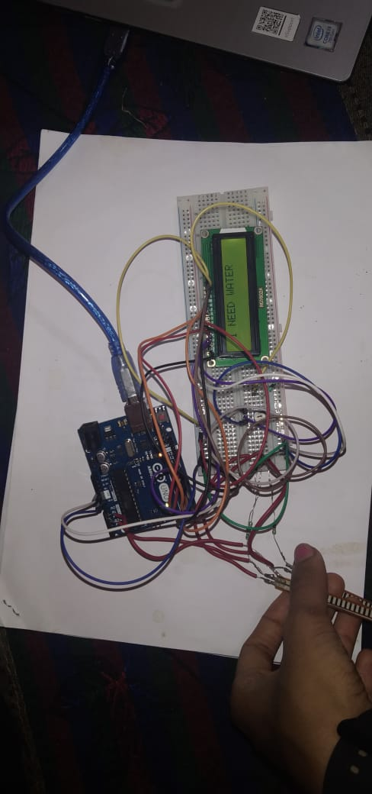
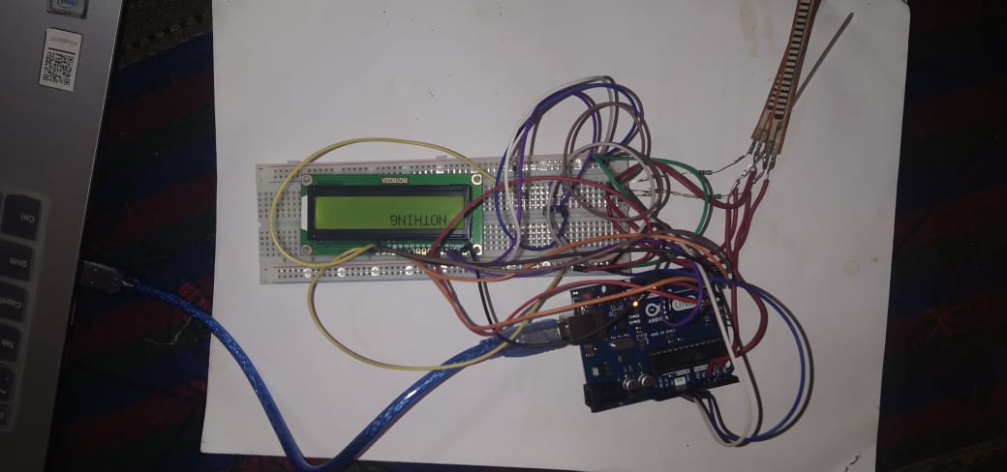
Results
Output with bending of finger
Output without bending of finger

Slide 16
Advantages
Advantages
This System eliminates the barrier in communication between mute community and the normal people.
It is also useful for speech impaired and temporarily paralysed people.
Easy to operate: Anyone can operate it easily.
Easy to define gestures: we can add or define our own gestures.
Communication is possible in any language.
Flexible to users.
It takes less power to operate system

Slide 17
Conclusion & Future Scope
Conclusion
This project aims to lower the communication gap between the deaf or mute community and the normal world. Using data gloves, disabled people can also grow in the community and makes nation come together, as percentage of disabled people are millions in count. Making their future better is making the nation better.
Future Scope
Future implementation can be made by enhancing the quality of the mobile application which can be used to produce a lot of technical quality research as in what is to be implemented to assist them more.
It can be implemented in various fields like in airport and railway stations to assist the speech impaired.
A handy and portable hardware device with the pair of data gloves can be manufactured so that a deaf and dumb person can communicate to any normal person anywhere.

Slide 18
References
[1] Anwar Jamdal, Ahmed Al-Maflehi “On design and implementation of a sign-to-speech/text system” 2017 International Conference on Electrical, Electronics, Communication, Computer, and Optimization Techniques (ICEECCOT) , 08 February 2018
[2] Abhinandan Das, Lavish Yadav,Mayank Singhal “Smart glove for Sign Language communications” 2016 International Conference on Accessibility to Digital World (ICADW), 08 June 2017
[3] Ajay Suri, Sanjay Kumar Singh, Rashi Sharma, Pragati Sharma, “Development of Sign Language using Flex Sensors”, 2020 International Conference on Smart Electronics and Communication (ICOSEC), 07 October 2020
[4] Nikhita Praveen,Naveen Karanth, M S Megha, “Sign language interpreter using a smart glove” , 2014 International Conference on Advances in Electronics Computers and Communications, 08 January 2015

Slide 19
Progress Work
1st October : Mini project topic searched and discussed.
5th October : Mini project topic was finalised as Smart Gloves for Deaf and Dumb.
28th October : Software installation was done
10th November : Hardware components were purchased.
20th November : Checking different connections and tried with different components and collected information for code.
12th December : Started working on Power point presentation .
18th December : 50% project work was done.
22th December : Started working on report.

Slide 20
Milestones/Schedule
Milestone | Baseline Date | Target Date | Achievement
Software Installation | 28/10/2020 | 28/10/2020 | Successful
Project Code | 23/11/2020 | 25/10/2020 | Successful
Power Point Presentation | 12/12/2020 | 27/12/2020 | Completed
Report | 22/12/2020 | 08/01/2020 | Completed

Slide 21
Thank You

