Slide 1
“CAR NUMBER PLATE DETECTION USING MATLAB”
Mini Project - II
Sowmya.L - 1NH18EC108
Nivedita Salimath - 1NH18EC080
Navya.M.K - 1NH18EC075
Meghanashree.C - 1NH18EC128
Guided By
Mr. Aravinda K.
Senior Assistant Professor
Dept. of ECE
New Horizon College of Engineering, Bengaluru

Slide 2
Contents
Introduction
Literature Review
Existing System
Problem Statement & Objectives
Circuit Diagram & working
Algorithm / Flow Chart
Block Diagram
Result & Discussion
Advantages
Conclusion / Future Scope
Reference
Progress Work
Milestone/schedule

Slide 3
Introduction
A vehicle registration plate is a metal or plastic plate attached to a motar vehicle or a trailer for official identification purposes.
The registration number is a numeric or an alphanumeric code that uniquely identifies the vehicle within the issuing region’s database.
The ANPR(Automatic Number plate Recognition ) system is based on image processing technology.
It is one of the necessary systems designed to detect the vehicle number plate.
ANPR system is used at many places like Petrol pumps, Shopping Malls, Airports etc.

Slide 4
In order to detect the car number plate we require three codes as follows :-
Template Creation
Letter Detection
Plate Detection
Template Creation:
This is used to call the saved images of alphanumeric and then save them as a new template in MATLAB memory.

Slide 5


Letter Detection: Reads the characters from the input image and find the highest matched corresponding alphanumeric.
Plate Detection:
Process the image and then call the above two m-files to detect the number.

Slide 6
Literature Review
Title of the paper | Author & Year of Publication | Outcome | Limitation
An intelligent control system using an efficient license plate location and recognition approach | Saeed Rastegar , Reza Ghaderi, Gholamreza Ardeshipr & Nima Asadi ,2009. | Location of the Number plate | Failed to recognise characters
License plate recognition from still images and video sequences : A survey | Loumos, V.Kayafas September 2008. | Trying Different images and processing from the video sequence | Little complex to implement
A Novel multiple license plate extraction technique for complex background in Indian traffic condition | Chirag N. Paunwala, Suprava Patnaik. 2007. | License plate extraction techniques | Segmentation of character is not done
An efficient method of license plate location | D. Zheng, Y. Zhao, J.Wang 2005. | Different methods for extraction of license plate | Failed to detect the characters from the number plate

Slide 7
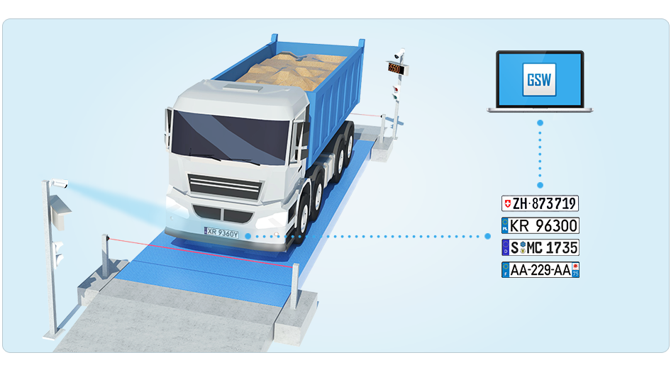
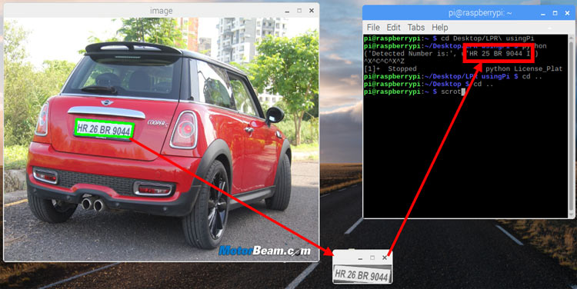
Existing System
ANPR(Automatic Number Plate Recognition)
CRS(Computer Recognition System)
OCR(Optical Character Recognition)
Vehicle Number Plate Detection, MATLAB

Slide 8
Problem Statement & Objectives
Problem Statement:
In today’s world with the increasing number of vehicles day by day it’s not possible to manually keep a record of vehicles. So we need a system which keeps a record and provides whenever required.
Objectives:
The main objective of this project is to design an efficient automatic vehicle identification system by detecting vehicle number plate. The system first would capture the vehicles image as soon as the vehicle reaches the security checking area. The captured images are then extracted by using the segmentation process. Optical character recognition is used to identify the characters. The obtained data is then compared with the data stored in their database. The system is implemented and simulated on MATLAB and performance is tested on real images.

Slide 9
Block Diagram
Input Image
Pre-processing of image
Localization of Plate region and character segmentation
Comparison with Templates
Database of Template
A – Z & 0-9
Maximum correlated Template
Output Vehicle number

Slide 10
As before mentioned we require 3 codes are template creation, letter detection , plate detection.
Circuit Diagram & Working
Firstly in template creation we have design the code to save all the binary images of alphanumeric into a directory or file named as ‘New templates ’. That directory is called in letter direction. Then in the plate detection code file the letter detection code file is called when we process the image.
As the program start you will get the number plate image popup in figure window and the number in the command window.

Slide 11
Flow Chart
Start
Is
Character
?
Template Creation of all alphanumeric
Pre-process the image
Is Character in Template
?
Output Vehicle Number
Plate region extraction and segmentation of character
Stop
Save Character

Slide 12
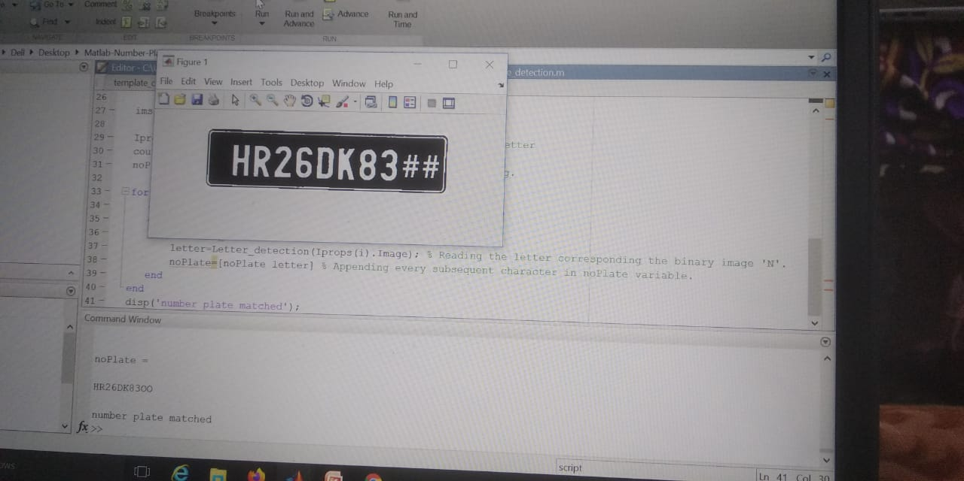
Results & Discussion
As per the objective of our project the car number plate from the given image that is HR26DK83 is matched with the output of the MATLAB code.

Slide 13
Advantages
Improving road safety.
Reduces crime.
Gives officers better information to work with.
Giving a greater police presence.
Increasing the percentage of stop/searches that lead to an arrest.
Pre-paid parking members can easily differentiated from non-members.

Slide 14
Conclusion & Future Scope
Conclusion : Our algorithm successfully detects the number plate region from the image which consists of vehicle number & then character segmentation ,recognition. We have applied our algorithm on many images and found that it successfully recognition. The project was designed keeping in mind the automation of number plate detection system for security reason that could replace the current system of manual entry. This project was a success in recording the number plate of a vehicle although it has got its own limitation of image processing and other hardware requirements.
Future Scope:
The plate number is used to automatically enter pre-paid members and calculate parking fee for non-members.
The car number is used to calculate the travel fee in atoll-road ,or used to double –check the ticket.

Slide 15
References
Saeed Rastegar, Reza Ghaderi, Gholamreza Ardeshipr & Nima Asadi, " An intelligent control system using an efficient License Plate Location and Recognition Approach", International Journal of Image Processing (IJIP) Volume(3), Issue(5) 252, 2009.
Loumos, V.; Kayafas, E.,”License plate recognition from still images and video sequences: A survey” IEEE Transactions on Intelligent Transportation Systems, volume 9, issue 3, pages 377-391, September 2008.
Chirag N. Paunwala, Suprava Patnaik, “A Novel Multiple License Plate Extraction Technique for Complex Background in Indian Traffic Conditions”, In Proceedings of International Journal of Image Processing, vol.4, issue2, 2007
D. Zheng, Y. Zhao, and J. Wang, “An efficient method of License Plate location,” Pattern Recognit. Lett. vol. 26, no. 15, pp. 2431–2438, 2005.

Slide 16
Progress Work
20th February: Mini project topic were searched and discussed.
26th February: Mini project topic was finalised as Car Number Plate Detection using MATLAB.
06TH March: MATLAB 2016 software installation was done .
9th March: Collecting the information required for writing code and worked on writing our project code.
11th March: 50% of project code was complete .
12th March: started working on power point presentation.
16th March: started working on report.

Slide 17
Milestones/Schedule
Milestone | Baseline Date | Target Date | Achievement
Software Installation | 06/03/2020 | 06/03/2020 | Successful
Project Code | 09/03/2020 | 11/03//2020 | Done
Power point presentation | 12/03/2020 | 01/04/2020 | Done
Report | 16/03/2020 | 28/04/2020 | Done

Slide 18
Thank You

