Slide 1
MAHINDRA THAR-USER JOURNEY MAP

Slide 2
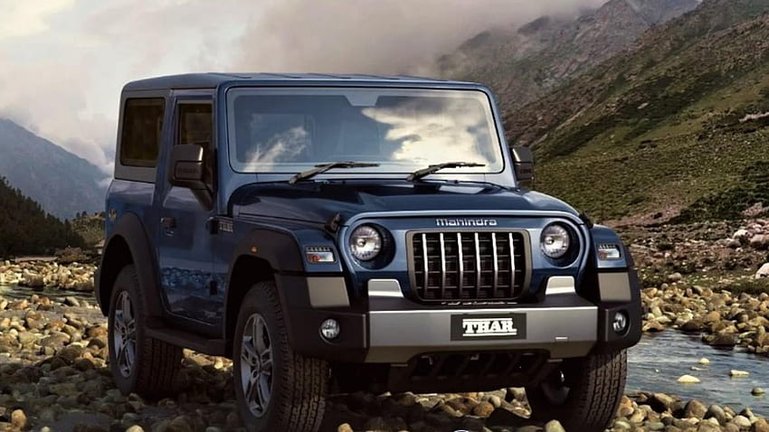
HISTORY It was introduced by mahindra group on October 4,2010.
FEATURES:
1.Produces excellent traction and stability in terrains.
2.Classic jeep like boxy design with a modern touch.
3.Low range gearbox for challenging terrains.
3.7-inch touch screen with apple car play and android auto
4.Multi information display.
5.Dual air bags for driver and front passenger.

Slide 3

Benefits of thar
1.High ground clearance,water wanding ability upto 650mm.
2.Powerful engine and manual and automatic gear transmission.
3.Modern infotainment system,water resistant interiors.
4.ABS with EBD,ESP with roll over mitigationand,hill desent control and roll cage.
5.Suspension and ride quality,automatic climate control.

Slide 4

Disadvantages of thar: 1.very limited cargo space ,less practical for families. 2.fuel efficiency especially in the petrol variant. 3.lack of advanced features like adas. 4.stiff suspension designed for off road. 5.the cabin get noised at higher speeds due to wind. 6.high price for top variant. 7.limited dealer and service network in some areas.

Slide 5
SOLUTIONS:
1.The company need to enlarge the space in the car for comfort.
2.Need to improve millage in the petrol variant.
3.Need to update the features such as ADAS etc.
4.Need to change the suspension in order to go smoothly on both ofroads and city roads.
5.The cabin needs to have good speakers so that the noise cannot distract.
6.The price for the top variant should be decreased.
7.Should expand the dealership in all areas of india.

