Slide 1
AI AGENT FOR OPERATING A BACKEND SYSTEM USING NATURAL LANGUAGE
USE CASE - 5
BACKOPS.ai
Team Members:
Niveditha
Aishwarya
Harsha
Koushik
Luddy Hackathon Fall 2024, Third Edition.
November 17, 2024

Slide 2
Outline
Motivation
Preliminary
Key technique proposed for this use case
Llama + Slot
Mongo DB
Gradio UI
Results
Summary

Slide 3
Motivation - Why Work on AI Agents for Backend Systems?
Observation: Backend operations are always complex and require technical expertise.
Importance: Especially for non-technical users, automating backend tasks reduces errors, saves time, and improves resource management.
Difficulties: Challenges include understanding diverse user commands, accurately mapping intent to backend actions and ensuring the system is robust and scalable.

Slide 4
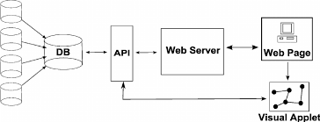
Sample traditional backend system:
Normal user with normal language
*Figure from ResearchNet.

Slide 5
Let's Introduce you the future of backend
BACKOPS.ai

Slide 6
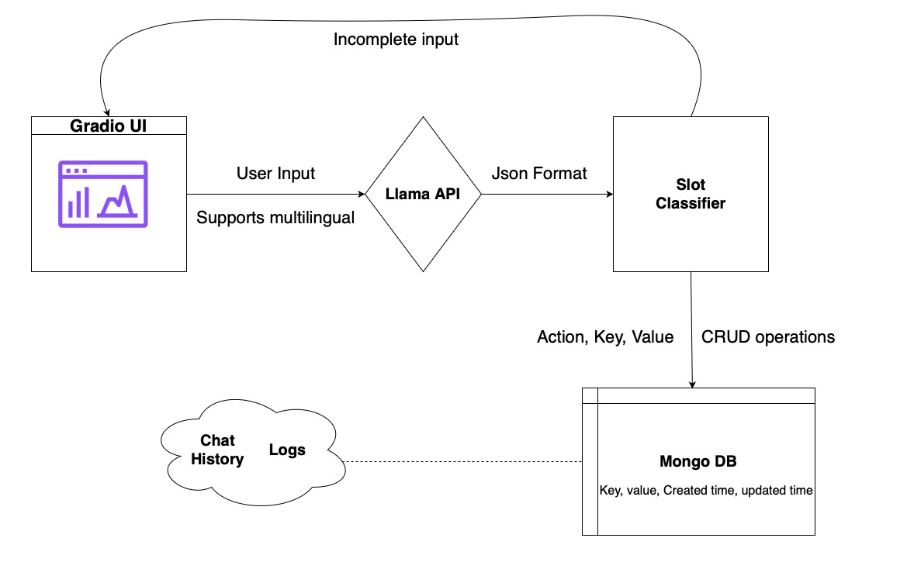
BACKOPS.ai Architecture

Slide 7
Preliminary
Natural Language Processing in Backend Systems
Traditional Backend System Limitations
AI-Powered Backend Systems
MongoDB Operations
Frontend and User Interaction

Slide 8
System Architecture
Flow:
User Input → Gradio UI → LLAMA API
The user provides a command, e.g., "Insert team01 with value value1."
The Gradio UI sends the input to the LLAMA API.
LLAMA API → Classifier → Slot Filling
LLAMA API processes and sends structured JSON to classify and fill slots.
Slot Validation → MongoDB Operations
Validates extracted slots (action, key, value).
Executes the corresponding database operation.
Database Response → Gradio UI

Slide 9
Gradio UI - Intuitive Interface for Seamless Interaction
Objective: Enable users to interact with the backend via natural language in an intuitive UI.
Core Components: Chatbot interface for any natural language interaction.
Language dropdown for multilingual support.
Log previews for system transparency and debugging.
Additional Features: FAQ section for user guidance.
Data visualizations for KPIs like actions executed, response times, etc.
Benefits: Enhances user experience with intuitive design.
Provides insights into system performance and user behavior.

Slide 10
Streamlining NLP Processing and Slot Classification
Purpose:
Integrates action extraction and slot filling to streamline processing while efficiently handling multiple user commands through a decision-based flow.
Benefits:
Reduces latency by avoiding redundant API calls, improves accuracy by extracting structured data in one step, and enables real-time action handling with robust error management.
Flow:
User Input → LLAMA API → Extracted Slots → Slot Classification, minimizing intermediate decision points for a seamless operation.

Slide 11
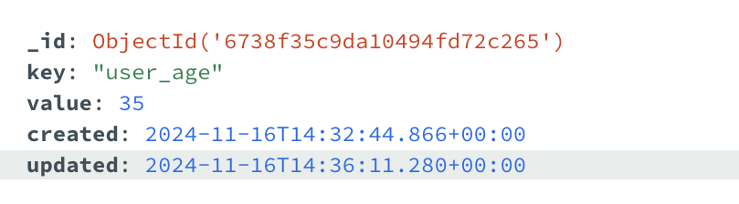
Database Design
Structure:
Key-value storage with created and updated timestamps, organized into collections for user data, logs, and chat history.
Features:
Provides persistent storage for user actions and system logs, supports query operations (insert, update, retrieve, delete), and tracks historical interactions for audits and debugging.
Advantages:
Ensures traceability, easy retrieval, and scalability to handle increasing user interaction data.

Slide 12
Future Scope
Implement advanced NLP pipelines like Hugging Face or LangChain for improved language understanding and contextual accuracy.
Use OpenAI API or more advanced LLMs to efficiently handle complex backend operations.
Enable support for structured data and multiple database systems to enhance scalability.
Add authentication and access control mechanisms for sensitive operations.
CICD pipeline implementations.

