Slide 1

GHOUSIA COLLEGE OF ENGINEERING
ANUDIP FOUNDATION
Title: PASSWORD STRENGTH BACKGROUND
Subtitle: Enhancing Security with Visual Authentication
Under the guidance of: Miss VANISHA KN
Presented by: SYEDA MISBAH
NIVEEDITHA T K
HUZAIFA KOUSER
MADIHA MAHIN

Slide 2

CONTENT
Password strength is crucial for security.
Visual feedback helps users create stronger passwords.
We'll demonstrate how to implement a password strength background using HTML, CSS, and JavaScript

Slide 3
INTRODUCTION
What is Image Password Strength?
A method of authentication using images instead of traditional text-based passwords.
Combines usability and security by leveraging visual memory.
Why Use It?
Harder to guess or brute-force.
More engaging for usersthod of authentication using images instead of traditional text-based passwords.
Combines usability and security by leveraging visual memory.
Dynamically adjusts image background blur based on password strength (length).
Enhances user feedback visually without traditional strength meters.

Slide 4
How it works:
1. Password Strength Checker:
A JavaScript function analyzes the password's length, complexity (using uppercase, lowercase, numbers, and special characters), and uniqueness against common patterns.
2. Strength Score:
The checker assigns a score, typically ranging from 0 (weak) to 4 (strong) or similar.
3. Background Adjustment:
Based on the score, CSS styles are applied to the background element, changing its color, blur, or other visual characteristics.
4. HTML Structure:
A HTML element, often a div or a background element, is used to hold the background and allow CSS to manipulate its visual properties.

Slide 5
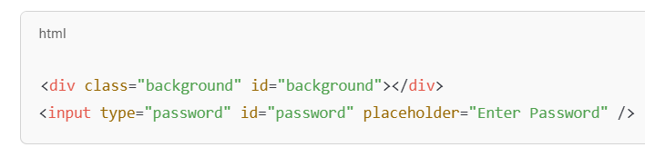
Key Components
HTML: Structure of the image-based password system.
CSS: Styling for user interface.
JavaScript: Logic for password validation and strength checking
Sample Code:
<div class="background" id="background"></div>
<input type="password" id="password" placeholder="Enter Password" />
The background div is styled separately and blurred dynamically.
User interaction is tied to the password input.

Slide 6
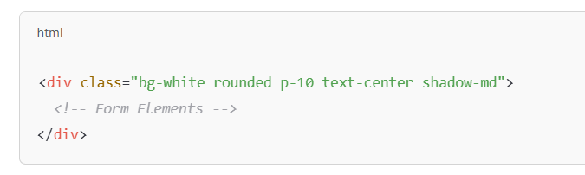
CSS Styling
Key Benefits:
Rapid UI development
Responsive and mobile-ready
Utility-first styling
example code :

Slide 7
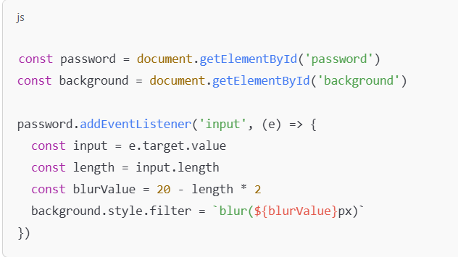
JavaScript Logic
How it works:
Listens for input in the password field.
Reduces blur on the background as the password gets longer.
Encourages stronger passwords visually (longer = clearer background).

Slide 8
Background Blur Effect
Visual Behavior:
Initial state: background is heavily blurred (blur = 20px).
Each additional character reduces blur by 2px.
At 10 characters → blur = 0 → background is clear.
Effect Purpose:
A creative way to guide users to type longer passwords.

Slide 9
Benefits of This Approach
Visually engaging
Immediate feedback
No extra libraries or dependencies
Can be extended for more complex password rules (e.g., symbols, numbers)
Future Enhancements (Optional)
Use zxcvbn.js for real password strength analysis
Add color-based feedback (red/yellow/green)
Add image overlays or other visual feedback styles
Make it mobile-responsive

Slide 10
ADVANTAGES & CHALLENGES
Advantages
Enhanced Security: Harder to guess than text passwords.
User-Friendly: Leverages visual memory.
Customizable: Can use personal or unique images.
Challenges
Implementation Complexity: Requires careful design.
Accessibility Issues: May not be suitable for visually impaired users.
Storage Requirements: Images take up more space than text

Slide 11
CONCLUSION
A simple project combining HTML/CSS/JS for password usability
Shows the power of visual UI feedback
Easy to integrate into modern login or signup forms
Image-based passwords offer a secure and innovative alternative to traditional methods.
Future Scope: Integration with AI for adaptive security.

Slide 12
THANK
YOU

