Slide 1
Qcow2-snapshots
2020-03-27

Slide 2
Qcow2-snapshots

Slide 3
Qcow2-snapshots

Slide 4
Qcow2-snapshots

Slide 5
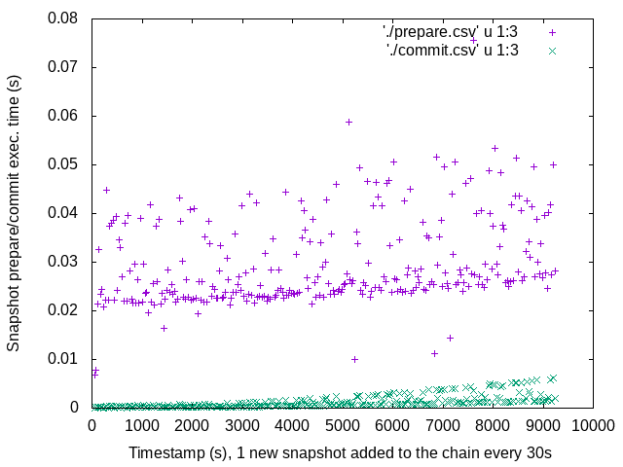
Qcow2-snapshots

