Slide 1
Qcow2 meeting 01/05/2020

Slide 2
A deeper look at the performance drop on long chains
Experiment:
1. Boot VM on a disk with chain size = {1 | 300}
2. Read entire disk in the guest to populate qcow2 L1/L2 caches
3. Drop guest page cache so that subsequent accesses go to virtual disk
4. Read the entire disk again and profile the hypervisor during that operation
    Chain size 1: 33 seconds
    Chain size 300: 53 seconds

Slide 3
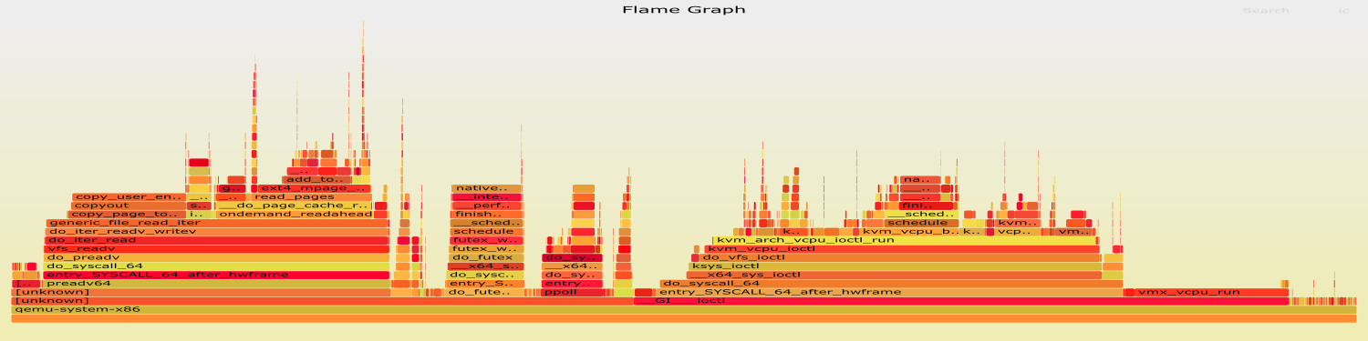
Reading the entire disk: profiling (perf) results
Driver I/O
Chain size
1
Driver
poll & wait
Guest runs

Slide 4
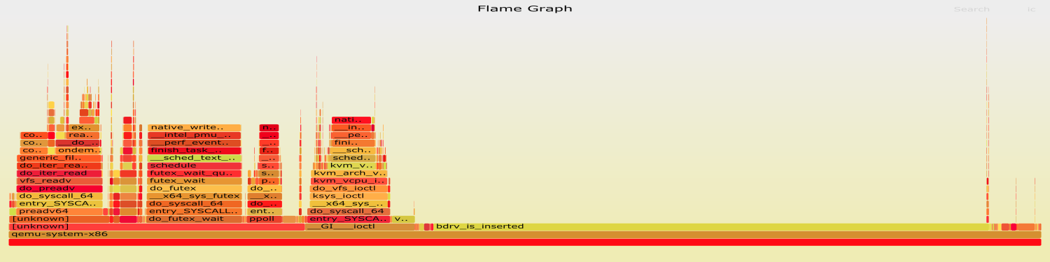
Reading the entire disk: profiling (perf) results
Chain size
1
Chain size
300
bdrv_is_inserted

Slide 5
Memory footprint with long chains
- Measure qemu’s peak RSS when
1) simply booting then halting the VM → “No IO”
2) booting, reading entire disk, halting
VM memory set to 4 GB
+406MB
+630MB
+200MB
+160MB
(25%)
+300MB
(46%)

Slide 6
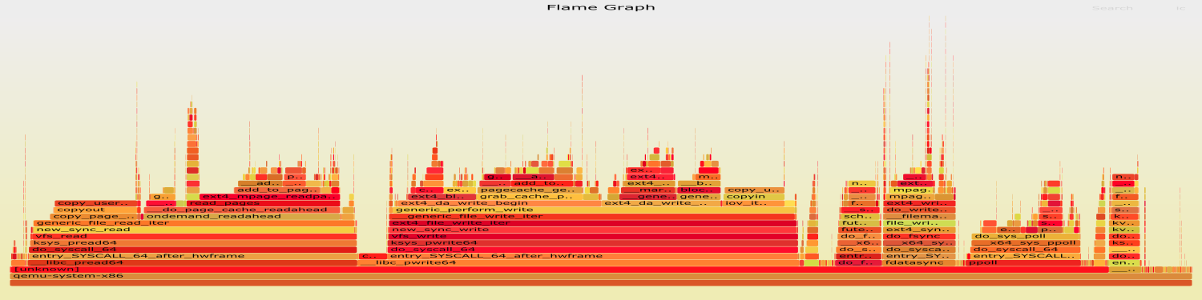
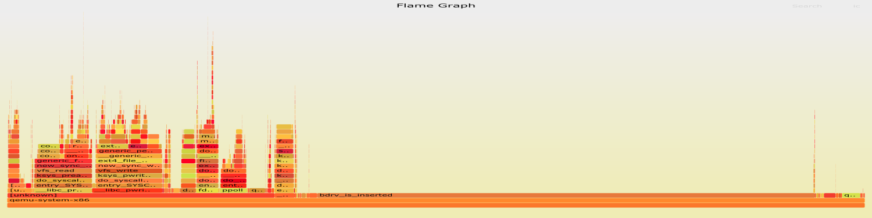
Streaming
1. Boot VM on a chain of a given size
2. Stream all the chain, profiling with perf + measure peak RSS: 1→ 0.61 GB, 300 → 1.14 GB!
Chain size
1
FS read/write on host
Chain size
300
bdrv_is_inserted

Slide 7
bdrv_is_inserted
- Just seems to check for the presence of a block device
- Called a very high amount of times even with no snapshots
- loop recursive, loop iterations seem proportional to chain size
- still trying to figure out where it is called from...

