Slide 1
Qcow2 snapshots

Slide 2
Disk Snapshots
VM
R/W
disk.qcow2

Slide 3
Disk Snapshots
VM
VMM receives snapshot
command
R/W
disk.qcow2
snapshot
.qcow2
R
(This is the actual
snapshot)

Slide 4
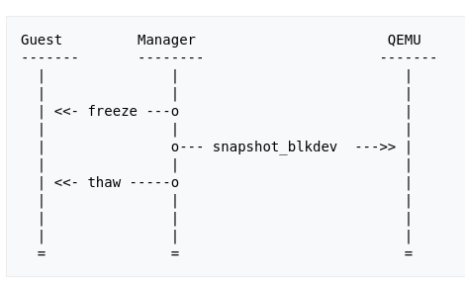
Disk Snapshots
Optionally need agent in the guest to freeze filesystem before snapshot

Slide 5
Streaming
VM
disk.qcow2
snapshot1
.qcow2
snapshot2
.qcow2
snapshot3
.qcow2

Slide 6
Streaming
VM
disk.qcow2
snapshot1
.qcow2
snapshot2
.qcow2
snapshot3
.qcow2
Flatten, can be done live

Slide 7
Streaming
VM
snapshot3
.qcow2

Slide 8
experiment
- Run Fio in guest
- Snapshot at regular intervals
- Stream at regular intervals
- Need to ask outscale for parameters to make that realistic

Slide 9
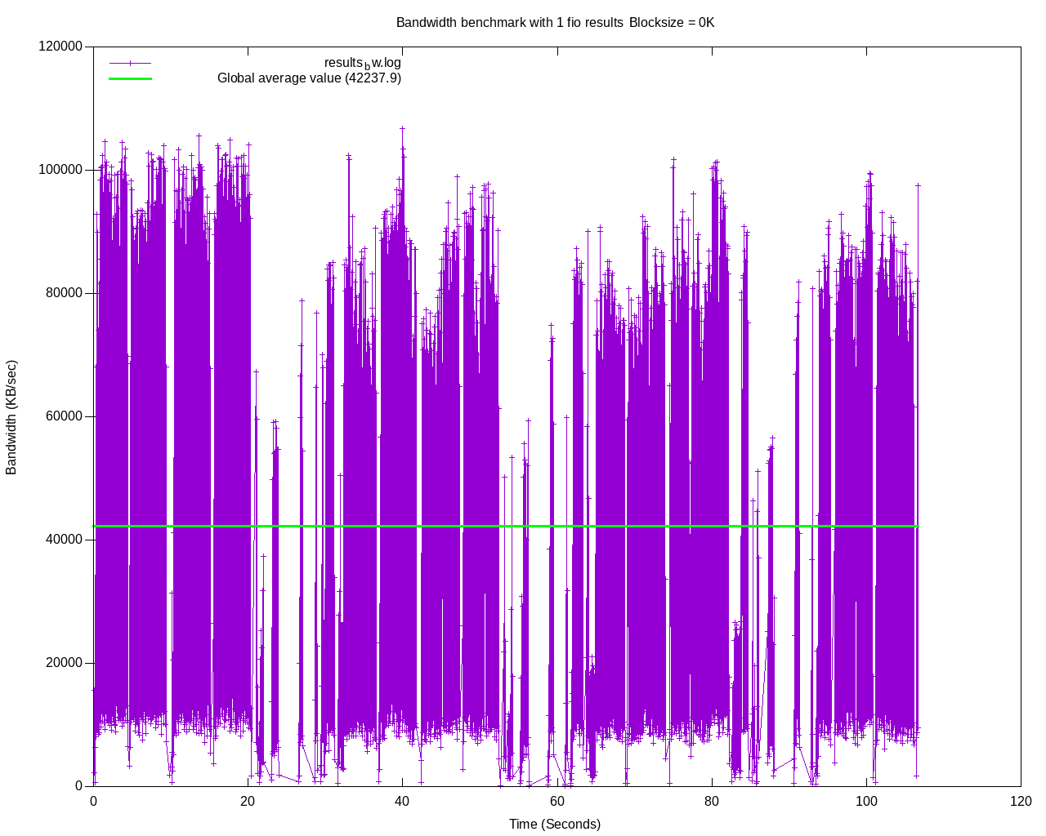
experiment

