Slide 1
QCOW2 update

Slide 2
QCOW2 format
QCOW2 vs. raw used to be features vs. performance but COW2’s performance are now comparable to raw in most cases
QCOW2 features include encryption, compression, internal COW snapshots, COW backing files (external snapshots)

Slide 3
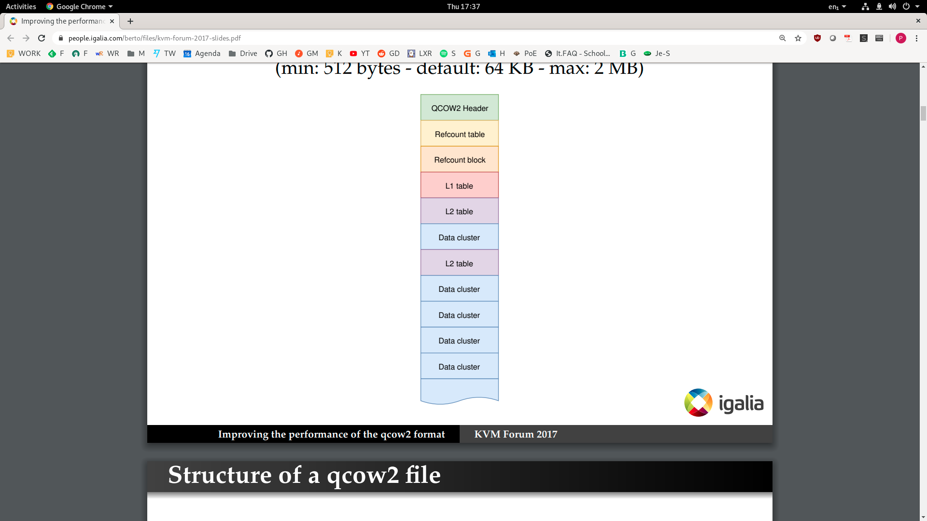
QCOW2 format
QCOW2 vs. raw used to be features vs. performance but COW2’s performance are now comparable to raw in most cases
QCOW2 features include encryption, compression, internal COW snapshots, COW backing files (external snapshots)
File divided into “clusters” of equal size, default 64 KB

Slide 4
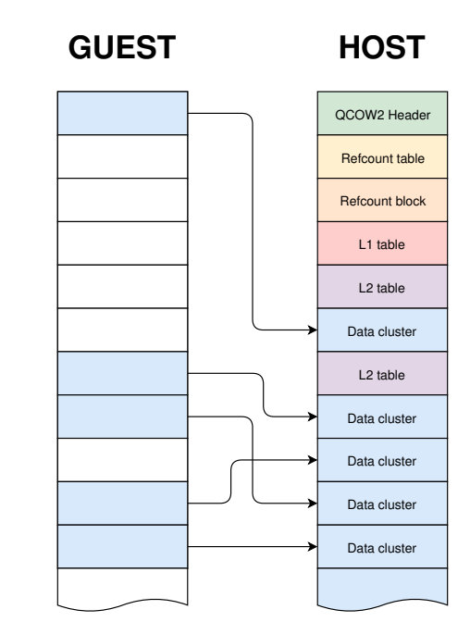
QCOW2 format
QCOW2 vs. raw used to be features vs. performance but COW2’s performance are now comparable to raw in most cases
QCOW2 features include encryption, compression, internal COW snapshots, COW backing files (external snapshots)
File divided into “clusters” of equal size, default 64 KB
Virtual disk seen by the VM divided into clusters of the same size, mapped to host clusters

Slide 5
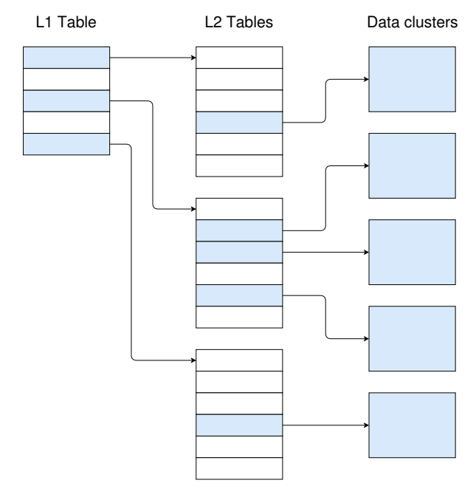
QCOW2 format
L1/L2 tables used to map guest addresses (virtual disk sectors addressed by the guest driver) to host addresses (offset in the file)

Slide 6
QCOW2 format
L1/L2 tables used to map guest addresses (virtual disk sectors addressed by the guest driver) to host addresses (offset in the file)
With backing files (snapshots), writes goes into the active layer, read server from the layer containing the last version
W
W
W
W
W
R

Slide 7
QCOW2 formats
A few problems that I saw mentioned a lot and that I believe are not responsible of the performance issues we see
  L2 cache size (I set it up to contain all L2)
  L2 cache thrashing with old entries after snapshots (I reboot before each read test)
  The need to read a COW cluster from backing file when only a subset is written
https://people.igalia.com/berto/files/kvm-forum-2017-slides.pdf
https://www.linux-kvm.org/images/9/92/Qcow2-why-not.pdf
https://blogs.igalia.com/berto/2015/12/17/improving-disk-io-performance-in-qemu-2-5-with-the-qcow2-l2-cache/

Slide 8
So what can it be?
Trying to understand what happens exactly on a read request for a cluster which is very far down the chain, for example 300
  I think we go through 300 L1 and L2 tables
  Lookup seems to be in constant times and should be cached – at least for L2
    What about L1 entries – they are supposed to be easy to cache because L1 table is small but now we have one L1 per snapshot

