Slide 1
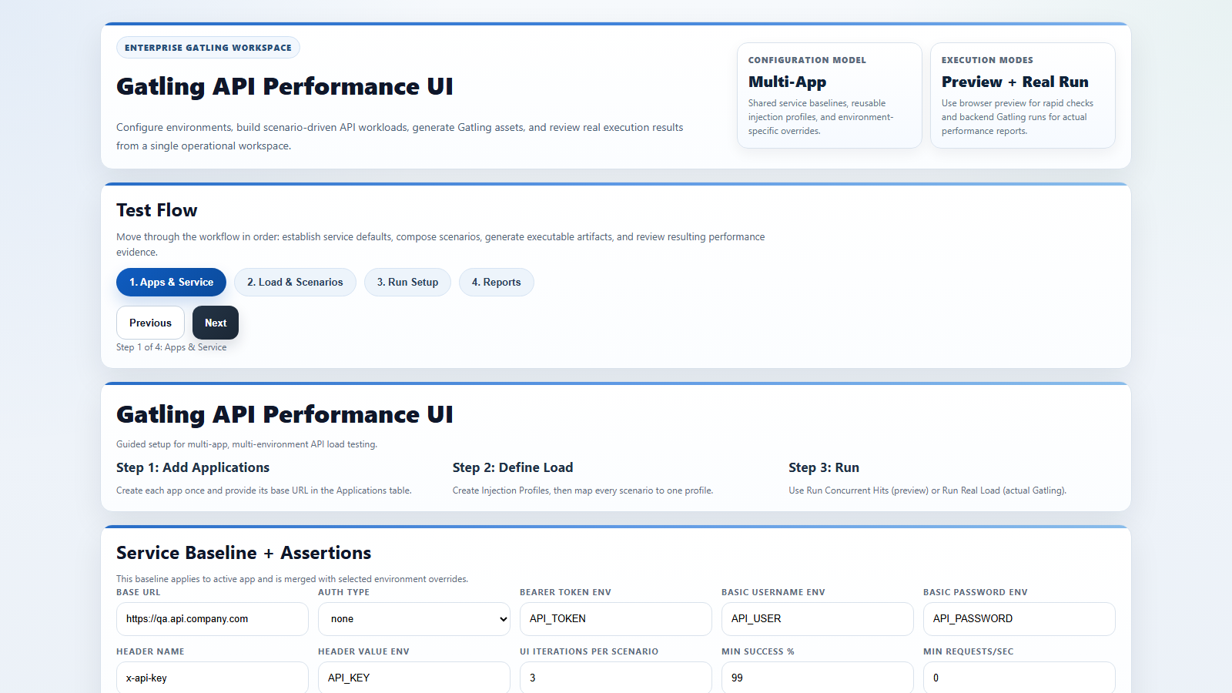
Gatling API Tool: Orders QA Scenario Runbook
â€¢ Project: orders-service performance validation
â€¢ Mode: preview + real backend Gatling
â€¢ Objective: stable p95 and 99%+ success

Slide 2
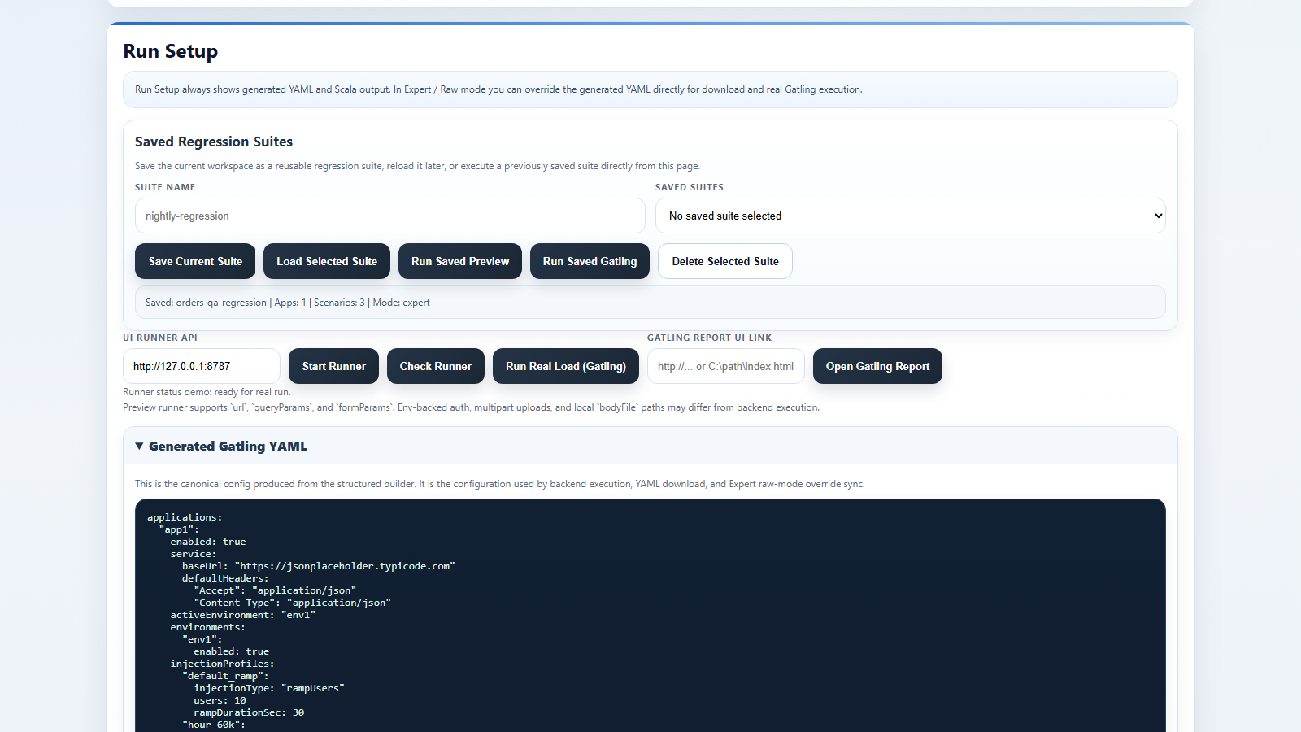
Step 1: Install and Start Workspace
â€¢ Run check-prerequisites.bat
â€¢ Run start-ui-workspace.bat
â€¢ Runner API target: http://127.0.0.1:8787

Slide 3
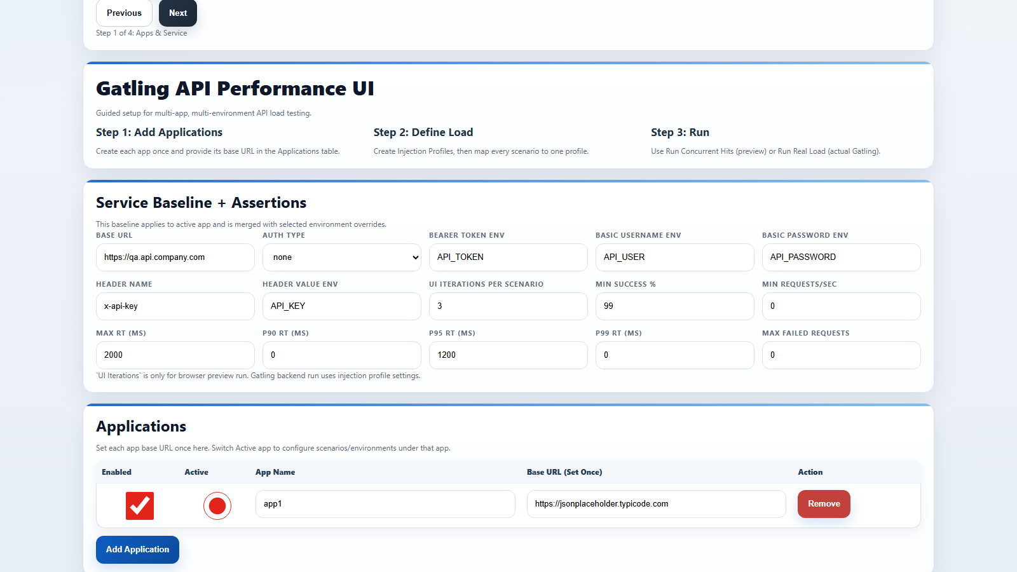
Scenario We Will Build
â€¢ Application: orders-service
â€¢ Environment: qa
â€¢ Flow: GET /orders -> GET /orders/#{orderId} -> POST /orders
â€¢ Assertions: success >= 99, p95 <= 1200ms

Slide 4
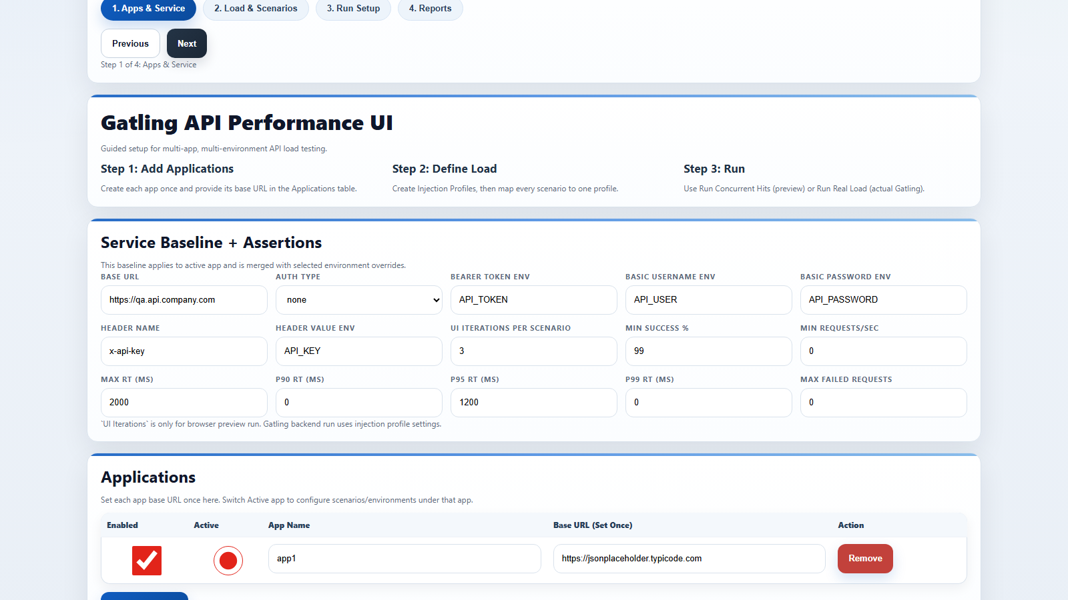
Step 2: Base Service and App Setup
â€¢ Base URL: https://qa.api.company.com
â€¢ Auth: bearer token from API_TOKEN
â€¢ Global assertions: success 99, maxRT 2000, p95 1200

Slide 5
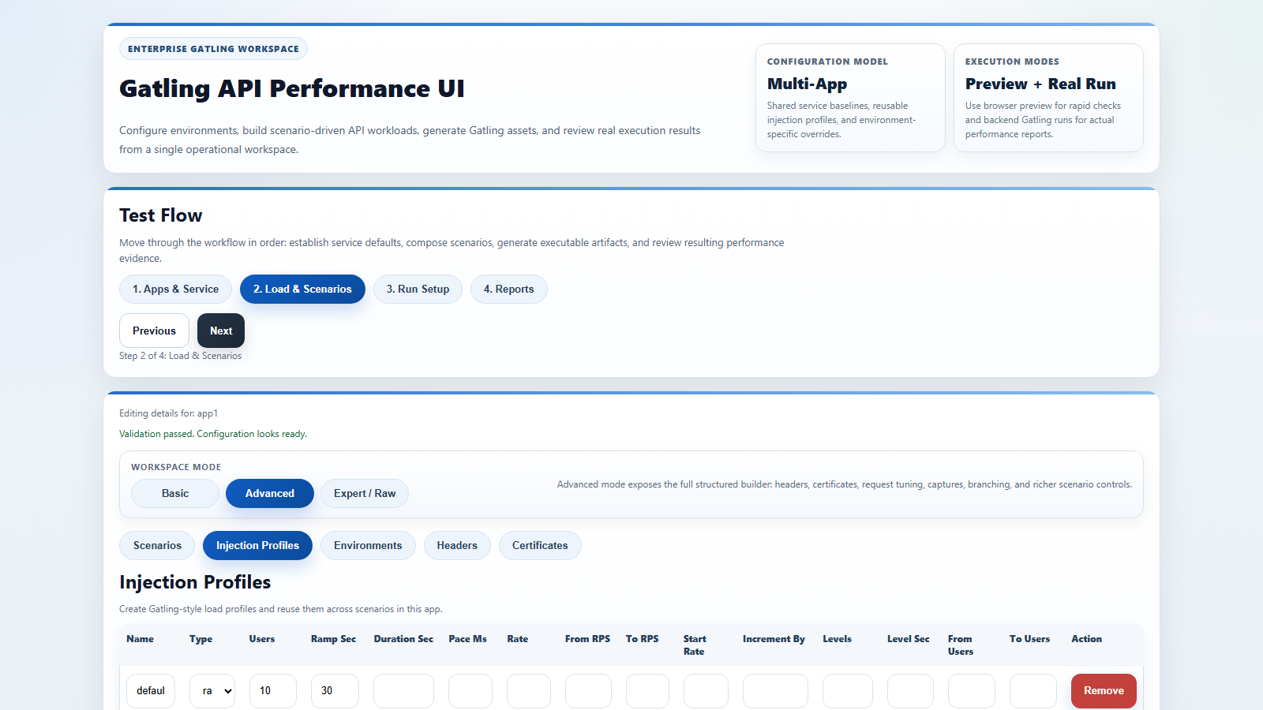
Step 3: Injection Profile Design
â€¢ smoke_5: 5 users / 15 sec
â€¢ baseline_20: ramp 20 users / 60 sec
â€¢ stress_80: ramp 80 users / 180 sec

Slide 6
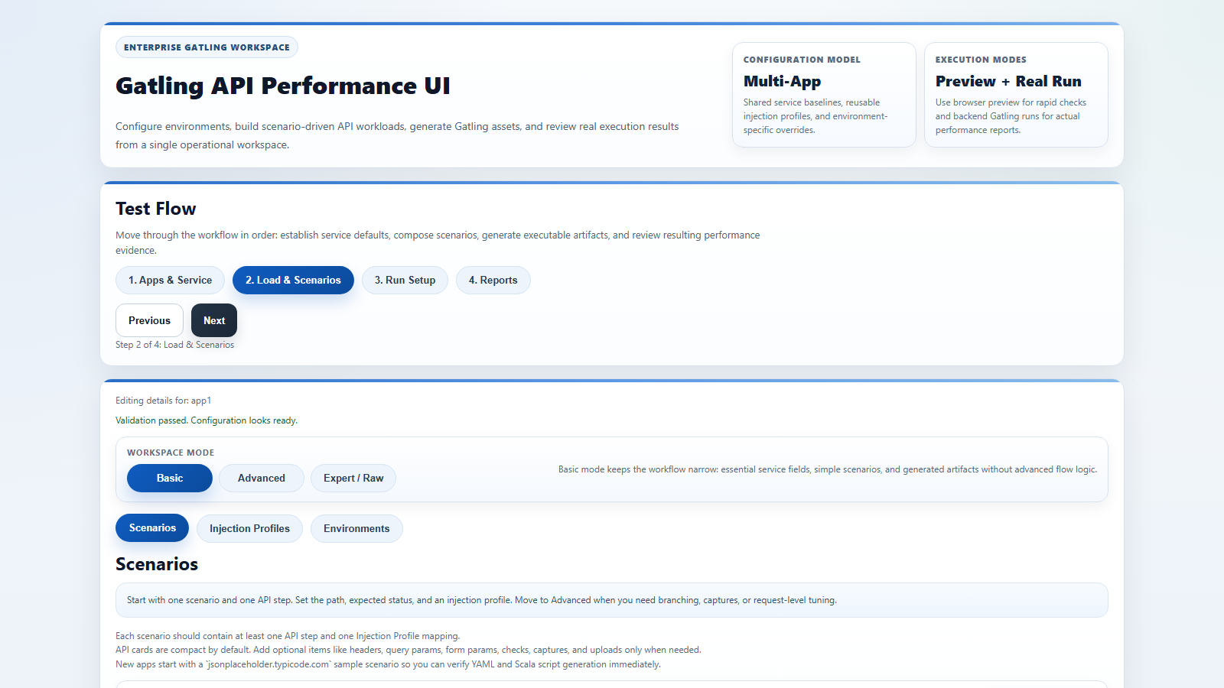
Step 4: Core Scenario Steps
â€¢ Step1 List Orders: GET /orders expected 200
â€¢ Step2 Get Order: GET /orders/#{orderId} expected 200
â€¢ Step3 Create Order: POST /orders expected 201

Slide 7
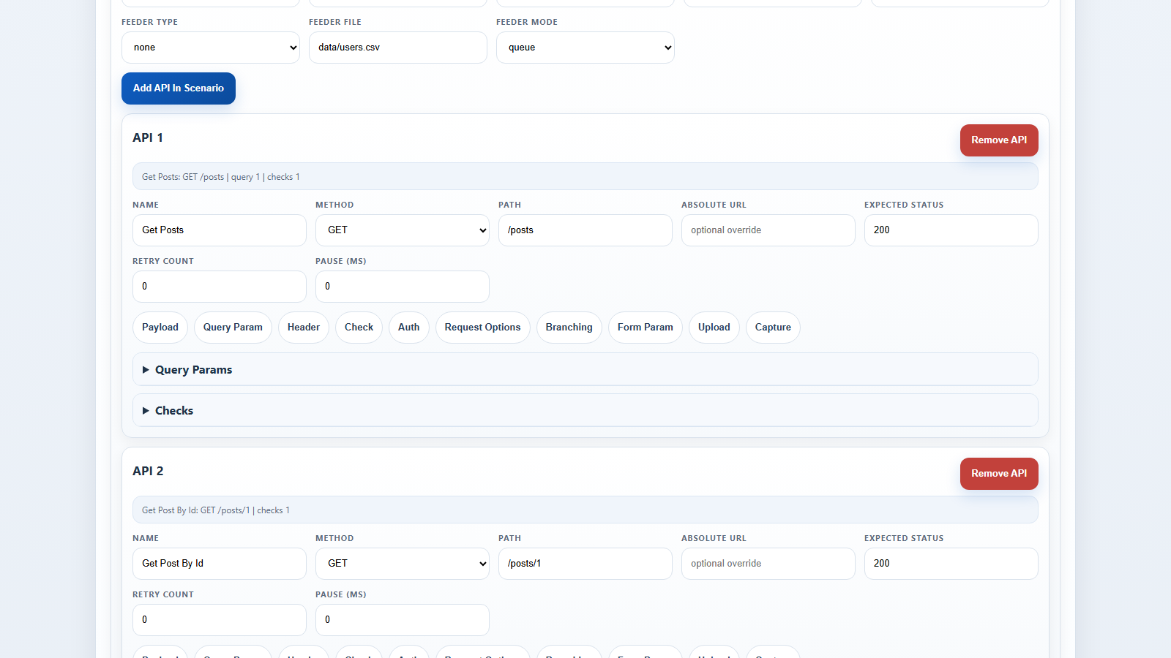
Step 5: Checks and Captures
â€¢ Checks: jsonPathExists($.items[0].id), bodyContains("order")
â€¢ Capture: $.items[0].id -> orderId
â€¢ Use #{orderId} in step 2 path

Slide 8
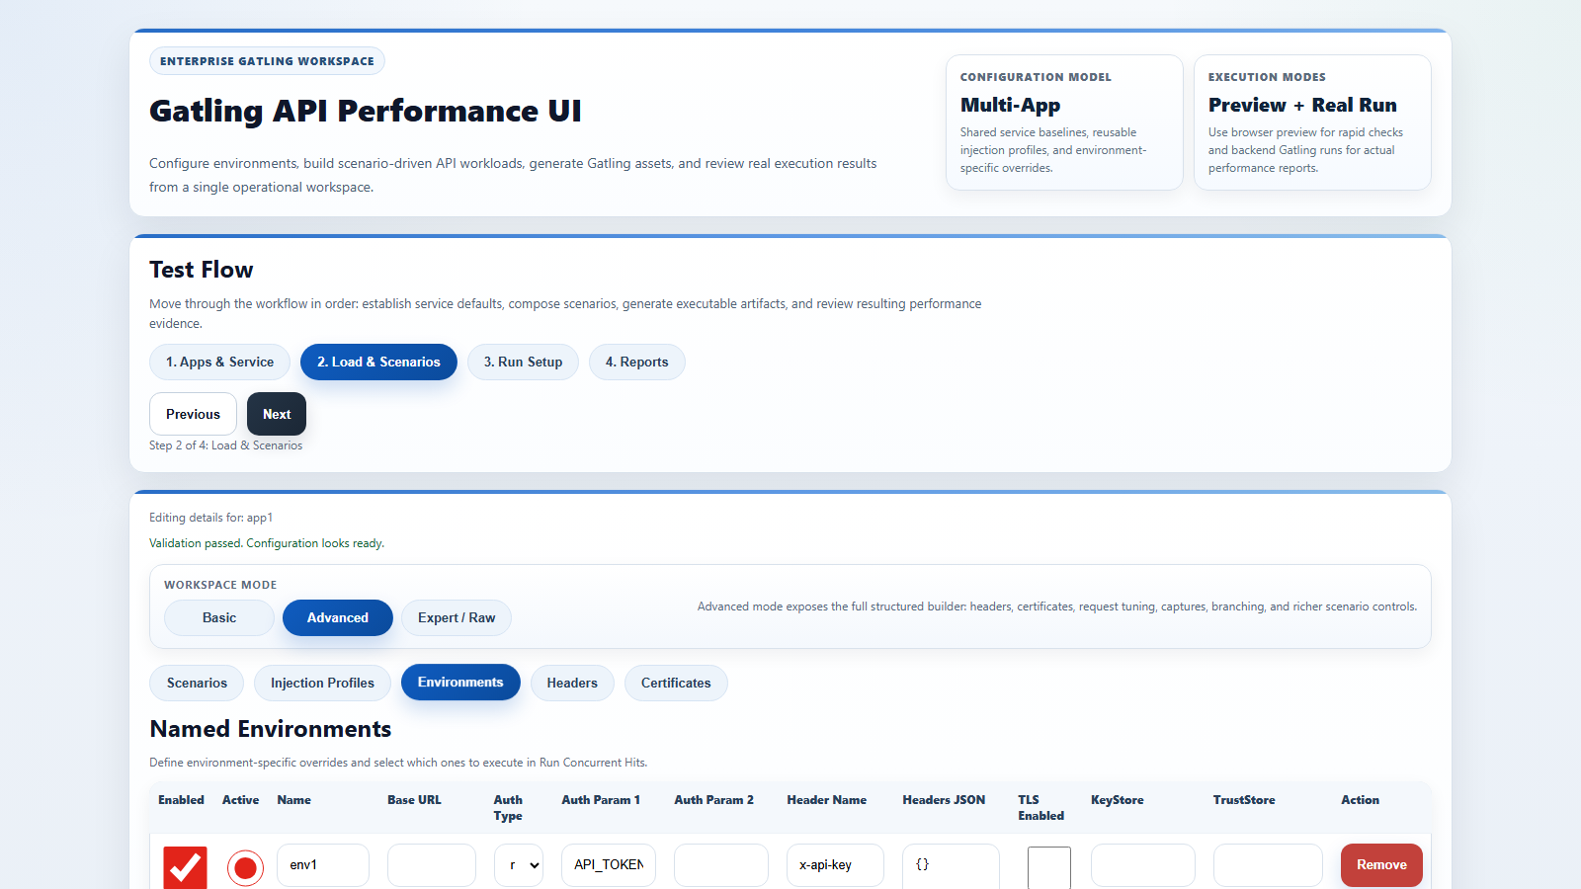
Step 6: Feeders, Params, and Body Files
â€¢ Feeder file: src/test/resources/data/users.csv
â€¢ Mode: circular for repeatability
â€¢ POST body: bodyFile src/test/resources/bodies/create-order.json

Slide 9
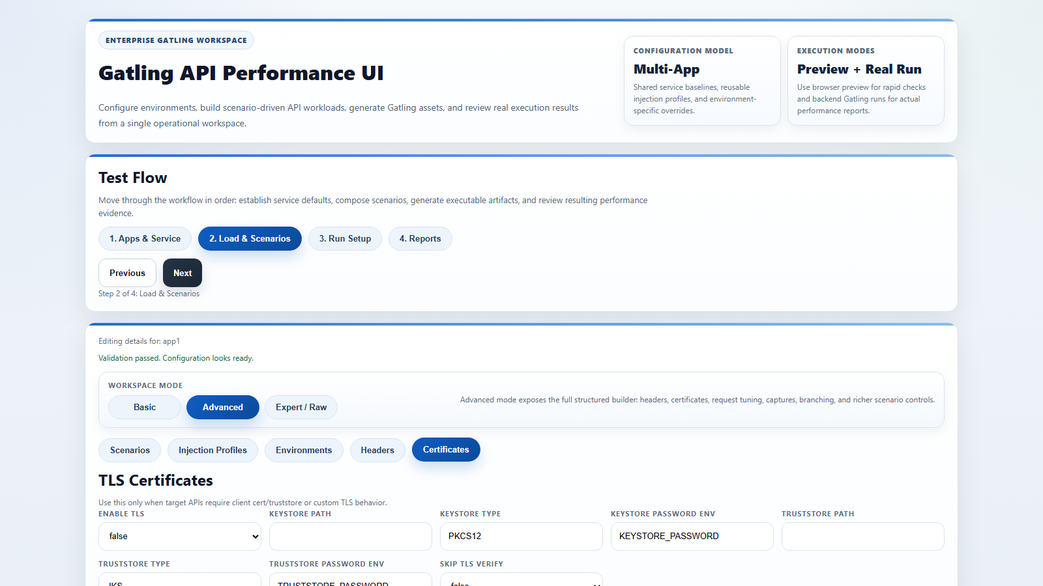
Step 7: Branching and Request Flags
â€¢ Conditional if/else: if #{customerTier} == premium then /orders/premium
â€¢ Else fallback route: /orders/standard
â€¢ Example operator set: equals, notEquals, contains, exists
â€¢ Flags: timeout 30000, disableFollowRedirect=true for validation

Slide 10
Conditional Statement Example (YAML)
â€¢ when: variable=customerTier operator=equals value=premium
â€¢ then: method=GET path=/orders/premium expectedStatus=200
â€¢ else: method=GET elsePath=/orders/standard elseExpectedStatus=200
â€¢ Use captures from prior step to drive the branch input

Slide 11
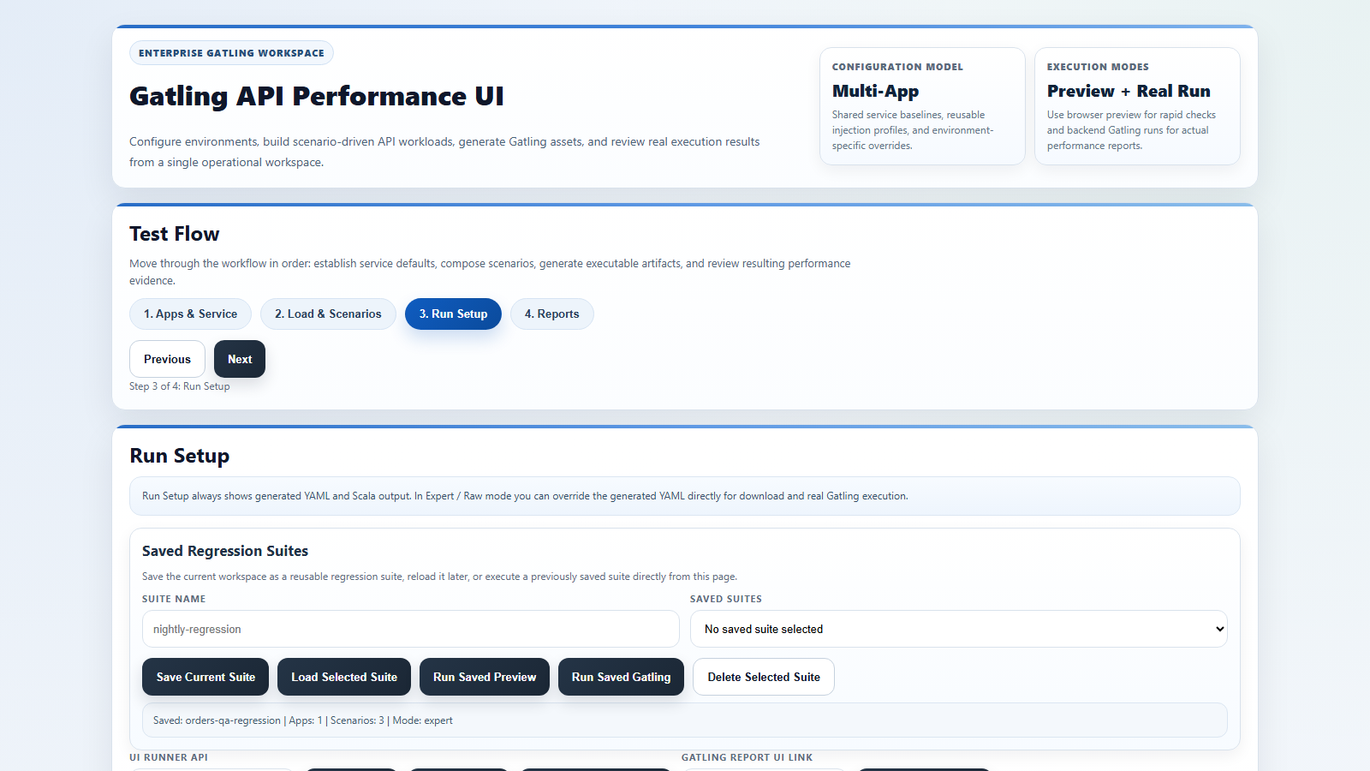
Step 8: Multipart, TLS, and Auth Variants
â€¢ Upload endpoint example: POST /orders/import with formUploads
â€¢ TLS: trustStore from env-backed password
â€¢ Environment auth override allowed for qa/prod-like

Slide 12
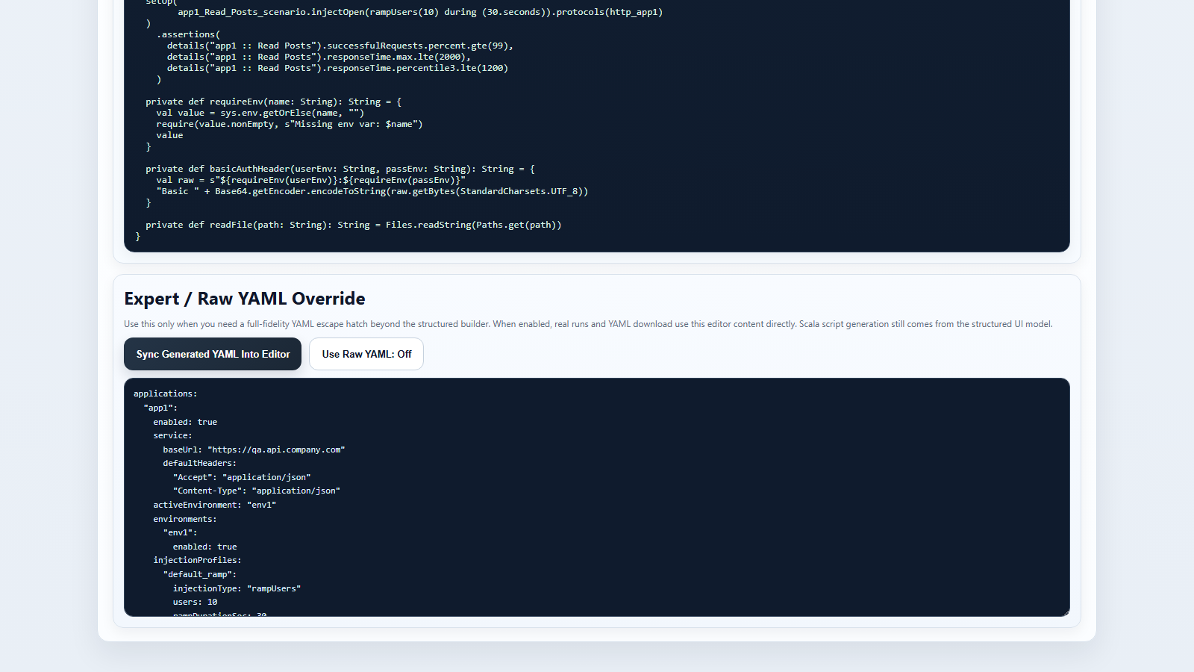
Step 9: Expert / Raw YAML Mode
â€¢ Click Sync Generated YAML Into Editor
â€¢ Turn Use Raw YAML On for only required overrides
â€¢ Recommended: retain profile names + assertion blocks unchanged

Slide 13
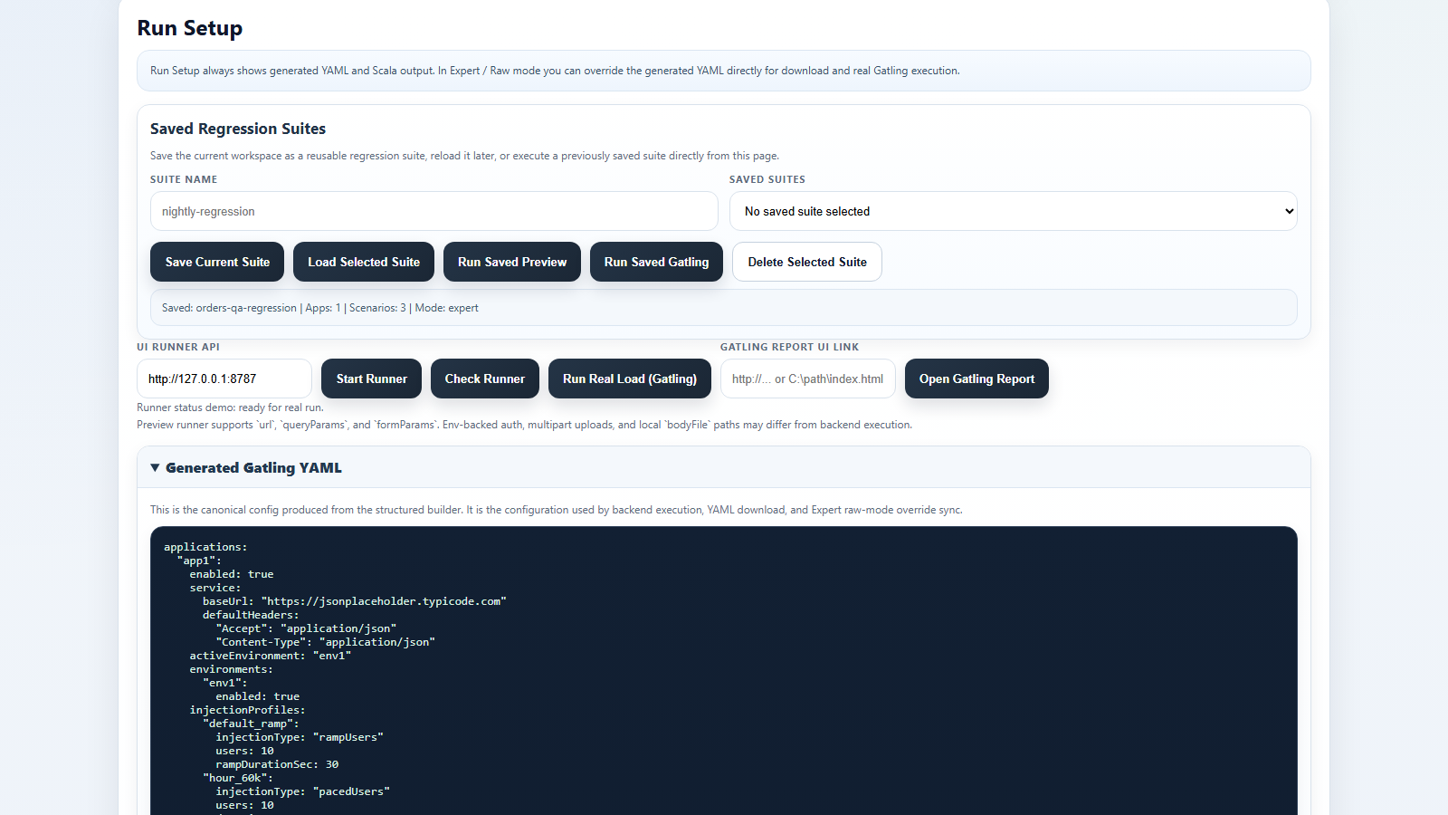
Step 10: Real Gatling Run
â€¢ Click Check Runner -> expect healthy
â€¢ Click Run Real Load (Gatling)
â€¢ Track job ID and output tail until report availability = Final

Slide 14
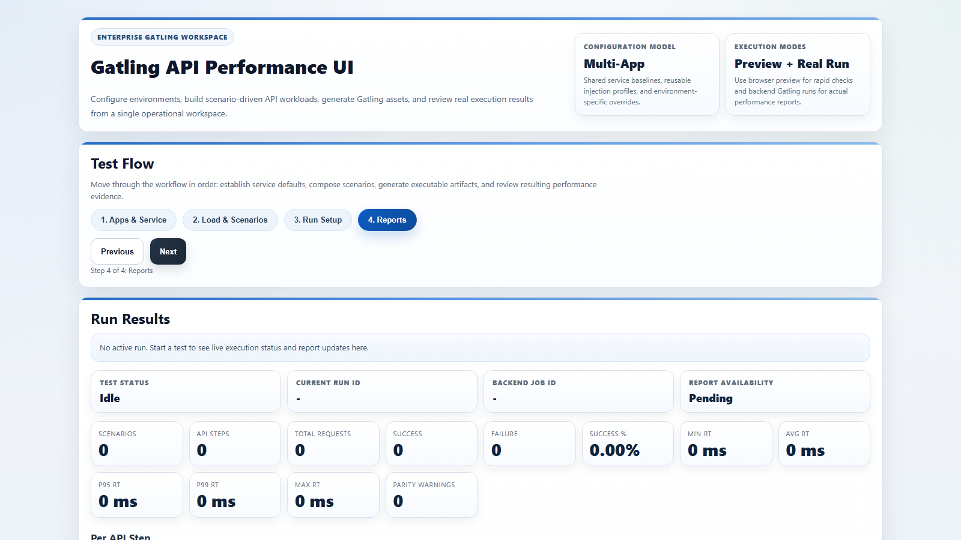
Step 11: Report Analysis and Troubleshooting
â€¢ KPI gates: success >= 99, p95 <= 1200, p99 <= 2000
â€¢ Review top failure reasons table first
â€¢ Use parity diagnostics to separate preview artifacts

Slide 15
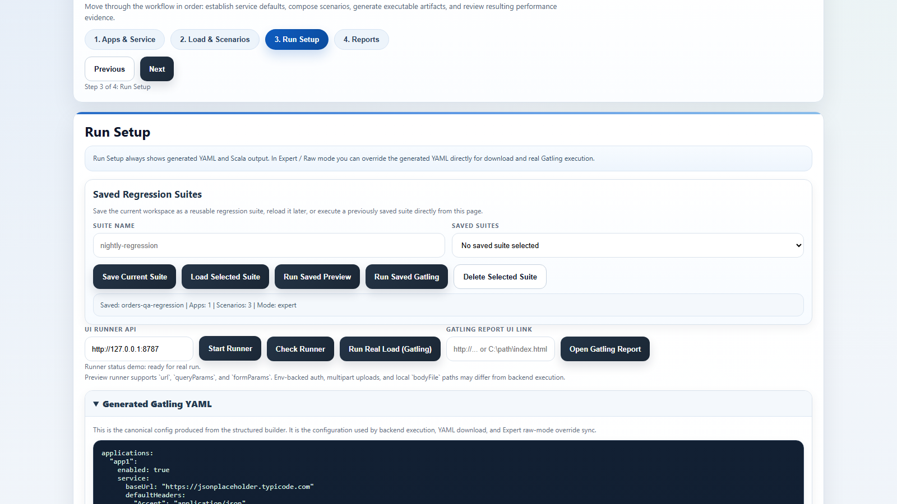
Step 12: Save Suites and Release
â€¢ Save suite as: orders-qa-regression
â€¢ Run build-release.bat for package + checksum
â€¢ Share dist zip + latest-bundle.sha256 to downstream teams

