Slide 1
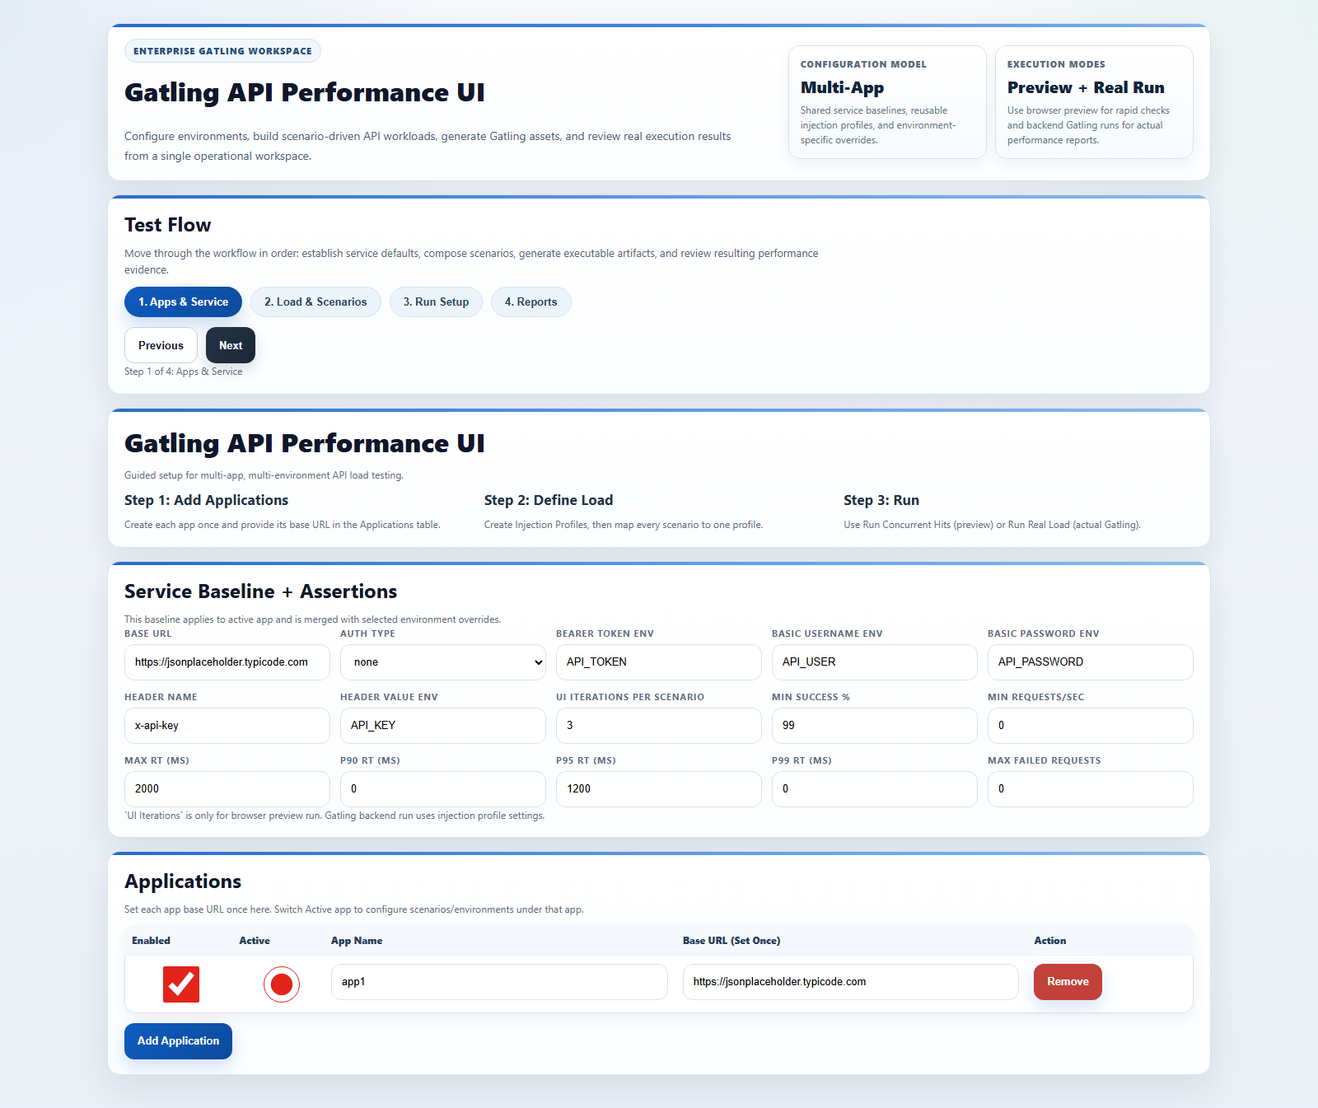
Gatling API Tool: Scenario-Driven Training
â€¢ Detailed installation-to-expert walkthrough
â€¢ Built around a realistic API scenario
â€¢ Preview + real Gatling execution paths

Slide 2
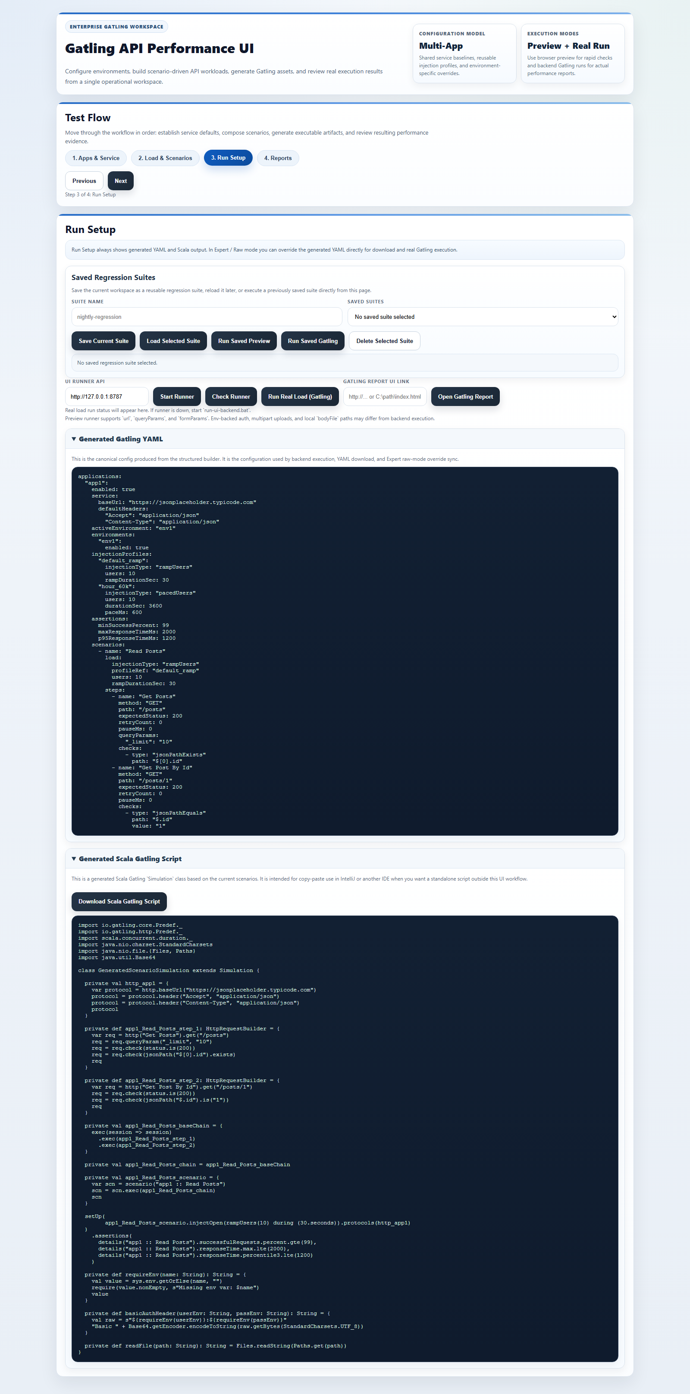
Step 1: Install and Start Workspace
â€¢ Run check-prerequisites.bat
â€¢ Run start-ui-workspace.bat
â€¢ Verify runner API and UI launch

Slide 3
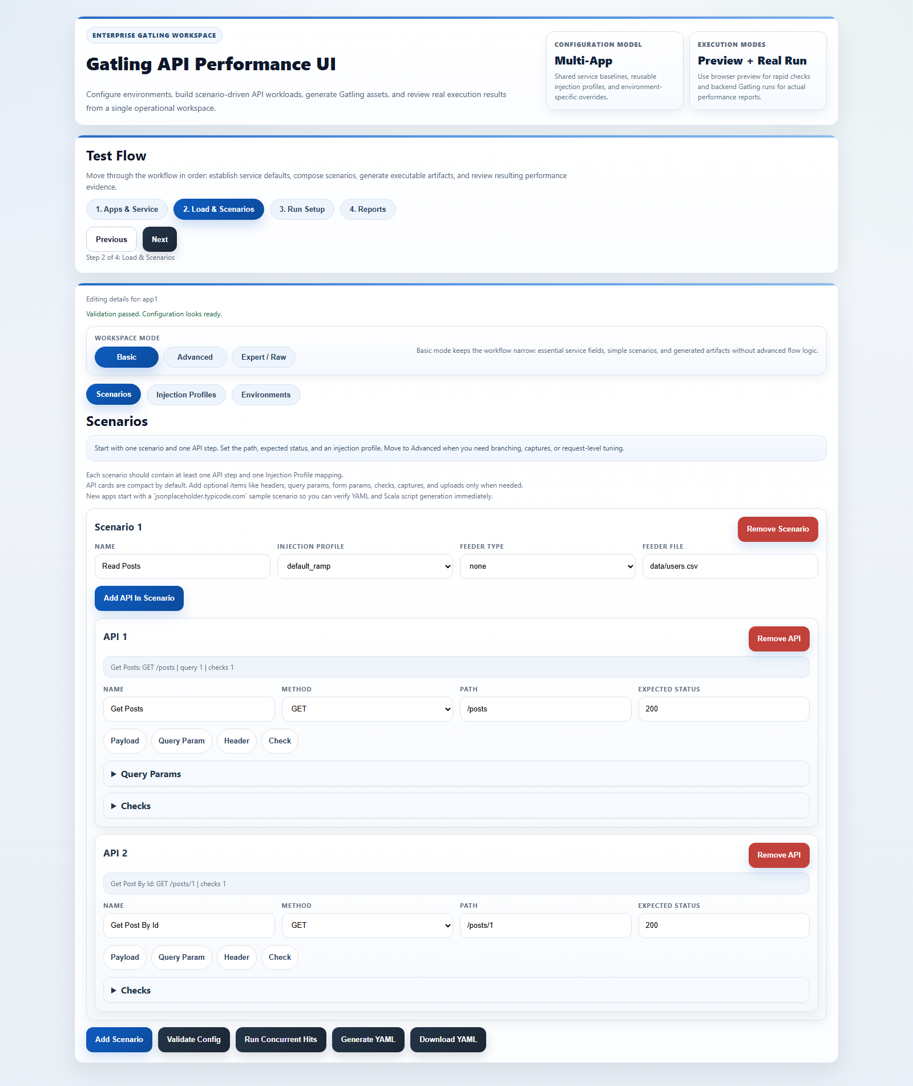
Scenario We Will Build
â€¢ Application: orders-service
â€¢ Environment: qa
â€¢ Flow: list orders -> get order -> create order
â€¢ Assertions: success >= 99%, p95 under threshold

Slide 4
Step 2: Base Service and App Setup
â€¢ Set base URL, auth strategy, and global assertions
â€¢ Create app entries and choose active app
â€¢ Keep app-level defaults clean before step-level overrides

Slide 5
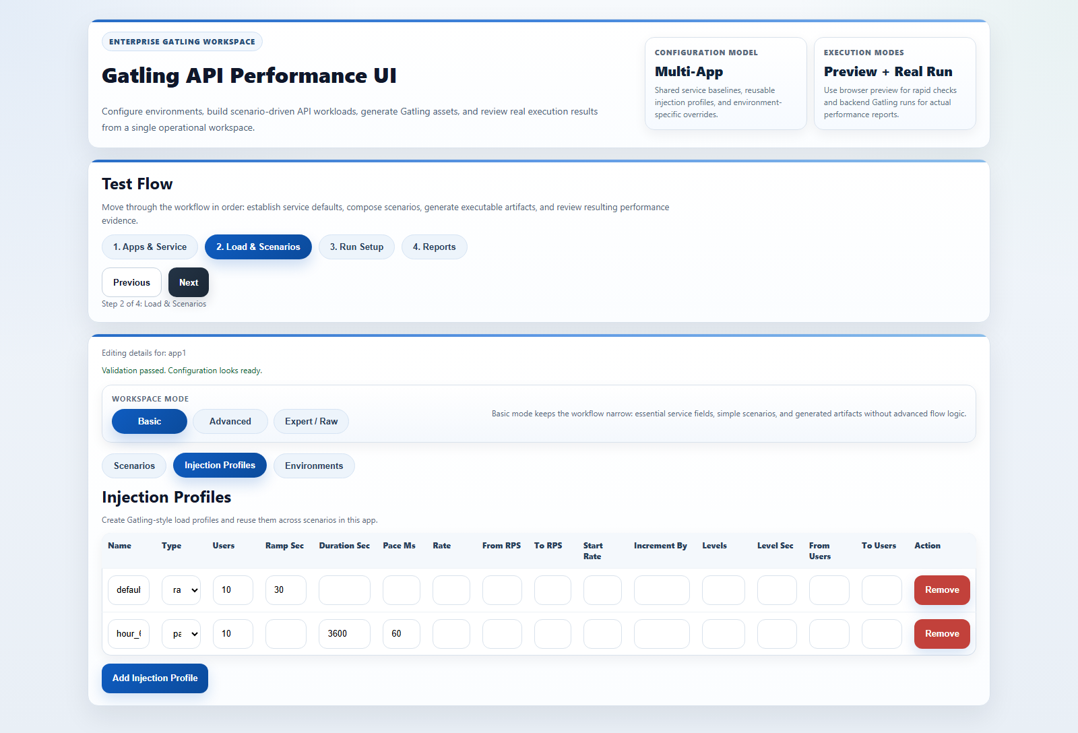
Step 3: Injection Profile Design
â€¢ Create smoke, baseline, and stress profiles
â€¢ Map each scenario to one profile
â€¢ Example: ramp 20 users over 60 sec for QA baseline

Slide 6
Step 4: Core Scenario Steps
â€¢ Add method/path/expectedStatus per API step
â€¢ Use compact cards first, then expand only needed sections
â€¢ Validate after each 2-3 steps

Slide 7
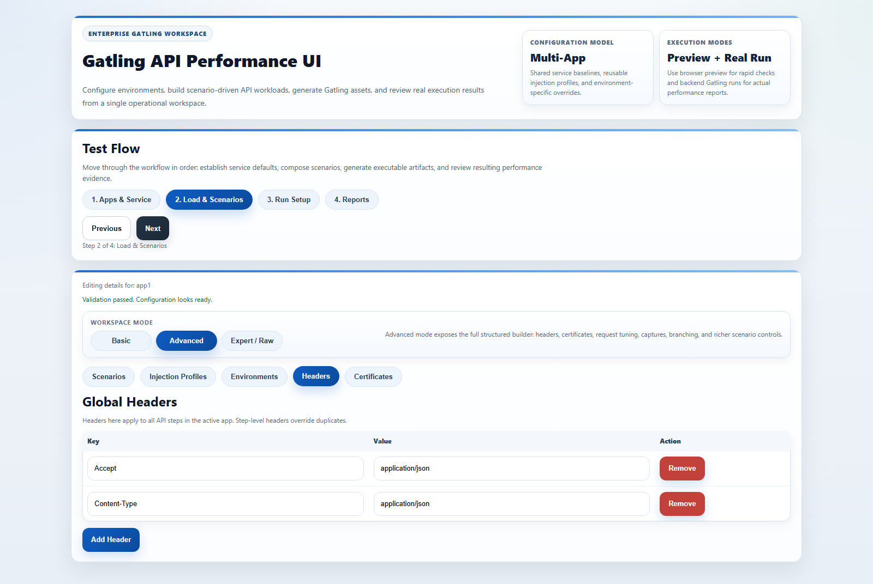
Step 5: Checks and Captures
â€¢ Add bodyContains/jsonPath checks to detect bad responses
â€¢ Capture IDs with saveAs and reuse with #{var}
â€¢ Use checks before captures for stable chaining

Slide 8
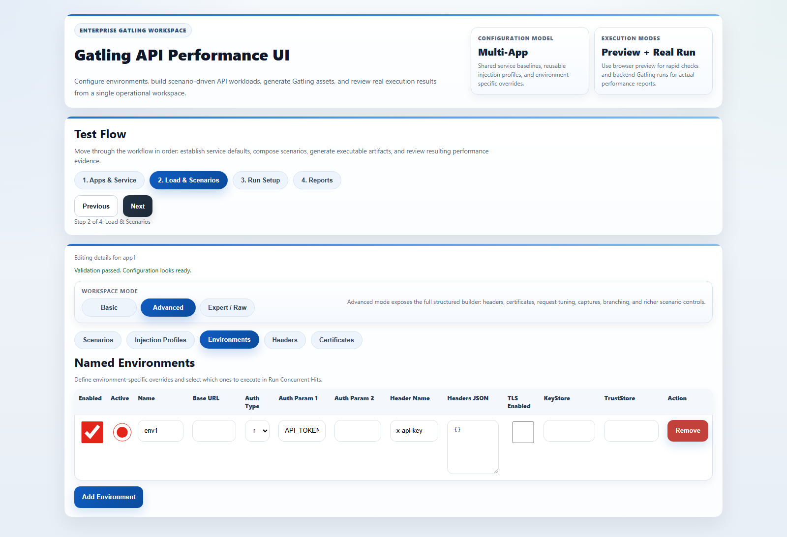
Step 6: Feeders, Params, and Body Files
â€¢ CSV feeder modes: queue, random, circular
â€¢ Use query/form params for search/filter APIs
â€¢ Use bodyFile for large payloads to keep UI readable

Slide 9
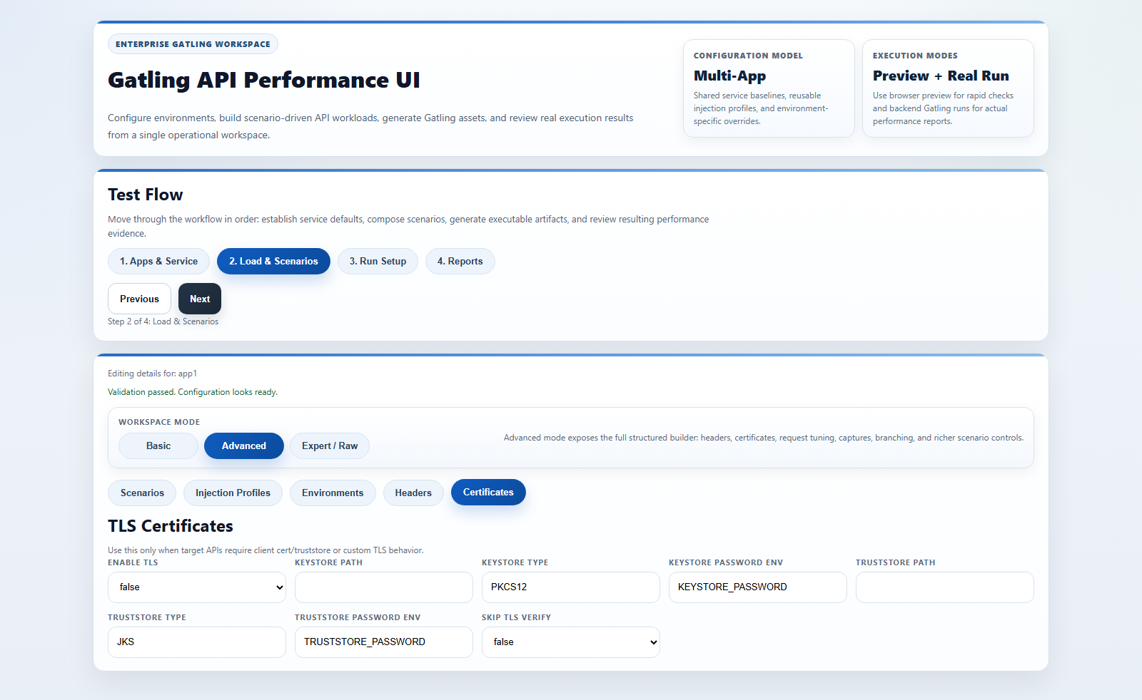
Step 7: Branching and Request Flags
â€¢ Configure conditional branches by captured variable
â€¢ Tune requestTimeout, redirects, encoding, silent mode
â€¢ Use else path for fallback behavior coverage

Slide 10
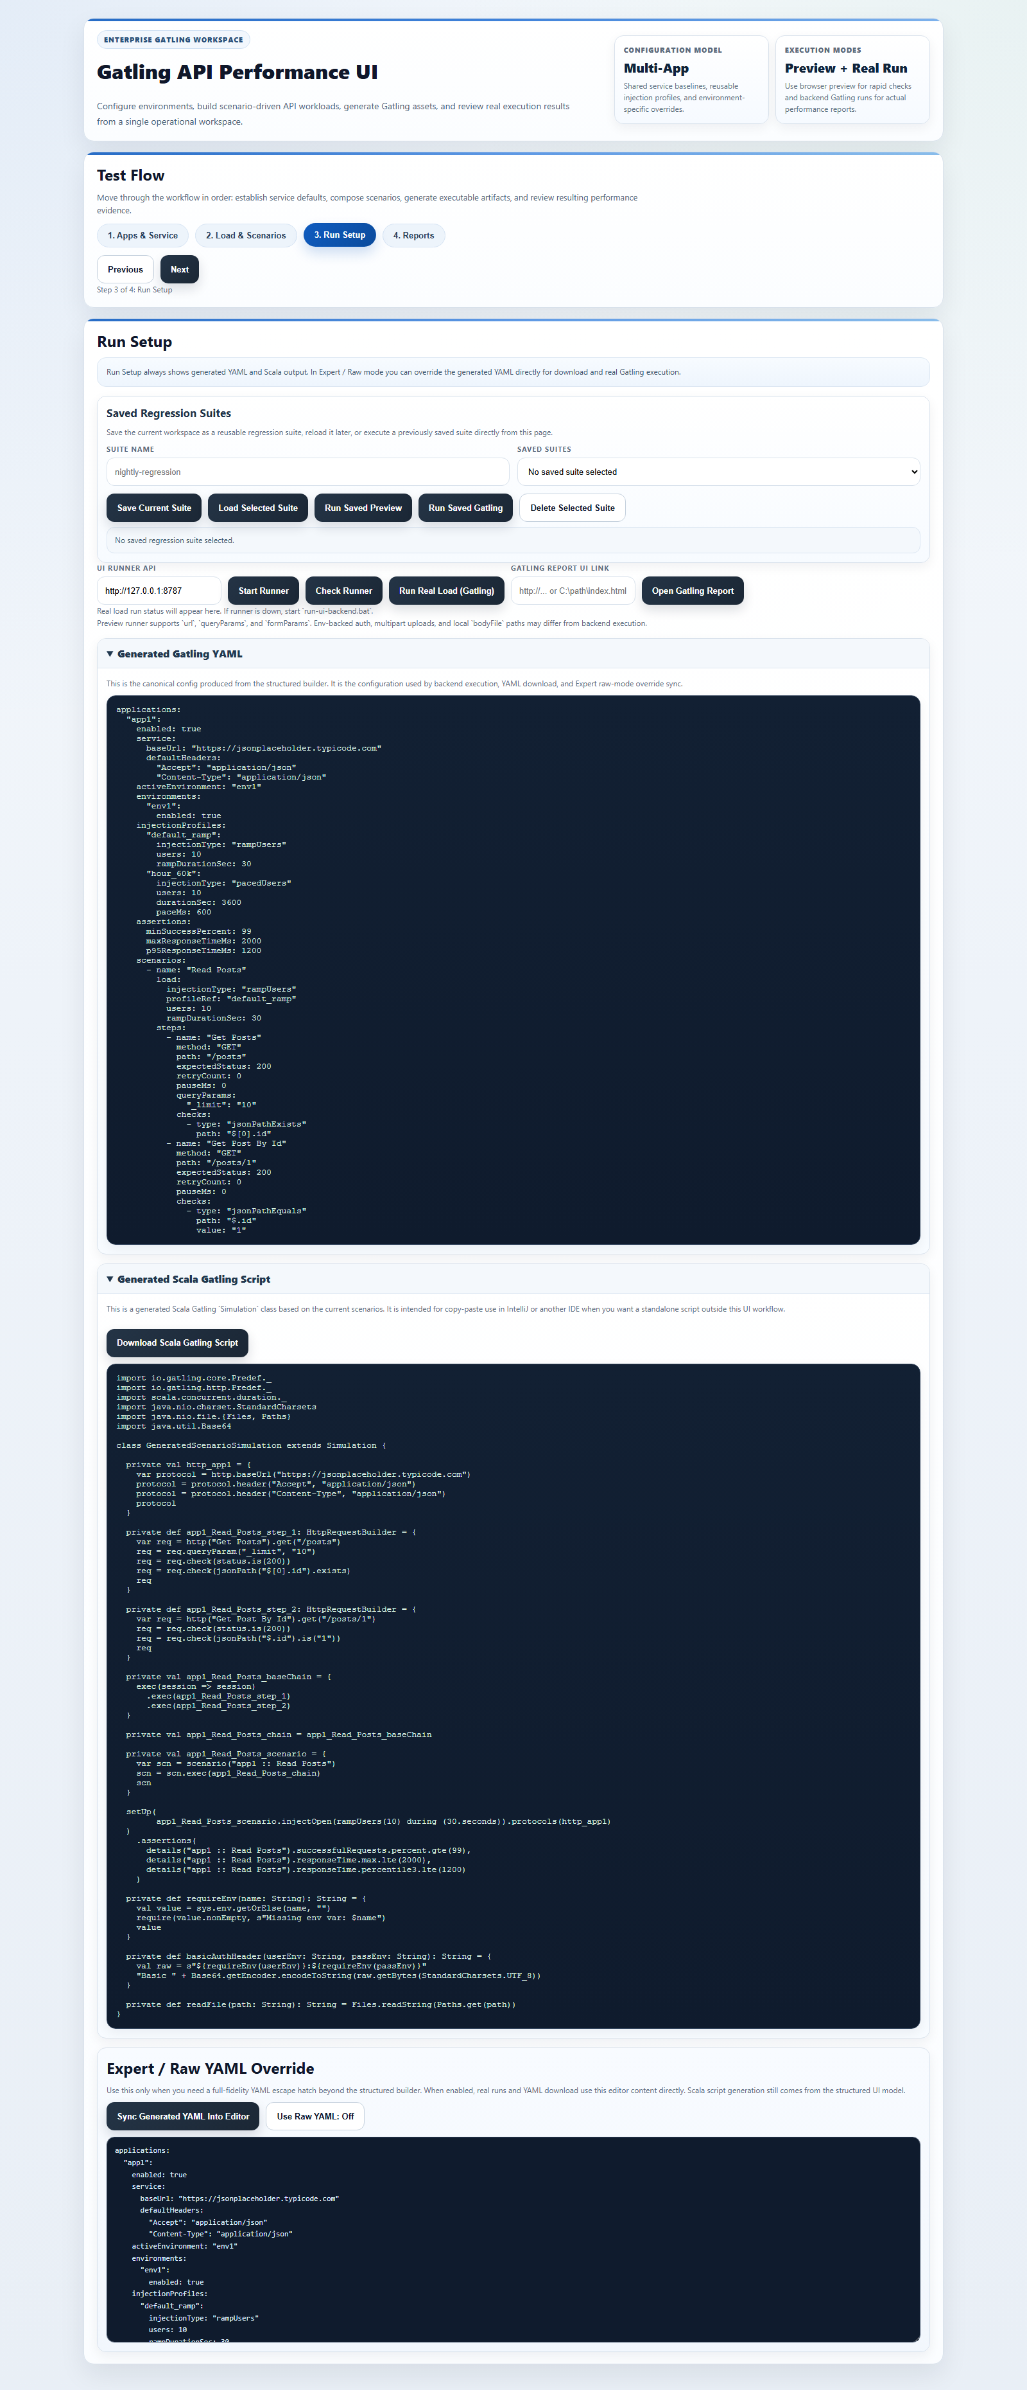
Step 8: Multipart, TLS, and Auth Variants
â€¢ Multipart formUploads for file APIs
â€¢ Service/environment TLS overrides for secure endpoints
â€¢ Bearer/basic/header auth per service or per step

Slide 11

Step 9: Expert / Raw YAML Mode
â€¢ Sync generated YAML into raw editor
â€¢ Enable raw override only for edge cases
â€¢ Keep a minimal diff from generated YAML for maintainability

Slide 12

Step 10: Real Gatling Run
â€¢ Check Runner, then Run Real Load
â€¢ Track run state, job ID, and output tail
â€¢ Use embedded report link when final report is ready

Slide 13
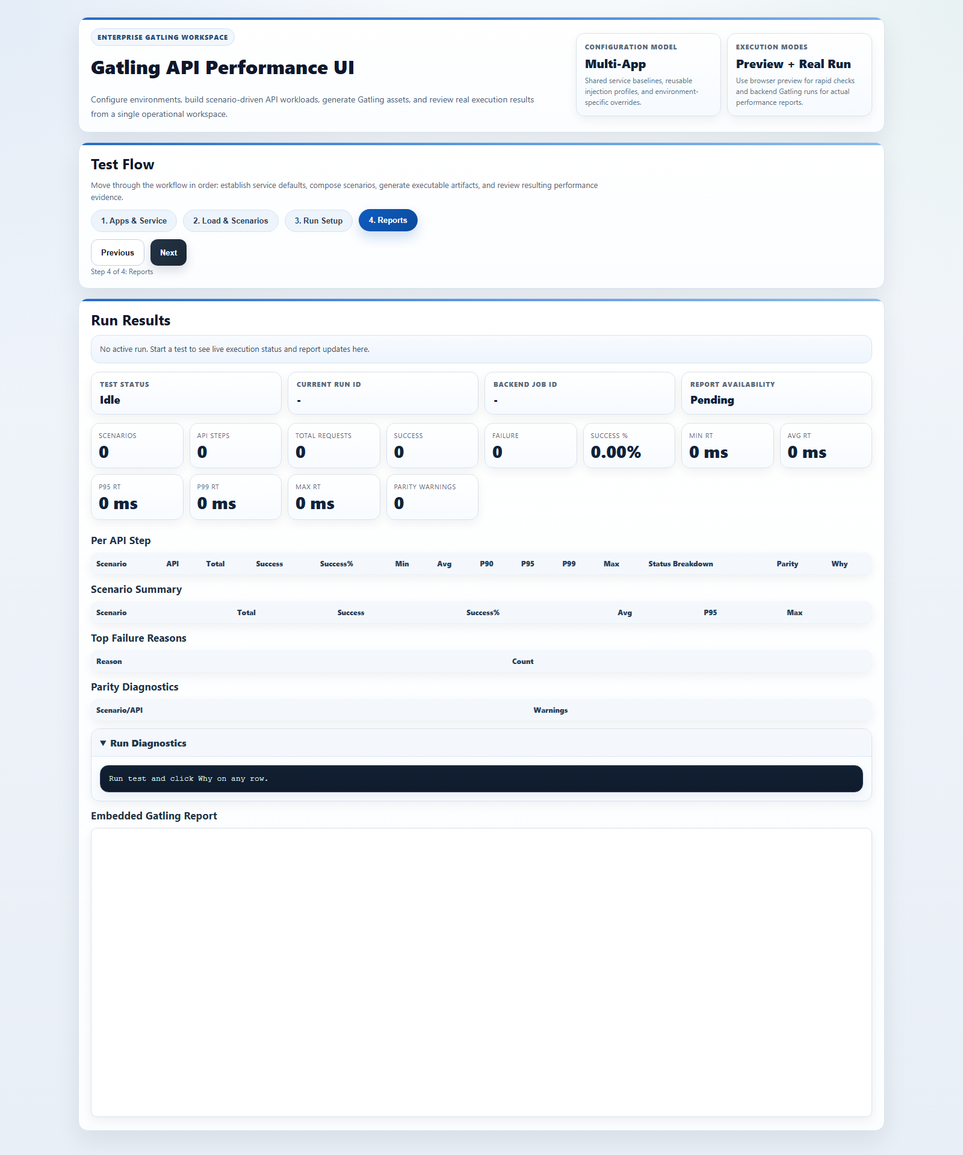
Step 11: Report Analysis and Troubleshooting
â€¢ Review KPI cards and per-step p95/p99
â€¢ Investigate failure reasons and parity diagnostics
â€¢ Differentiate preview limitations vs real backend behavior

Slide 14

Step 12: Save Suites and Release
â€¢ Save reusable regression suites in UI
â€¢ Use build-release.bat for distributable package
â€¢ Share zip + checksum for reproducible handoff

