Slide 1
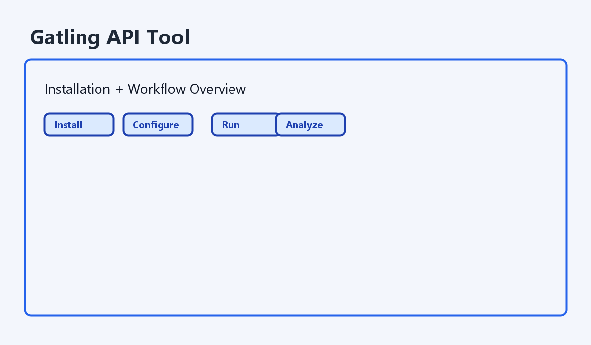
Gatling API Tool Training
Gatling API Tool Training
â€¢ Installation to expert scenario setup
â€¢ Covers preview + real Gatling execution
â€¢ Includes troubleshooting and release flow

Slide 2
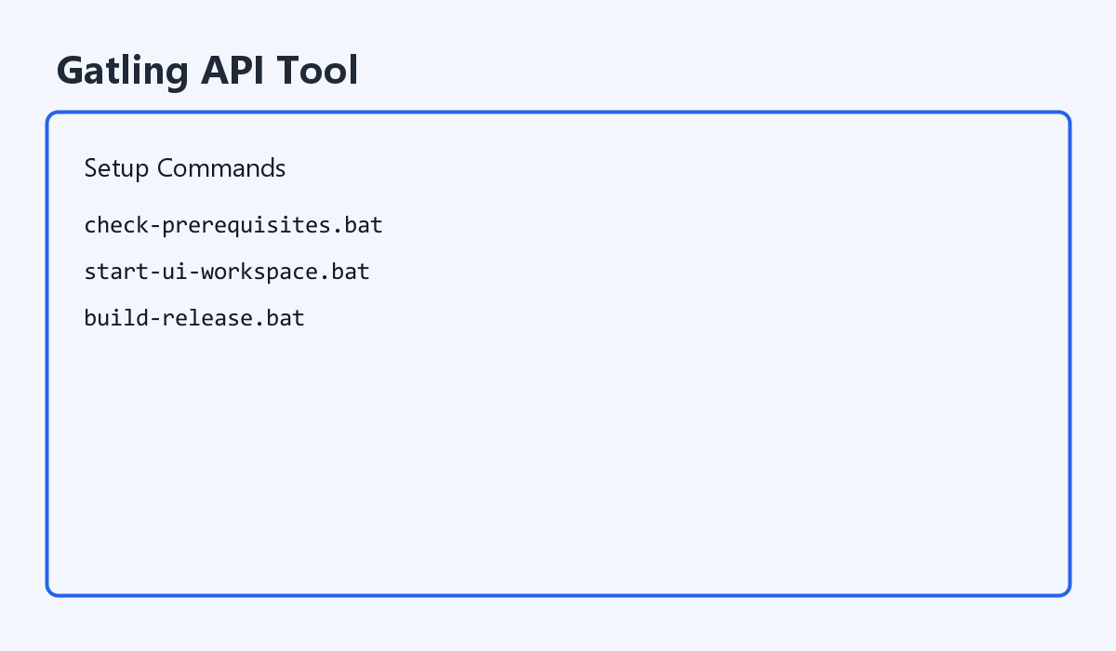
Installation and First Start
Installation and First Start
â€¢ Unzip project anywhere on disk
â€¢ Run check-prerequisites.bat
â€¢ Start with start-ui-workspace.bat
â€¢ Verify runner API is http://127.0.0.1:8787

Slide 3
Workflow Overview
Workflow Overview
â€¢ 1. Apps & Service: base URL, auth, assertions
â€¢ 2. Load & Scenarios: scenario steps + injection profiles
â€¢ 3. Run Setup: generate YAML/Scala, run real load
â€¢ 4. Reports: KPIs, failures, embedded report

Slide 4
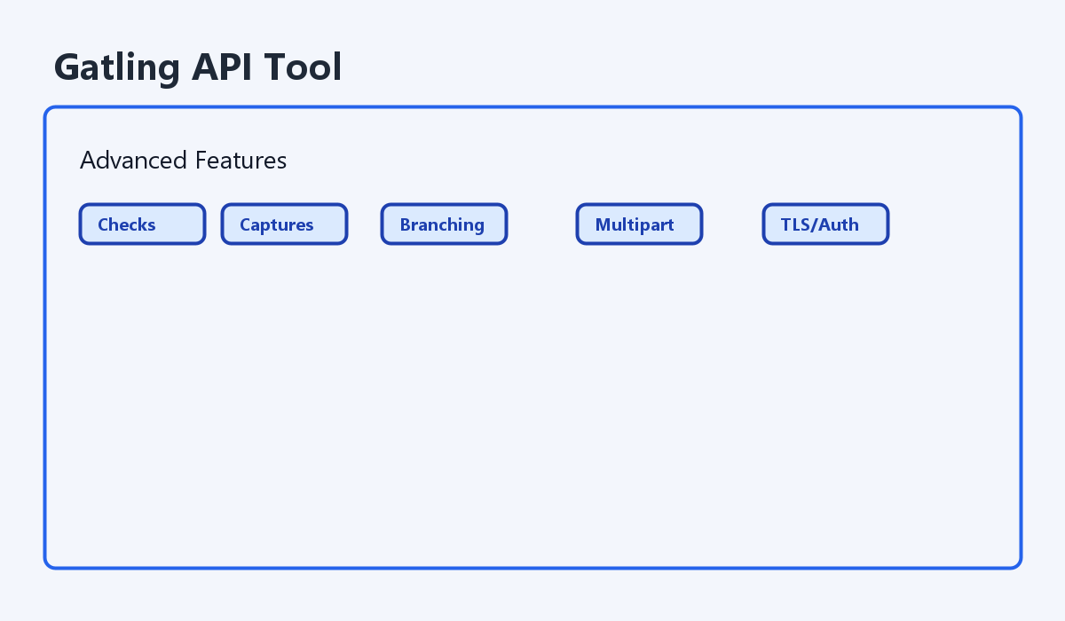
Advanced Scenario Features
Advanced Scenario Features
â€¢ Headers, query params, form params, body/bodyFile
â€¢ Checks: bodyContains, jsonPathExists, jsonPathEquals
â€¢ Captures with saveAs and reuse via #{var}
â€¢ Multipart upload and request behavior flags

Slide 5
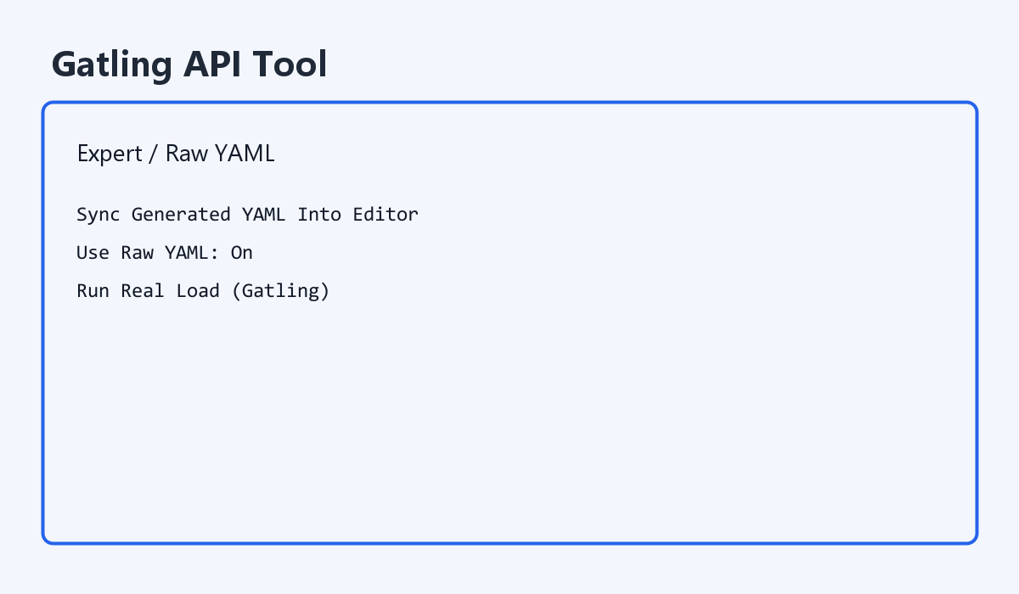
Expert / Raw Mode
Expert / Raw Mode
â€¢ Switch to Expert / Raw mode in UI
â€¢ Sync Generated YAML Into Editor
â€¢ Turn Use Raw YAML On only for targeted overrides
â€¢ Real runs + YAML download use raw content when enabled

Slide 6
Real Gatling Run and Diagnostics
Real Gatling Run and Diagnostics
â€¢ Use Check Runner before Run Real Load
â€¢ Monitor status tiles and live diagnostics
â€¢ Use report iframe and failure tables for root cause
â€¢ Use saved suites for repeatable regression

Slide 7
Portable Packaging and Release
Portable Packaging and Release
â€¢ create-portable-bundle.bat creates timestamped zip
â€¢ build-release.bat runs checks + package + checksum
â€¢ dist/latest-bundle.txt stores latest artifact path
â€¢ dist/latest-bundle.sha256 stores integrity hash

Slide 8
Demo Plan (Recommended)
Demo Plan (Recommended)
â€¢ Create app + QA environment
â€¢ Add feeder, checks, captures, injection profile
â€¢ Run preview, then run real Gatling
â€¢ Review p95/p99 and save suite

