Slide 1
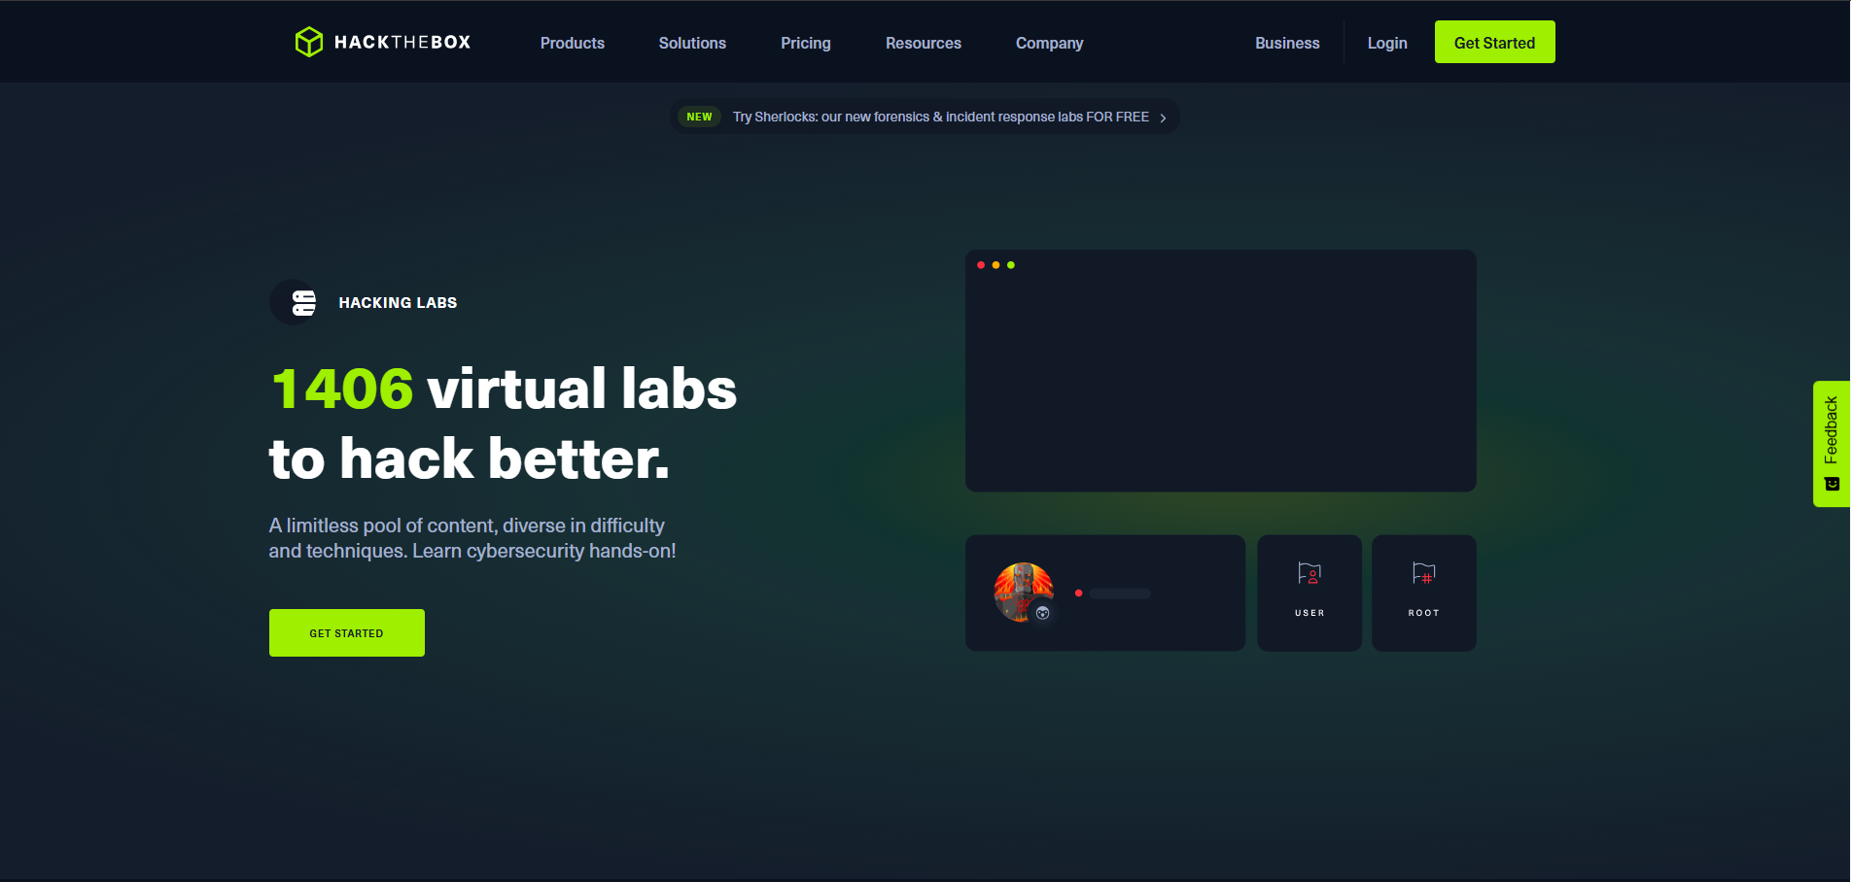
HACK THE BOX -STYLISH
GROUP-12
NAGESH KARINGA(11716570)
NIVESH SYREDDY(11707974)

Slide 2
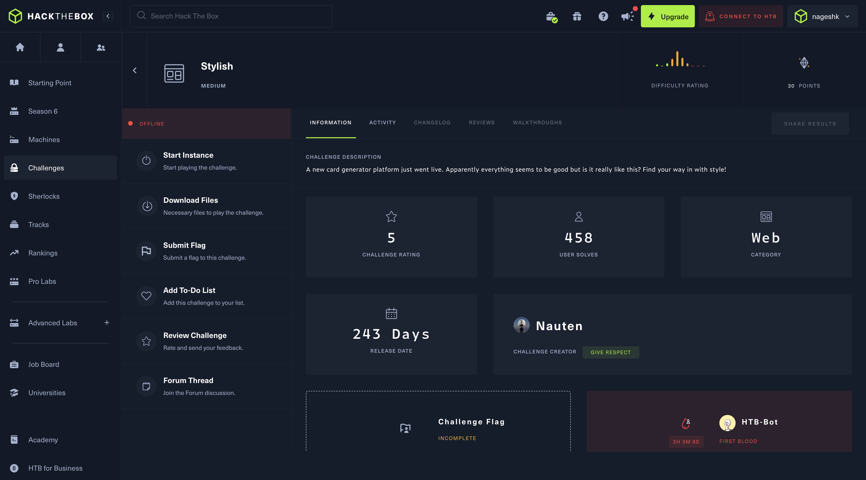


STYLISH CHALLENGE OVERVIEW
CATEGORY | WEB-BASED EXPLOITATION
DIFFICULTY | MEDIUM
OBJECTIVE | Exploit vulnerabilities in the Stylish application to extract the flag.

Slide 3
COMMON HACKING TECHNIQUES FOR WEB APPS
SQL INJECTION
CROSS SITE SCPRTING (XSS)
COMMAND INJECTION
EXPLOITING WEAK CONTENT SECURITY POLICIES
CSRF ATTACKS
EXPLOITING ADMIN PANELS AND TOKENS

Slide 4
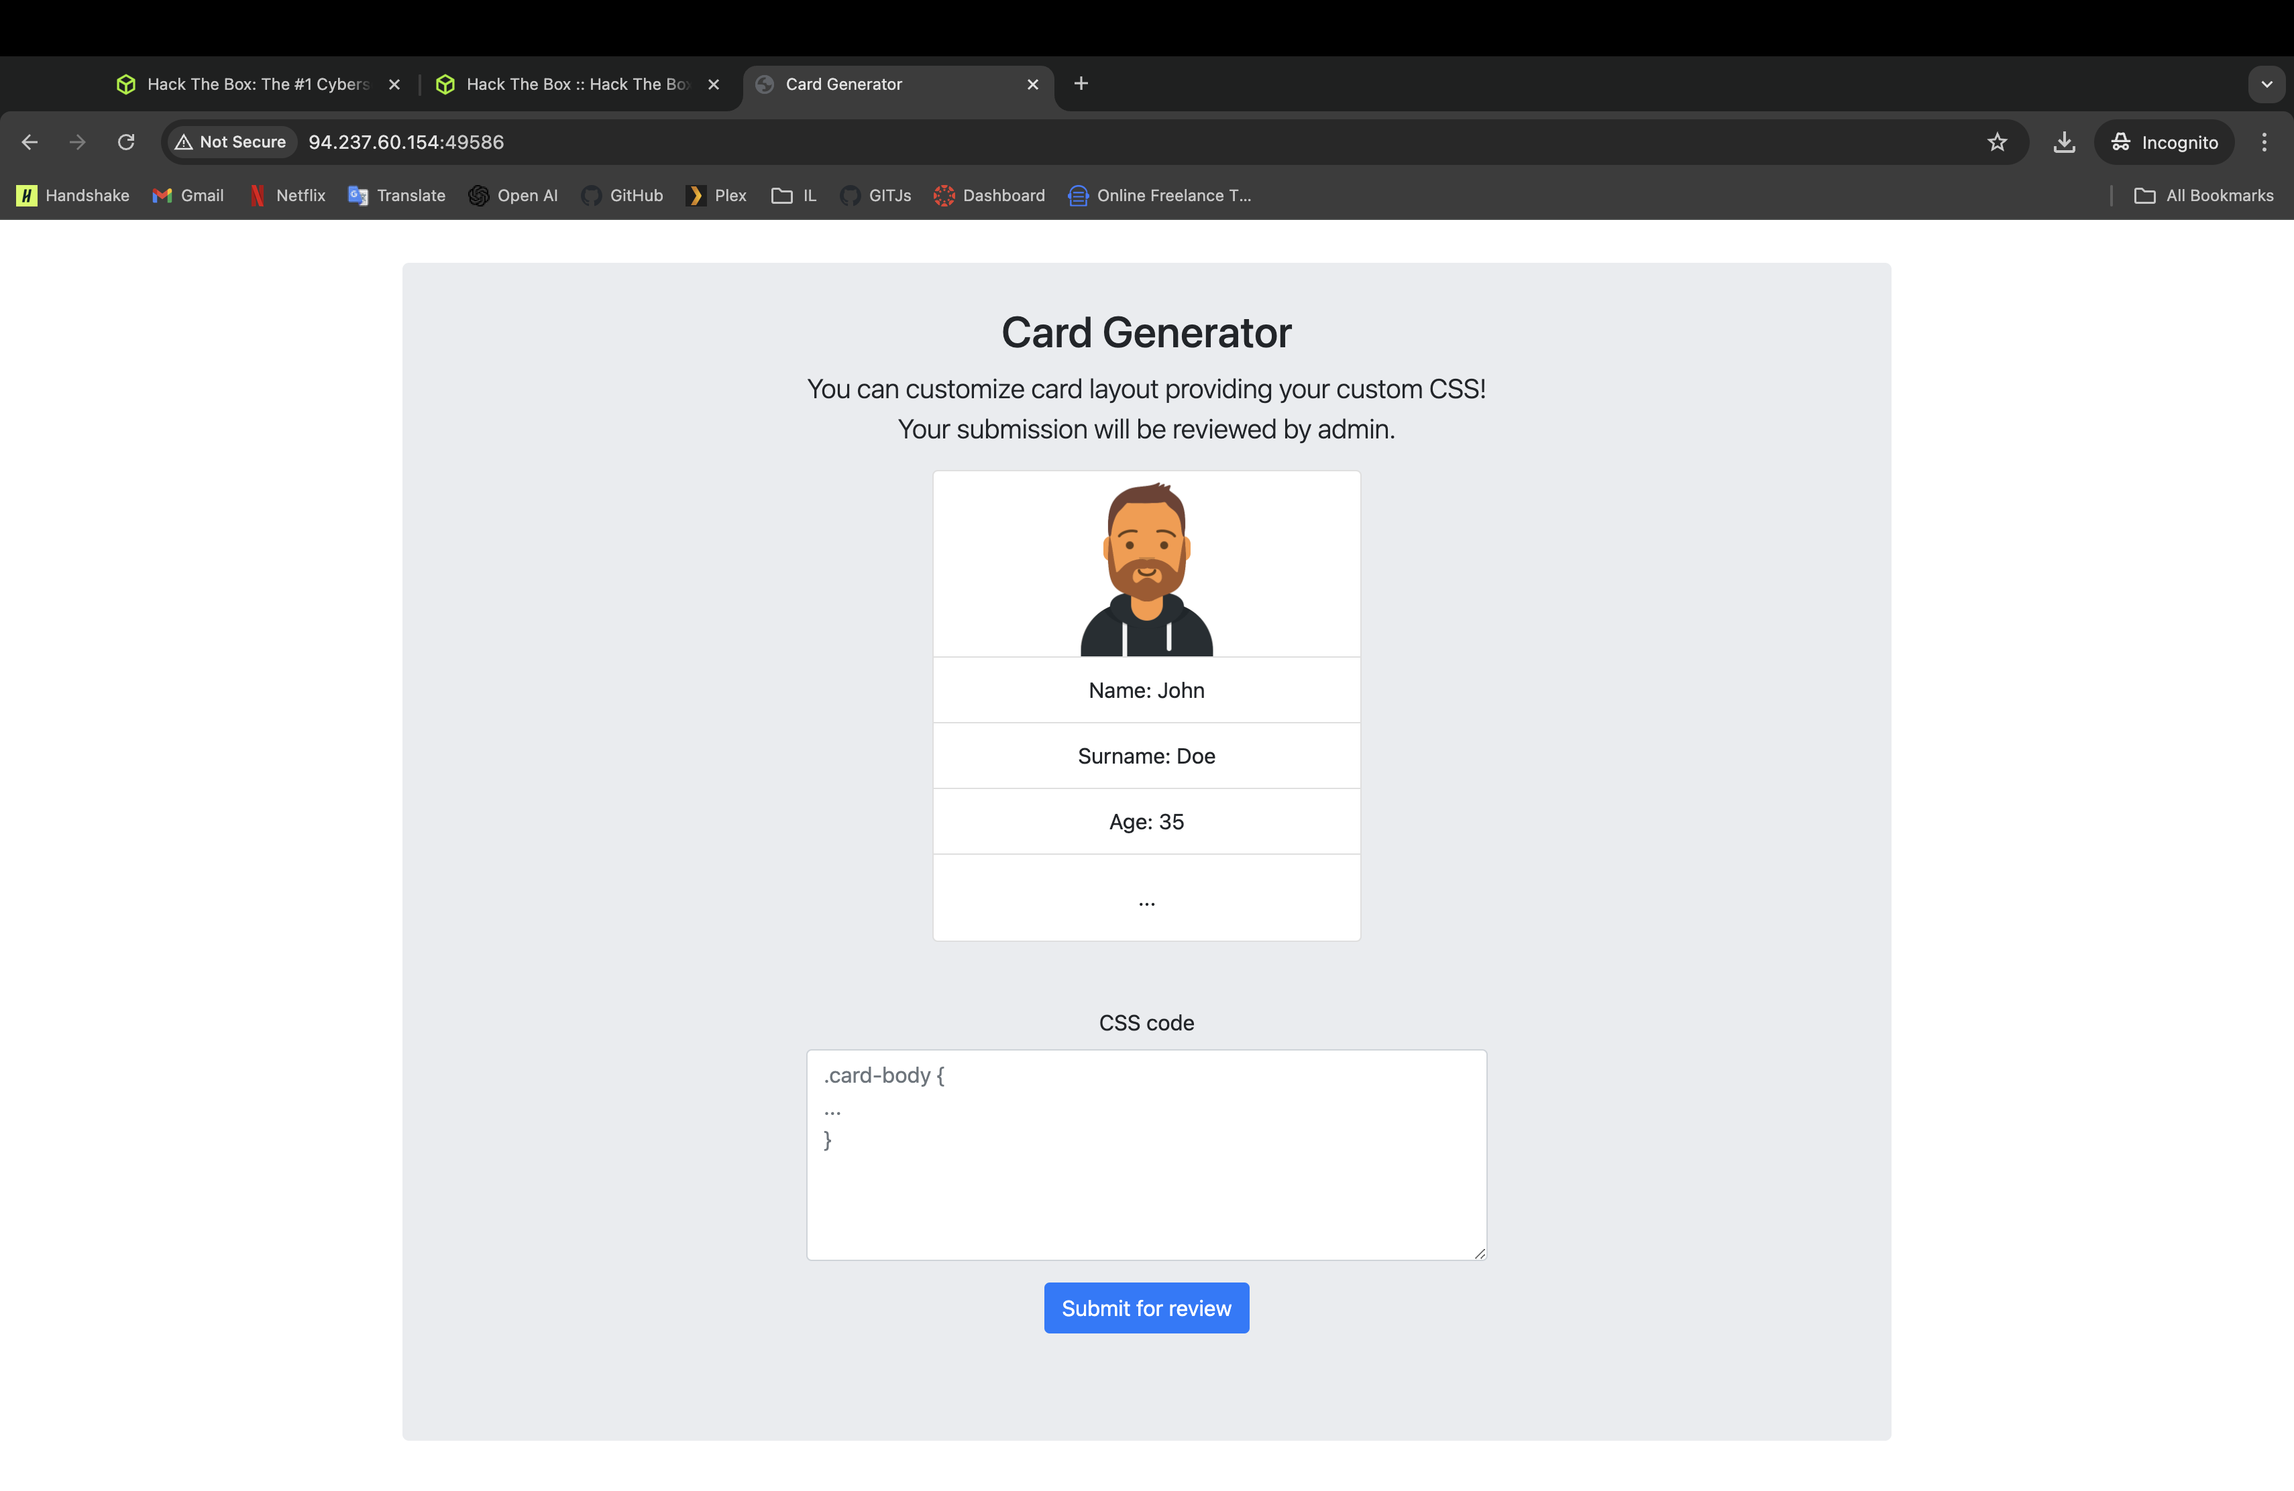



WEB APP OVERVIEW
INPUTS
Custom CSS submission form
PROCESSING
Submissions stored in the database
REVIEW
Admin reviews the code and approves/rejects it

Slide 5
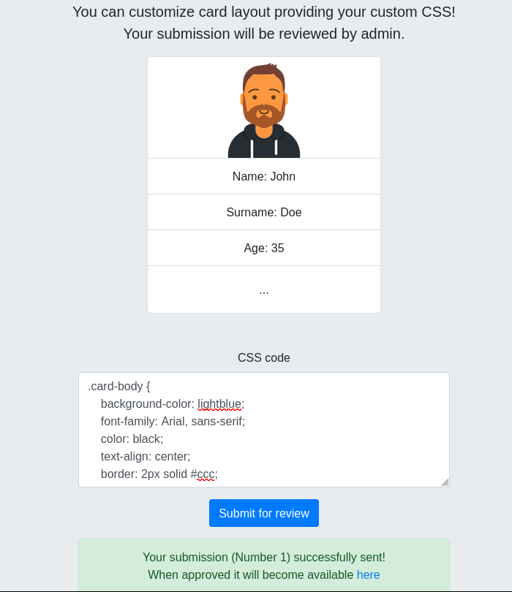
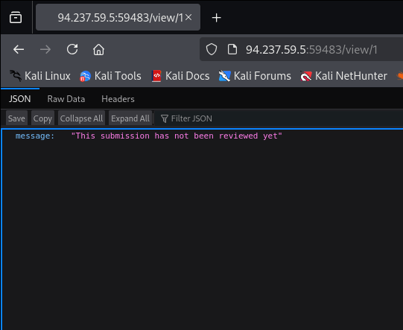
SUBMIT INITIAL PAYLOAD/CSS

Slide 6
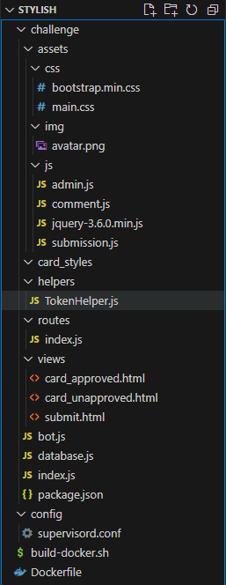
SOURCE CODE REVIEW
Assets
Backend
styles (CSS), images (img), and JavaScript (js) for user interface elements.
Backend logic resides in bot.js (admin bot behavior) and database.js (SQL interactions for handling submissions).
HTML Templates
Routing and Initialization
views folder contains templates (submit.html, card_approved.html) to render forms and UI states dynamically.
routes/index.js maps endpoints to app logic, and index.js initializes the server and middleware.
Utility files
Deployment
TokenHelper.js handles token-related operations, indicating potential authentication or validation mechanisms.
Uses Dockerfile and supervisord.conf for efficient deployment in containerized environments.

Slide 7

SOURCE CODE REVIEW
Key Vulnerabilities identified while reviewing the source code
1
The submissionID parameter in SQL queries is not sanitized
2
Tokens (approvalToken and rejectToken) are generated using a pseudo-random shuffle function
3
CSS payloads submitted via /api/submission/submit are rendered in a headless browser

Slide 8
SOURCE CODE REVIEW
Key Vulnerabilities identified while reviewing the source code
4
The Content-Security-Policy (CSP) explicitly allows external fonts
5
Unapproved submissions can only be viewed by the admin

Slide 9
POSSIBLE HACKING TECHNIQUES BASED ON VULNERABILITIES
SQL Injection
Puppeteer Execution
Approval Token Manipulation
CSP Bypass via Font Directive
Restricted Access to Unapproved Submissions

Slide 10
EXPLOITATION PLAN
Exploit SQL Injection
Puppeteer Exploitation
Use the SQL injection vulnerability to extract database information.
Leverage Puppeteer to access internal resources or exfiltrate data.
Token Forgery
Access Admin Panel Tokens
Exploit the weak token generation logic to forge valid tokens for admin endpoints.
Use the API endpoints for admin-only submissions

Slide 11
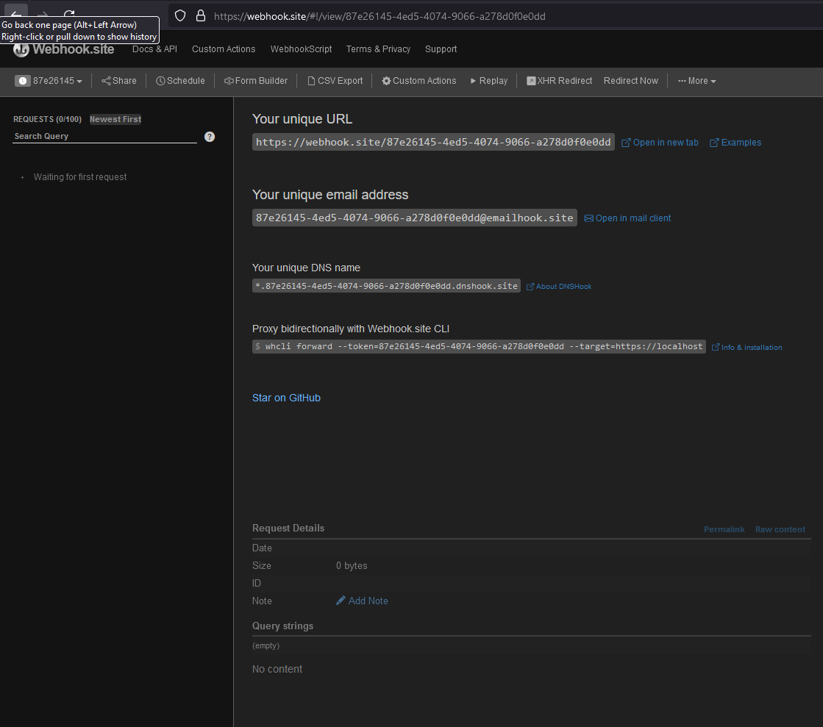
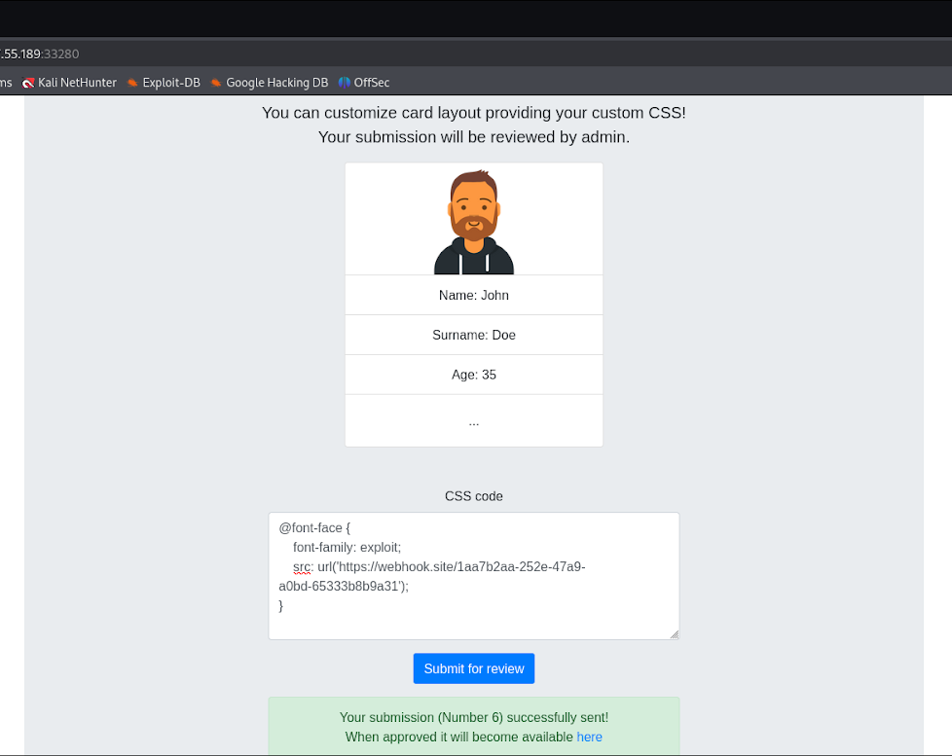
EXTERNAL API REQUESTS

Slide 12
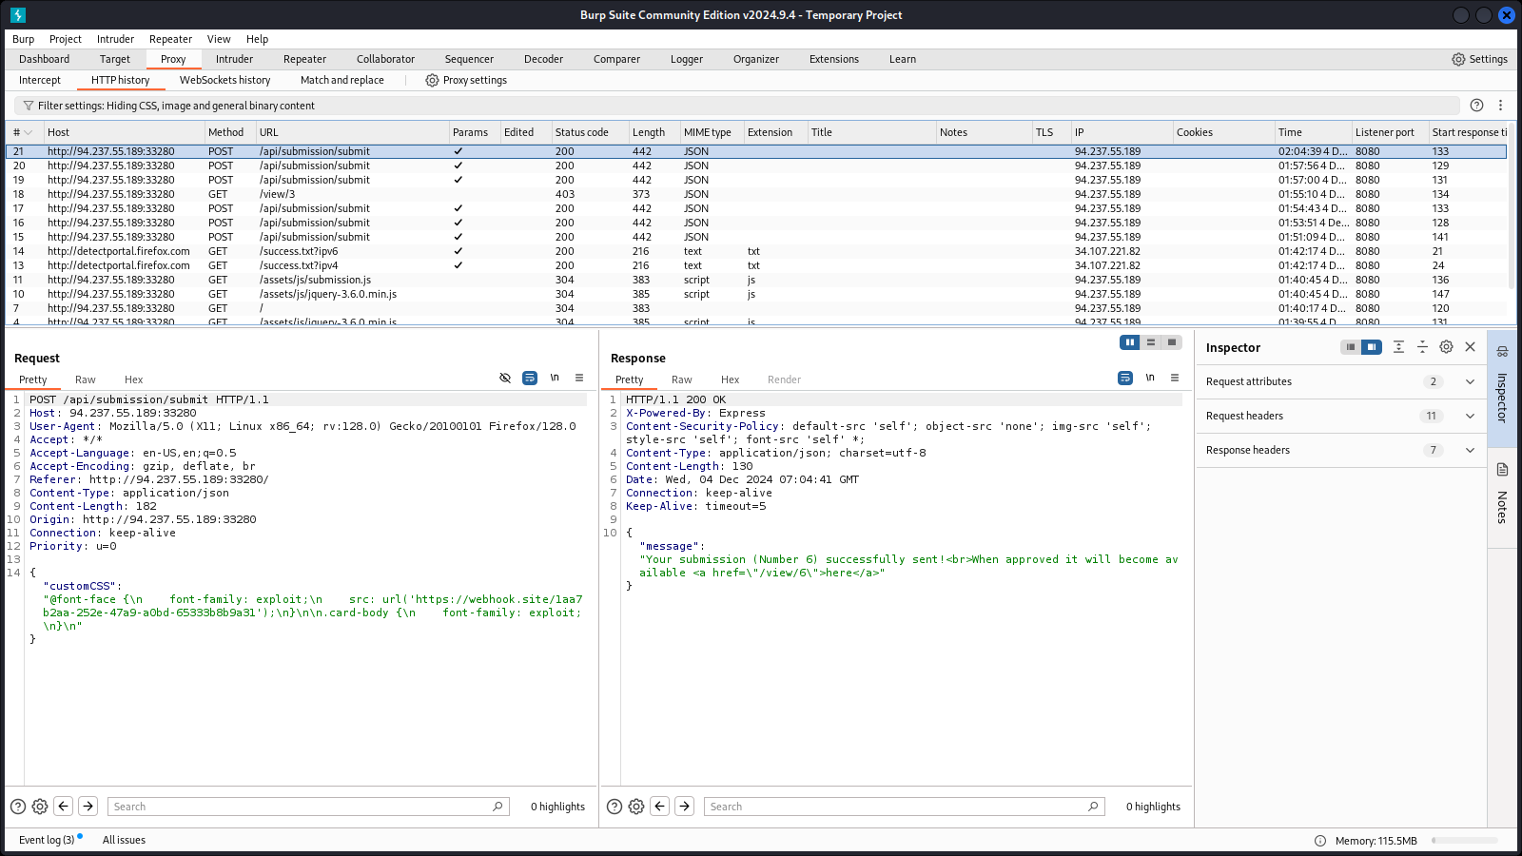
EXTERNAL API REQUESTS

Slide 13
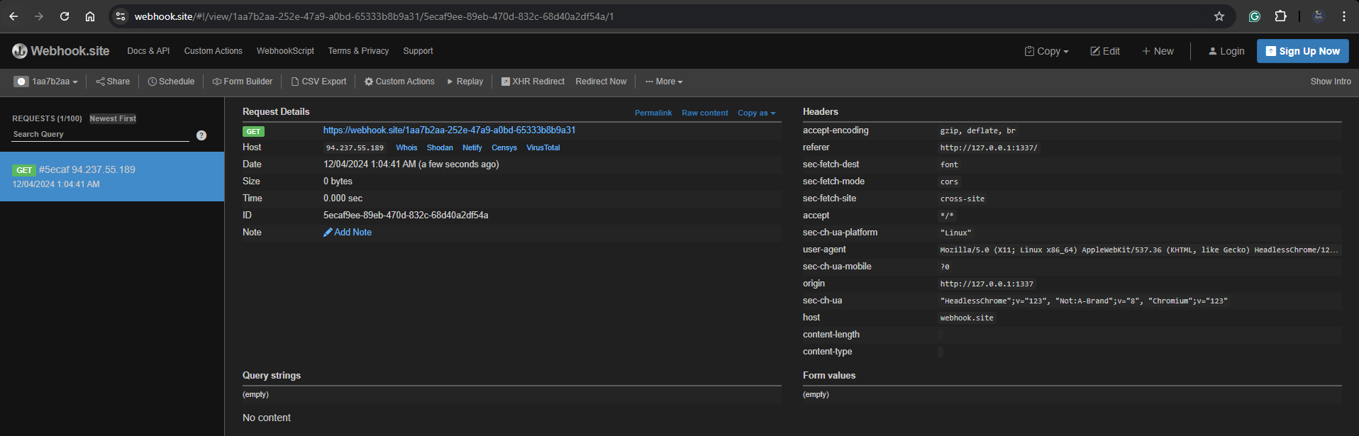
EXTERNAL API REQUESTS

Slide 14
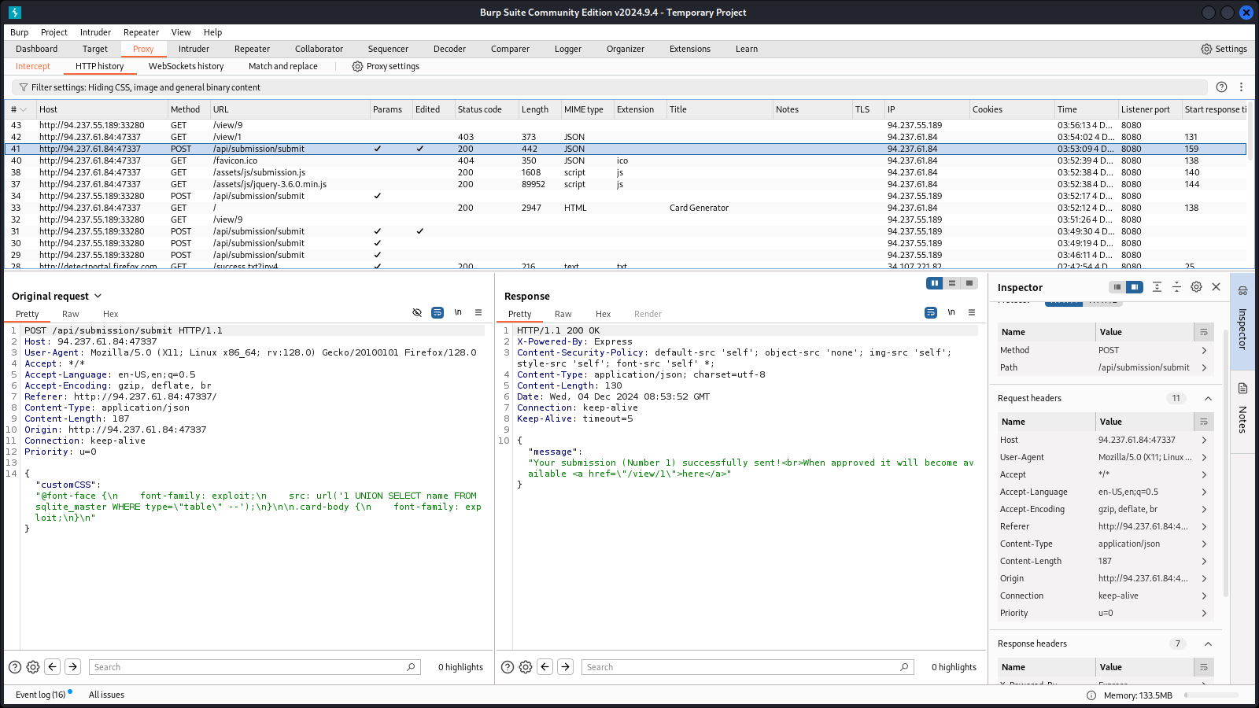
SQL INJECTION

Slide 15
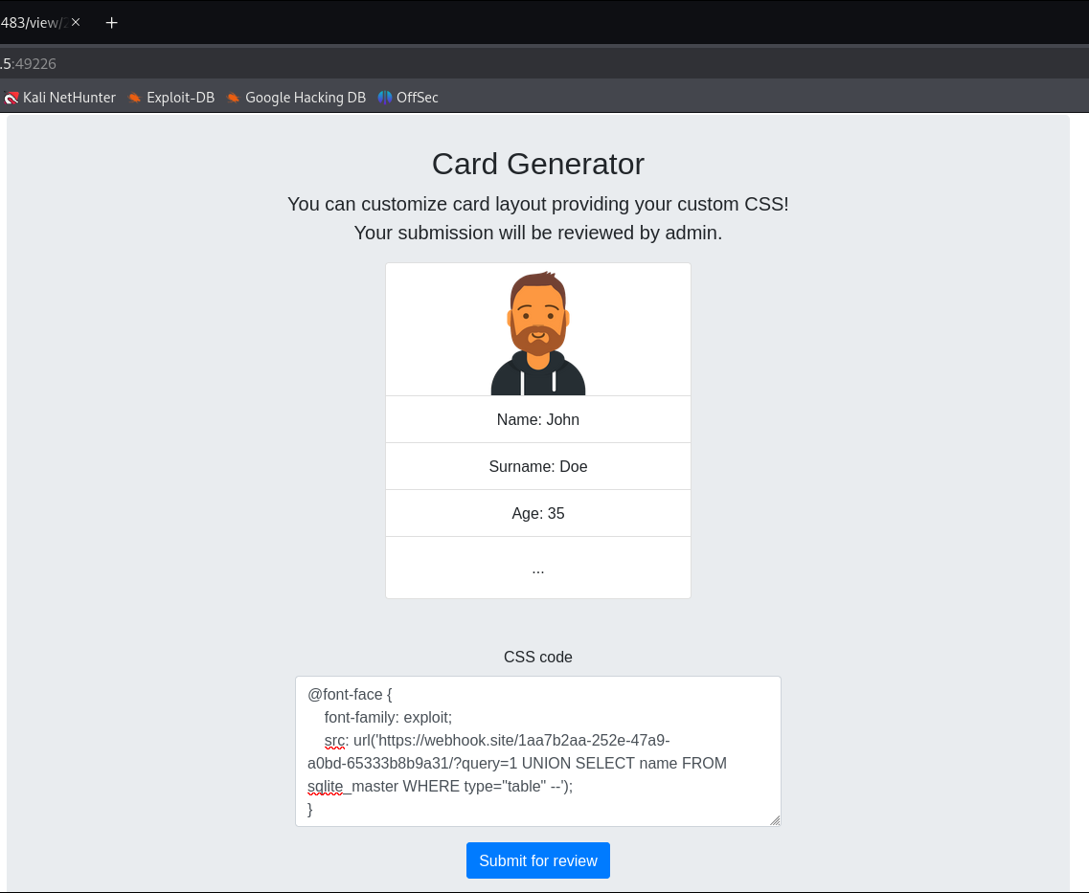
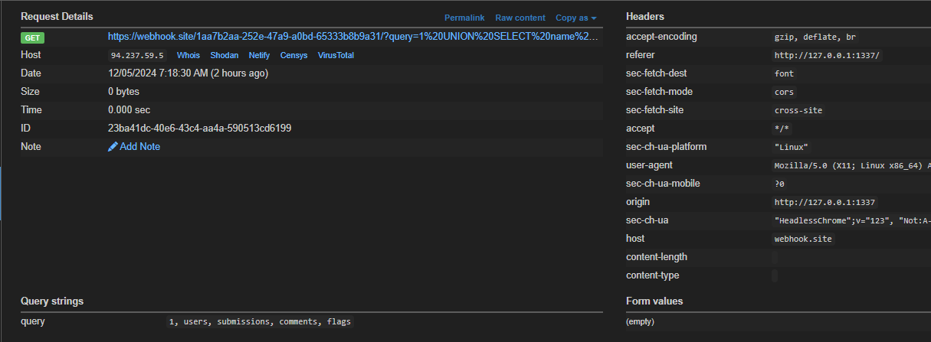
SQL INJECTION WITH WEBHOOK

Slide 16
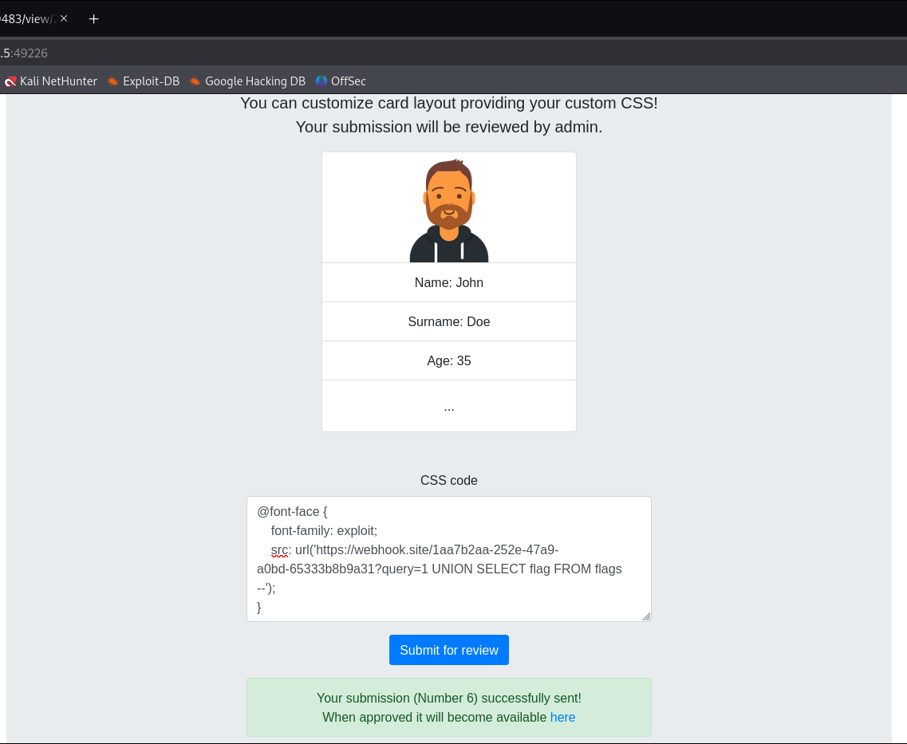
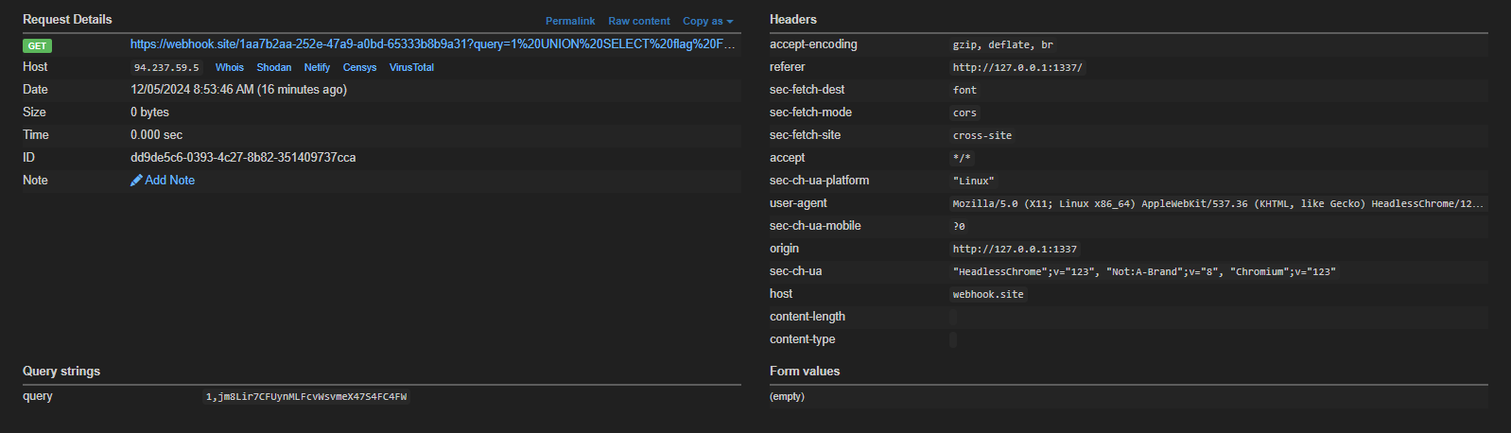
SQL INJECTION WITH WEBHOOK:
jm8Lir7CFUynMLFcvWsvmeX47S4FC4FW

Slide 17
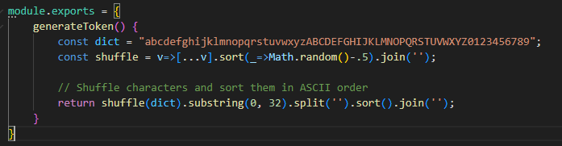
TOKEN FORGERY
In this stage, we forge the approval token to make the submissions approved without admin intervention.

Slide 18
FUTURE ACTION PLAN
SQL Injection to Change Approval Status
Explore Advanced Vulnerabilities
Bypass Token Validation
Trigger Puppeteer Exploitation

Slide 19
CHALLENGES FACED
Lack of prior knowledge and skills on HTB
Fully understanding source code
Small Team size
Designing the right payload for SQL Injection

Slide 20
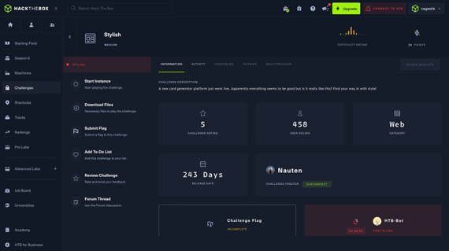
KEY TAKEAWAYS
Hands-on with Hack The Box
Analyzing a web app source code
Burpsuite API interception
Webhook Implementation
STYLISH
Payload generation for
SQL Injection
Vulnerability Identifications
Formulating a Exploitation Plan

Slide 21
FAKE FLAG DETECTED
We detected a fake flag that is stored in the application database. We found that randomly while going through the source code.
'HTB{f4k3_fl4g_f0r_t3st1ng}'

