Slide 1
Secure Data Hiding in Images Using Steganography
CAPSTONE PROJECT
Presented By:
Student Name : Nivesh Pai
College Name & Department : Computer Science and Engineering, KLE Technological University

Slide 2
OUTLINE
Problem Statement
Technology used
Wow factor
End users
Result
Conclusion
GitHub Link
Future scope

Slide 3
Problem Statement
To build a Flask-based image steganography web application that encrypts and decrypts messages hidden inside images using pixel manipulation

Slide 4
Technology used
Backend: Flask (Python)
Frontend: HTML, CSS, JavaScript
Libraries: OpenCV, Base64
Hosting : Vercel

Slide 5
Wow factors
Vercel is used to deploy a user-friendly website to encrypt and decrypt images using flask-based web application
Uses a custom delimiter (###END###) to extract messages correctly and prevent loss of data
Base64 library was used to convert encrypted images into text-based format to display images quickly and to download them without file storage

Slide 6
End users
General users : Anyone looking to privately store or share confidential images.
Researchers and Academics – Students and researchers studying cryptography and steganography.
Professional users – Companies or IT professionals interested in secure communication and data hiding techniques for work usage.
Journalists – Those needing a secure way to transmit sensitive information without detection.
Government & Military Personnel – For secure and covert data transmission in military usage.

Slide 7
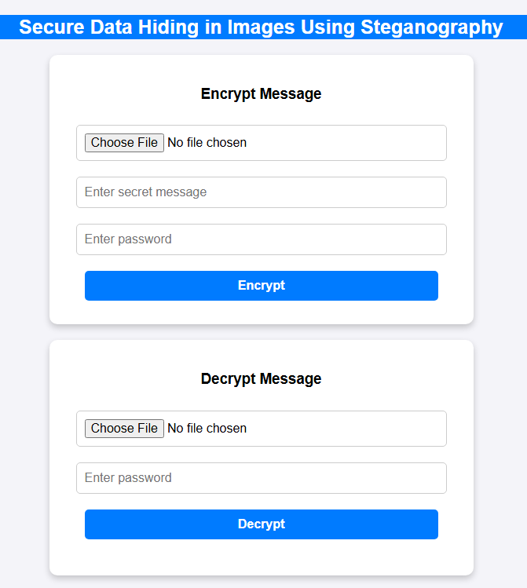
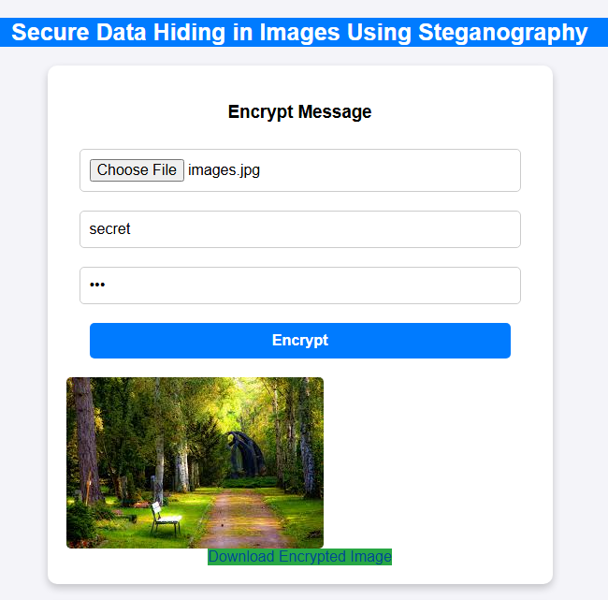
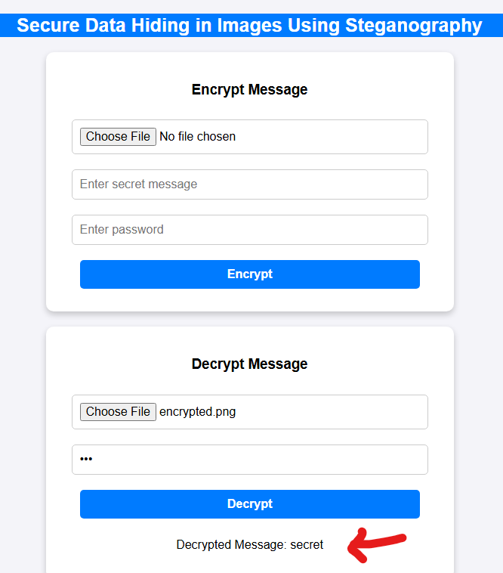
Results
Encryption
Decryption
Homepage

Slide 8
Conclusion
The project demonstrates the process of image steganography by encrypting and decrypting images. Using Flask and OpenCV, data hiding was done. With its password protection and pixel manipulation, the code ensures confidentiality. The project is hosted on Vercel for easy usage. Future improvements can be implemented to enhance encryption techniques and optimize storage.

Slide 9
GitHub Link
GitHub link : https://github.com/Niveshpai/Stegnography-nivesh
Project link : stegnography-nivesh.vercel.app/

Slide 10
Future scope
Vercel’s serverless deployment may cause issues with large size images due to memory and execution limits.
Hence, a server-based platform like AWS (EC2, S3, Lambda with EFS) or Azure (VMs, Blob Storage, Functions with durable storage) could be used, since these platforms provide more flexibility, persistent storage, and higher resource limits for image processing.

Slide 11
THANK YOU

