Slide 1
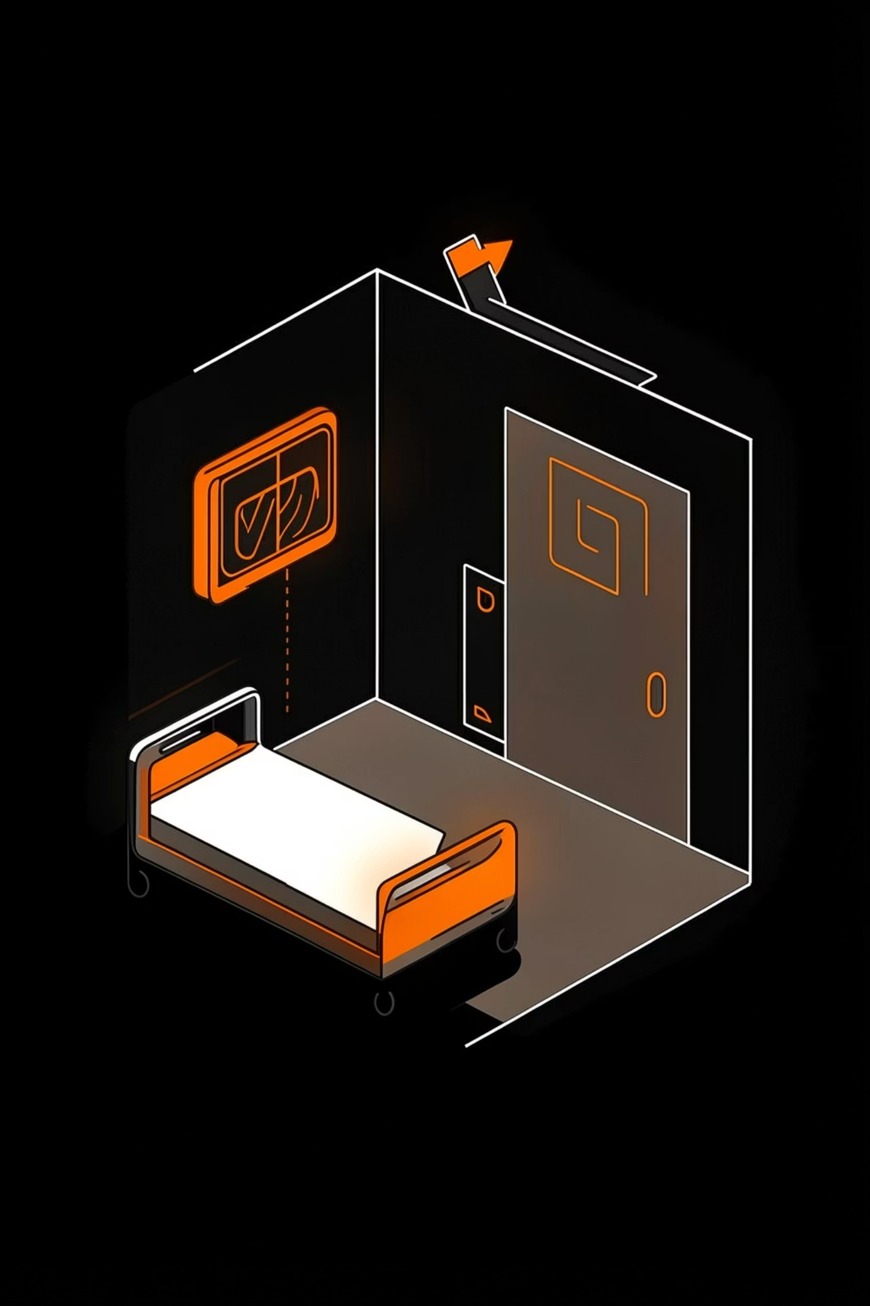
Emergency Hospital Resource Optimizer
A smart, multi-solver dispatch system that routes disaster patients to the right hospital — in real time, at scale.
EHODR
DISASTER RESPONSE
QUANTUM-INSPIRED

Slide 2

The Problem: When Disaster Strikes, Chaos Follows
🚨 Overflow Risk
⏱ Time Is Critical
Sending all patients to the nearest hospital instantly overloads ICU beds, ventilators, and staff.
Critical patients (Severity 3) lose precious minutes waiting at a full facility instead of getting care.
📋 No Clear Coordination
Without a smart dispatcher, human coordinators can't track every hospital's real-time capacity simultaneously.

Slide 3
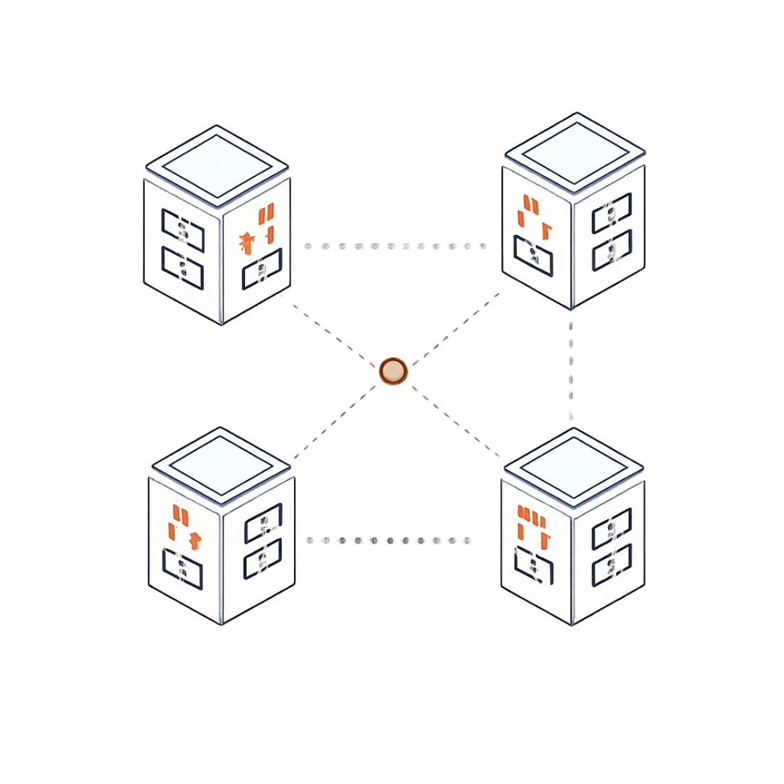
Our Approach: A Super-Smart Digital Dispatcher
EHODR takes two inputs — patient severity (1–3) and distance to each hospital — and instantly calculates the optimal allocation for every patient.
🚑 Prioritize the Critical
⚖️ Balance the Load
Severity 3 patients go to the nearest hospital with open ICU capacity.
No hospital ever exceeds its available beds, ventilators, or doctors.
🎯 Minimize Transit Cost
The system's core goal: keep the total “cost score” as low as possible.

Slide 4

Tech Stack & Hardware
Three solvers share one math layer, then route automatically based on problem size.
QUBO
QAOA
Simulated Annealing
Dynamic routing logic
Shared math layer
All allocation variants are encoded into one optimization model before solving.
True quantum solver — simulated
Best for small problems: ≤18 qubits. Uses quantum circuits to search the solution space.
Memory: 2^n
Quantum-inspired classical solver
Scales to any size and quickly finds strong solutions by escaping local minima.
Scales beyond 18 qubits
Automatic switching
If the instance is small, route to QAOA; otherwise, switch to Simulated Annealing.
Decision rule
Small problem? Use the quantum path. Larger problem? Use the classical fallback.
QUBO
Solver
Output
Problem encoding
QAOA or SA
Best allocation
Why this works: the system keeps one consistent objective, then chooses the fastest solver that fits the hardware and problem size.

Slide 5
Key Features & Capabilities
EHODR delivers a comprehensive suite of tools for real-time disaster response, designed to optimize resource allocation and enhance decision-making.
📝 Patient Triage Registrar
Interactive intake form for real-time patient registration, automatically calculating Emergency Severity Index (ESI) scores based on symptoms for precise prioritization.
⚙️ Dynamic Disaster Presets
Instantly load high-stress scenarios like Mass Casualty, Pandemic Surge, or Earthquake, allowing for rapid deployment and simulation of critical events.
🛡️ Constraint Safety & Heuristics
Multi-dimensional solvers guarantee allocation within hospital capacity limits (ICU beds, ventilators, staff) and route critical patients based on specialties and safe transit times.
📊 Visual Telemetry & Reporting
Interactive dashboards, including Resource Load Visualizers and Distance Heatmaps, provide granular insights into patient allocations and system performance with CSV export.
🤖 EOC Command Advisor
A draggable, client-side chatbot overlay provides diagnostic analysis and advisory support, ensuring continuous guidance even in offline scenarios.

Slide 6
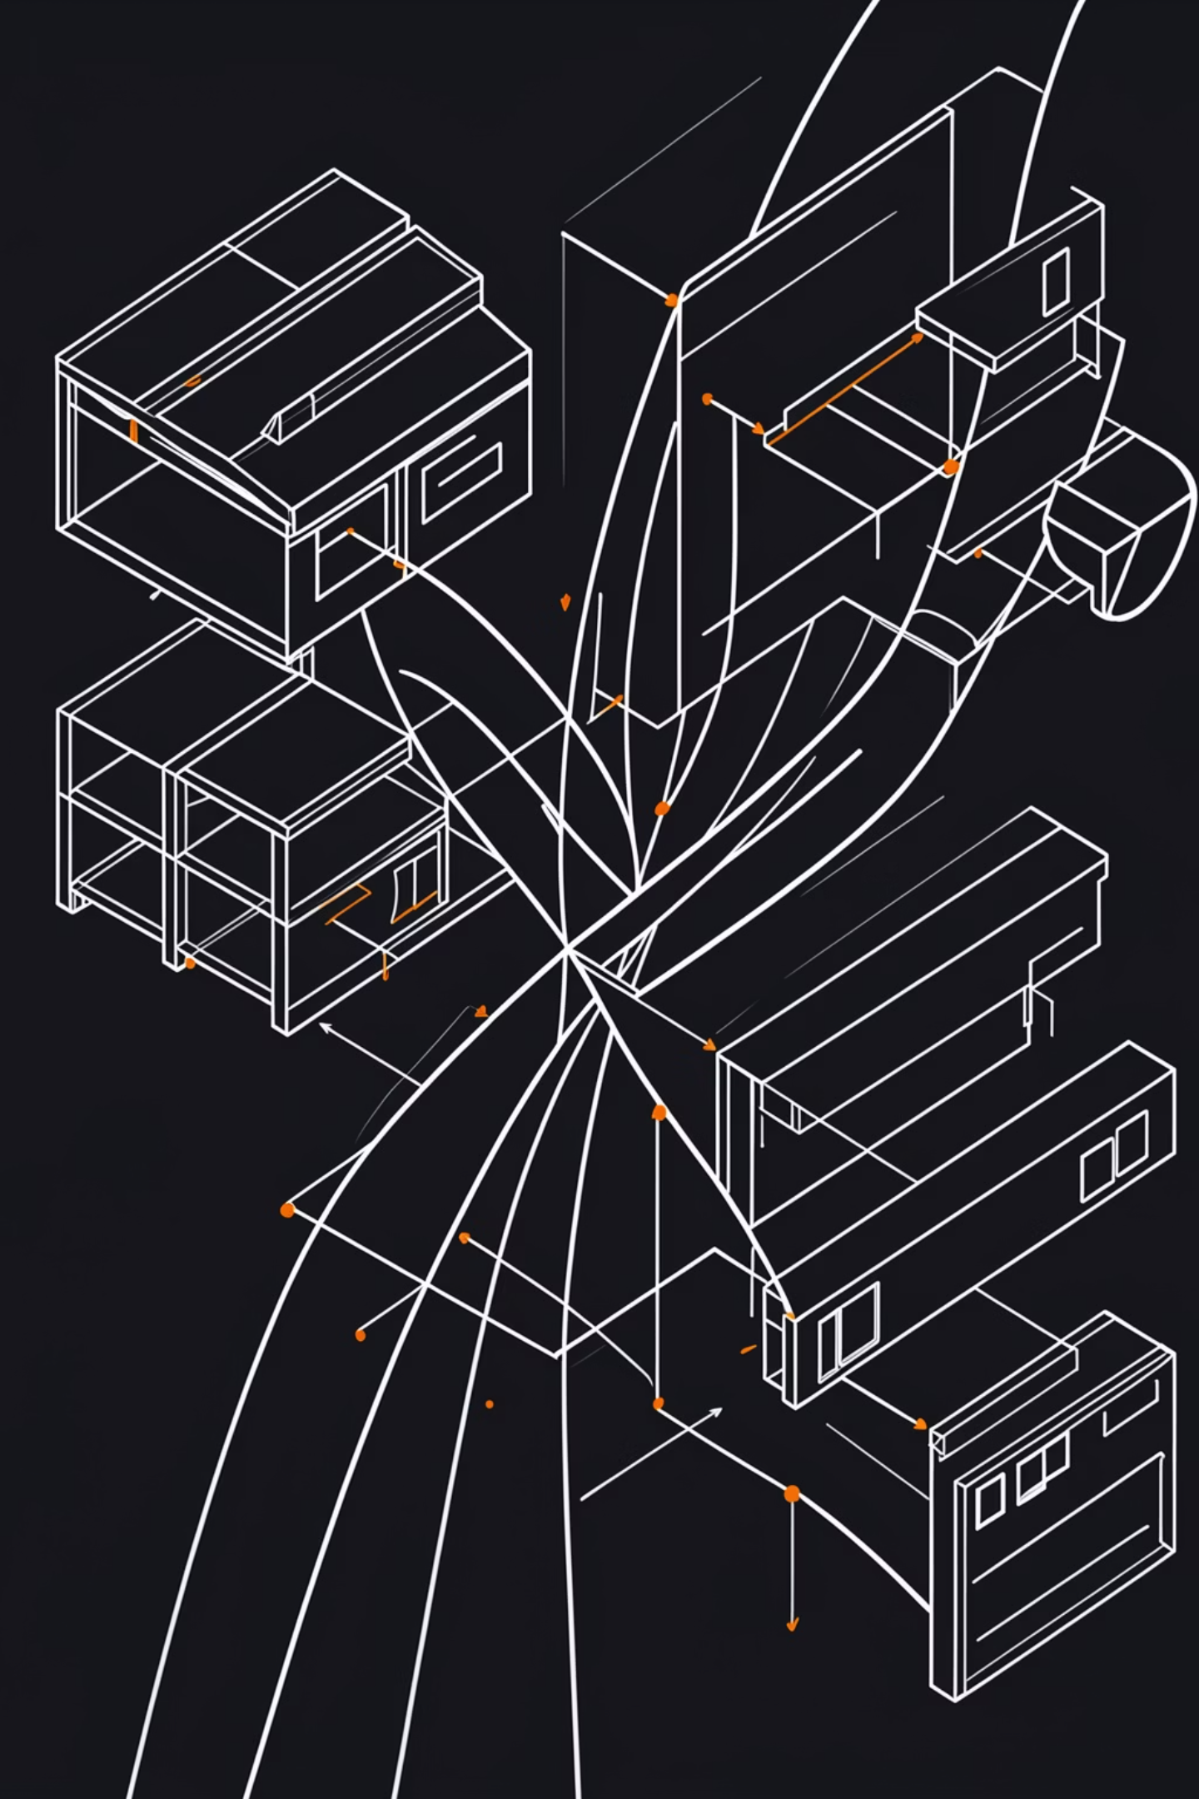
Thank You!
We've developed a system that brings order to chaos, optimizing emergency hospital resource allocation with speed and precision.
For questions or further discussion:
Email: info@ehodr.com
Website: www.ehodr.com

