Slide 1

Customer Shopping Behavior Analysis
Uncovering insights from 3,900 transactions to guide strategic business decisions.

Slide 2
Dataset at a Glance
3,900
18
Transactions
Columns
37
50
Missing Values
Locations
Review Rating column
Features span demographics, purchase details, and shopping behavior — including discounts, promo codes, and subscription status.

Slide 3

Data Preparation in Python
01
Load & Explore
Imported via pandas; df.info() and describe()
02
Clean & Standardize
Imputed missing ratings by category median; renamed to snake_case
03
Feature Engineer
Created age_group bins and purchase_frequency_days
04
Load to Database
Cleaned DataFrame loaded into PostgreSQL for SQL analysis

Slide 4
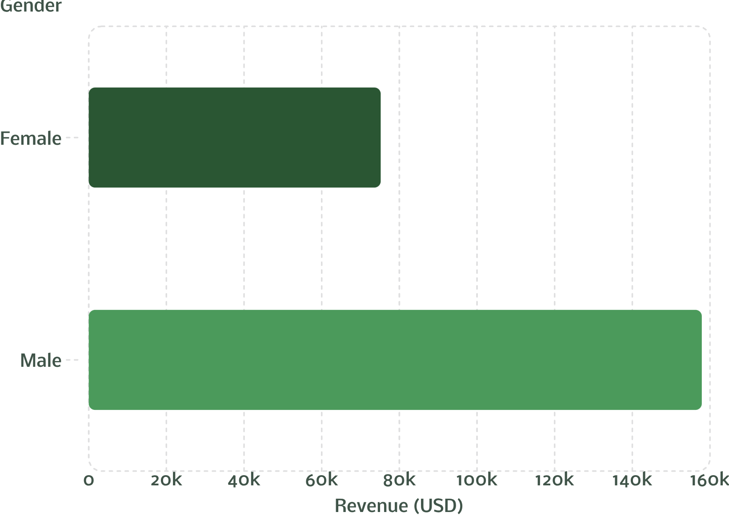

Revenue by Gender
Key Finding
Male customers generated more than double the revenue of female customers — $157,890 vs. $75,191.
Male shoppers represent 68% of the dataset (2,652 of 3,900 records).

Slide 5
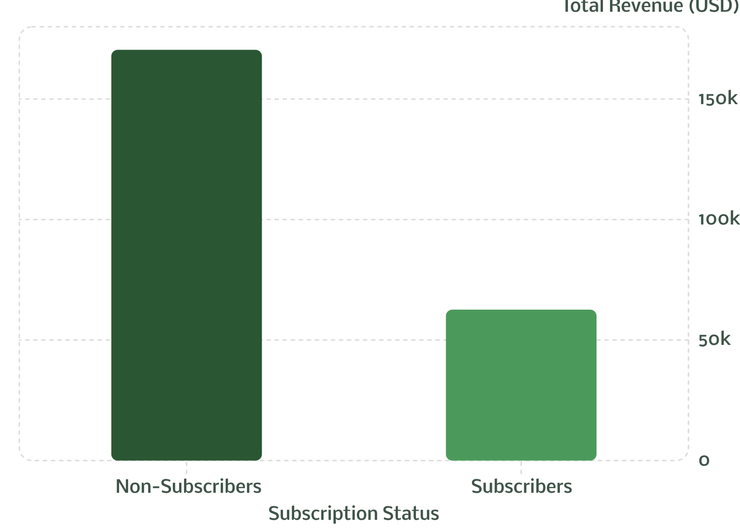
Subscribers vs. Non-Subscribers
Insights
Non-subscribers: 2,847 customers · avg. spend $59.87
Subscribers: 1,053 customers · avg. spend $59.49
Only 27% of customers are subscribed
Similar avg. spend, but subscribers are vastly underrepresented.

Slide 6
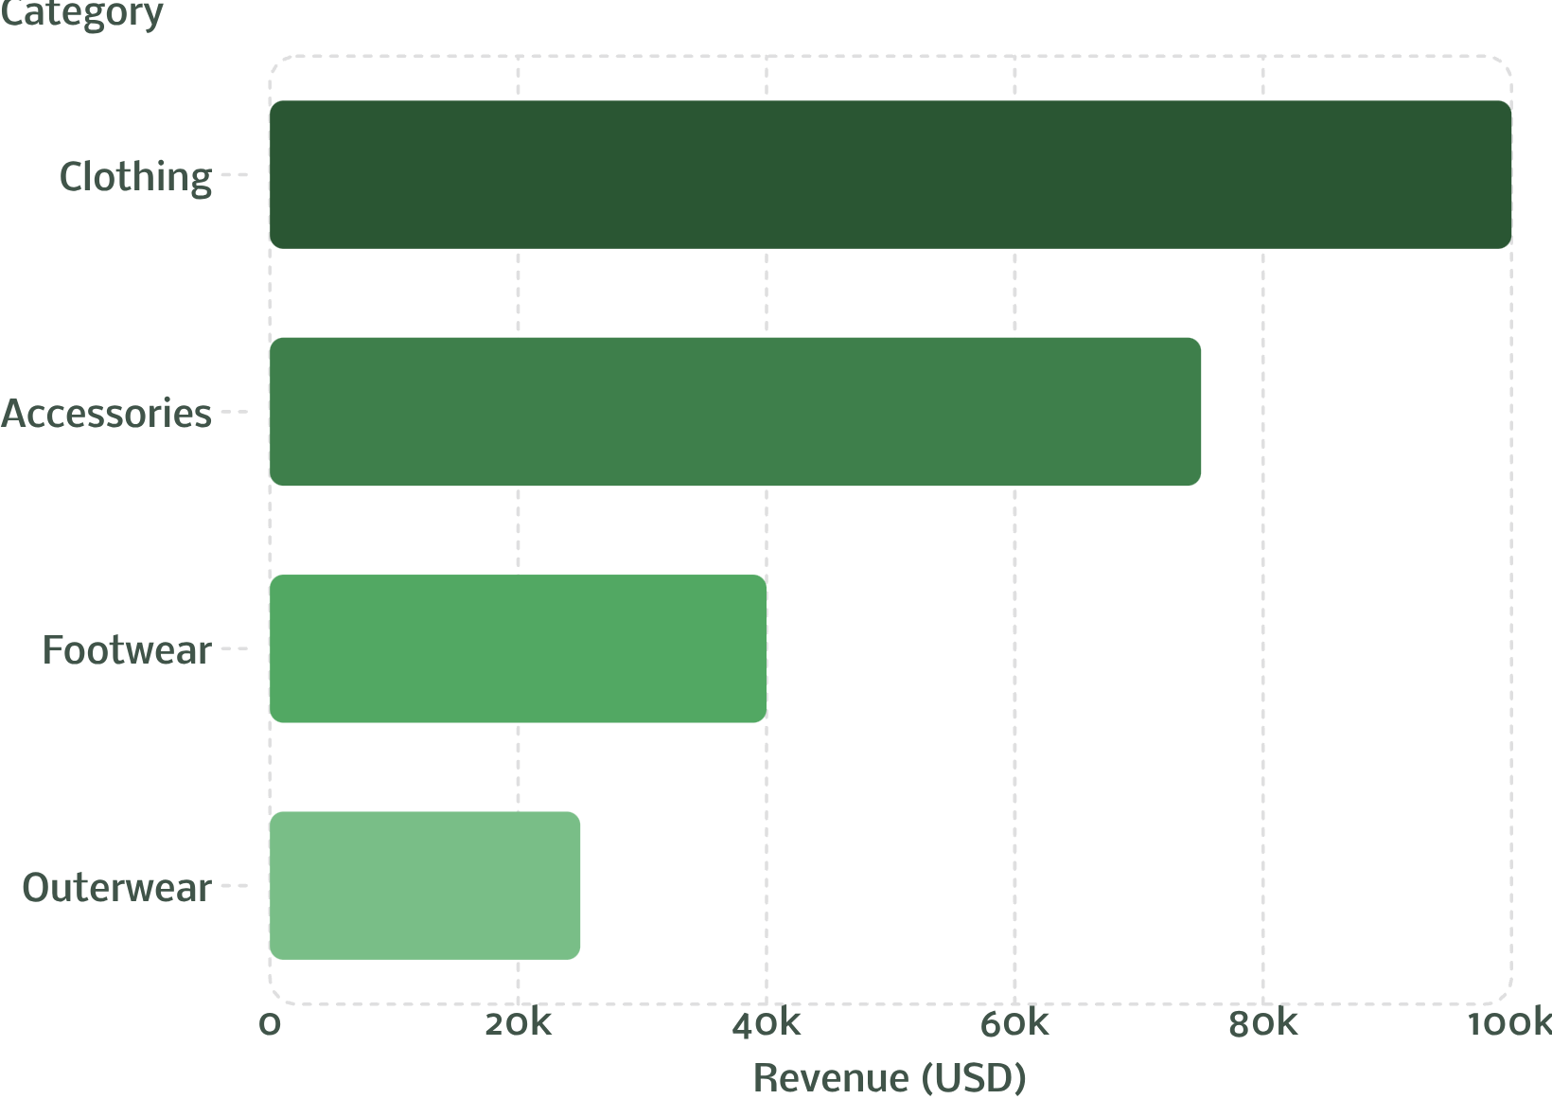
Top Products & Categories
Highest-Rated Products
Revenue by Category
Product | Avg Rating
Gloves | 3.86
Sandals | 3.84
Boots | 3.82
Hat | 3.80
Skirt | 3.78

Slide 7

Shipping & Discount Insights
Express vs. Standard
Most Discounted Products
Express avg: $60.48
Standard avg: $58.46
Hat (50%), Sneakers (49.66%), Coat (49.07%)
High-Spending Discount Users
839 customers used discounts and spent above average

Slide 8
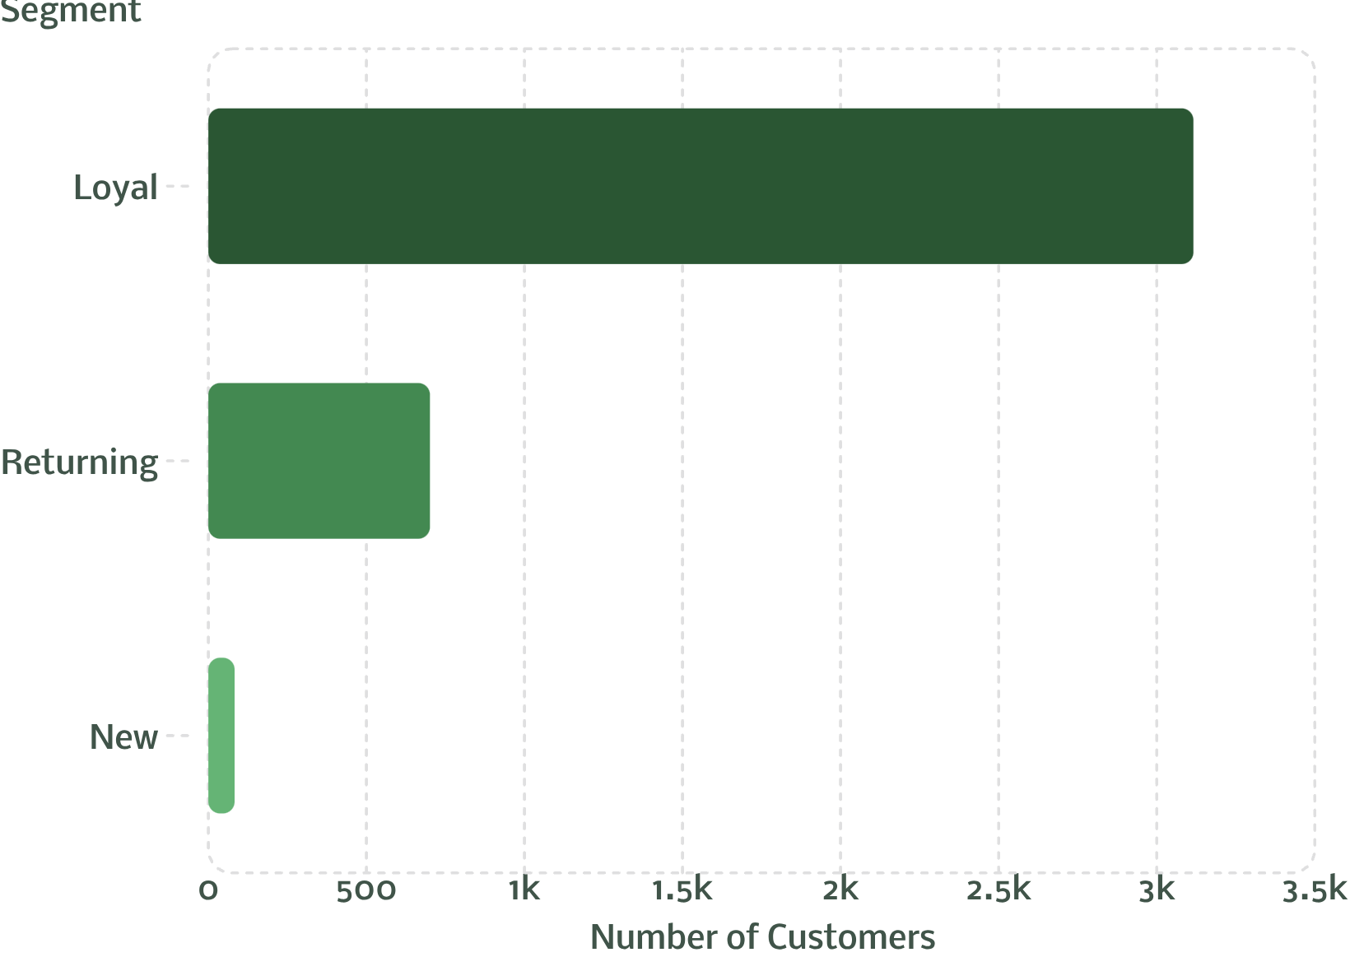
Customer Segmentation
Segment Breakdown
Loyal: 3,116 customers — dominant segment
Returning: 701 customers
New: Only 83 customers
Of customers with 5+ purchases, 958 are subscribers vs. 2,518 non-subscribers.

Slide 9
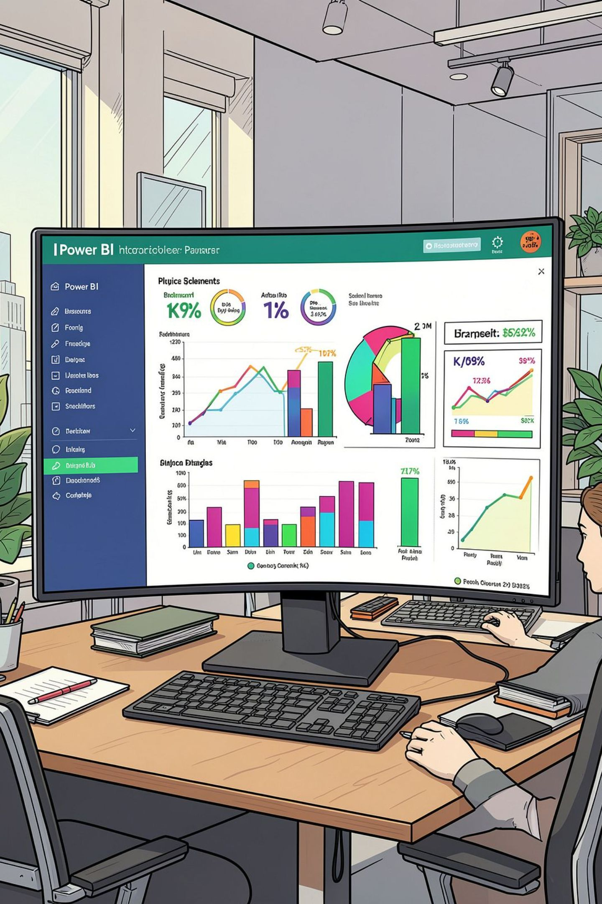
Power BI Dashboard
3.9K Customers
Total transactions tracked
$59.76 Avg Purchase
Across all categories
3.75 Avg Rating
Overall review score
Filters
Subscription, Gender, Category, Shipping

Slide 10
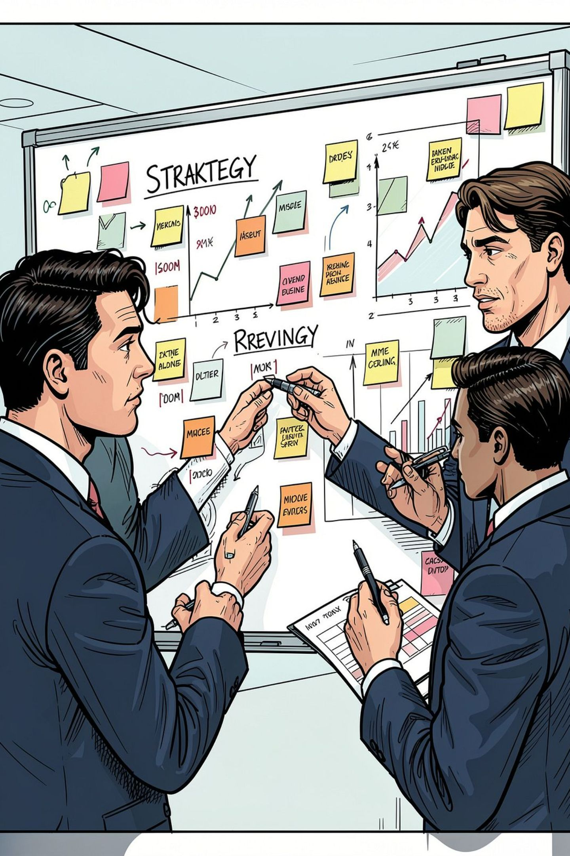




Business Recommendations
Boost Subscriptions
Promote exclusive subscriber benefits
Loyalty Programs
Reward repeat buyers to grow the Loyal segment
Review Discount Policy
Balance sales lift with margin control
Targeted Marketing
Focus on high-revenue age groups & express-shipping users

