Slide 1
Layouts
Week 7 - IST 263

Slide 2
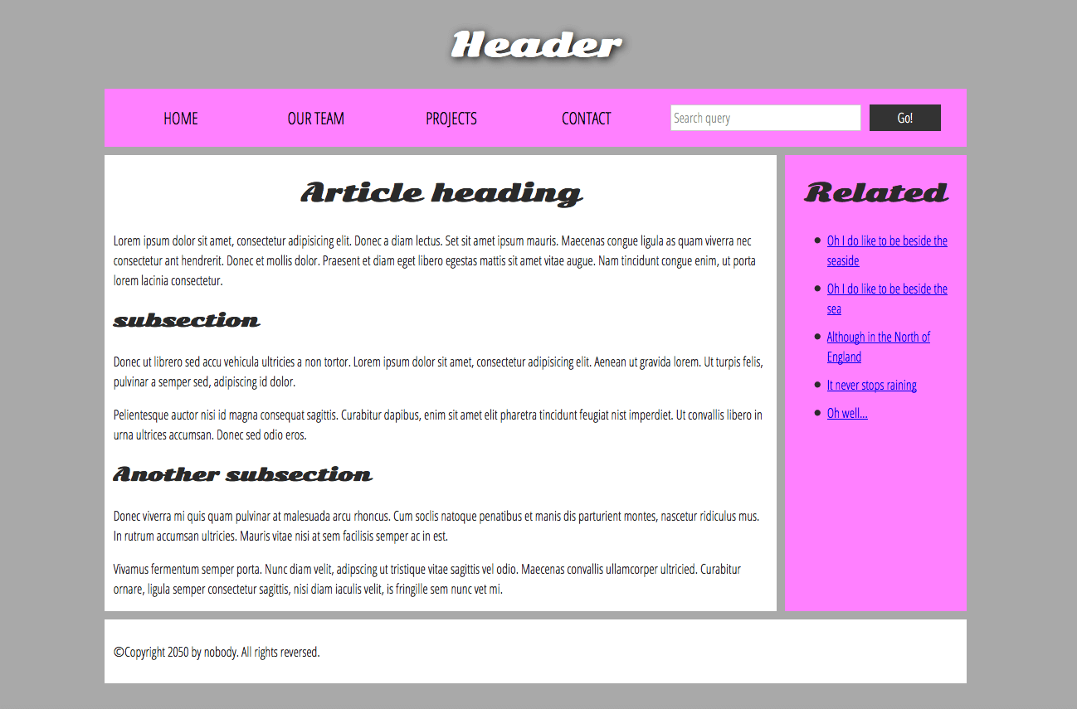
HTML 5 Elements
Header
Nav
Aside
Main
Article
Section
Footer
Notes:
Semantic wrappers => describes the structure of a web document
Why should you do this?
Screen readers
Help Web crawlers
https://developer.mozilla.org/en-US/docs/Learn/HTML/Introduction_to_HTML/Document_and_website_structure

Slide 3

Grid System
Standard web page width is usually 960px or 1200px
12 grid column

Slide 4
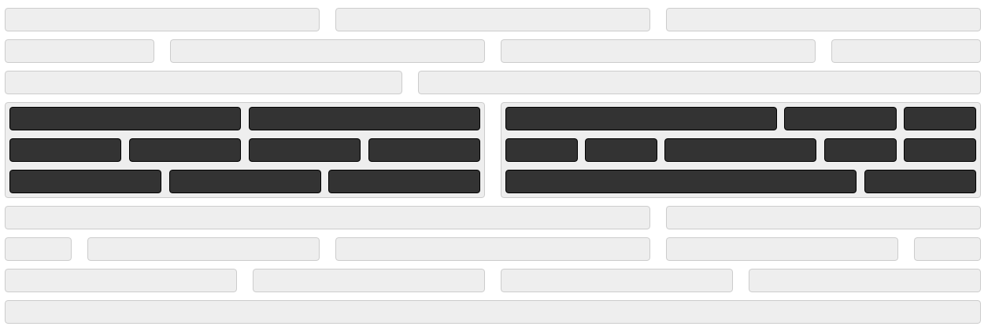
Grid System Combinations

Slide 5
Notes:
Semantic wrappers => describes the structure of a web document
Why should you do this?
Screen readers
Help Web crawlers
https://developer.mozilla.org/en-US/docs/Learn/HTML/Introduction_to_HTML/Document_and_website_structure

Slide 6
Responsive Design
Next Class

