Slide 1
Things don’t get easy
you have to get better

Slide 2
Responsive Design

Slide 3
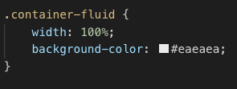
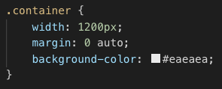
ContainerS
Layout should be consistent when the browser resizes
Avoid horizontal scrolling
Fluid Containers
Non-Fluid Containers

Slide 4
Display Range
User’s visible area of a web page
Device | Visible Area Available (Width in px)
Laptops | 1200 - 1600px | Medium or Large
Tablets | 768 - 1024px | Small
Mobile Devices | 320 - 736px | Extra Small

Slide 5
Responsive Design
This is used to make web page look good in all different devices
Desktop
Tablets
Mobile Devices
Notes:
Discuss constraints when viewing web pages on mobile devices
Talk about increase in mobile traffic, difference in processor.
need to load content quickly in a mobile device
https://www.w3schools.com/css/css_rwd_viewport.asp
Example sites - https://www.w3schools.com/w3css/tryw3css_templates_architect.htm

Slide 6
Viewport
Users are used to scrolling vertically, but not horizontally.
Instruct browser how to control dimension and scale content
<meta name="viewport" content="width=device-width, initial-scale=1">
Notes:
https://developer.mozilla.org/en-US/docs/Mozilla/Mobile/Viewport_meta_tag

Slide 7
media Query
/* Smartphones (portrait and landscape) ----------- */
@media only screen
and (min-device-width : 320px)
and (max-device-width : 480px) {
/* Add CSS styles here */
}
Notes:
@rule is used to apply part of a style sheet based on a result
https://developer.mozilla.org/en-US/docs/Web/CSS/@media

