Slide 1

AUTOMATION ASSESSMENT & ROADMAP
Assessing current automation landscape and charting the path to a unified, AI-powered framework.

Slide 2
Challenges in the Current Framework Landscape
Our research shows the current framework has significant drawbacks — a strong case for moving to a unified approach.

Slide 3
Multiple Frameworks Across Applications
Different implementations and standards across projects (BDD, TestNG, etc.).
01
Obsolete and Redundant Components
02
Some suites and utilities are no longer actively maintained, and deprecated test cases continue to exist in execution suites.
Fragmented Architecture
03
Business logic, element interactions, and utilities are distributed across multiple layers, increasing complexity.
Frequent locator updates increase maintenance overhead.
04
High Maintenance Effort
(contd.)

Slide 4
Inconsistent Test Data Management
Multiple test data sources and synchronization issues impact test reliability.
05
Limited Test Traceability
06
Test cases are not functionally grouped, making maintenance and impact analysis difficult.
Insufficient Validation and Visibility
07
Limited step-level verification and debugging capabilities.
08
No AI-assisted failure analysis, test insights, or intelligent reporting.
Lack of AI Adoption

Slide 5
Why Aspire Unified Framework (AFTA)
Here is why a single, AI-powered framework across all brands is the right way forward.

Slide 6
AI-Powered Automation
01
AI Self-Healing for automatic recovery from locator changes.
AI Auto POM to generate and maintain page objects automatically.
Report Portal-Powered Analytics for AI-driven failure analysis, execution insights, and trend identification.
One Framework Across Brands
02
Standardized automation framework across all brands, including Orpos.
Reduced framework duplication and maintenance effort.
Modern Playwright-Based Architecture
03
Faster execution with up to 60% improvement compared to the current Selenium-based approach.
Built-in auto-wait mechanisms for improved stability.
Supports parallel execution for reduced regression cycle time.
Trace Viewer – Replay test execution step-by-step with screenshots, network calls, DOM snapshots, and timings for faster root cause analysis.
Rich execution reports with screenshots and detailed logs.
04
Enhanced Debugging and Observability

Slide 7
Auto POM – Intelligent Locator & AI Fallback Strategy
How intelligent, multi-level locator generation with AI fallback makes automation faster and far easier to maintain.

Slide 8


Business Value : Auto POM is a Chrome extension that creates production-ready Page functions — eliminating manual locator management and reducing script failures.
Objective — Generate robust, maintainable POM locators and automation-ready code via a multi-level fallback strategy with AI assistance.
Key Benefits — Less manual effort, higher locator reliability, faster automation, and production-ready POM code.
CORE MECHANISM OF AUTOPOM
1
2
Locator Priority
AI Fallback
Prioritizes ID, Name, Data & Accessibility attributes, CSS selectors, then XPath — resolving the most reliable locator before any AI is invoked.
When deterministic strategies fail or score low-confidence, AI reads the DOM, element attributes & surrounding context to propose stable, maintainable locators.

Slide 9
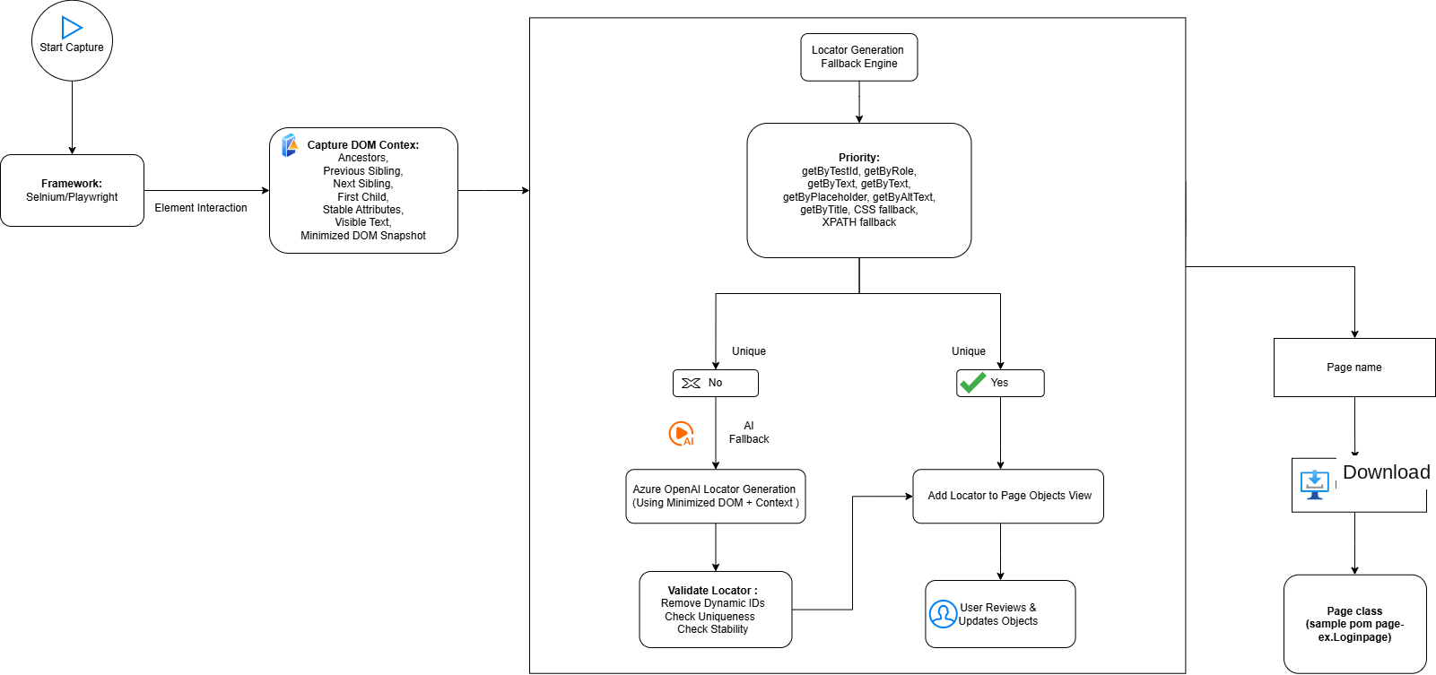
AUTO POM ARCHITECTURE

Slide 10
Self-Healing – Test Automation
A self-correcting suite that recovers from UI changes on its own, cutting flakiness and manual upkeep.

Slide 11





Business value – Fixing flaky tests on its own – Less maintenance - Faster releases
Playwright · TypeScript · Azure OpenAI GPT-4.1 · Chrome Extension
WHAT IT DELIVERS
Self-correcting suite
Deterministic tiers absorb most UI changes; AI handles novel breaks.
Lower flakiness & upkeep
Cuts manual selector maintenance and false failures substantially.
Validated end-to-end
Proven against the live Ann Taylor staging funnel.
THREE-TIER FALLBACK CHAIN
DB Primary
Smart Locators
AI Healing
Stored locator resolved
direct from elements table
role → testId → text → css
→ xpath, placeholder
GPT-4.1 vision + DOM context, confidence-gated

Slide 12
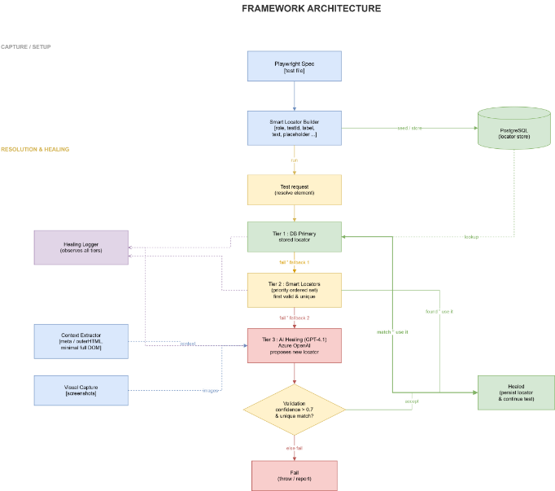
SELF HEALING ARCHITECTURE

Slide 13
Image Based Automation Tool – Visor
Visual automation framework that combines OpenCV image matching, OCR, and input control into one Node.js package — enabling automation of Windows applications without DOM or browser access.

Slide 14
IMAGE BASED AUTOMATION TOOL – VISOR
KEY FEATURES
Install via npm​​
Run `npm install@aspiresys/visor`​
Launch it with `npx visor-inspector`.​
https://www.npmjs.com/package/@aspiresys/visor
​
1
Multi-scale image matching
2
Full-screen and region-based OCR
3
Automated mouse and keyboard input
4
Barcode scanning
5
Built-in display scaling detection

Slide 15
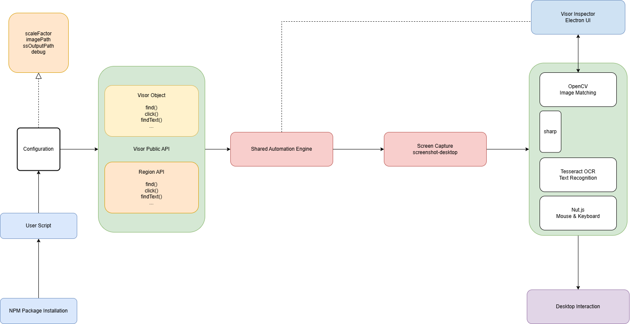
VISOR ARCHITECTURE

Slide 16


AFTA DASHBOARD
Unified Test Automation Platform for Execution, Reporting and Analytics
Features in AFTA
▶
Test Runner
IN PROGRESS
Execute and monitor test suites with build history and report access
Implementation of multiple user login and User scheduling history with timestamp
▤
Test Data Generator
Generate reusable test data for faster execution..
▦
Reports
Centralized insights into execution results and trends.
ROADMAP
◷
Scheduler
Automate recurring and parameterized test executions
AI-Powered Test Summaries
AI-Based Failure Analysis
Root Cause Suggestions
Test Data Management Tool​
Email &Teams Notifications​
Flaky Test Detection ​
TECH STACK
Layer | UI | Backend | CI/CD | Reports | Integrations | Storage
Stack | Angular, TypeScript | Node.js, Express | Jenkins | JUnit XML, Allure | Report Portal, SVN, Lambda Test | SQLite

Slide 17
ONGOING ACTIVITIES – AUTOMATION TEAM
MAINTENANCE & SHADOWING ACTIVITIES
REGRESSION SUITE — SPRINT 26.16 /26.17​ Automation scripting completed in Sprint 26.16 for AT and Loft — both Desktop and Mobile Web.
Jenkins job triggered, achieving an 84–85% pass rate.
Report shared with the Everest Automation team for approval on PR #1652.
Received KT from the Everest team on test suites across all brands — suite ownership, execution strategy, and Jenkins auto-scheduled jobs.
Understood daily execution processes, regression cycles, and automation maintenance workflows.
Analyzing daily Sanity Suite failures and performing RCA across automation, environment, and application issues.
Automated validation of Data Layer variables using Playwright across end-to-end user journeys.
Dynamic comparison of Data Layer values against UI data, business rules, and expected behavior.
Comprehensive reporting with PASS / FAIL / MISSING status, detailed comparison results, and HTML/CSV reports for faster analysis
DATA LAYER VALIDATION

Slide 18
PLANNED ACTIVITIES – AUTOMATION TEAM
ORPOS MIGRATION
Current framework built on Java and Sikuli to be migrated to Playwright and Visor.
ECOMM MIGRATION
Current framework is built on selenium/java to be migrated to playwright/typescript(AFTA FRAMEWORK) Execution will be based on priority based testcases.
CHICOS SHADOWING/MAINTAINANCE
Framework analysis is currently underway, with shadowing of the Chicos suites scheduled to begin shortly.
UI DASHBOARD – PHASE 2
Implementation of multiple user login
User scheduling history with timestamp
AI-powered test summaries

Slide 19
Thank You
Questions & Discussion
Automation Team

