Slide 1
QUALITY ENGINEERING
AI-Augmented
Self-Healing Test Automation
Tests that fix themselves when the UI changes — so your suite stays trustworthy.
Client Briefing · Proof of Concept Validated

Slide 2
THE PROBLEM
Most test failures aren't real defects
They're broken locators — and they cost you every release
1
2
3
Brittle by design
Constant UI churn
Noise buries signal
Each test points to an element by a single address. Rename an id or restyle a class and the test breaks — even though the feature works perfectly.
Modern web apps change all the time. Component libraries regenerate names, redesigns reshuffle the page. Every change can turn the suite red.
Teams burn hours triaging false failures, lose trust in the suite, and start ignoring it — so the real defects slip through.
Self-Healing Test Automation
2

Slide 3
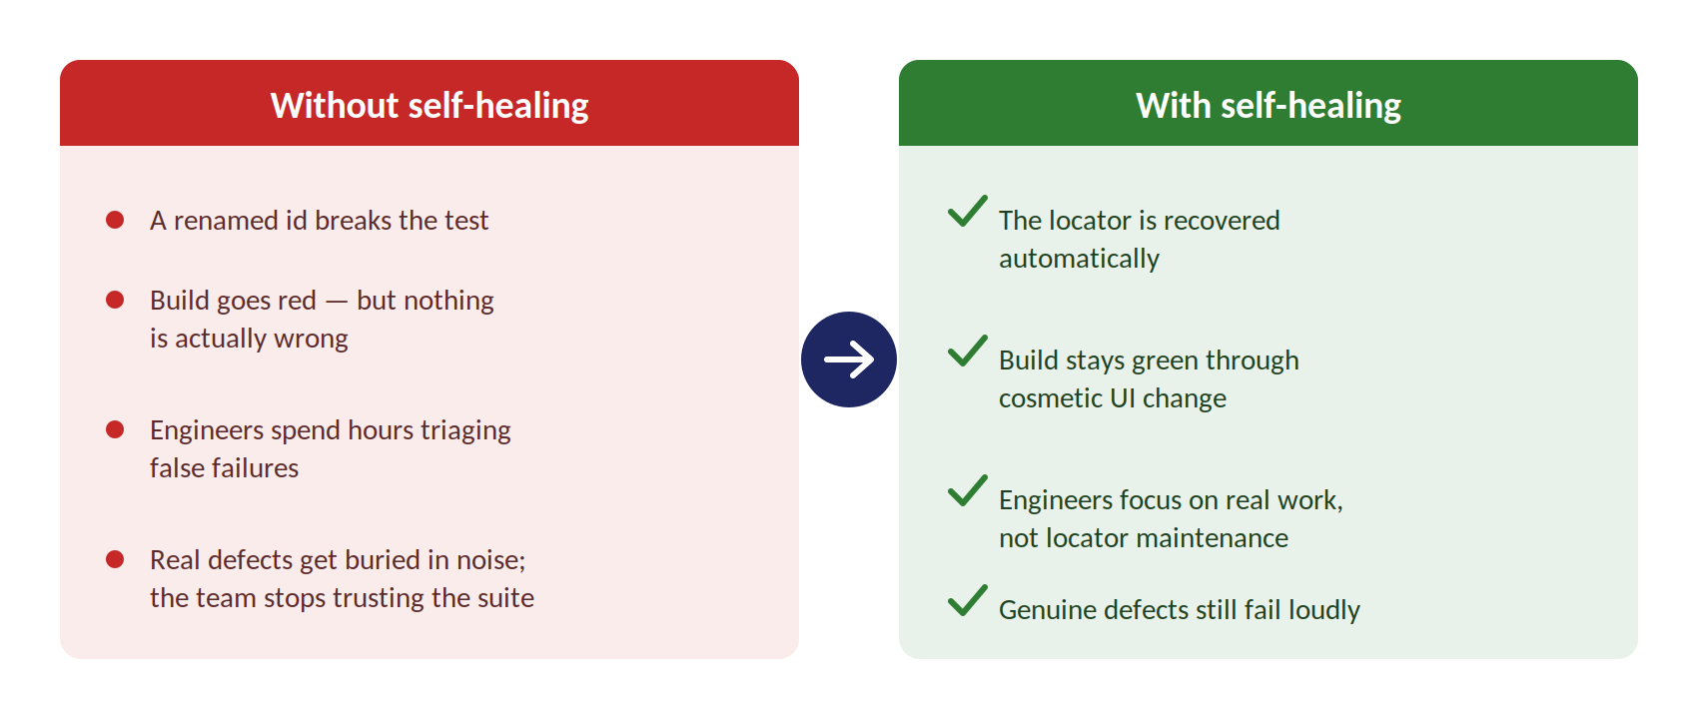
THE SOLUTION
A layer that heals broken locators automatically
Self-Healing Test Automation
3

Slide 4
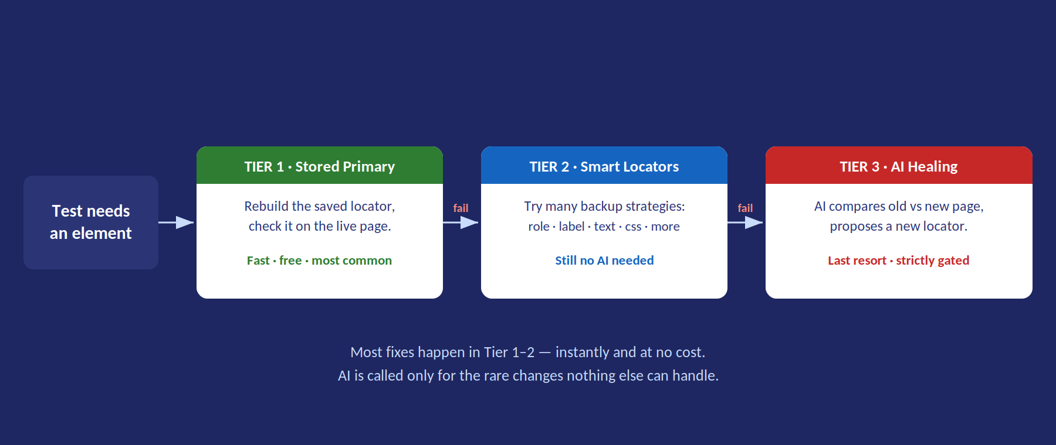
HOW IT WORKS
Three tiers — AI is the last resort, not the default

Slide 5
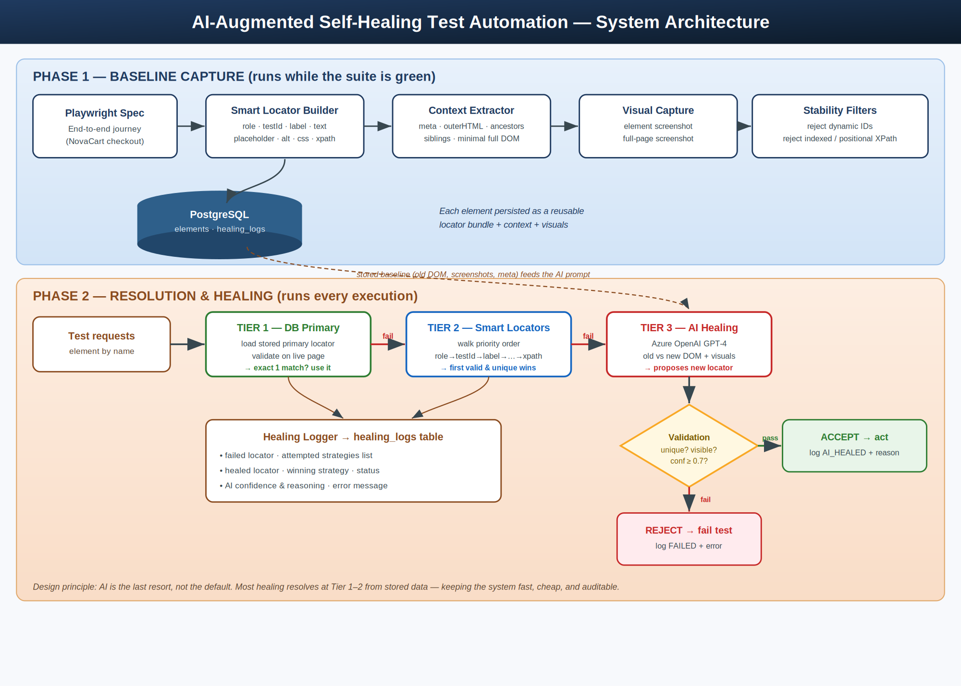
ARCHITECTURE
Two phases: learn the page, then heal it
Capture records a rich baseline while tests are green; the engine uses it to resolve and heal at runtime
Self-Healing Test Automation
5

Slide 6
WHY YOU CAN TRUST IT
It heals what's safe — and refuses what isn't
✓
Exactly one match
✓
Confidence gated
A healed locator must point to one — and only one — visible element. Zero or many matches are rejected, so it never clicks the wrong thing.
An AI suggestion below a confidence bar is discarded, not trusted.
✓
Stable only
✓
Real defects still fail
Auto-generated ids and position-based locators are rejected — they'd just break again.
If a feature is genuinely gone, there's nothing to heal to. The test fails, as it should.
Self-Healing Test Automation
6

Slide 7
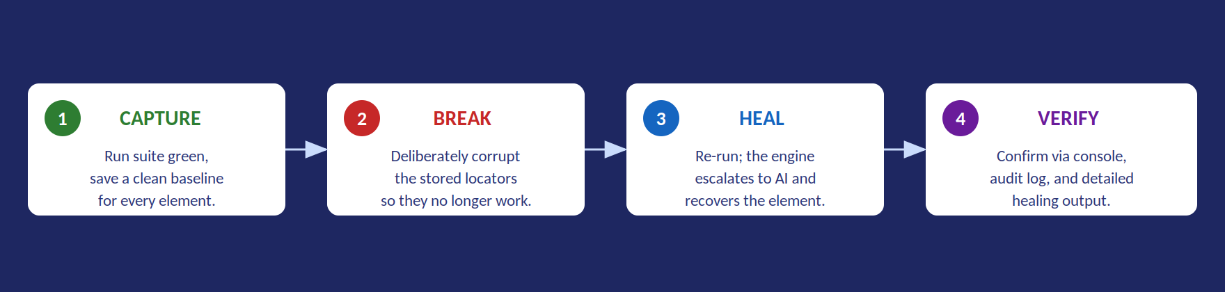
HOW WE PROVED IT
We broke it on purpose — then watched it recover
Validated on a realistic 15-step e-commerce checkout journey — browse, select, add to cart, apply promo, check out.

Slide 8
RESULTS
What we observed
✓
Healing works
!
Safe by design
With every stored locator deliberately broken, the AI tier recovered uniquely-identifiable elements — proposing working locators that passed all safety gates.
The journey continued to completion. Screenshots and page context were captured and stored as designed.
One element was one of twelve identical product links — with no unique, stable way to tell them apart.
The framework refused to heal rather than guess. That safe refusal is a feature: a system that guesses is more dangerous than one that stops.
Self-Healing Test Automation
8

Slide 9
ROADMAP
From proof of concept to production
NOW
NEXT
STRATEGIC
Move all credentials into managed secrets
Store locators as structured data for robust rebuilding
Verify a heal found the right element, not just a unique one
Promote successful AI heals back into storage — the system learns
Better anchoring for list & grid items
Support for embedded frames & richer interactions
Reporting dashboard: healing rate, AI usage, confidence
Cost controls around AI calls
Self-Healing Test Automation
9

Slide 10
IN SHORT
Less noise. More signal.
A suite you can trust again.
Heals broken locators automatically through cosmetic UI change
Calls AI only as a last resort — fast, low-cost, auditable
Refuses to guess when no safe locator exists, so real defects still surface
Proven end-to-end; ready for a hardening & production phase

