Slide 1










Self-Healing Test Automation Framework
Playwright + TypeScript • Resilient automation that recovers from UI drift instead of breaking
HOW IT HEALS — 3-TIER FALLBACK
BENEFITS OVER MANUAL AUTOMATION
Tier 1 — DB Locator
Tests adapt to UI drift instead of hard-failing
Primary selector persisted in the database. Fastest, deterministic path.
Self-corrects — far less selector maintenance
Lower flakiness, fewer false failures
Tier 2 — Smart Locators
Cheap tiers absorb most changes; AI only for novel cases
Scoped CSS/XPath, attribute & text heuristics. Including placeholder, role, testid.
IN PROGRESS
ROADMAP
Tier 3 — AI Healing
Timing optimization
iframe traversal
Azure OpenAI GPT-4.1 inspects live DOM, returns a self-verified locator only when lower tiers miss.
Optimizing timings and testing the average time taken for various types of locators and AI healing.
Healing across nested frame contexts.
Shadow DOM
Piercing shadow roots where standard locators fail.
Validated end-to-end against a live staging environment

Slide 2
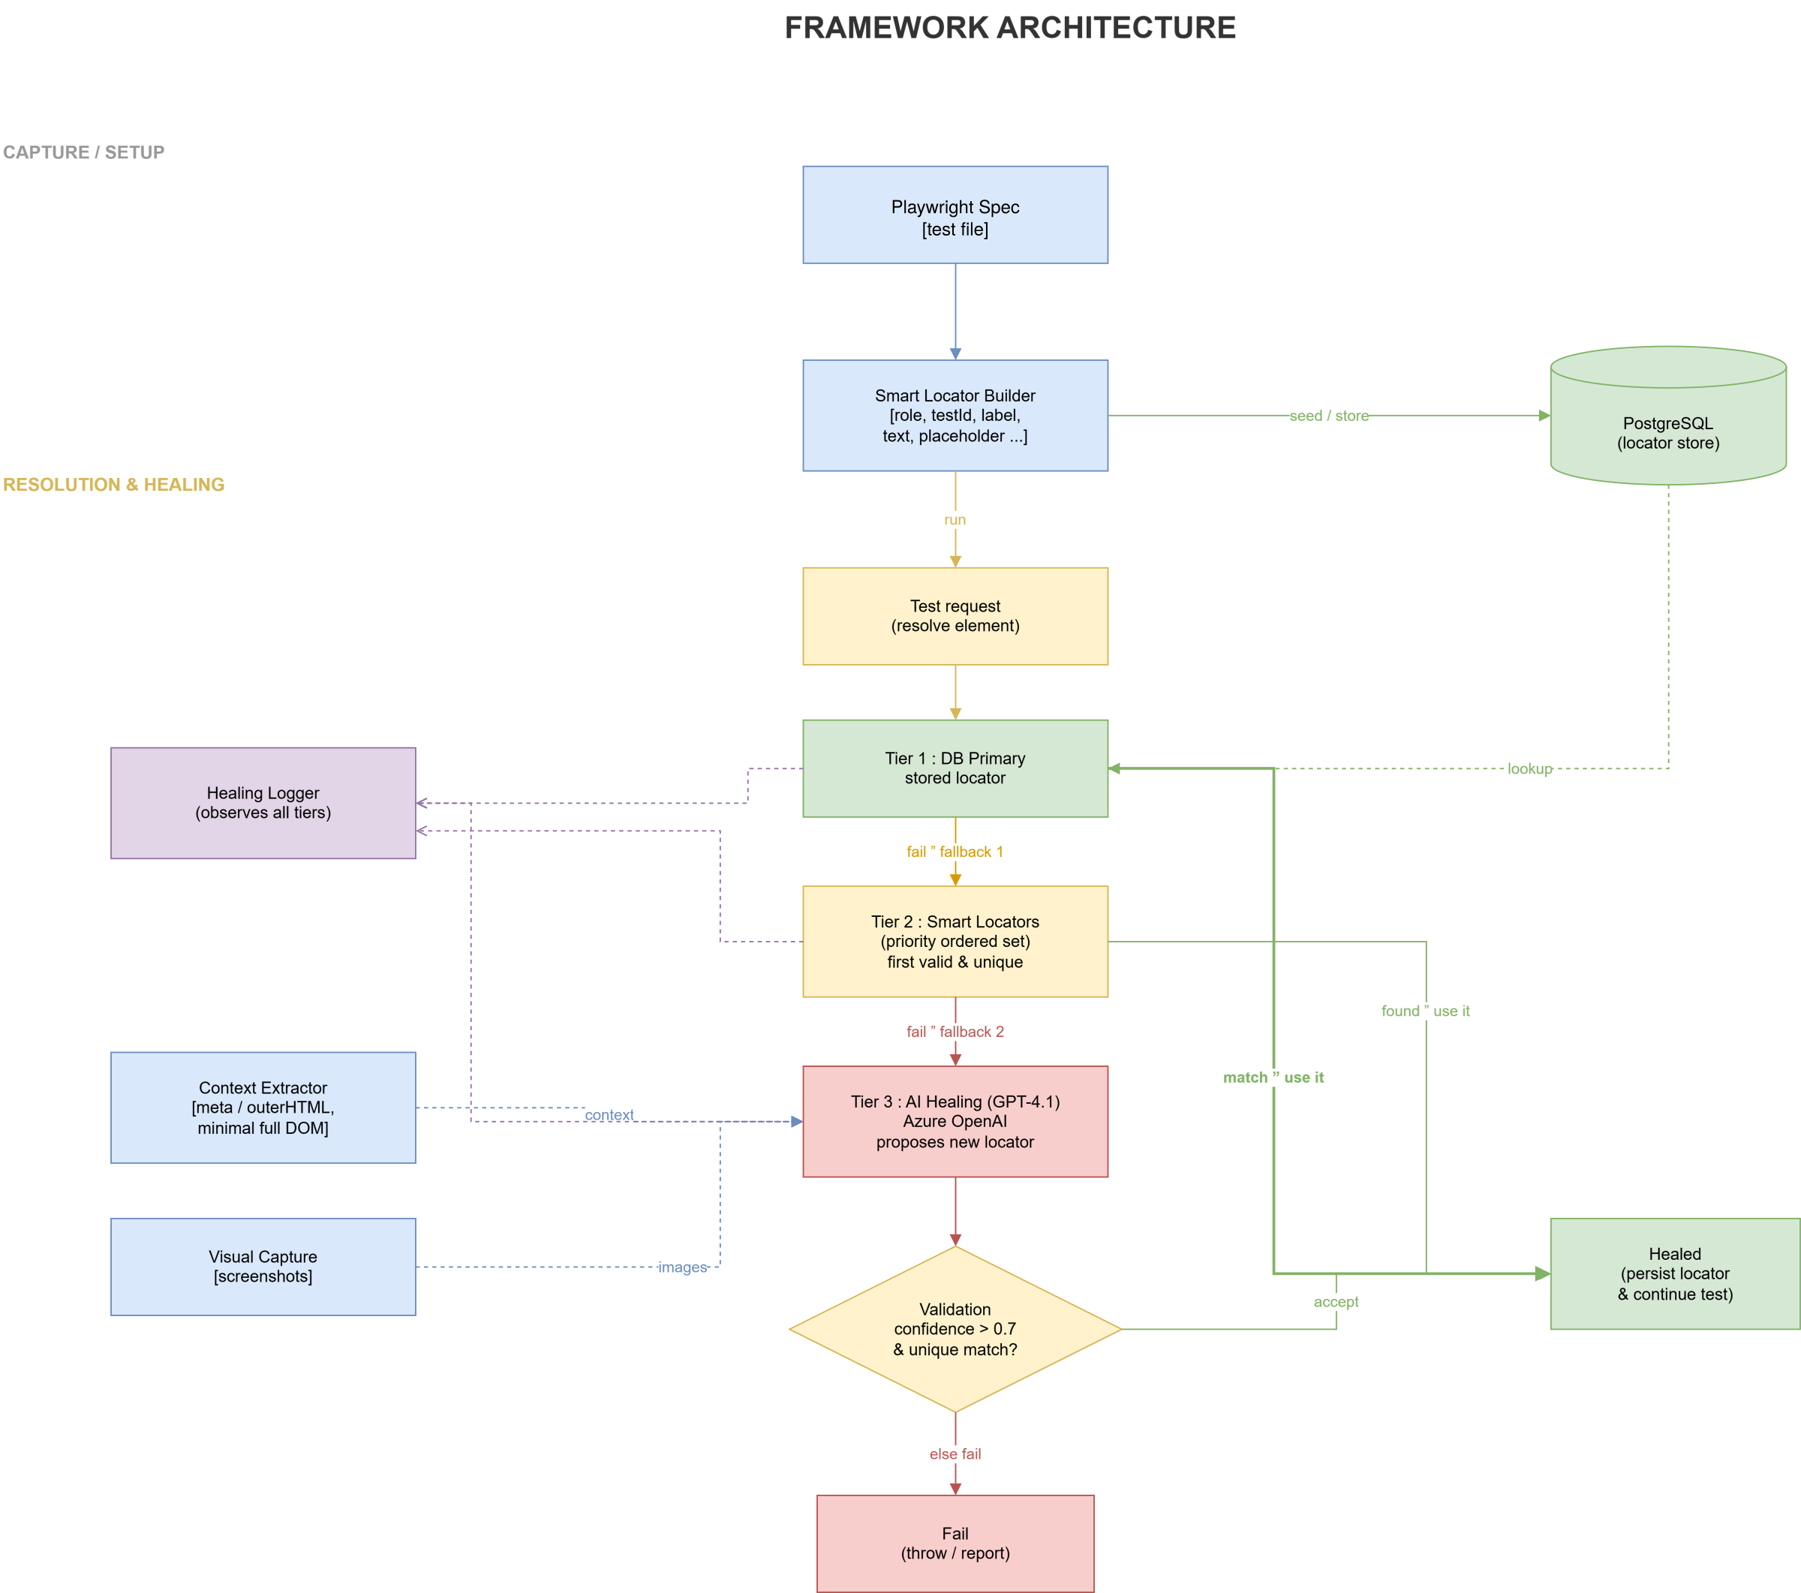
Framework Architecture
Three-tier resolution & healing flow — DB primary → smart locators → AI healing, with heal write-back to the locator store

