Slide 1










Self-Healing Test Automation
Playwright · TypeScript · Azure OpenAI GPT-4.1
WHAT IT DELIVERS
IN PROGRESS
Self-correcting suite
Write healed locators back to the elements table — AI cost & latency decay as the suite matures.
Deterministic tiers absorb most UI changes; AI handles novel breaks.
Lower flakiness & upkeep
Cuts manual selector maintenance and false failures substantially.
ROADMAP
Validated end-to-end
iframe traversal — healing across nested frame contexts. Shadow DOM — piercing shadow roots where standard locators fail.
Proven against the live Ann Taylor staging funnel.
THREE-TIER FALLBACK CHAIN
1 · DB Primary
2 · Smart Locators
3 · AI Healing
Stored locator resolved
direct from elements table
role → testId → text → css
→ xpath, placeholder
GPT-4.1 vision + DOM context,
confidence-gated

Slide 2
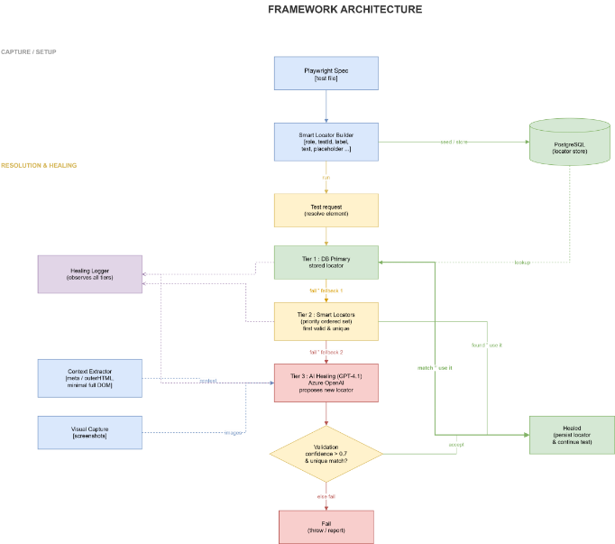

Slide 3
Maintenance & Shadowing — Progress Update
A Visual Automation Framework
Key Features
Visor combines OpenCV image matching, OCR text recognition, mouse and keyboard automation, and desktop application control into one Node.js package.
It enables visual interactions with Windows applications without requiring DOM or browser access.
Multi‑scale image matching
Full‑screen and region‑based OCR
Automated mouse, and keyboard input
Barcode scanning.
Built‑in display scaling detection.

Slide 4
Maintenance & Shadowing — Progress Update
MAINTENANCE & SHADOWING ACTIVITIES
REGRESSION SUITE — SPRINT 26.16 / 26.17
Received KT from the Everest team on test suites across all brands — suite ownership, execution strategy, and Jenkins auto-scheduled jobs.
Understood daily execution processes, regression cycles, and automation maintenance workflows.
Analyzing daily Sanity Suite failures and performing RCA across automation, environment, and application issues.
Investigating and resolving Regression Suite failures to improve stability and execution reliability.
Raised PRs for automation fixes covering both Desktop and Mobile test scenarios.
Collaborated with the team on framework components, execution dependencies, and reporting mechanisms.
Improved suite health by addressing script issues and validating fixes through re-execution.
Began reporting application bugs to the functional team to raise defects in JIRA.
Automation scripting completed in Sprint 26.16 for AT and Loft — both Desktop and Mobile Web.
Jenkins job triggered, achieving an 84–85% pass rate.
Report shared with the Everest Automation team for approval on PR #1652.
Failures observed with Hover functionality in existing and new test steps — under investigation for earliest resolution.
Received TC update for Sprint 26.17 following Everest Functional team review and approval.
Started analysis on Sprint 26.17 TCs to plan automation scripting.

Slide 5
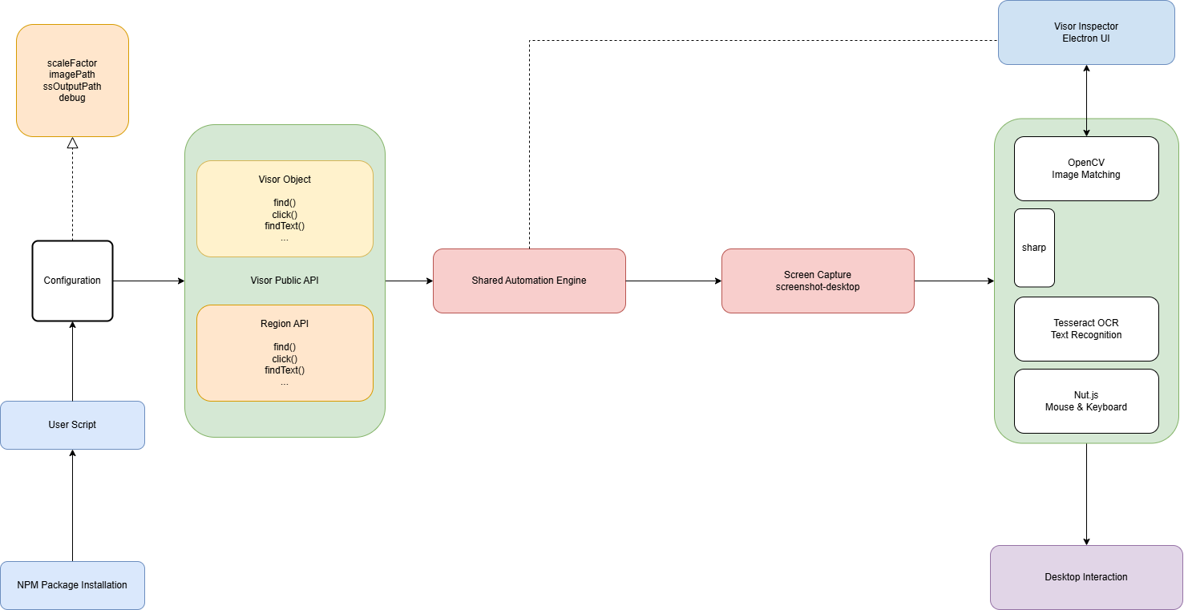
Architectural Diagram

Slide 6
Auto POM – Intelligent Locator Generation & AI Fallback Strategy
Objective
01
Automatically generate robust and maintainable Page Object Model (POM) locators and automation-ready code using a multi-level fallback strategy with AI assistance.
Locator Generation Priority
02
Uses a multi-level fallback approach to generate the most reliable locator by prioritizing ID, Name, Data Attributes, Accessibility Attributes, CSS Selectors, and XPath before invoking AI.
03
AI Fallback Logic
When conventional locator strategies fail or return low-confidence results, AI analyzes the DOM structure, element attributes, and surrounding context to generate stable and maintainable locator recommendations.
04
Key Benefits
Reduces manual effort in locator creation, improves locator reliability, accelerates automation development, and generates automation-ready Page Object Model (POM) code with higher maintainability.

Slide 7
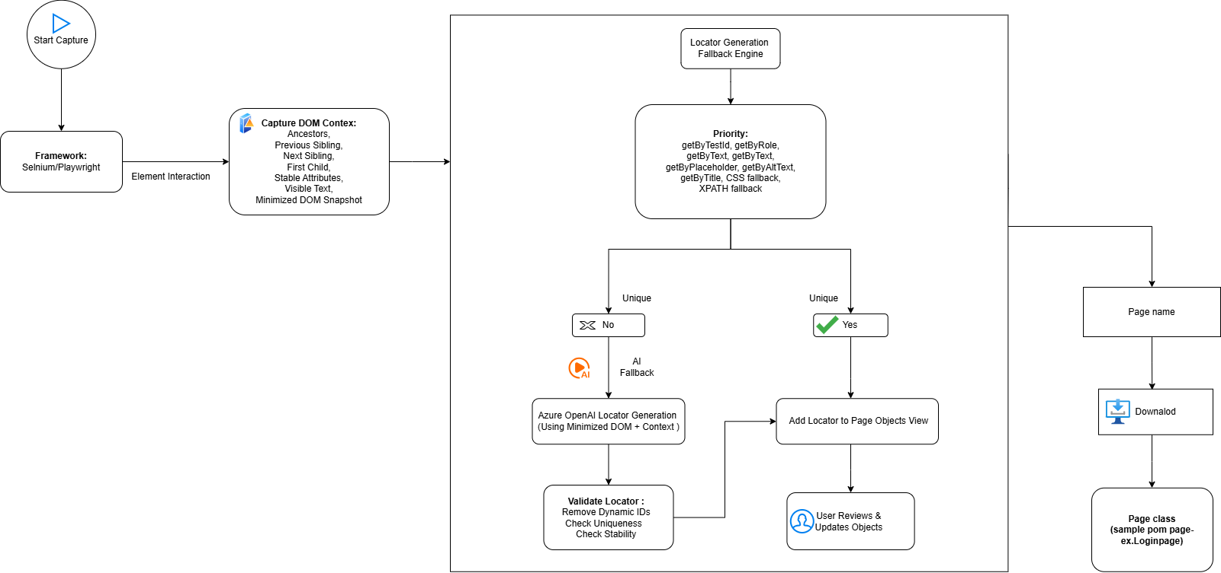
Architecture diagram

