Slide 1

AUTOTOMATION ASSESSMENT & ROADMAP
Current architecture analysis – Workons – Future Roadmap

Slide 2
CHALLENGES IN THE CURRENT FRAMEWORK LANDSCAPE
01
Multiple Frameworks Across Applications
05
Inconsistent Test Data Management
Different implementations and standards across projects (BDD, TestNG, etc.).
Multiple test data sources and synchronization issues impact test reliability.
02
Obsolete and Redundant Components
Limited Test Traceability
Some suites and utilities are no longer actively maintained, and deprecated test cases continue to exist in execution suites.
06
Test cases are not functionally grouped, making maintenance and impact analysis difficult.
03
Fragmented Architecture
07
Insufficient Validation and Visibility
Business logic, element interactions, and utilities are distributed across multiple layers, increasing complexity.
Limited step-level verification and debugging capabilities.
04
08
Lack of AI Adoption
High Maintenance Effort
No AI-assisted failure analysis, test insights, or intelligent reporting.
Frequent locator updates increase maintenance overhead.

Slide 3
Why aspire unified framework (AFTA)
AI-Powered Automation
AI Self-Healing for automatic recovery from locator changes.
AI AutoPOM to generate and maintain page objects automatically.
Report Portal-Powered Analytics for AI-driven failure analysis, execution insights, and trend identification.
01
One Framework Across Brands
02
Standardized automation framework across all brands, including Orpas.
Reduced framework duplication and maintenance effort.
Modern Playwright-Based Architecture
03
Faster execution with up to 60% improvement compared to the current Selenium-based approach.
Built-in auto-wait mechanisms for improved stability.
Supports parallel execution for reduced regression cycle time.
Enhanced Debugging and Observability
04
Trace Viewer – Replay test execution step-by-step with screenshots, network calls, DOM snapshots, and timings for faster root cause analysis.
Rich execution reports with screenshots and detailed logs.

Slide 4
Auto POM – Intelligent Locator & AI Fallback Strategy
Business Value – Creates production ready Page functions eliminating manual locator management and reducing script failures.
01
Objective
Automatically generate robust and maintainable Page Object Model (POM) locators and automation-ready code using a multi-level fallback strategy with AI assistance.
02
Locator Generation Priority
Uses a multi-level fallback approach to generate the most reliable locator by prioritizing ID, Name, Data Attributes, Accessibility Attributes, CSS Selectors, and XPath before invoking AI.
03
AI Fallback Logic
When conventional locator strategies fail or return low-confidence results, AI analyzes the DOM structure, element attributes, and surrounding context to generate stable and maintainable locator recommendations.
04
Key Benefits
Reduces manual effort in locator creation, improves locator reliability, accelerates automation development, and generates automation-ready Page Object Model (POM) code with higher maintainability.

Slide 5
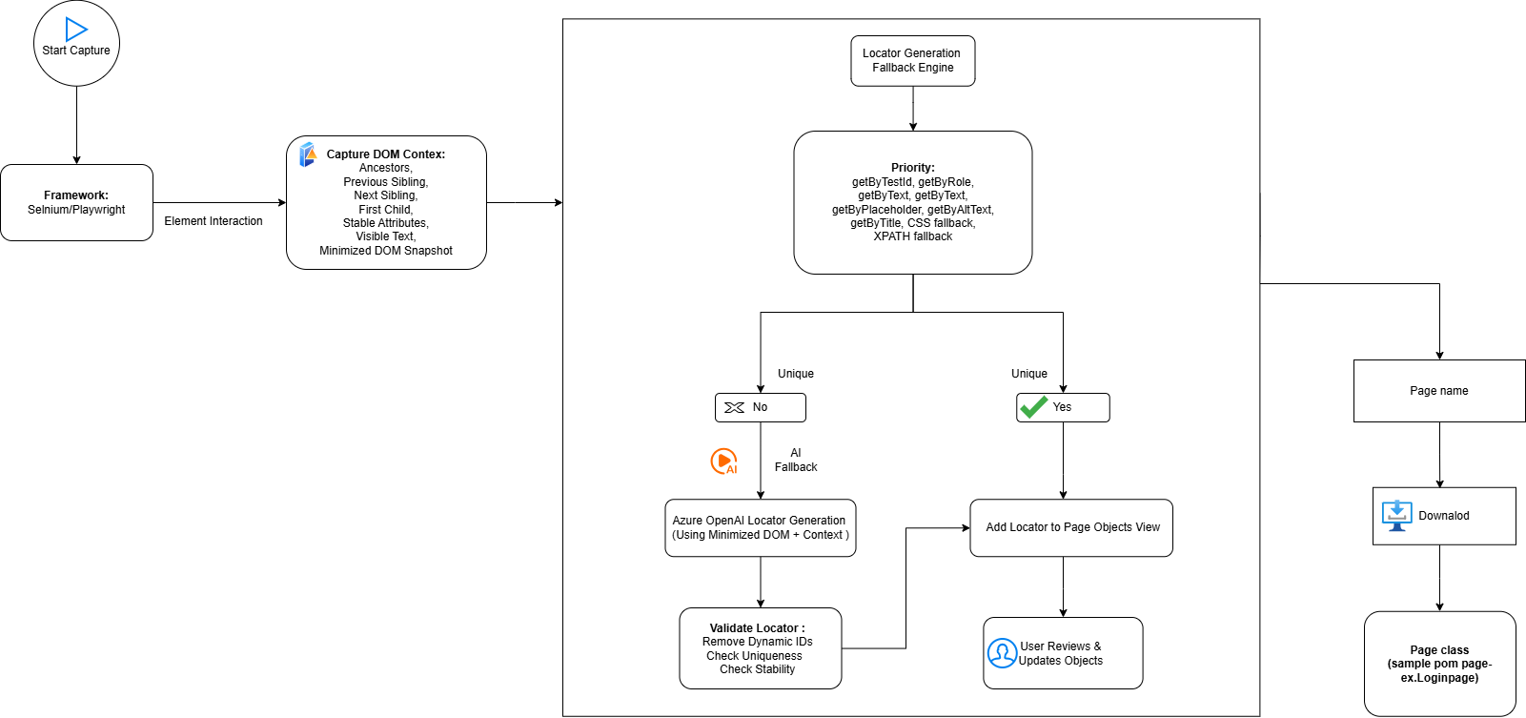
Autopom architecture

Slide 6







SELF HEALING – TEST AUTOMATION
Business value – Fixing flaky tests on its own – Less maintenance - Faster releases
Playwright · TypeScript · Azure OpenAI GPT-4.1
WHAT IT DELIVERS
Self-correcting suite
Deterministic tiers absorb most UI changes; AI handles novel breaks.
Lower flakiness & upkeep
Cuts manual selector maintenance and false failures substantially.
Validated end-to-end
Proven against the live Ann Taylor staging funnel.
THREE-TIER FALLBACK CHAIN
1 · DB Primary
2 · Smart Locators
3 · AI Healing
Stored locator resolved
direct from elements table
role → testId → text → css
→ xpath, placeholder
GPT-4.1 vision + DOM context, confidence-gated

Slide 7
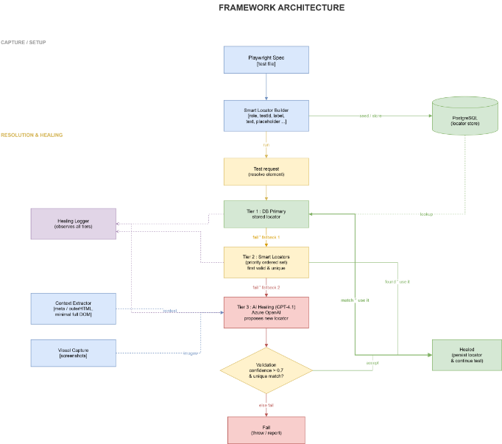
SELF HEALING ARCHITECTURE

Slide 8
IMAGE BASED AUTOMATION TOOL – VISOR
A Visual Automation Framework
Key Features
Visor combines OpenCV image matching, OCR text recognition, mouse and keyboard automation, and desktop application control into one Node.js package.
It enables visual interactions with Windows applications without requiring DOM or browser access.
Multi‑scale image matching
Full‑screen and region‑based OCR
Automated mouse, and keyboard input
Barcode scanning.
Built‑in display scaling detection.

Slide 9
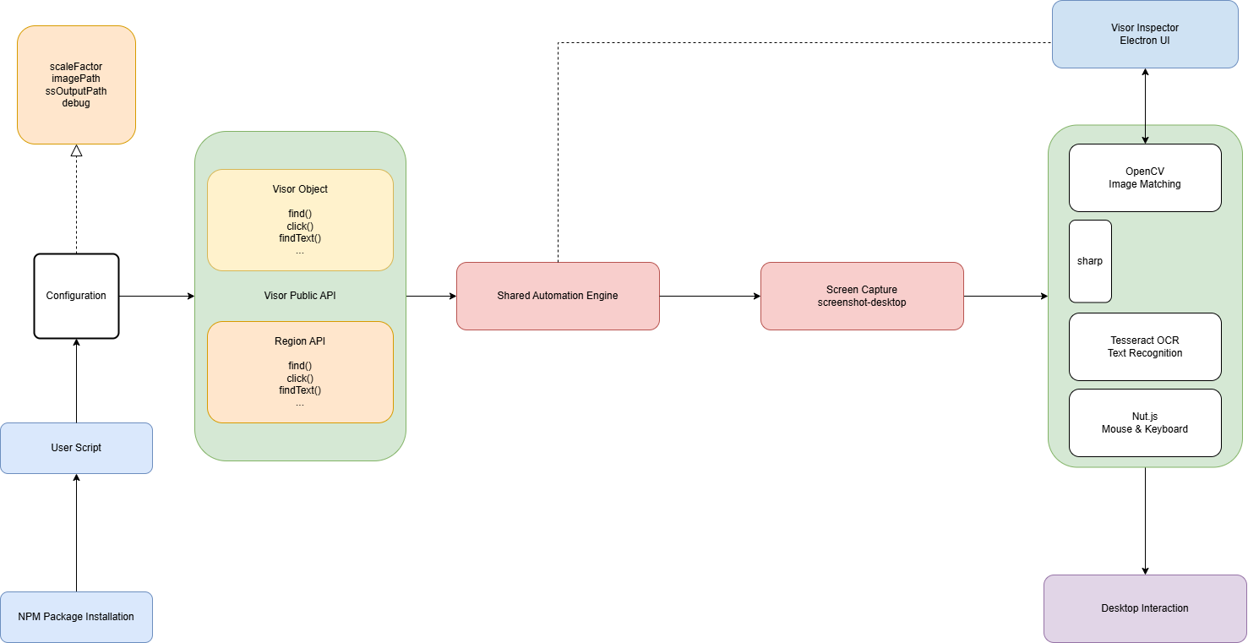
VISOR ARCHITECTURE

Slide 10


AFTA Dashboard
Unified Test Automation Platform for Execution, Reporting and Analytics
Features In AFTA:
▶
Test Runner
Execute and monitor test suites with build history and report access
IN PROGRESS
Implementation of multiple user login and User scheduling history with timestamp
📜
Test Data Generator
Generate reusable test data for faster execution..
📊
Reports
Centralized insights into execution results and trends.
ROADMAP
Scheduler
Automate recurring and parameterized test executions
Test Data Management Tool​
Email &Teams Notifications​
Flaky Test Detection ​
📅
AI-Powered Test Summaries
AI-Based Failure Analysis
Root Cause Suggestions
TECH STACK
Layer | UI | Backend | CI/CD | Reports | Integrations | Storage
Stack | Angular, TypeScript | Node.js, Express | Jenkins | JUnit XML, Allure | ReportPortal, SVN, LambdaTest | SQLite

Slide 11
ONGOING ACTIVITIES – AUTOMATION TEAM
MAINTENANCE & SHADOWING ACTIVITIES
REGRESSION SUITE — SPRINT 26.16 /26.17​ Automation scripting completed in Sprint26.16 for AT and Loft — both Desktop and Mobile Web.
Jenkins job triggered, achieving an 84–85%pass rate.
Report shared with the Everest Automation team for approval on PR #1652.
Received KT from the Everest team on test suites across all brands — suite ownership, execution strategy, and Jenkins auto-scheduled jobs.
Understood daily execution processes, regression cycles, and automation maintenance workflows.
Analyzing daily Sanity Suite failures and performing RCA across automation, environment, and application issues.
Automated validation of Data Layer variables using Playwright across end-to-end user journeys.
Dynamic comparison of Data Layer values against UI data, business rules, and expected behavior.
Comprehensive reporting with PASS / FAIL / MISSING status, detailed comparison results, and HTML/CSV reports for faster analysis
DATA LAYER VALIDATION

Slide 12
PLANNED ACTIVITIES – AUTOMATION TEAM
ORPOS MIGRATION
Current framework built on Java and Sikuli to be migrated to Playwright and Visor.
ECOMM MIGRATION
Current framework is built on selenium/java to be migrated to playwright/typescript(AFTA FRAMEWORK) Execution will be based on priority based testcases.
CHICOS SHADOWING/MAINTAINANCE
Planned
UI DASHBOARD – PHASE 2
Planned

Slide 13
Thank You

