Slide 1
Excel final assessment
Name – NIVETTA T
Employee ID - 4294

Slide 2
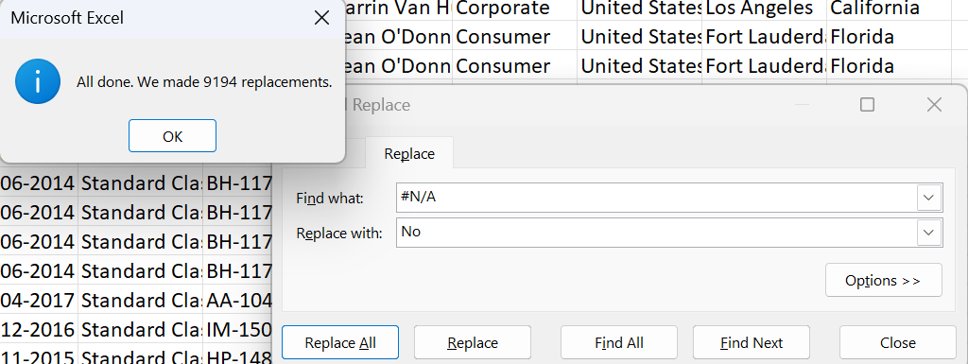
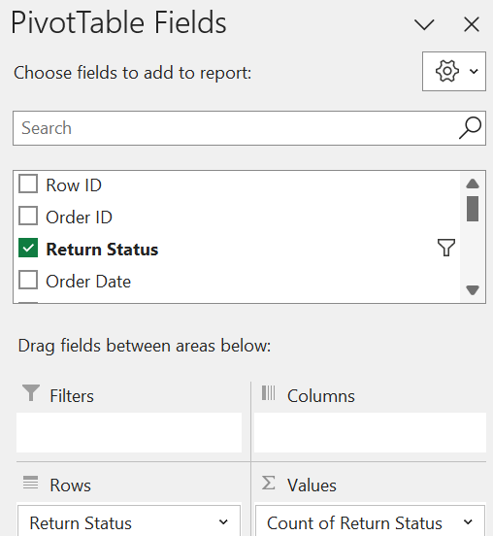
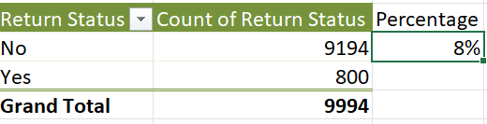
QUESTION 1
Insights: First all the N/A values were replaced with No as those products were not returned. (cntrl+f > replace all). Then the total orders is shown in pivot. We need to get count for Yes and No, then calculate using returned/total*100 as the return percentage
Formula: Used pivot: put return status as rows and count of it in columns.
returned/total*100
Insights: 800 orders out of 9994 were returned, which is 8%.

Slide 3
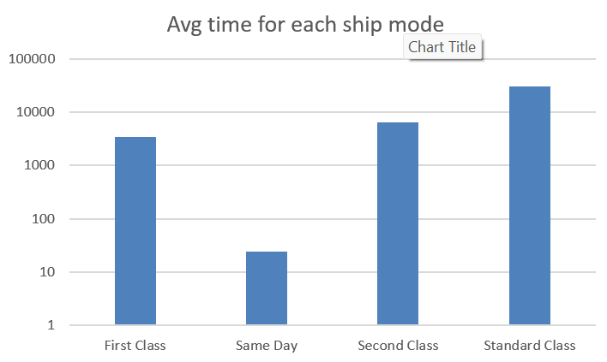
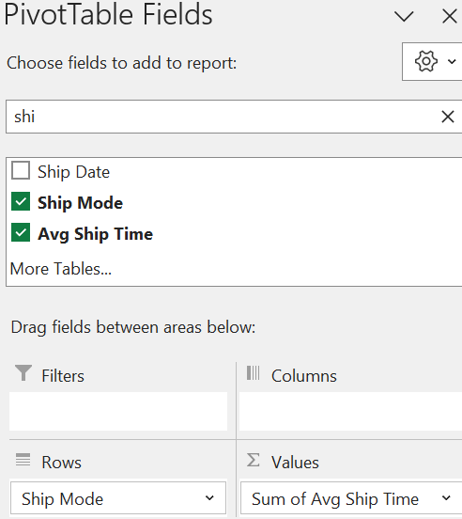
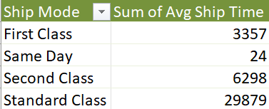
QUESTION 2
Formula: Insert a new col: Avg ship time in org data (shipd date – order date)
Inference: First insert pivot. Rows > Ship Mode, Values > Avg Ship Time. Then insert Bar chart to find the highest category.
Insights: Same day ship mode has the least ship time whereas Standard class has the most

Slide 4
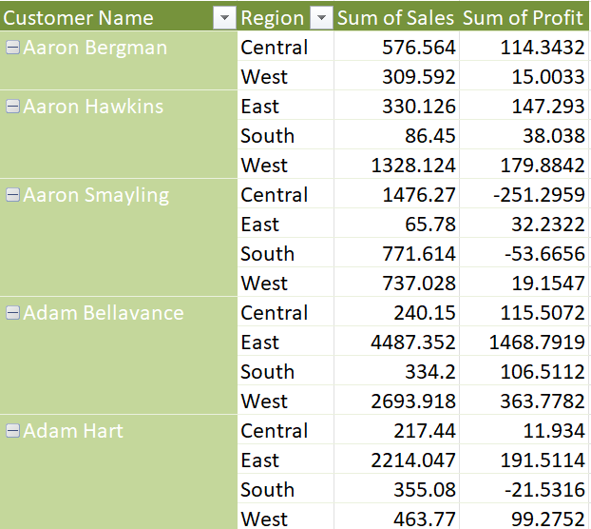
QUESTION 3
Formula: Use pivot: put rows: Customer Name, Region. Values> Sales sum and profit sum.
Inferences: put in tabular view. The report which is there is customer segmentation based on region, sales and profit from a single customer.
Insights: We can find the customer who is contributing the most to profit and sales bus doing CUSTOM SORT. Order by descending in profit and sales. And then to retain them we can offer special discounts and deals to then to increase the retention rate.

Slide 5
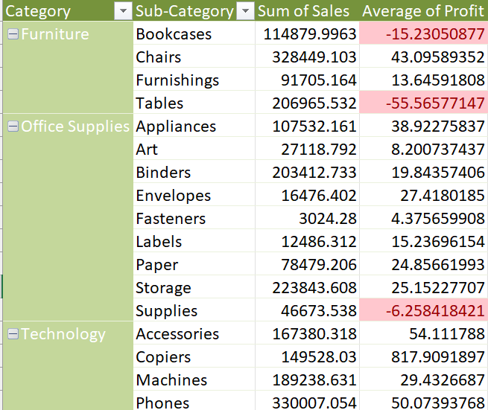
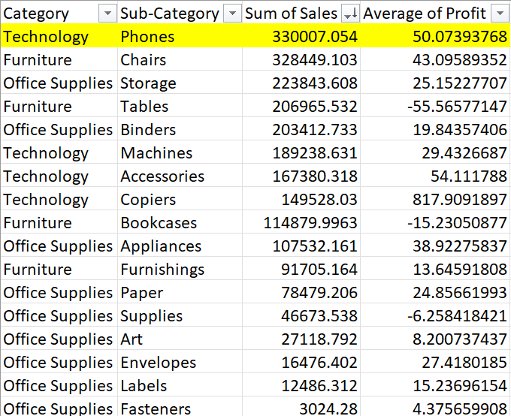
QUESTION 4
Inference: First use pivot to put rows> category, sub-category. Values> sum of sales and avg profit.
Then change the layout view to tabular format and fill blanks in order to sort
Formula: Sort based on sum of sales in descending order to find the category and subcategory of the highest sales.
Insights: From the bar graph we can see that Phones is generating the most sales whereas fasteners is the least

Slide 6
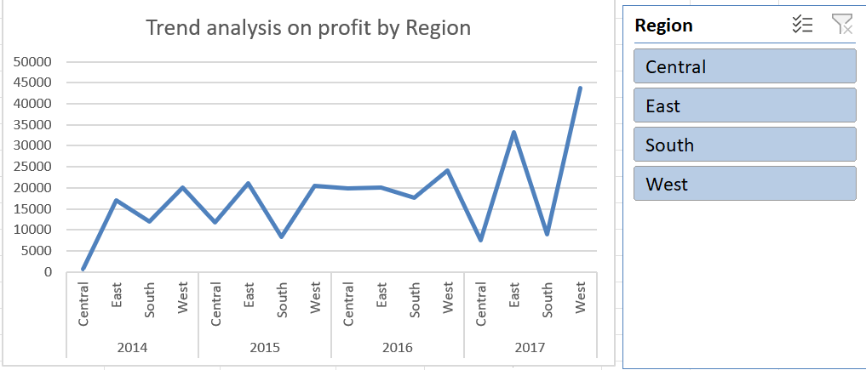
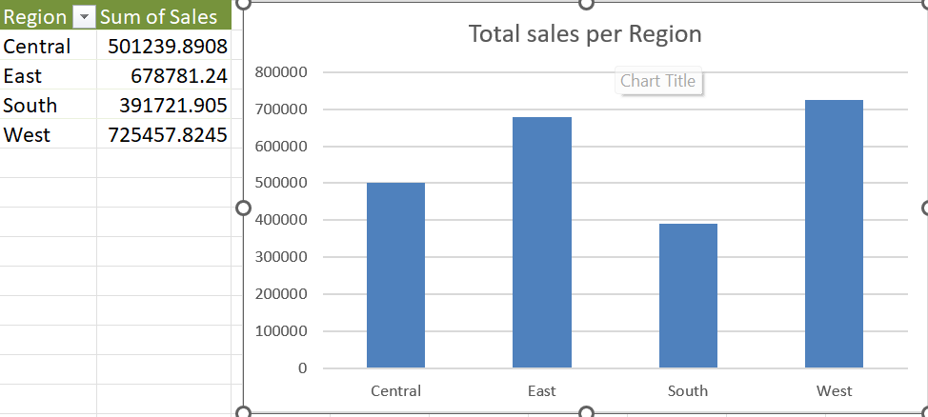
QUESTION 5
Formula: Use pivot to put rows> region, values> sum of sales.
Inference: Change layout to tabular format and insert bar and line graph to graphically see trend and total sales per region
Insights: West region is generating the most sales, whereas south is the least. Use the filters to filter region wise and see the trend of data in each year by region. Ex: in 2017 east and west performed the best.

Slide 7
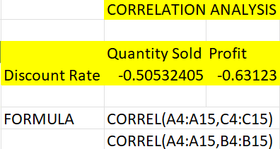
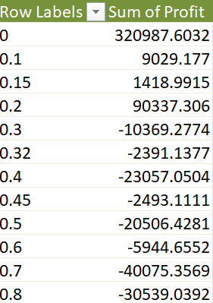
QUESTION 6
Formula: To find correlation between two columns use =correl() function. Use pivot. Rows: discount and values: sum of profit
Inferences: CORREL(A4:A15,C4:C15) This will result in a value between -1 and 1. closer to one more the correlation else less correlation.
Insights: From the correl matrix we can see that both have a negative correlation with discount rate. Profit and qty sold shares a negative correl with discount rate

Slide 8
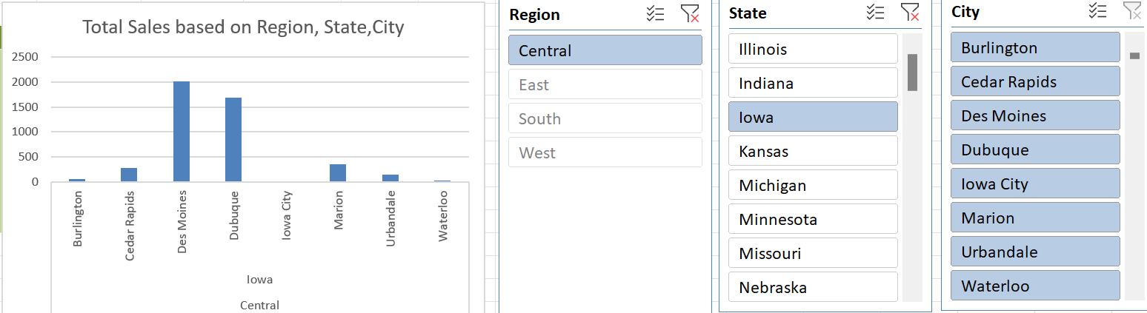
QUESTION 7
Formula: First select the original dtaa and then insert pivot. Rows>Region,State,City and values: total sales
Inferences: To visualize the number insert the bar chart and insert slicers as they will aid in concentrating on areas you want to analyse and hide the rest
Insights: In the above example we can see that in cebtral region, Iowa state the city Des Moines is performing very well and Iowa city is close to zero. Perhaps we can close the Iowa state store and concentrate on areas which are perfoming well to increase market.

Slide 9
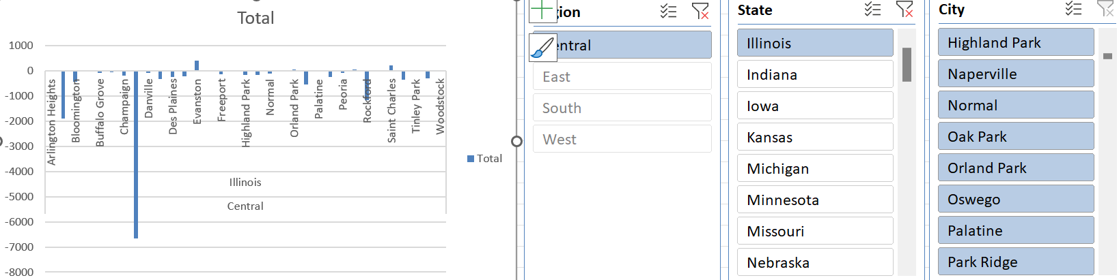
Q7 - continuation
In this example, we can see that the central region , Illinois is not performing well almost all outlets are getting negative sales. Hence we must increase marketing there to improve store presence and thereby increase profit to market expansion

Slide 10
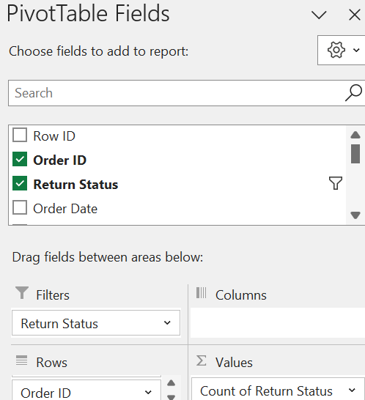
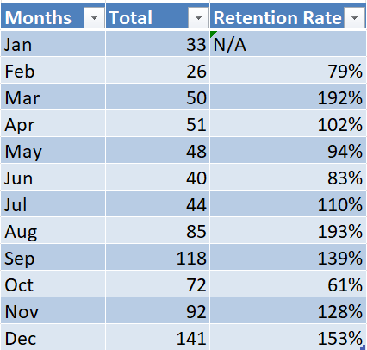
QUESTION 8
Formula: Use pivot to put rows> Months, order ID. Values: return count.
Inferences: put it in tabular view format and off grandtotal and sub total. Then fill empty blanks with preceeding value.
Insights: Highest retention rate as we can see is the month March which indicates the most returns happens during the month of march and the least in October.

Slide 11
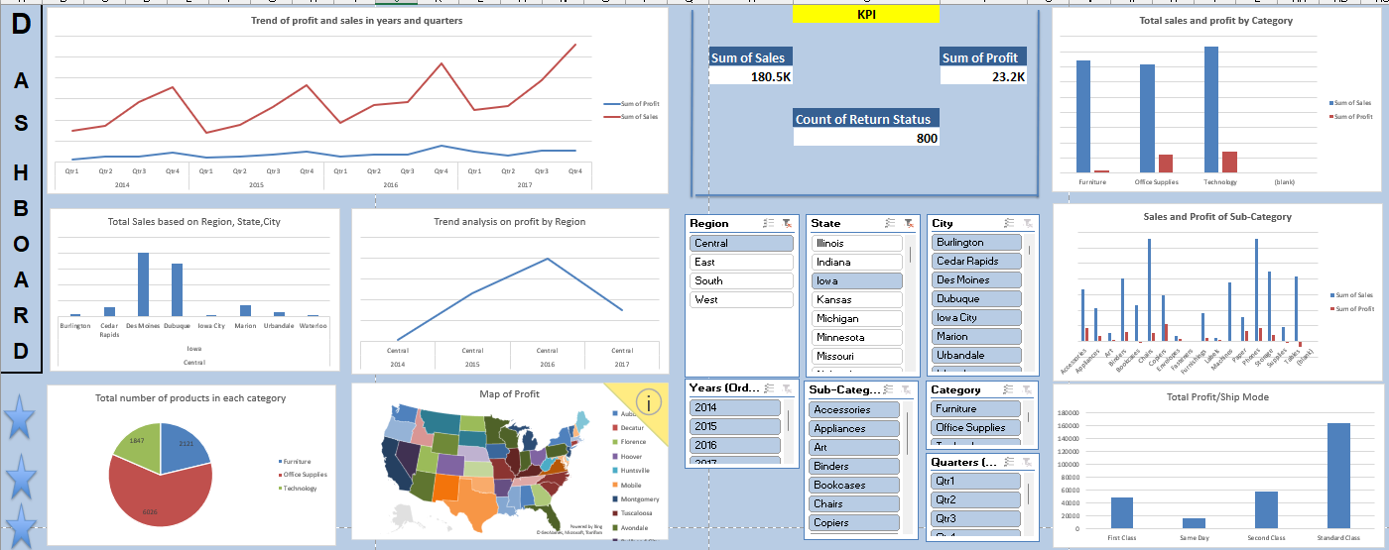
QUESTION 9
Formula: a
Steps involved: a
Insights: a

Slide 12
DASHBOARD
All the charts are connected using the slicers. Use the slicers to drill down into aspects that you want for analysis.
Bar charts, line charts, Trend analysis and a map is all included in the dashboard to derive insights such as:
Category/Sub- Category giving most Profit/Sales
Showing region wise sales by Map
Trend analysis through the years using Quarters
Pie chart showing count of products in each category
Showing distribution of shop mode

