Slide 1
Excel Finals
Nivetta T
4294

Slide 2
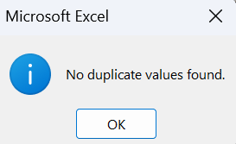
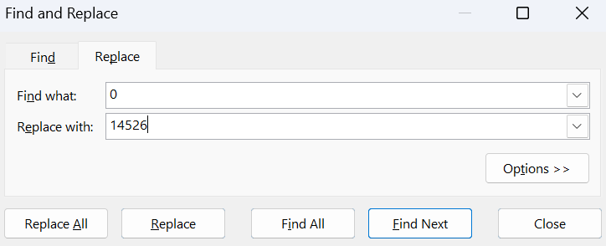
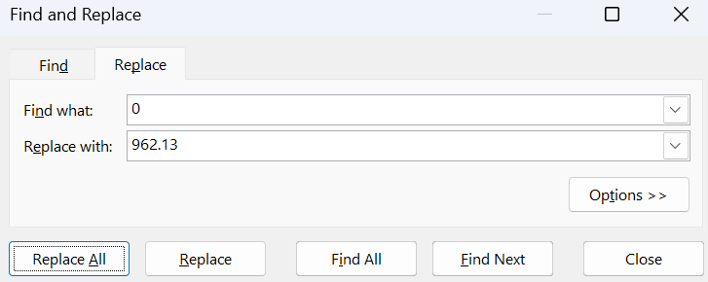
Q1
INSIGHTS
No duplicate values found.
Null values found in columns: view, likes,dislikes & cmnt count.
STEPS
The null values in likes, dislikes and comment_cnt columns were imputed with mean of each column. For categorical values, Filter was used to get rid of null values.
FORMULA
Like null value imputation: =AVERAGE(I7:I16203)
Then, find and replace

Slide 3
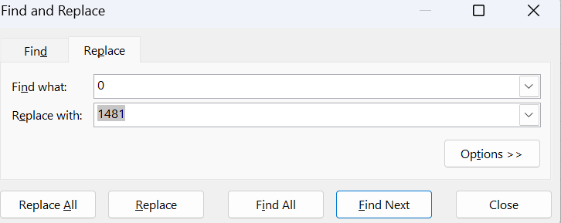
Q1
INSIGHTS
No duplicate values found.
Null values found in columns: view, likes,dislikes & cmnt count.
STEPS
The null values in likes, dislikes and comment_cnt columns were imputed with mean of each column. For categorical values, Filter was used to get rid of null values.
FORMULA
Like null value imputation: =AVERAGE(I7:I16203)
Then, find and replace

Slide 4
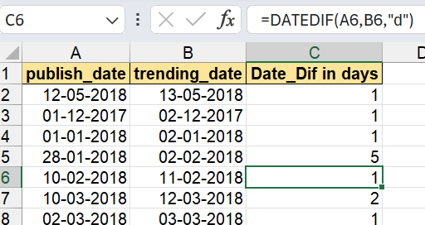
Q2
DATEDIF(A5,B5,"d")

Slide 5
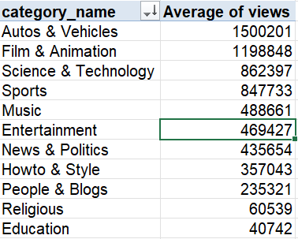
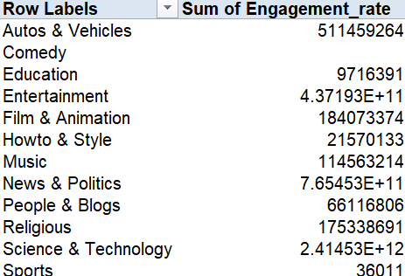
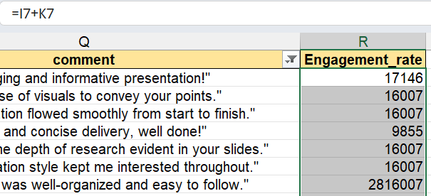
Q3
INSIGHTS
Autos and vehicles have highest avg views as shown in pivot table
STEPS
Average found by pivot table.
FORMULA
Engagement=likes+cmt_cnt
=I7+K7

Slide 6
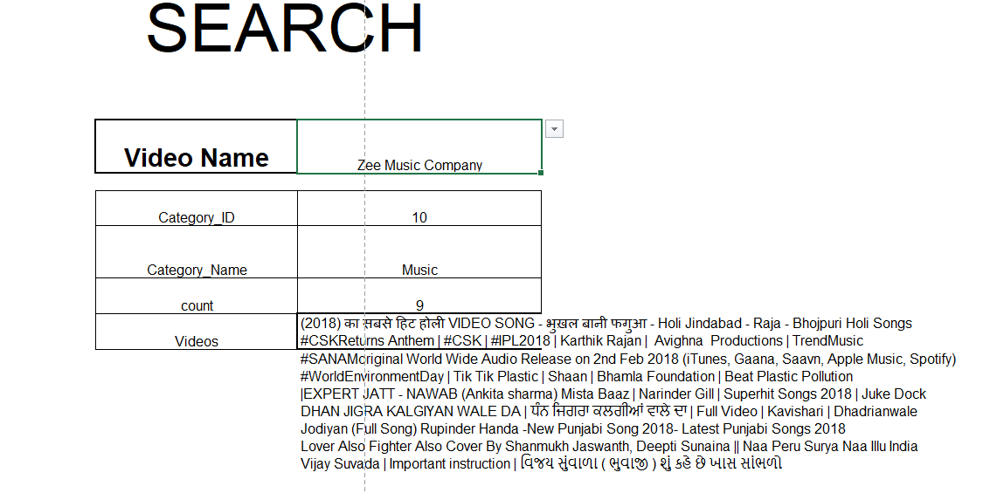
Q4
INSIGHTS
NA
STEPS
DATA VALIDATION FOR VID NAME AND THEN USE FORMULAS TO RETRIEVE VALUES
FORMULA
category id - XLOOKUP(J8,'YouTube data'!D:D,'YouTube data'!E:E,0)
XLOOKUP(J12,Category!A:A,Category!B:B,0)
COUNTA(FILTER('YouTube data'!C:C,'YouTube data'!F:F=Sheet11!J14))
FILTER('YouTube data'!C:C,'YouTube data'!F:F=Sheet11!J14)

Slide 7
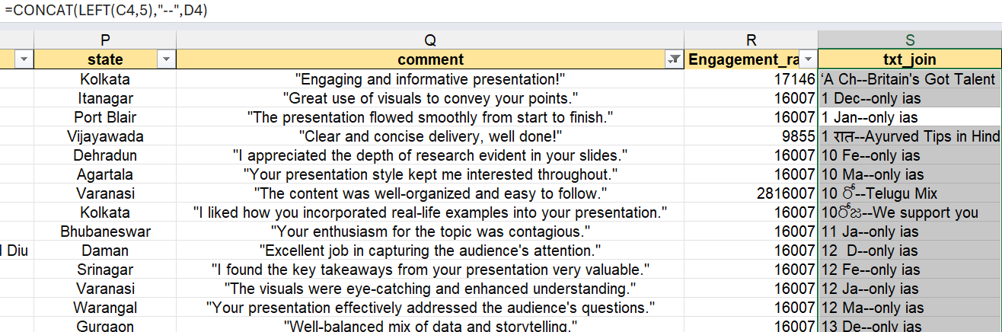
Q5
INSIGHTS
)
here
STEPS
GET NEW COL, PUT FORMULA TO CONACT 2 COLS AND MAINTAIN READABILITY
FORMULA
Text_concat: =CONCAT(LEFT(C2,5),"--",D2)

Slide 8
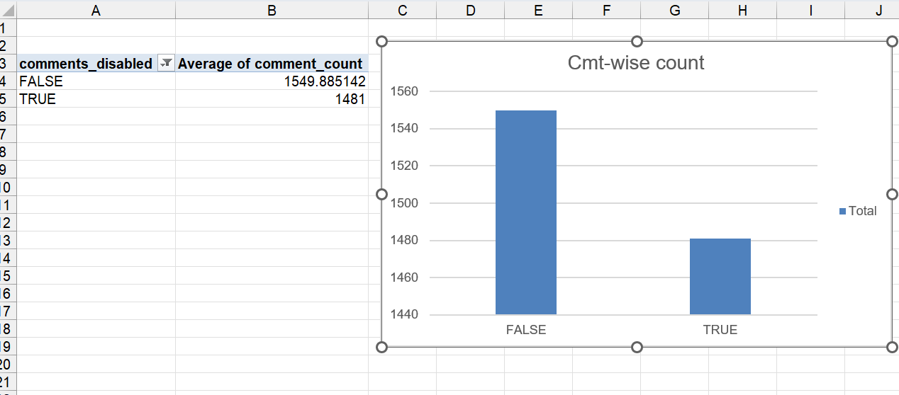
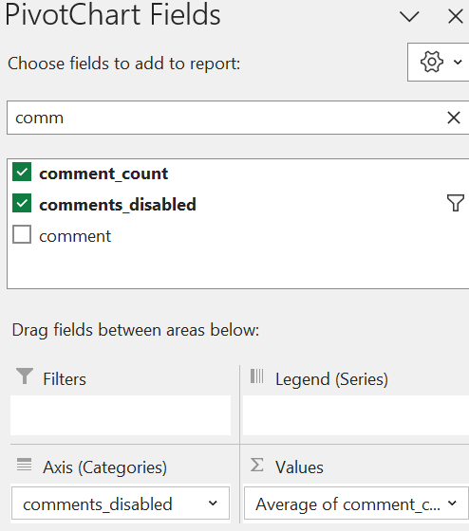
Q6
INSIGHTS
The graph show that there are more for false than true.
STEPS
Insert pivot table from all data, assign row: cat_name and value: cmt_cnt and set to avg
FORMULA
Done using pivot

Slide 9
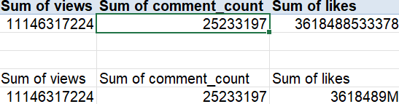
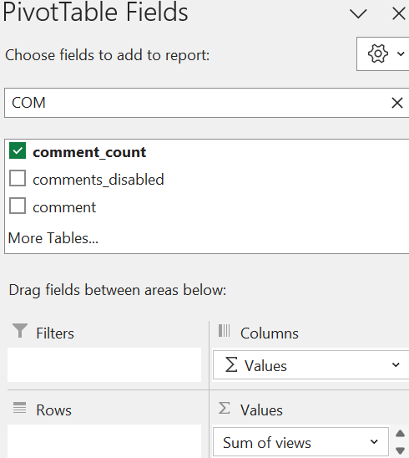
Q7
INSIGHTS
KPI CALC
STEPS
USED PIVOT TABLE (PUT ALL THE FIELDS ASKED FOR IN VALUES)TO GET KPIS
OASTED WITHOUT FORMULA AND FORMATED TO SHOW IN MILLIONS.
FORMULA
PIVOT

Slide 10
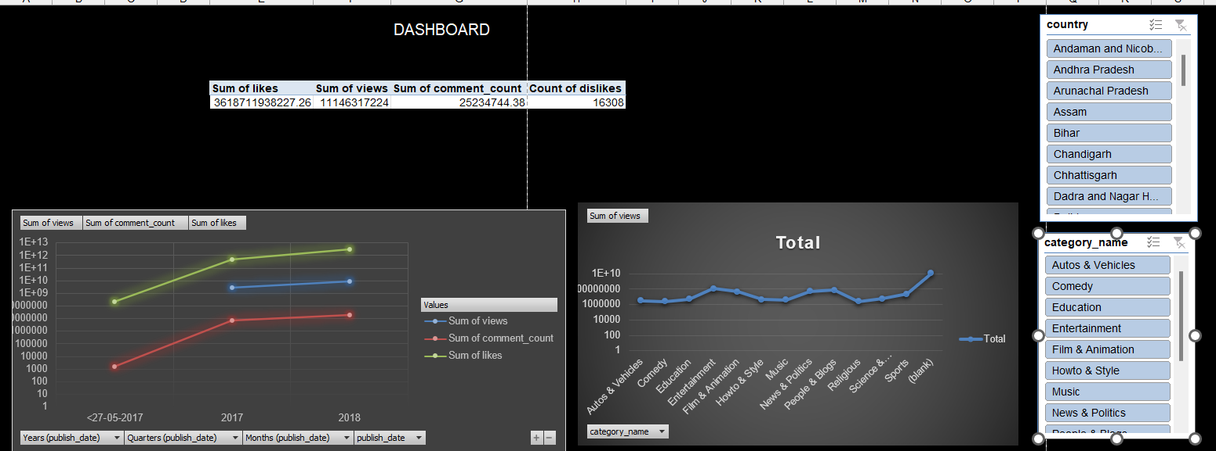
Q7
INSIGHTS
here
STEPS
USED PIVOT TABLE (PUT ALL THE FIELDS ASKED FOR IN VALUES)TO GET KPIS
OASTED WITHOUT FORMULA AND FORMATED TO SHOW IN MILLIONS.
FORMULA
here

Slide 11
Q7
INSIGHTS
here
STEPS
USED PIVOT TABLE (PUT ALL THE FIELDS ASKED FOR IN VALUES)TO GET KPIS
OASTED WITHOUT FORMULA AND FORMATED TO SHOW IN MILLIONS.
FORMULA
here

Slide 12
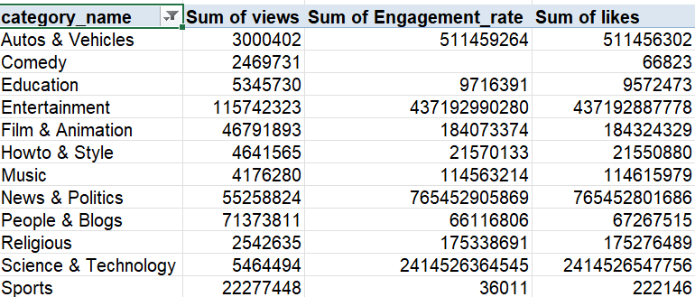
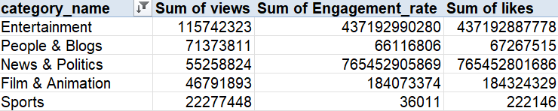
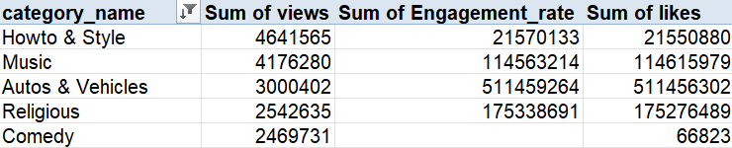
Q8
INSIGHTS
Entertainment is the most well performing category.
Howto & style is the most underperforming category.
STEPS
Used pivot Table. Rows: Category_name. Values:view,engagement_rate and likes.
Sorted multiple clms in desc order and used filter to show top 5.
Edited filter to show bottom 5
FORMULA
here

Slide 13
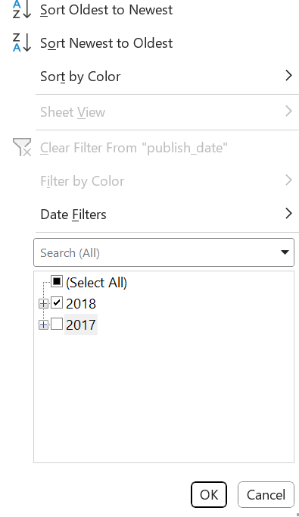
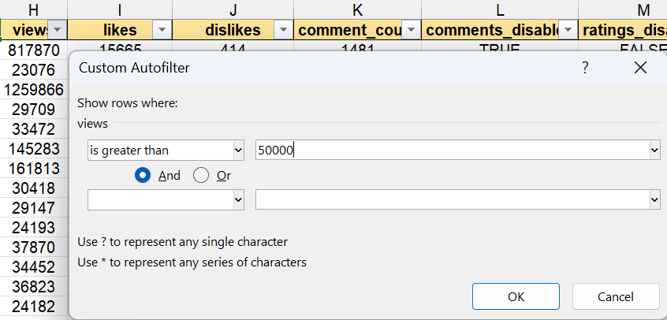
Q9
INSIGHTS
There are toal of 4452 rows of data which have been published in year 2018 and has view count over 50K
STEPS
CNTRL+SHT+L TO FILTER DATA. FILTERING BASED ON PUB_DATE. ONLY TO SHOW 2018 YEAR.
SORTING VIEWS COLUMN > 50K VIEWS ONLY
FORMULA
Using Filter functions alone.

Slide 14

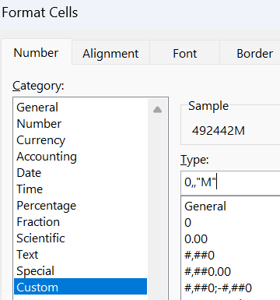
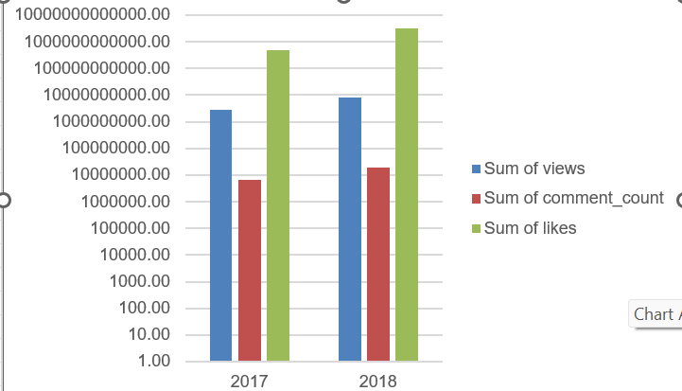
Q10
INSIGHTS
Year 2018 has performed better that year 2017. There is a great increase in number of likes and the sum of views. There is little change in comment count.
STEPS
Use pivot table: Rows: Year(pub_date), Values: (views,cmt_cnt,sum_likes)
Format numbers, insert chart, change to log scale for better readability.
FORMULA
Used pivot

Slide 15
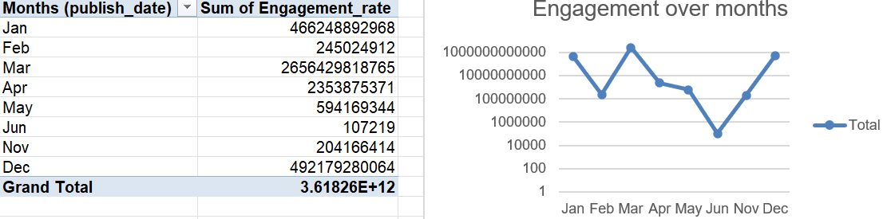
Q11
INSIGHTS
A steady increase in engagement is noticed from months June to December.
STEPS
Use pivot tables
FORMULA
here

Slide 16
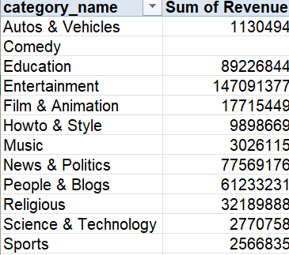
Q12
INSIGHTS
Most revenue generated from Entertainment sector and least from comedy followed by music.
STEPS
Used pivot with category and revenue.
FORMULA
Use forecast.linear() to forecast revenue using known data.

Slide 17
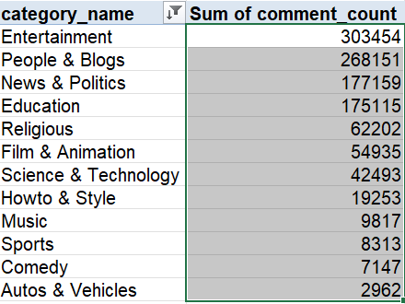
Q13
INSIGHTS
Most for entertainment
STEPS
Used pivot and then sort
FORMULA
Used pivot and sort

Slide 18
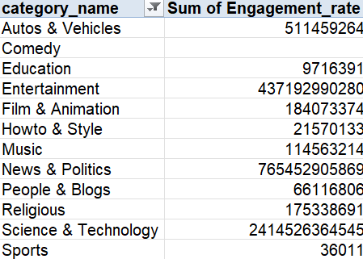
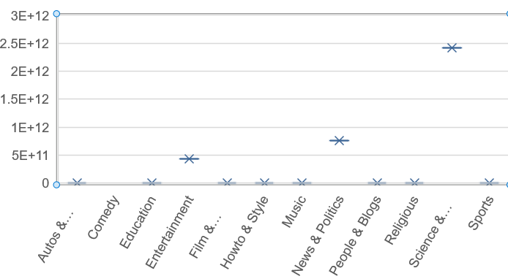
Q14
INSIGHTS
here
STEPS
here
FORMULA
here

Slide 19
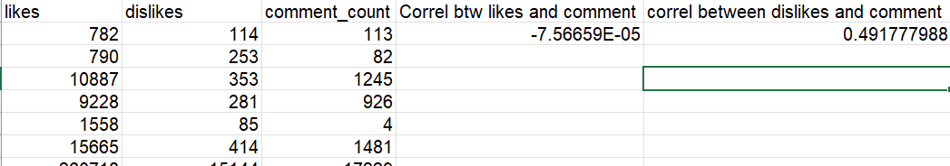
Q15
INSIGHTS
Positive correl observed btw dislikes and comment
STEPS
Create unique clms in new sheet and use formula
FORMULA
= CORREL(A:A,C:C)

Slide 20
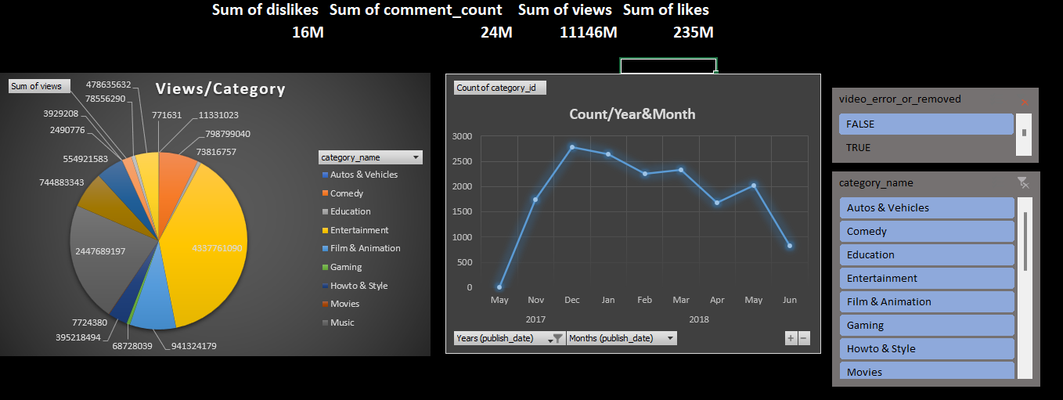
Q16
INSIGHTS
here
STEPS
here
FORMULA
here

Slide 21
Q17
INSIGHTS
here
STEPS
here
FORMULA
here

Slide 22
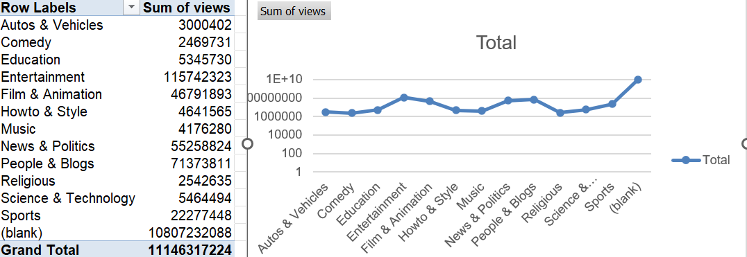
Q18
INSIGHTS
here
STEPS
here
FORMULA
here

Slide 23
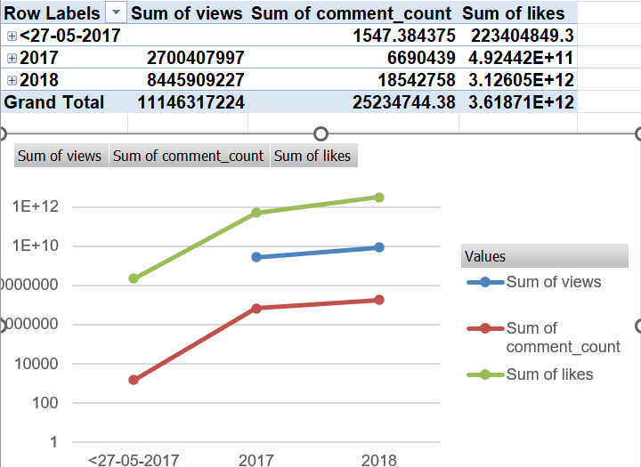
Q16
INSIGHTS
All categories increased over time
STEPS
Use pivot
FORMULA
Use pivot

Slide 24
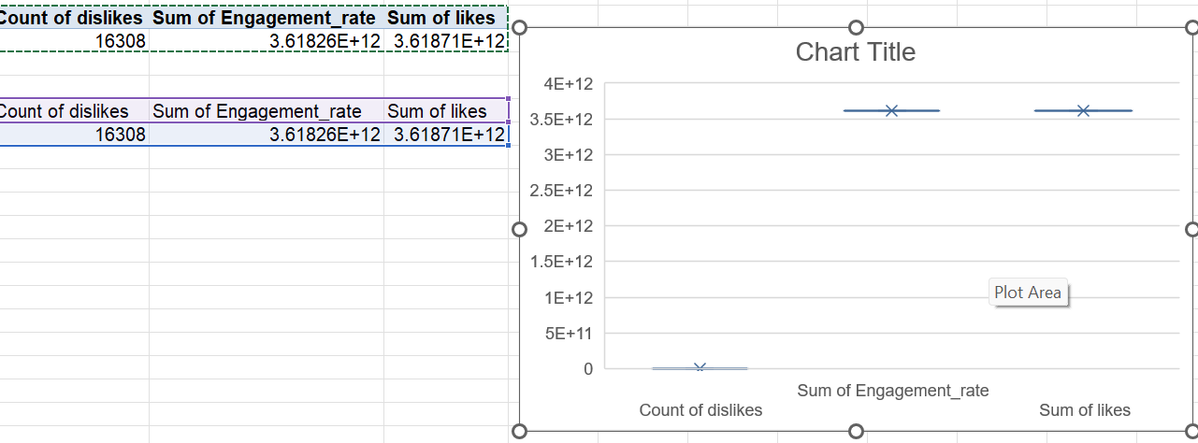
Q17
INSIGHTS
here
STEPS
here
FORMULA
here

Slide 25
Q18
INSIGHTS
here
STEPS
MAKE PIVOT , TREND OF GIVEN COLS OVER YEARS
THE SELECTED TIME FRAME IS IN YEARS.
FORMULA
here

Slide 26
Q19
INSIGHTS
ALL ARE SEEN TO BE INCREASING OVER TIME
STEPS
MAKE PIVOT , TREND OF GIVEN COLS OVER YEARS
FORMULA
here

Slide 27
Q20
INSIGHTS
here
STEPS
here
FORMULA
here

