Slide 1
LDPC / THE SIGNAL LAB
DIGITAL COMMUNICATION SYSTEMS
DCS SEMINAR · MODULE 07
A little structure.
A lot less noise.
x1
x3
x4
x5
x8
x2
x6
x7
Low-Density Parity-Check Codes and Their Application in Modern Communication Systems
A visual journey from Hamming codes to the channel capacity limit.
c1
c2
c3
c4
MODULE 07 · INFORMATION THEORY & CODING
01 / 16
Notes:
Open the live lab before presenting. Ask: if a radio receives the wrong bit, how could it know? The answer is structured redundancy. This seminar connects Module 7 linear block codes, error correction, and channel capacity.
Caveat: A visual journey from Hamming codes to modern error correction.
Live lab: https://ldpc-signal-lab.heartyring65.chatgpt.site

Slide 2
LDPC / THE SIGNAL LAB
DIGITAL COMMUNICATION SYSTEMS
01 / THE PROBLEM
Noise changes the message.
A receiver sees a measurement, not a perfect bit. Error correction gives it evidence beyond that measurement.
01
02
03
Noise
Redundancy
Recovery
Thermal noise and interference shift received amplitudes. A hard decision can flip a bit.
Transmit extra, structured bits. Valid messages obey shared constraints.
Use those constraints to infer the most likely transmitted codeword.
information bits → encoder → noisy channel → decoder
MODULE 07 · INFORMATION THEORY & CODING
02 / 16
Notes:
Redundancy costs bandwidth or time. We exchange that cost for reliability at a lower signal level. Distinguish error detection from correction: detecting a violated rule is easier than finding the original message.
Live lab: https://ldpc-signal-lab.heartyring65.chatgpt.site

Slide 3
LDPC / THE SIGNAL LAB
DIGITAL COMMUNICATION SYSTEMS
02 / THE SYLLABUS CONNECTION
Start with Hamming.
Hamming (7,4) carries 4 information bits in 7 transmitted bits. Its minimum distance is 3.
01
02
03
Shared foundation
Hamming (7,4)
LDPC
Both Hamming and LDPC are linear block codes defined by parity constraints.
A syndrome identifies any one-bit error. Two-bit errors are not safely corrected by the basic decoder.
Longer blocks, sparse graphs, soft information, and iterative local updates.
s = H rᵀ over GF(2)
MODULE 07 · INFORMATION THEORY & CODING
03 / 16
Notes:
The syndrome is zero for a valid codeword. With the Hamming parity-check matrix, every column is a different nonzero binary vector. One error produces the column associated with its position. Do not claim that basic Hamming (7,4) can reliably distinguish every double error while correcting singles.
Caveat: Hamming (7,4) is not extended Hamming (8,4), which adds SECDED behavior.
Live lab: https://ldpc-signal-lab.heartyring65.chatgpt.site

Slide 4
LDPC / THE SIGNAL LAB
DIGITAL COMMUNICATION SYSTEMS
03 / THE MATHEMATICAL FOUNDATION
A code is a set of rules.
H has m rows and n columns. Every row is one parity equation. Arithmetic is modulo 2.
01
02
03
Codeword
Dimension
Code rate
A length-n binary vector x satisfying every parity equation.
k = n − rank(H), using rank over GF(2). Dependent rows do not add new rules.
R = k/n. A lower rate spends more transmitted bits on redundancy.
H x = 0 (mod 2) R = [n − rank(H)] / n
MODULE 07 · INFORMATION THEORY & CODING
04 / 16
Notes:
Write a row such as x1 XOR x3 XOR x6 = 0. If five values in a six-bit check are known, the sixth is implied. The equation uses a column-vector convention; the Hamming slide uses the equivalent received row-vector convention with a transpose.
Live lab: https://ldpc-signal-lab.heartyring65.chatgpt.site

Slide 5
LDPC / THE SIGNAL LAB
DIGITAL COMMUNICATION SYSTEMS
04 / WHY LOW DENSITY?
Sparse is the whole point.
Most entries of H are zero. Each bit participates in only a few checks, even as the block becomes large.
01
02
03
Variable degree
Check degree
Work per iteration
This lab uses three edges per variable node.
Each parity check has six variable neighbors.
Linear in the number of graph edges for a fixed-degree construction.
E = n dᵥ = m d꜀ here: dᵥ = 3, d꜀ = 6
MODULE 07 · INFORMATION THEORY & CODING
05 / 16
Notes:
A dense matrix would connect nearly everything and make iterative processing expensive. Sparse graphs keep each update local. Four-cycles correlate messages quickly; avoiding short cycles and selecting degree distributions matters for performance. The nominal design rate is one half; actual rank determines the true rate.
Caveat: The teaching graph may have short cycles. Standards use carefully designed constructions.
Live lab: https://ldpc-signal-lab.heartyring65.chatgpt.site

Slide 6
LDPC / THE SIGNAL LAB
DIGITAL COMMUNICATION SYSTEMS
05 / ENCODING
Build a valid codeword.
Choose information bits. Solve the parity constraints. Transmit all n bits.
01
02
03
Choose
Solve
Verify
Pick k free coordinates after Gaussian elimination over GF(2).
Calculate pivot coordinates from the reduced parity equations.
Check that Hx = 0 before transmission.
u ∈ {0,1}ᵏ → x ∈ {0,1}ⁿ with Hx = 0
MODULE 07 · INFORMATION THEORY & CODING
06 / 16
Notes:
Sparse H does not imply a sparse generator matrix. Generic encoding can be more expensive than decoding. Structured quasi-cyclic constructions allow efficient encoding in real systems. The lab sends randomized valid codewords in the interactive sample.
Caveat: The lab encodes using GF(2) elimination. Production QC-LDPC encoders exploit matrix structure.
Live lab: https://ldpc-signal-lab.heartyring65.chatgpt.site

Slide 7
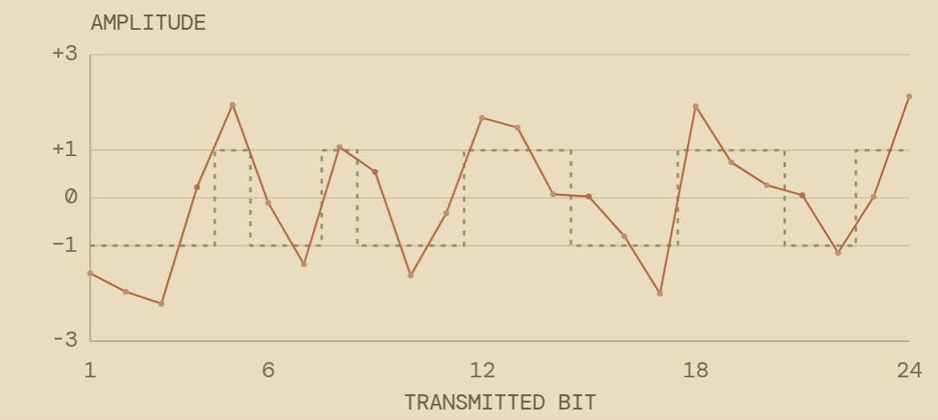
LDPC / THE SIGNAL LAB
DIGITAL COMMUNICATION SYSTEMS
06 / THE CHANNEL MODEL
Bits become a waveform.
Binary phase-shift keying sends 0 as +1 and 1 as −1. Add white Gaussian noise.
01 Modulate
s = 1 − 2x, giving a unit-energy coded symbol.
02 Corrupt
y = s + z, where z is Gaussian with variance σ².
03 Normalize
The SNR slider is Eb/N₀ per information bit, not per coded symbol.
σ² = 1 / [2R · 10^(Eb/N₀[dB]/10)]
MODULE 07 · INFORMATION THEORY & CODING
07 / 16
Notes:
Rate appears in the noise normalization because one information bit consumes 1/R coded symbols. Without that factor, comparing code rates or reporting Eb/N0 would be misleading. This is a memoryless AWGN model; it does not model fading, intersymbol interference, or synchronization.
Caveat: Real-valued BPSK, one coded bit per real channel use, symbol energy normalized to one.
Live lab: https://ldpc-signal-lab.heartyring65.chatgpt.site

Slide 8
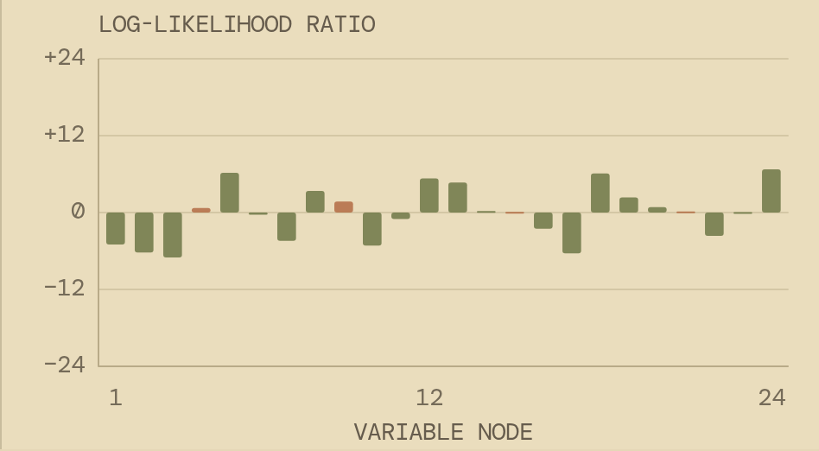
LDPC / THE SIGNAL LAB
DIGITAL COMMUNICATION SYSTEMS
07 / SOFT INFORMATION
“Probably zero” is useful.
A hard decision discards confidence. The log-likelihood ratio keeps both the sign and strength of the evidence.
01 Positive LLR
Favors bit 0. Larger magnitude means stronger confidence.
02 Negative LLR
Favors bit 1. The decoder can revise its initial decision.
03 Near zero
The channel offers little evidence. Neighboring checks matter more.
Lch = ln[P(y | x=0) / P(y | x=1)] = 2y / σ²
MODULE 07 · INFORMATION THEORY & CODING
08 / 16
Notes:
Equal prior probabilities are assumed. Show two received values, y=0.01 and y=2. Both hard-decide to zero, yet their confidence is different. A soft decoder uses that distinction. The lab clips messages to magnitude 24 for numerical stability.
Live lab: https://ldpc-signal-lab.heartyring65.chatgpt.site

Slide 9
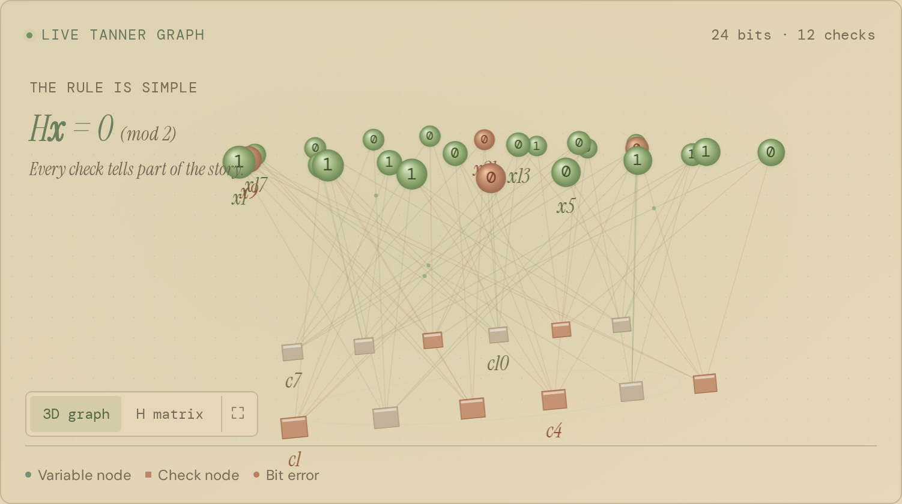
LDPC / THE SIGNAL LAB
DIGITAL COMMUNICATION SYSTEMS
08 / THE TANNER GRAPH
Turn a matrix into a conversation.
Circles represent bits. Squares represent checks. An edge exists exactly when Hⱼᵢ = 1.
01 Variable nodes
Keep channel evidence and incoming check messages.
02 Check nodes
Enforce an even XOR sum across their neighbors.
03 Extrinsic evidence
A message excludes the edge it is sent back on. Avoid immediate self-reinforcement.
one matrix entry of 1 = one graph edge
MODULE 07 · INFORMATION THEORY & CODING
09 / 16
Notes:
Rotate the graph and click a node in the lab. Trace its highlighted edges. The 3D layout is only a visualization: rotating it does not change the matrix or code. A Tanner graph is bipartite; edges connect variables to checks, never two variables directly.
Live lab: https://ldpc-signal-lab.heartyring65.chatgpt.site

Slide 10
LDPC / THE SIGNAL LAB
DIGITAL COMMUNICATION SYSTEMS
09 / BELIEF PROPAGATION
Local messages. Global inference.
The sum-product decoder alternates check updates and variable updates in the log domain.
01
02
03
Check update
Variable update
Hard decision
Combine incoming beliefs from every other variable connected to this check.
Add channel LLR to check messages from every other check.
Sum all incoming check messages and channel evidence; decide from the sign.
L꜀→ᵥ = 2 atanh[ ∏ tanh(Lᵥ′→꜀ / 2) ]
MODULE 07 · INFORMATION THEORY & CODING
10 / 16
Notes:
Products exclude the destination variable. Variable-to-check sums exclude the destination check. The posterior sum includes every check. This flooding schedule updates all checks before updating variables. On a tree this computes exact marginals; on a graph with cycles it is an iterative approximation.
Caveat: Normalized min-sum approximates the check update using sign products and minimum magnitude; this lab uses α = 0.8.
Live lab: https://ldpc-signal-lab.heartyring65.chatgpt.site

Slide 11
LDPC / THE SIGNAL LAB
DIGITAL COMMUNICATION SYSTEMS
10 / LIVE DEMO
Give the receiver a harder day.
Open the lab. Move Eb/N₀, generate new noise, and watch confidence evolve one iteration at a time.
01 1 · Start at 2 dB
Inspect the red bit errors and unsatisfied checks.
02 2 · Press play
Follow the LLR bars and parity-check count. Pause or step at any iteration.
03 3 · Lower the SNR
Notice failed convergence and occasional wrong valid codewords.
Noise is random. Recovery is not guaranteed.
OPEN THE INTERACTIVE LAB ↗
MODULE 07 · INFORMATION THEORY & CODING
11 / 16
Notes:
Allow about two minutes. Use the default reproducible sample first. New noise changes the random seed; changing SNR keeps the same noise draw scaled to a different level. Move to Performance to show the difference between one frame and Monte Carlo statistics.
Live lab: https://ldpc-signal-lab.heartyring65.chatgpt.site

Slide 12
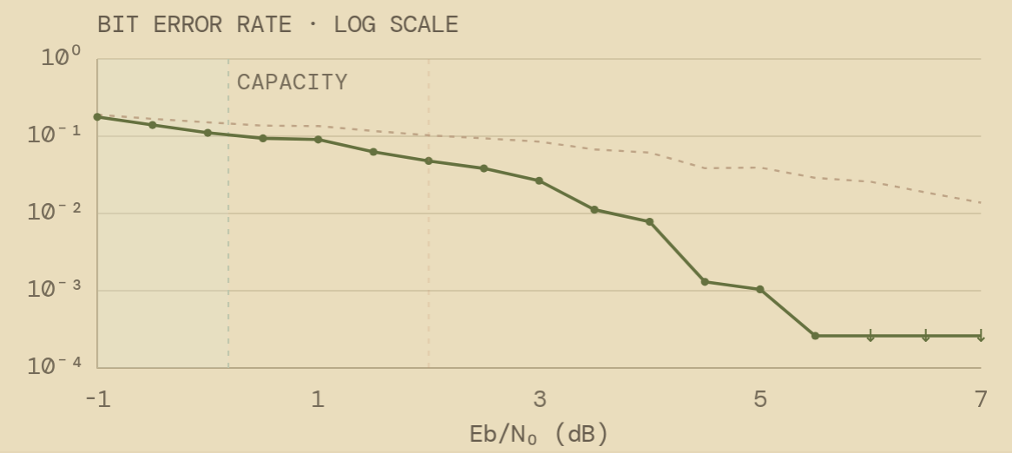
LDPC / THE SIGNAL LAB
DIGITAL COMMUNICATION SYSTEMS
11 / MEASURING PERFORMANCE
One recovered frame is not a curve.
Bit error rate counts incorrect bits across many independent frames at each Eb/N₀.
01 BER
Number of incorrect coded bits divided by transmitted coded bits.
02 Waterfall
Many long, well-designed LDPC codes show a steep BER improvement above a threshold.
03 Finite samples
Zero observed errors does not prove zero BER. Collect more frames.
Illustrative teaching code · 160 frames / point · ↓ indicates zero errors
MODULE 07 · INFORMATION THEORY & CODING
12 / 16
Notes:
The performance chart compares the received hard decisions and decoded codeword bits on the same coded BPSK channel. It is not a fair uncoded-versus-coded information-throughput benchmark. Short teaching codes can show rough curves and poor gains. A Hamming comparison would need matching energy normalization and enough trials.
Caveat: The lab measures 160 frames at each of 17 SNR points. Down arrows mark zero errors at 1/N as a plotting indicator, not a confidence bound.
Live lab: https://ldpc-signal-lab.heartyring65.chatgpt.site

Slide 13
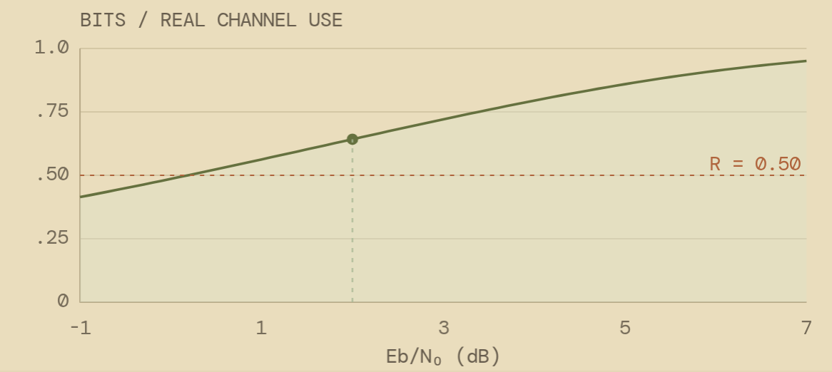
LDPC / THE SIGNAL LAB
DIGITAL COMMUNICATION SYSTEMS
12 / THE SHANNON CONNECTION
A limit, not a decoder.
Below channel capacity, suitable sequences of sufficiently long codes can make error probability arbitrarily small.
01 General AWGN
For a real Gaussian input: C = ½ log₂(1 + S/N) bits per real channel use.
02 BPSK constraint
Binary input limits capacity to at most 1 bit per real use. The lab plots I(X;Y) for BPSK.
03 Finite block length
A small code with a finite iteration budget cannot promise capacity-achieving performance.
BPSK-constrained AWGN capacity, not a measured decoding threshold
MODULE 07 · INFORMATION THEORY & CODING
13 / 16
Notes:
Capacity is a property of a channel and its input constraints, not the performance of a particular decoder. The lab computes binary-input mutual information by Gaussian integration and solves C=R numerically. Do not place the universal −1.59 dB label at a rate-one-half BPSK threshold.
Caveat: At R = 1/2, the BPSK-constrained asymptotic Eb/N₀ threshold is about 0.19 dB. The wideband Gaussian limit −1.59 dB is a different operating limit.
Live lab: https://ldpc-signal-lab.heartyring65.chatgpt.site

Slide 14
LDPC / THE SIGNAL LAB
DIGITAL COMMUNICATION SYSTEMS
13 / REAL-WORLD COMMUNICATION
These checks travel everywhere.
LDPC moved from Gallager’s 1962 idea to large, practical communication and storage systems.
01
02
03
5G NR
Satellite & Wi-Fi
Storage
LDPC protects data channels. Polar codes handle control information. See 3GPP TS 38.212.
DVB-S2 combines LDPC with an outer BCH code. Modern Wi-Fi supports LDPC.
Soft reads and LDPC help recover data as flash memory becomes noisier.
Structure in the code. Reliability in the system.
MODULE 07 · INFORMATION THEORY & CODING
14 / 16
Notes:
Avoid saying all 5G channels use LDPC or that all Wi-Fi traffic uses it. Different standards and configurations select different codes. Practical decoders trade throughput, power, memory, iteration count, and reliability.
Live lab: https://ldpc-signal-lab.heartyring65.chatgpt.site

Slide 15
LDPC / THE SIGNAL LAB
DIGITAL COMMUNICATION SYSTEMS
14 / TAKEAWAYS
A little structure goes a long way.
Hamming gives the foundation. Sparse graphs make local inference practical. Long, carefully designed codes approach capacity.
01
02
03
Remember the rule
Remember the process
Remember the caveat
Valid codewords satisfy Hx = 0 over GF(2).
Soft information, extrinsic messages, iterative updates.
Parity success means a valid codeword. It does not prove the original message was recovered.
Questions worth asking: rate? block length? channel? decoder? evidence?
MODULE 07 · INFORMATION THEORY & CODING
15 / 16
Notes:
Close by returning to the opening question. The receiver does not know the transmitted bits; it combines noisy evidence with shared constraints. In the lab we know the original codeword to visualize true errors, which a real receiver cannot directly observe.
Live lab: https://ldpc-signal-lab.heartyring65.chatgpt.site

Slide 16
LDPC / THE SIGNAL LAB
DIGITAL COMMUNICATION SYSTEMS
15 / REFERENCES & REPRODUCIBILITY
Follow the evidence.
Foundations, standards, and the exact assumptions behind this seminar.
01
02
03
Foundations
Standards
Lab settings
R. G. Gallager (1962), Low-Density Parity-Check Codes, IEEE TIT. C. E. Shannon (1948), A Mathematical Theory of Communication.
3GPP TS 38.212, NR multiplexing and channel coding. ETSI EN 302 307-1, DVB-S2. IEEE 802.11, wireless LAN.
Regular (3,6), n = 24/48/96, actual GF(2) rank, BPSK/AWGN, flooding schedule, LLR clipping ±24, deterministic seeds.
DOI: 10.1109/TIT.1962.1057683 · 10.1002/j.1538-7305.1948.tb01338.x. The downloadable deck includes speaker notes and an editable design.
MODULE 07 · INFORMATION THEORY & CODING
16 / 16
Notes:
The source code and README document all simulation assumptions. Use the CSV export for a reproducible single-frame report. The BER chart uses all-zero codewords: for a linear code on a symmetric BPSK/AWGN channel with a symmetric decoder, this does not restrict the ensemble BER. Cite the standards for applications, not the small lab for standard performance.
Caveat: DOI: 10.1109/TIT.1962.1057683 · 10.1002/j.1538-7305.1948.tb01338.x. The downloadable deck includes speaker notes and an editable design.
Live lab: https://ldpc-signal-lab.heartyring65.chatgpt.site

