Slide 1
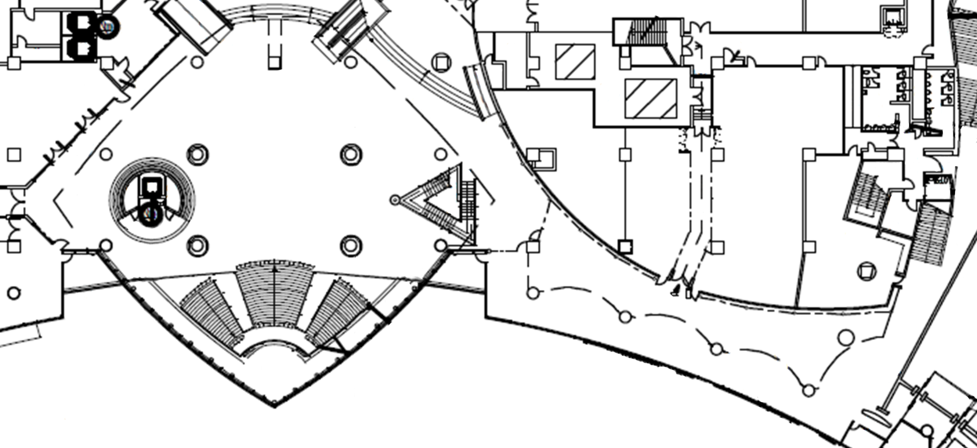

slopes and stairs going towards a (slightly elevated) wide space to the north, where there are a few shops and escalators and elevators for accessing the rest of the building
y direction
approximate location of origin of coordinate system of the dataset
x direction
N
ferry ticket shop entrances
escalator going down (to parking lot)
there are shops on this side of the corridor, so some people exit from the tracking area here
stairs to third floor
corridor continues (toward convenience store, ferry waiting room, and elevators to offices for people who work in the building)
corridor continues
(toward train station)
this area is traversable, but not covered by tracking system. some people pass through here
stairs going down (for exiting the building)
restaurant entrance
this area is traversable, so some people may enter it and stop being tracked
exit toward east part of ATC
10m

