Slide 1
RFQ – Diagnostic Service Tool

Slide 2
Revision History
Issue no. | Page no. | Rev no. | Reason for Change | Date | Updated By
1 | 1-15 | 0 | Initial release | 16-04-2026 | PRR

Slide 3
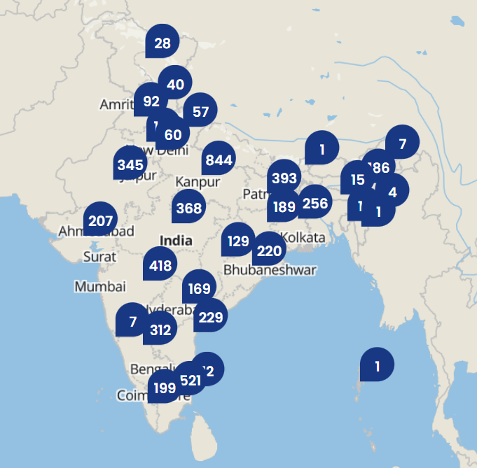
DEPLOYMENT COVERAGE & DEALER NETWORK SUPPORT
The proposed diagnostic solution shall be designed to support deployment across the entire dealer network of TVS Motor Company, covering both domestic and international operations.
Currently, the dealer network consists of:
Approximately 4000 domestic dealers (India)
Approximately 1000 International Business (IB) dealers across multiple countries
Key Requirements:
The system architecture (server, application, and VCI hardware) must be scalable and capable of supporting global deployment across all dealer locations.
The solution should ensure consistent performance and accessibility irrespective of geography, including regions with varying network conditions.
The server infrastructure must be designed to support:
Multi-region access
Load balancing and high availability
Low-latency communication for diagnostics and flashing operations
Commercial & Rollout Expectation:
The diagnostic tool is intended to be standardized and mandated across all dealer locations.
All domestic and IB dealers are expected to procure and adopt the solution as part of the service ecosystem.
Scalability Considerations:
The system should support future expansion of dealer network without major architectural changes.
Provision for regional customization (if required) while maintaining a unified core platform.

Slide 4
PROJECT ROADMAP
Phase 1 – Pilot Deployment (Current Year)
Initial deployment will be carried out at a pilot dealer location – Neo Motors, Bannerghatta
Objectives of pilot phase:
Validate end-to-end diagnostics and ECU flashing workflows
Test VCI hardware performance in real-time conditions
Evaluate user experience and service team feedback
Identify and resolve initial defects and performance issues
Future Roadmap
1. Gradual Rollout
Phase-wise deployment across:
Domestic dealer network
International Business (IB) dealers
2. Software Update Strategy
The system shall support:
Regular software updates for new vehicle models and ECU changes
Over-the-Air (OTA) / Web-based updates for seamless deployment
Version control and backward compatibility
3. Feature Enhancements
Continuous improvement based on:
Dealer feedback
Service team requirements
New vehicle technologies
Planned enhancements may include:
Advanced diagnostics features
AI-based flashing optimization
Improved UI/UX
Enhanced automation (e.g., Smart campaigns)
4. Scalability & Performance
Architecture should be designed to:
Handle increasing number of users and devices
Support high data throughput for diagnostics and flashing
Enable multi-region deployment with optimized performance
5. Maintenance & Support
Supplier shall provide:
Ongoing technical support and maintenance plan
Bug fixes and performance updates
Documentation for future enhancements

Slide 5
HARDWARE COMPATIBILITY
1.Protocol Compatibility
The VCI prototype must support all major automotive diagnostic communication protocols, including:
CAN , CAN FD (for current and future vehicle platforms)
KWP2000 (ISO 14230)
K-Line (ISO 9141)
This ensures compatibility across:
Legacy vehicle platforms
Current production vehicles
Upcoming vehicle architectures
2. Communication Interfaces
The VCI hardware shall support multiple connectivity options:
Wi-Fi (Mandatory – Primary Interface):
High-speed diagnostics and ECU flashing
Software updates and log file transfer
Bluetooth (Optional / Secondary):
Short-range diagnostics
Limited use cases due to lower speed
USB Type-C (Mandatory):
Wired communication
Debugging and development support
Firmware update and recovery
3. Cross-Platform Compatibility
The VCI must be compatible with multiple operating systems:
Linux Windows Android
The device shall expose standard REST APIs / drivers to enable seamless integration with:
Web-based diagnostic applications
Tablet, PC, and mobile platforms
4. Memory Requirements
The VCI shall include a minimum of 32 MB non-volatile flash memory
This memory will be used for:
Temporary storage of ECU flash files
Log buffering
Firmware and diagnostic data handling
5. Compliance & Certification
The VCI hardware must comply with CE Certification standards for acceptance of the tool at global level
6. User Interface & Indications
The hardware shall include:
LED indicators for status (power, connection, data transfer, error)
Buzzer alerts for user notifications (connection success/failure, flashing status)
This ensures ease of use for technicians in service environments.

Slide 6
COMMERCIAL EXPECTATIONS & PRICING MODEL
1.Initial Design & Development Cost (One-Time)
Cost for:
Hardware design
Prototyping
Firmware development
Testing and validation
2. Manufacturing & Supply Cost (Recurring)
Per-unit cost for:
Mass production
Supply to dealers
Cost should be optimized for large-scale deployment across dealer network

Slide 7
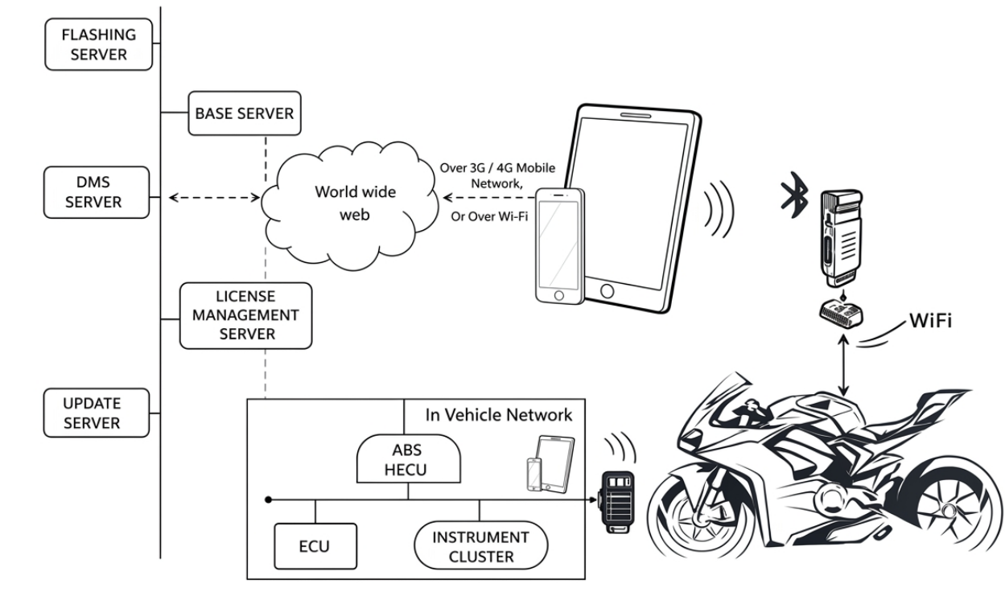
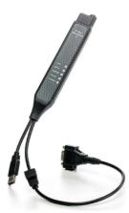

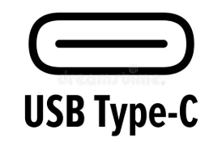

EXPECTED SERVER CLIENT ARCHITECTURE
Central server storing and distributing ECU flash files for programming
Local server acting as bridge for communication and real-time processing
Manages dealer operations and ensures diagnostics are linked to job card closure
VCI
Controls user access, authentication, and software licensing
OBD PORT
Provides latest software updates and new vehicle data

Slide 8
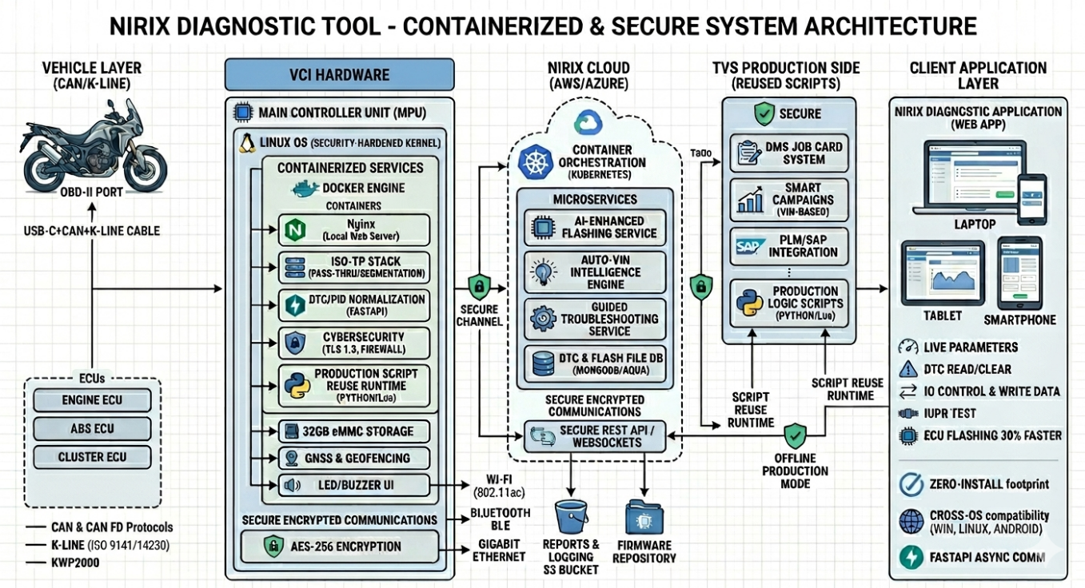
EXPECTED CONTAINERIZED & SECURE SYSTEM ARCHITECTURE
Note : It is intended only as a reference for understanding the overall approach and does not define the exact supported technologies or security implementations.
Propose and share a finalized, detailed technical architecture covering all aspects of system design, scalability, security and deployment for the development of the solution.

Slide 9
EXPECTED REQUIREMENTS FOR SERVER SPECIFICATIONS
The server architecture should support:
Local Server (Edge Deployment) at dealer level for fast diagnostics and flashing
Central/Cloud Server (Optional / Future Scope) for:
Data synchronization
Updates and analytics
Remote monitoring
The solution must be scalable to support multi-region deployments.
Platform & OS Support
The server shall support:
Linux
Windows
Must specify:
OS version compatibility
Any required licenses
Application & Middleware Requirements
Support for web-based application hosting
Backend support using:
Node.js / Python / Java (any suitable framework)
REST API support for communication between:
VCI ↔ Server Server ↔ Client (UI)
Database Requirements Support for:
Relational Databases (PostgreSQL / MySQL)
NoSQL (MongoDB – optional for logs/JSON data)
Database should store:
DID, DTC, CVN data , Flash files metadata
Logs and diagnostics history , User and access control data
Performance & Scalability Should support:
Multiple concurrent users (dealers/technicians)
High-speed data transfer for flashing
Low latency communication
Must be: Horizontally scalable, Capable of handling future increase in load
Security Requirements
Secure communication (HTTPS, TLS encryption)
Role-based access control (Admin / Developer / Operator)
Data protection for:
Vehicle data, Customer data , Flash files
Protection against: Unauthorized access , Data tampering
Update & Maintenance
Support for:
Remote software updates
Patch management
Backup and recovery mechanisms

Slide 10
AQ POINTS
S.No | AQ’s
1 | Sleek and modern, now 30% faster, intuitive and user friendly with a revamped interface featuring 20 new capabilities for handling multiple protocols.
2 | Auto VIN Detect Intelligence. The app seamlessly connects with the Tech Pro VCI to automatically read the VIN from the vehicles ECU.
3 | Whether it's scanned over UDS or K line over KWP, it adapts intelligently, selecting the vehicle and variant flawlessly, ensuring 100% reliability every time
4 | Unlocking apps, key features, diagnostics, ECU flashing, DTC library, CVN library all just a tap away.
5 | No more manual selection of flash files, no more errors.
6 | Features available - fault codes for quick diagnostics, real time battery voltage monitoring, alerts for any new ECU software updates, ECU communication status along with other key details.
7 | Vehicle health Report
8 | Live tracking with an instinctive interface that categorises parameters for quick access to crucial data, making diagnosis effortless.
9 | Encounter a negative response? Just tap the info button for insights into NRC courses and unlock practical solutions with ease.
10 | Active DTCs gets displayed at the top for a quick overview in the Read DTC screen.
11 | Freeze frame allows to view the recorded sensor data from the moment the DTC occurs.
12 | Smart troubleshoot and view PDF for finding the sensor location, possible causes for the DTC and troubleshooting steps
13 | Guided Troubleshooting provide step by step guidance by the TVS photo map.
14 | Perform write data and IO controls with new enhanced UI.
15 | Info icon to view preconditions ensuring accurate and successful testing every time.
16 | 100% Software Updates ensures all vehicles receive necessary updates as a prerequisite for job card closure
17 | Smart Campaigns - TVS service engineers create campaigns by assigning VIN numbers via the web dashboard. No more manual ECU flashing
18 | DMS Job Card System - Job cards can only be closed after successful flashing, ensuring complete quality, compliance and accountability.
19 | AI based enhancement has reduced flashing time by 30%
20 | Monitor critical information like VIN, battery voltage, CVN and calibration ID before and after flashing.
21 | Scan 2.0 equips technicians with real time tracking, making it easy to identify and resolve issues if flashing encounters any barrier.
22 | Quick troubleshooting with log viewing and screen recording. Troubleshooting are made simpler.
23 | View and share log files. No more searching through device storage.
24 | Floating button is accessible across all the screens, gives quick access to log file sharing, screen recording plus a direct call to toll free number for instant support.

Slide 11
PROJECT TIMELINE
POC (Proof of Concept) Delivery:
Complete development and delivery of initial working prototype by May 2026
POC should include:
Basic diagnostics functionality
Initial VCI hardware integration
Communication with vehicle ECUs
Validation & Trials:
Conduct validation at dealer level by July 2026
Includes:
Real-time testing in service environment
Performance validation (diagnostics & flashing)
Issue identification and resolution
Level 2 Enhancements:
Implement advanced features and improvements by August 2026
Includes:
Performance optimization
UI/UX enhancements
Additional diagnostic and flashing capabilities
Source Code & Ownership
Must provide complete source code, including:
Application software
Firmware (VCI)
Supporting libraries and APIs
Knowledge Transfer (KT)
Must conduct comprehensive knowledge transfer sessions for the TVS team, covering:
System architecture (hardware & software)
Code structure and logic
Diagnostic and flashing workflows
Deployment and maintenance procedures

Slide 12
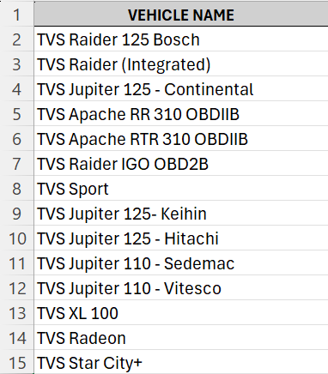
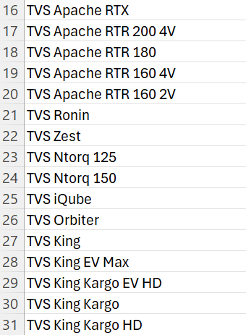
LIST OF VEHICLE MODELS TO BE COVERED

Slide 13
DATAS FOR EACH MODEL
Jupiter 125 Continental - Benchmarking.pptx
TVS Apache RTR310 OBDIIB - Benchmarking.pptx
TVS Apache RR310 OBDIIB - Benchmarking.pptx
TVS JUPITER 110 Sedemac - Benchmarking.pptx
TVS JUPITER 110 VITESCO - Benchmarking.pptx
TVS Jupiter 125 Hitachi - Benchmarking.pptx
TVS Radeon - Benchmarking.pptx
TVS Raider 125 Bosch \u0026 Integrated - Benchmarking.pptx
TVS Raider IGO OBDIIB - Benchmarking.pptx
TVS Sport - Benchmarking.pptx
TVS XL 100 - Benchmarking.pptx
TVS iQube - Benchmarking.pptx
TVS Orbiter - Benchmarking.pptx

Slide 14
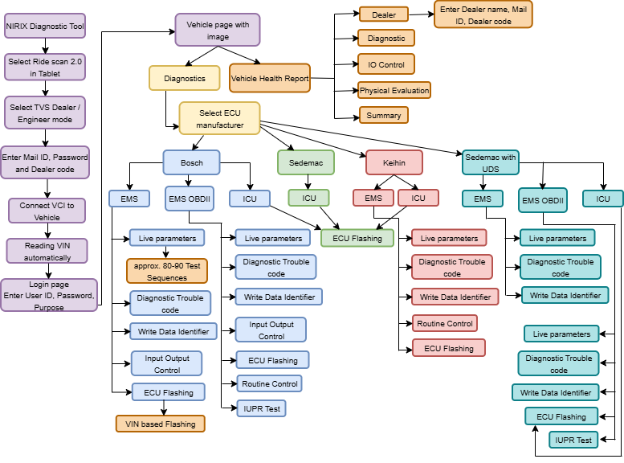
FLOW AND FEATURES TO BE ADDED - REFERENCE

Slide 15
THANK YOU

