Slide 1
Whom to Silence, Whom to Amplify
Centrality-Targeted Hybrid Control of Rumour–Correction Competition on Social Networks
A leakage-controlled re-implementation and extension of the SAIR model (Li et al., IEEE Transactions on Big Data, 2026), tested on the PHEME Twitter rumour dataset: Charlie Hebdo, Sydney Siege and one Ottawa story
Nivithasri A · Project report and presentation · October 2026

Slide 2
The problem: rumours and corrections compete
Two levers, three questions
What happens in a crisis
• False or unverified claims spread within minutes, and corrections follow while the rumour is still growing.
• Both messages draw from the same pool of users who have not yet taken a side, so they compete for attention.
What a platform can do
• Silence: block rumour accounts or remove their posts (moves spreaders out of the conversation).
• Amplify: run a fact-check campaign or recruit credible accounts to broadcast the correction.
• Either lever can be aimed at all users or at selected, well-connected accounts.
Questions of this project
• 1. Does the published SAIR model fit real rumour data when it is implemented faithfully and without information leakage, and do its per-user factors (emotion, popularity, content fit, connectivity, friend power) matter?
• 2. Given a model that fits, how should blocking and a correction campaign be combined, and at what effort?
• 3. Whom should the intervention target: hubs by degree, PageRank, betweenness, or random accounts?
Approach
• Re-implementation → honest model contest with validation → ablation → control model SAIR-C → targeting on the real follow graph and on synthetic scale-free networks.

Slide 3
The base paper: SAIR (Li et al., 2026)
Malicious vs anti-malicious information on a layered network
Model
• Four states: S not yet sided, I spreads the rumour, A spreads the correction, R stopped.
• Each user's push toward the rumour: Drif1 = sigmoid((2·P1 − 1)·Mult_eff), with P1 = share of the user's sided friends who support the rumour. Drif2 = 1 − Drif1.
• Mult_eff comes from a regression on emotion similarity, popularity, content fit, influence of higher / lower network layers and group attraction.
• Population drives δ1 = mean Drif1 over susceptible users, δ2 = 1 − δ1, which enter the rate equations (Eq. 26).
Claims we test
• Good fit to Twitter data; every push factor matters (Fig. 7); the strong layer and active groups push harder (Fig. 8); own traits matter early, external factors later (Fig. 6).
# | Problem in the paper | Our fix
C1 | Eq. 26 attaches δ1 to A and δ2 to I | δ1 drives I, δ2 drives A
C2 | Eq. 24 binomial looks like a new quantity | its mean is Drif, so δ = mean Drif
C3 | 'Initiative' never defined | dropped
C4 | regression target unspecified | first side is I (sided users)
C5 | similarity + raw mutual-friend count | Jaccard of friend lists
C6 | γ used twice | group weight renamed w_part
• Six corrections were needed before the model could be run at all; all are logged in DECISIONS.md.

Slide 4
Data: PHEME rumour threads
The only public set with stance labels, follow edges and retweets together
Set | N (posters) | I users | A users | neutral | bin (min) | window (h)
Charlie Hebdo | 8251 | 7389 | 157 | 705 | 60 | 135
Sydney Siege | 3105 | 2834 | 148 | 123 | 60 | 46
Ottawa story | 721 | 441 | 266 | 14 | 15 | 31
Leakage controls
• User features use only the user's own posts written before taking a side, plus the profile; retweeted text is never used.
• Friend power counts only timestamped replies and retweets received before the user's entry.
• PageRank on follow edges only; groups from profile features, not from shared retweets.
• Tripwire: every single feature must have AUC ≤ 0.95 for the side taken. Highest observed: 0.763 (friend power, Ottawa story), explained by pre-entry social proof.
• Within threads that contain both sides, the friends' majority P1 predicts the side at chance level: its overall separation is thread identity.
• Only FALSE and UNVERIFIED stories are kept: supporters of true news are not rumour spreaders.
• A user's side is fixed by their first support or deny post; users who only ask or comment stay susceptible.
• Fitting target: cumulative entry curves C_I(t), C_A(t), trimmed at 99% + 12 h.
• N counts posting users only, so shapes and timing are compared, not peak heights.
• Follow edges exist only among each thread's participants (a limitation for every network quantity).

Slide 5
The paper's flaw: Eq. 26 cannot let both sides grow
A structural result (proof in the report, Section 4.2)
Corrected Eq. 26 with δ2 = 1 − δ1
• dI/dt = I·(δ1·S − (1 − δ1)) > 0 ⇔ δ1 > 1 / (1 + S)
• dA/dt = A·((1 − δ1)·S − δ1) > 0 ⇔ δ1 < S / (1 + S)
• For S in [0, 1]: S/(1 + S) ≤ 1/2 ≤ 1/(1 + S), so both conditions can never hold together.
Consequence
• At any moment at most one of rumour and correction can grow. In the data both grow together in the first hours of every set, and the paper itself describes this 'cooperative' phase.
• The model reduces to source pulses followed by decay, and fits worst of all nine candidates.
Set | AIC Eq. 26 (c) | AIC main model | Eq. 26 worse by
Charlie Hebdo | -1064.8 | -1657.7 | 593.0
Sydney Siege | -384.8 | -684.7 | 299.9
Ottawa story | -1334.9 | -1952.8 | 617.8
• Lower AIC is better; a difference above about 10 is decisive here.
• This is why we keep the paper's mechanism (the friends'-majority drive) but change the equations.

Slide 6
Our model: SAIR-H+
SAIR rates driven by the friends' majority, plus Bass external influence and source injection
Equations
• dS = −β·δ1·I·S − α·δ2·A·S − (η_I + η_A)·S
• dI = β·δ1·I·S + η_I·S − γ·I
• dA = α·δ2·A·S + η_A·S − ε·A
• dR = γ·I + ε·A
• I grows iff β·δ1·S > γ and A grows iff α·δ2·S > ε: independent conditions, so co-growth is possible.
Mechanisms
• Friends'-majority drive δ1 from data friend counts, re-weighted by the model's own curves, so interventions feed back.
• Bass (1969) external influence η: users meet rumours and corrections outside the observed population.
• Source injection θ: each source tweet moves θ·w_s/Σw of the population into I or A, w_s = log(1 + author followers).
Nine models compared
• (a) constant rates, (a+) with Bass; (b), (c) Eq. 26; (d) SAIR-H, (d+) with Bass; (d)-uniform and (d+)-uniform with the same push κ for every user; (e) mean-field.
Fitting protocol
• Least squares on normalised cumulative curves; AIC per set and in total.
• Bounded Nelder–Mead in log space, rates in [1e-3, 50] per hour, 20–25 random starts plus cross-model starts.
• Euler steps in a numba kernel, bitwise identical to the Python loop; every run checkpointed.
Main model
• (d+)-uniform: best total AIC over the three sets, so one model serves every event in the control experiments.

Slide 7
Model contest
AIC per set and in total (lower is better)
Model | k | AIC Charlie Hebdo | AIC Sydney | AIC Ottawa story | AIC total
(a) constant-rate SAIR | 5 | -1563.0 | -460.2 | -1859.1 | -3882.3
(a+) constant-rate + Bass | 7 | -1570.6 | -658.8 | -1954.6 | -4184.1
(b) Eq. 26, uniform drive | 2 | -1066.5 | -386.8 | -1337.5 | -2790.8
(c) Eq. 26 (corrected) | 3 | -1064.8 | -384.8 | -1334.9 | -2784.5
(d) SAIR-H | 7 | -1583.1 | -456.6 | -1880.8 | -3920.4
(d+) SAIR-H + Bass | 9 | -1587.8 | -680.4 | -1950.8 | -4218.9
(d) SAIR-H, uniform drive | 6 | -1661.5 | -458.7 | -1877.0 | -3997.2
(d+) SAIR-H+, uniform drive (main) | 8 | -1657.7 | -684.7 | -1952.8 | -4295.2
(e) SAIR-H mean-field | 7 | -1559.0 | -456.2 | -1876.9 | -3892.1
• Main model total AIC -4295.2; next best (d+) -4218.9.
• The drive adds information: main beats (a+) by 87.1 AIC on Charlie Hebdo and 25.9 on Sydney; on the story κ fits to 0.
• Bass is decisive where corrections start before any denying source: (a+) beats (a) by 198.6 on Sydney.
• The paper's regression ranking adds nothing: the uniform drive beats the ranked one by 78.4 AIC on Charlie Hebdo.
• κ, w and α are not identifiable from cumulative curves; their values are never interpreted.

Slide 8
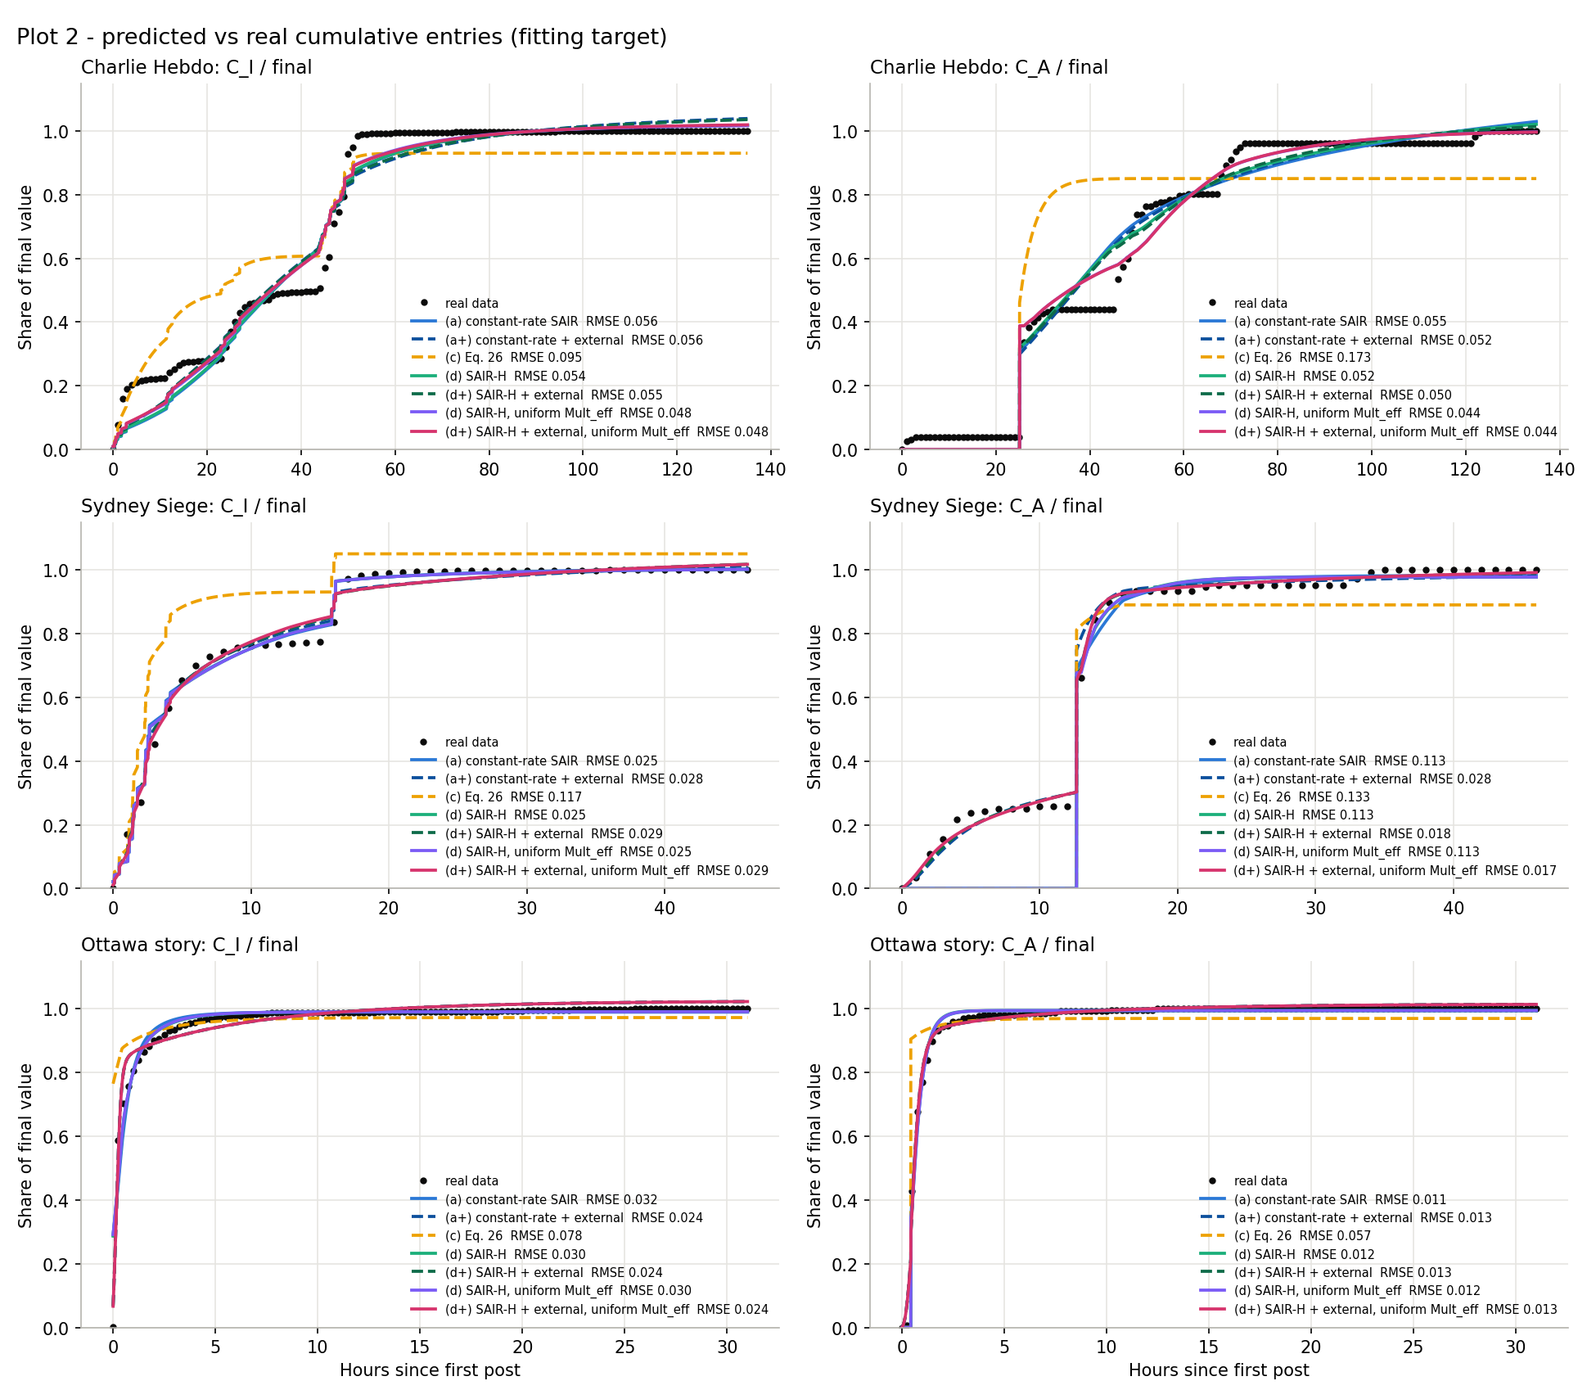
Validation: fits, forecasts, recovery
How far the main model can be trusted
Set | cut (h) | (a) | (a+) | main | (d)-unif.
Charlie Hebdo | 44.00 | 0.328 | 0.361 | 0.331 | 0.366
Sydney Siege | 9.00 | 0.360 | 0.366 | 0.328 | 2.468
Ottawa story | 2.25 | 0.109 | 0.036 | 0.028 | 0.109
• Table: held-out pooled RMSE after the cut. The main model forecasts as well as or better than constant rates; no model can forecast a later wave before its source tweets appear.
• Parameter recovery (Charlie Hebdo, 5 noise seeds × 10 starts): only 1 of 5 seeds reached the noise floor, so the 8-parameter fit needs many starts.
• Extra starts (30 per seed + one at the truth): from the truth every seed reaches the noise floor and β, α, γ, ε, θ are recovered; κ is not identifiable. Random starts reach the floor in 2 of 150 runs: the earlier failures were the optimiser.
• Moving-block bootstrap: κ on Charlie Hebdo in [4.8, 50.0], reaching the bound of 50.
Fitted cumulative curves of all models

Slide 9
What drives the spreading: ablation
Refit ΔAIC > 0 means the component is needed
Main model: knock-out | ΔAIC CH | ΔAIC SS | ΔAIC story | peak Δ% CH
network P1 → global share | 95.9 | -1.2 | 0.0 | 0.6
source injection θ = 0 | 305.4 | 184.3 | 70.9 | -52.3
Bass external η = 0 | -3.8 | 226.0 | 80.8 | -1.4
• Source injection is essential everywhere (ΔAIC 305.4 on Charlie Hebdo; without it the rumour peak falls by 52.3%).
• Bass external influence is decisive on Sydney (ΔAIC 226.0) and the story.
• The friends'-majority network matters on Charlie Hebdo (ΔAIC 95.9).
• None of the paper's per-user factors matters: each moves the rumour peak by about 1% or less, and several refits are better without them (popularity: -38.6 AIC on Charlie Hebdo).
• Reason: almost all users enter by retweet, so only profile text exists before entry; the leak-free features are weak.
Paper-faithful model: factor | ΔAIC CH | ΔAIC SS | peak Δ% CH
emotion (S_emo = 1) | 6.2 | 0.1 | 0.1
popularity (Pop = 1) | -38.6 | -0.8 | 0.9
content fit (Info_match = 1) | -0.1 | 0.0 | 0.0
connectivity (co = 1) | -24.6 | -4.9 | 0.9
friend power (fp = 1) | -10.3 | 0.4 | 0.4

Slide 10
The paper's claims against our results
Same model family, leak-free features, real data
Paper claim | Our result | Verdict
Eq. 26 fits the data well | Worst of nine models in every set; cannot produce co-growth | Does not match
Fig. 7: no popularity → push never peaks | Peak changes by under 1%; refit better without popularity | Does not match
Fig. 7: no emotion → much lower peak | At most about 0.4% change | Does not match
Fig. 7: no content fit / connectivity / friend power → lower, later peak | About 1% or less, partly the opposite sign | Does not match
Fig. 8: the strong layer pushes harder | Yes on Charlie Hebdo, not on Sydney | Partly
Fig. 8: push rises with group activity | Sign follows each set's regression coefficient | Partly / does not match
Fig. 6: own traits early, external later | Only two usable windows; own share falls between them | Partly at most
• What the data do support: SAIR-type contact and removal rates, source injection, external influence, and the friends' majority as a near step-like 'follow the majority' rule on Charlie Hebdo.

Slide 11
Control: SAIR-C
Blocking (u: I → B) and a correction campaign (v: S → A), compared at equal effort
Set | effort | block D/D0 | refute D/D0 | hybrid D/D0
CH | 2% | 0.974 | 0.970 | 0.971
CH | 5% | 0.934 | 0.930 | 0.929
CH | 10% | 0.865 | 0.370 | 0.016
Sydney | 2% | 0.977 | 0.970 | 0.974
Sydney | 5% | 0.942 | 0.918 | 0.925
Sydney | 10% | 0.884 | 0.263 | 0.290
Story | 2% | 0.925 | 0.923 | 0.924
Story | 5% | 0.800 | 0.806 | 0.801
Story | 10% | 0.526 | 0.623 | 0.541
Set-up
• Knobs scaled to each event: u = λu·γ, v = λv/T90 (the fitted rates differ by about 300× between sets).
• Damage D = ∫I dt relative to no control (D/D0); effort = fraction of N blocked plus fraction reached by the campaign.
• Each strategy's best point at exactly equal total effort (2%, 5%, 10% of N).
Result
• At 2–5% effort the strategies tie within a few points.
• At 10%: the hybrid tips Charlie Hebdo (D/D0 0.016, final C_A 0.92), refutation wins on Sydney (0.263) and blocking on the story (0.526).
• 'Hybrid is best' is not a general result; a weighted cost J favours hybrids partly by construction.

Slide 12
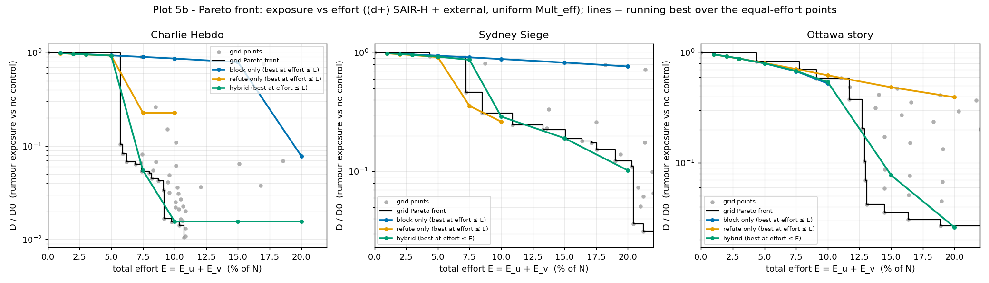
Is the tipping robust?
Charlie Hebdo at 10% effort under refits
Pareto front: exposure D/D0 against total effort
CH variant | κ | ΔAIC | hybrid D/D0 | final C_A | tipped
main | 12.48 | 0.0 | 0.016 | 0.92 | yes
kappa5 | 5.00 | 28.7 | 0.013 | 0.94 | yes
kappa12.5 | 12.50 | -2.0 | 0.016 | 0.92 | yes
kappa25 | 25.00 | -1.5 | 0.036 | 0.94 | yes
kappa50 | 50.00 | -0.8 | 0.037 | 0.94 | yes
fb_half | 0.09 | 100.9 | 0.720 | 0.32 | no
• κ is not identifiable, so it was fixed at 5–50 and the rest refitted: the tipping survives every κ.
• With the fallback P1 = 0.5 for users without sided friends the fit is worse by 100.9 AIC and nothing tips.
• Freezing δ1(t) removes up to 70.0% of the refute effect: the feedback runs through that fallback.

Slide 13
Targeting on PHEME: who to block
k = 50 accounts chosen on the follow graph
Set | action | degree | PageRank | betweenness | random ± CI
CH | block | 0.532 | 0.160 | 0.035 | 0.001 ± 0.002
CH | recruit | 0.977 | 0.977 | 0.977 | 0.975 ± 0.000
CH | hybrid | 0.985 | 0.985 | 0.973 | 0.970 ± 0.000
Sydney | block | 0.078 | 0.078 | 0.004 | 0.000 ± 0.000
Sydney | recruit | 0.974 | 0.974 | 0.974 | 0.973 ± 0.000
Sydney | hybrid | 0.996 | 0.985 | 0.982 | 0.968 ± 0.000
Story | block | 0.374 | 0.374 | 0.000 | 0.125 ± 0.101
Story | recruit | 0.926 | 0.925 | 0.926 | 0.908 ± 0.002
Story | hybrid | 0.975 | 0.977 | 0.875 | 0.840 ± 0.019
• Reduction of rumour exposure 1 − D/D0 (recruit scale s = 1).
• Block = accounts that would spread the rumour: they stop counting as rumour friends, and their source tweets lose their injection.
• Charlie Hebdo, block by degree: 0.532; friend-count channel alone 0.001, injection channel alone 0.502.
• So hubs win because they are the rumour's source authors, not because of conformity.
• At s = 1 every recruit injects like a news source and even random recruiting saturates: the next slide fixes this.

Slide 14
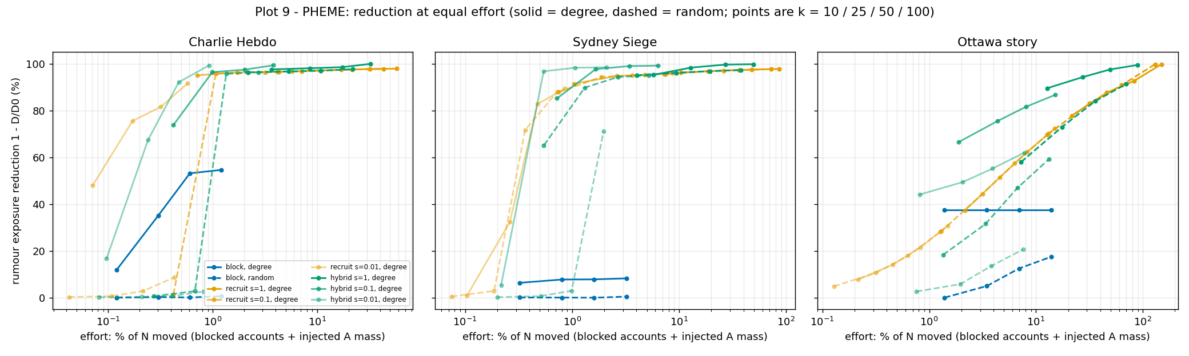
Targeting on PHEME: equal effort
Effort = % of N moved (blocked accounts + injected correction mass)
Reduction against effort; solid = degree, dashed = random
CH effort | block: degree [random] | recruit: degree [random] | hybrid: degree [random]
≤ 0.25% | 0.120 [0.000] | 0.755 [0.028] | 0.674 [0.004]
≤ 0.50% | 0.352 [0.003] | 0.815 [0.086] | 0.921 [0.007]
≤ 1.00% | 0.532 [0.003] | 0.950 [0.086] | 0.993 [0.028]
≤ 2.00% | 0.546 [0.006] | 0.963 [0.958] | 0.993 [0.957]
≤ 5.00% | 0.546 [0.006] | 0.963 [0.965] | 0.993 [0.964]
• With a small injection (s = 0.01) centrality matters: recruit 0.815 by degree vs 0.028 at random.
• An interaction: injection alone 0.005, friend counts alone 0.105, both 0.815.
• Recruit beats block at equal effort; hybrid is best from about 0.5–1% of N; same order at both ends of α's CI.

Slide 15
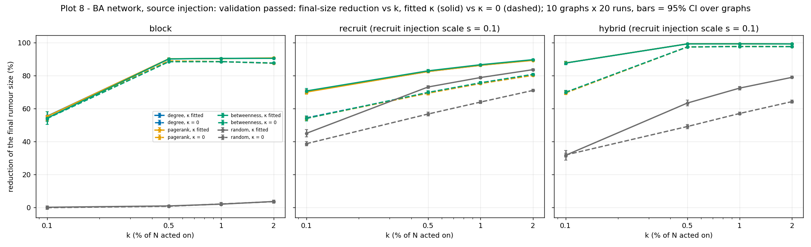
Targeting on Barabási–Albert networks
Agent-based SAIR-H+, 10 graphs × 20 runs, source injection on hubs
Final-size reduction against k; fitted κ (solid) and κ = 0 (dashed)
action, k | degree | PageRank | betweenness | random
block, 0.5% | 90.2% | 90.3% | 90.2% | 0.9%
block, 2.0% | 90.5% | 90.7% | 90.5% | 3.5%
recruit, 0.5% | 82.5% | 82.5% | 82.9% | 73.1%
recruit, 2.0% | 89.4% | 89.3% | 89.7% | 83.6%
hybrid, 0.5% | 99.3% | 99.3% | 99.3% | 63.3%
hybrid, 2.0% | 99.2% | 99.2% | 99.3% | 79.0%
• Calibrated (β×2, α×0.1) and validated: final C_I 0.879 vs 0.895 in the data, final C_A 0.025 vs 0.019, rumour peaks first; shape RMSE 0.134 (moderate).
• Hubs beat random by a wide margin; the three centralities pick the same hubs.
• Blocking works because hubs carry the source injection; conformity matters more for recruiting.

Slide 16
Limitations
What these results can and cannot support
• Posters-only population: silent readers are not observed, so peak heights are not comparable with the paper and '% of N' means % of the modelled population.
• The follow graph is collected per thread, so network quantities partly reflect participation; P1's separation is thread identity.
• Text features are weak: almost nobody writes before taking a side, so emotion and content fit rest on profile descriptions.
• κ (and w) are not identifiable from cumulative curves; random starts rarely reach the optimum of the 8-parameter fit.
• The Charlie Hebdo tipping depends on the global-share fallback for users without sided friends.
• The BA agent model is a calibrated analogue: two rates were rescaled to pass validation and the time profile matches only moderately.
• Control knobs are constant and act from t = 0; time-varying optimal control is not studied.
• Two events and one story, one platform; in both events the corrections come mostly from one story with almost no supporters.

Slide 17
Conclusions
Whom to silence, whom to amplify
• The published SAIR equations cannot describe a rumour and its correction growing together; a corrected, simpler structure (SAIR-H+) fits all three data sets best, and the paper's per-user factors are not supported once leakage is removed.
• What drives the spreading in these data is the broadcast of source tweets, outside influence, and on Charlie Hebdo a 'follow the sided-friends majority' rule.
• There is no universal best control: at equal effort the strategies tie at low effort; at higher effort the best mix depends on the event, and a striking tipping result depends on a modelling choice for users without sided friends.
• Whom to silence: the hubs, mainly because they are the rumour's source accounts. Whom to amplify: well-connected correctors, whose effect comes from shifting their followers' majority together with a small correction mass.
• Every number in the report is generated from the result tables and checked automatically; every decision and negative result is logged.

Slide 18
Future work
Next steps that the limitations point to
• Time-varying optimal control of blocking and refutation (as in Zhong et al., 2026) instead of constant knobs.
• A data set with complete follower graphs and exposure (views), to remove the posters-only limitation and make κ identifiable.
• Agent-based simulation directly on the real follow graph, and more events and platforms.
• Targeting rules that need no global centrality, such as acquaintance immunisation (Cohen et al., 2003).
• Combining the effort-fair comparison with a cost model that reflects real platform costs of blocking and of campaigns.

