Slide 1



The Transformative Impact of Artificial Intelligence on the Workforce
Artificial intelligence (AI) is rapidly transforming various aspects of our lives, including the workforce. This presentation will explore the multifaceted impact of AI on jobs, examining both the opportunities and challenges it presents.
by Nivithra R

Slide 2

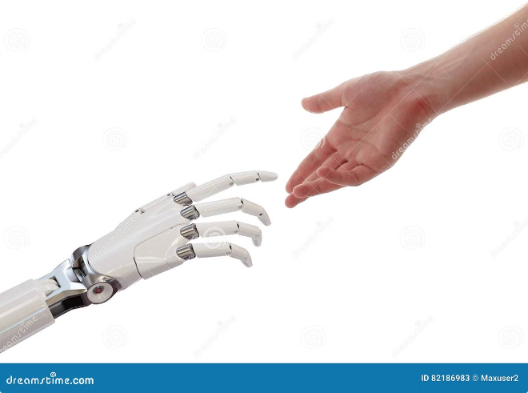
Introduction to AI
AI refers to the simulation of human intelligence in machines. AI systems are designed to perform tasks that typically require human cognitive abilities, such as learning, problem-solving, and decision-making.
1
Applications of AI
AI applications are increasingly prevalent across various industries, including healthcare, finance, transportation, and entertainment.
2
AI in Healthcare
AI is revolutionizing healthcare, from diagnosing diseases to developing personalized treatment plans.
3
AI in Finance
AI-powered systems are used for fraud detection, risk assessment, and automated trading in the financial sector.
4
AI in Transportation
Self-driving cars, traffic optimization, and predictive maintenance are some examples of AI's impact on transportation.

Slide 3

AI Driven Job Advantages
AI can augment human capabilities, leading to increased productivity, job creation, and improved decision-making.
Increased Productivity
New Job Creation
Enhanced Decision-Making
AI automates repetitive tasks, freeing up human workers to focus on more complex and creative endeavors.
The rise of AI has created new job roles, such as AI developers, data scientists, and AI ethicists.
AI's ability to analyze vast amounts of data provides valuable insights, supporting better business decisions and improved customer experiences.

Slide 4

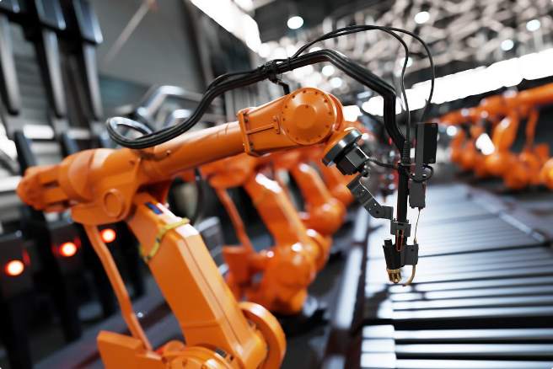



Workforce Disruptions Due to AI
While AI offers numerous benefits, it also presents some challenges, including job displacement, skill gaps, and potential economic inequality.
Job Displacement
Automation can lead to job losses in sectors where tasks can be easily automated, such as manufacturing, clerical work, and customer service.
Skill Gaps
The rapid evolution of AI requires workers to continuously upskill or reskill to remain competitive in an AI-driven job market.
Economic Inequality
The economic benefits of AI may not be evenly distributed, potentially exacerbating existing inequalities between different socioeconomic groups.

Slide 5

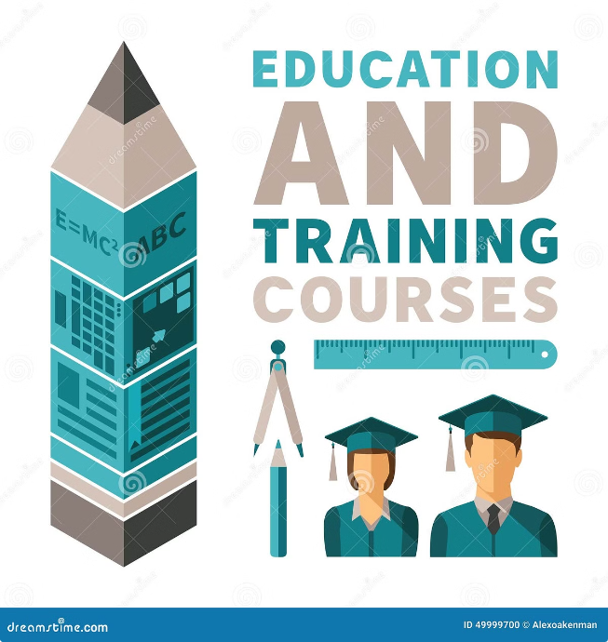
Balancing the Impact
Balancing the impact of AI on the workforce requires a multifaceted approach, including education, policy updates, and ethical AI development.
Education and Training
Investing in education and training programs focused on AI and related fields is crucial to prepare workers for the demands of the future workforce.
Policy and Regulation
Updating labor laws and implementing ethical guidelines for AI development can protect workers' rights and ensure fair use of AI technologies.
Ethical AI Development
Prioritizing the development of AI systems that are free from bias and ensure fair treatment for all users is essential for building trust and promoting responsible AI.

Slide 6


Conclusion
AI is reshaping the workforce, presenting both opportunities and challenges. By proactively addressing potential risks and embracing the benefits, we can harness AI to create a more prosperous and equitable society.
AI
Opportunity
Challenge
Automation
Increased productivity
Job displacement
Data analysis
Enhanced decision-making
Skill gaps
Innovation
New job creation
Economic inequality

Slide 7
Future Outlook
The future of AI in the workforce depends on how we navigate its challenges and leverage its opportunities.
By mitigating potential risks and leveraging the benefits, AI can help create a more fair and thriving society.

