Slide 1
Man in the middle ATTACK ohad Dali
What is MitM attack?
General Methodology.
How HTTPS mitigate MITM
CSRF Attacks

Slide 2
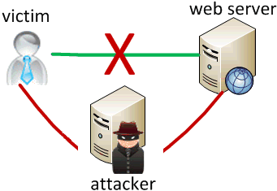
What is MitM attack?
A cyberattack where the attacker secretly intercepts and relays messages between two parties who believe they are communicating directly with each other.
This attack is relatively uncommon in the wired connection, since there are very few places where the attacker can insert himself between two communications terminals.

Slide 3
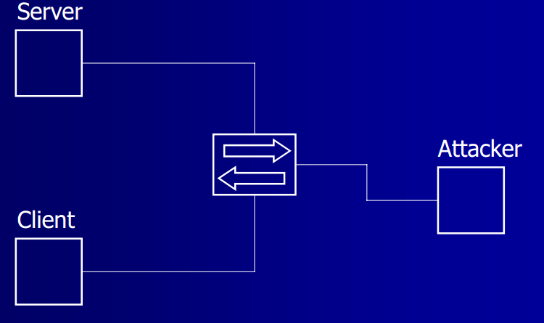
General methodology
This kind of attack is used often in the application layer in the OSI model , and more often base on HTTP.
The attacker splits the original TCP connection into 2 new connection, one between side A and the attacker and the other between the attacker and side B.

Slide 4
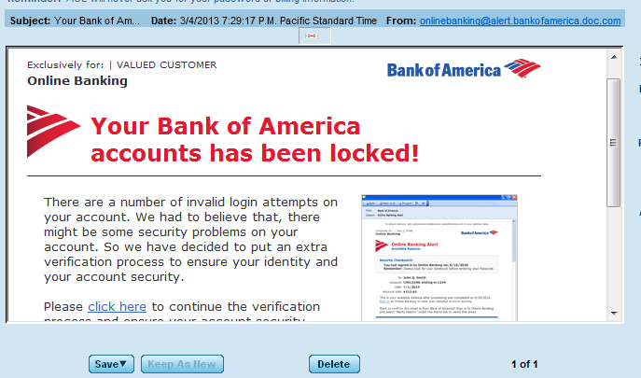
Simple example
An attacker puts up a fake bank website and entices the victim to that website(Phising). User enter his authentication details in the fake website. After that a
Meanwhile the attacker use those details to access to the real website and make changes in the victim account.
For this attack to work ,the attacker need to make sure that the victim will not realize that it’s a fake website.

Slide 5
Attack techniques
ARP poisoning – Sending fake ARP message and route the communication to an a specific computer.
ICMP redirects –using this feature of ICMP the attacker can instruct a router to forward destined for the victim to his machine.
DNS spoofing – The attacker reply to the victim with fake IP address. Also can be done by poisoning the DNS cache.

Slide 6

https
The main motivation for HTTPS is authentication of the visited website and the protection of the privacy and integrity of the exchanged data.
When a browser connects to an HTTPS server , the server will answer with it’s certficate.
HTTPS is based on public/private key cryptography. The public key is stored in the certificate of the server.

Slide 7
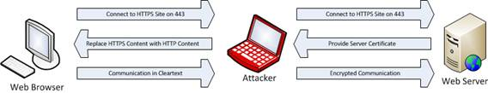
Https against mitm
When using HTTPS , the browser ask for the server’s certificate and checks two things: 1) If the owner info match the server name. 2) If the certificate signed by trusted CA.
Now ,for the attacker it will take more effort to impersonate to the server side.
Using SSLstrip will defeat this protocol.

Slide 8
CSRF attack
Cross Site Request Forgery.
Is a type of attack that occurs when a malicious website causes a user’s web browser to perform an unwanted action on a trusted site for which the user is currently authenticated.
The attack use the fact that the user is authorized on the trusted site.

Slide 9
Csrf example
Let’s assume that a user just logged in to his bank account, and meanwhile visit a malicious website. This website can run a script that send http request to the server for transferring money to the hacker attack.
The request will contain the session id that the user got from the server or the cookie that mention that the user is authorized.

Slide 10
Protection against CSRF
One time key – Using a fresh key for every get request.
Same-origin policy – prevents from malicious script on one page to access to sensitive data on another web page.

