Slide 1
API
Who, what, which, why?

Slide 2
What?
Set of requirements that govern how one application can talk to another
Define how a program will interact with the rest of the world, saving time, resources, and potentially legal entanglements along the way (by choosing what code to expose).
Notes:
-דרישות של איך אפליקציות מדברות אחת עם השנייה
-קובע מה העולם החיצוני רואה ומה לא. חוסך זמן ובעיות אבטחה

Slide 3
Which?
Client-server protocols based on HTTP protocol using requests and responses.
REST (Representational state transfer):
State-less API that relies on HTTP methods (POST, GET, PUT, DELETE, PATCH).
RPC (Remote procedure call):
API relying mostly on HTTP GET/POST methods. Works with requests and responses of specific procedures.

Slide 4
REST
Six constraints:
Stateless: no client context is stored on the server between requests.
Client-Server: separation of concern (next slide).
Cacheable: clients can cache responses. Well cached responses can eliminate some client-server interaction, improving scalability and performance.
Layered System: A client cannot tell if it is connected to an intermediate server or the direct server. Increases security and provides shared caches.
Code on demand: servers can extend the functionality of a client by transferring executable code.
Uniform interface: fundamental design of REST service in order to decouple the architecture.
Requests and response have a common architecture.
Notes:
Coupling – how related two classes are and how dependent they are on each other.

Slide 5
SEPERATION of concern
The principles behind the client-server constraints.
Separate the user interface concerns from data storage concerns (system internals).
Improves portability of user interface across multiple platforms and simplifies server components
Separate the protocol from the API in order to accommodate for all types of protocols to the organization’s API.

Slide 6
RPC
Initiated by the client who sends a request message to a server to execute a specific procedure call with the given parameters. The server replies to the client with the response of executing the method, and the application continues.
Implies a level of location transparency, because calling methods in local and remote locations are usually with the same name.
Advantage of this is that the location of the resource doesn’t matter to either the developer or the end-user.

Slide 7
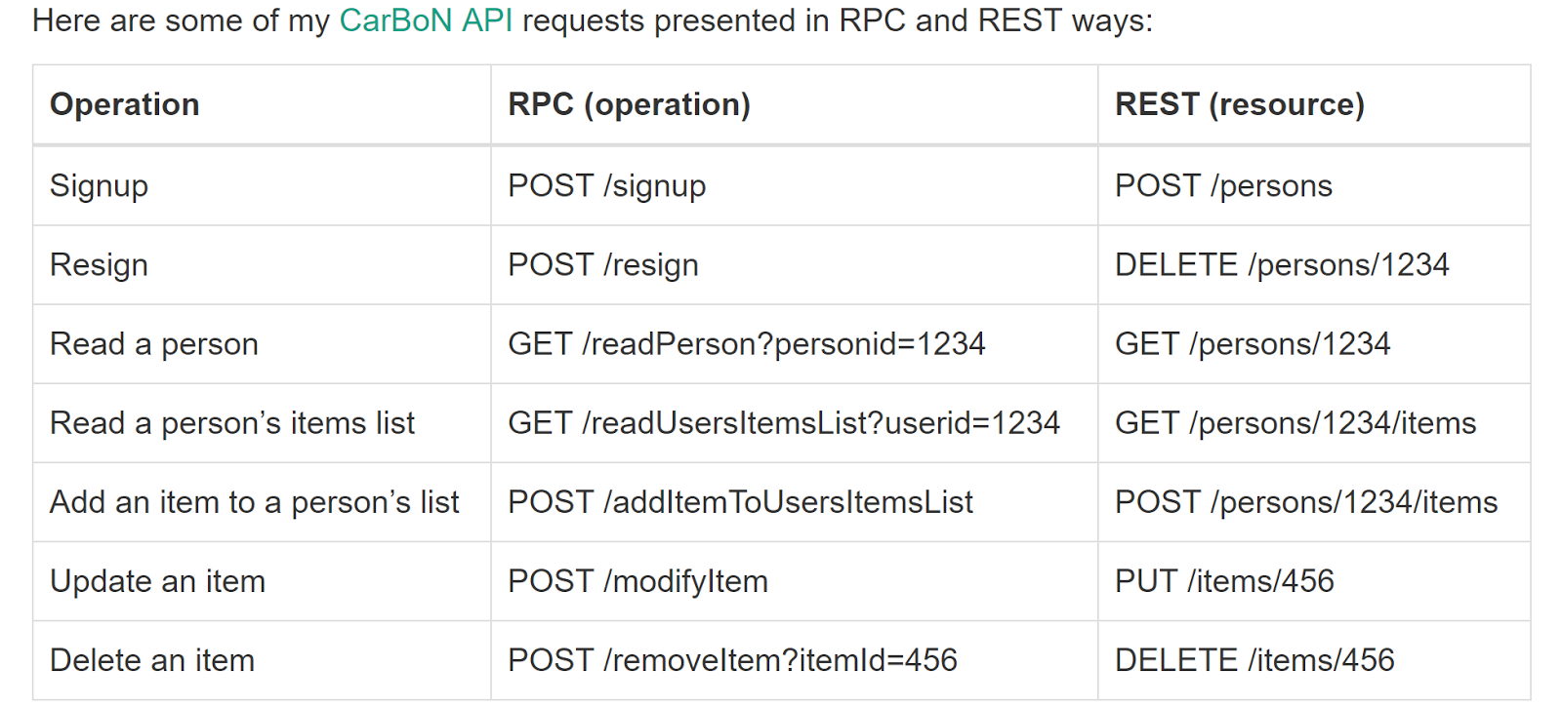
RPC vs rest

Slide 8
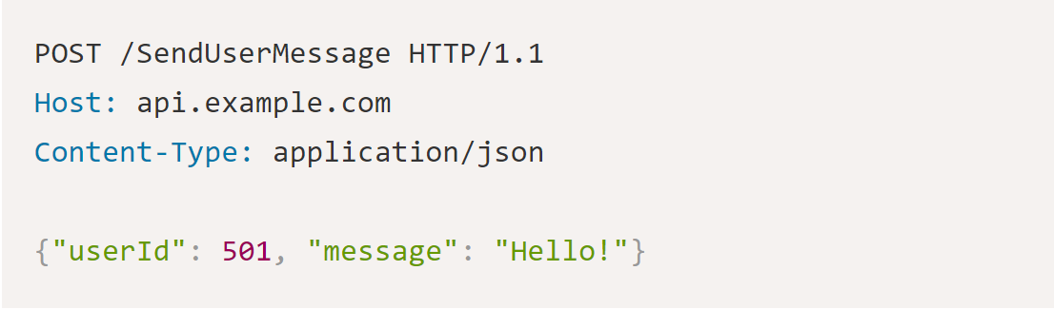
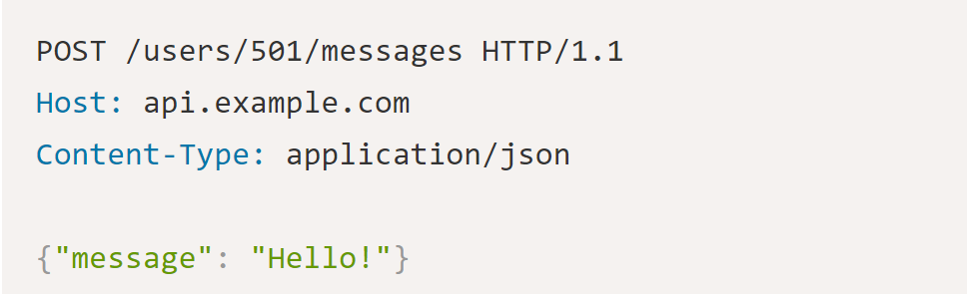
RPC VS REST
Send message “Hello!” to user 501
RPC
REST

Slide 9
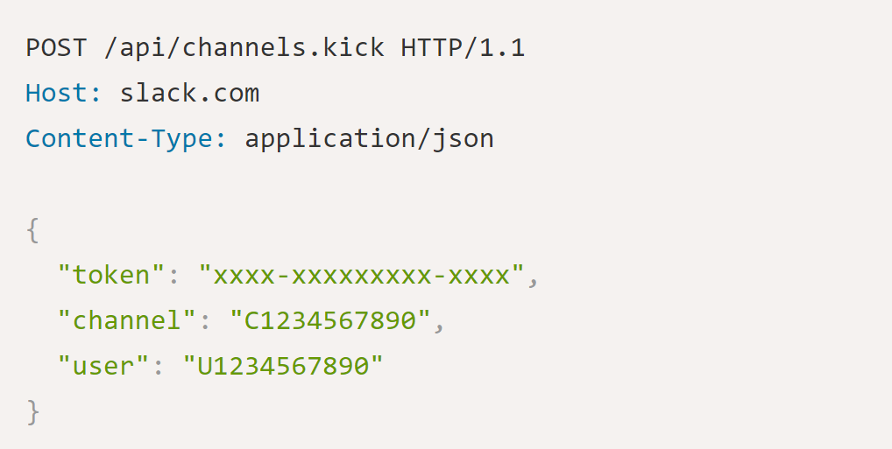
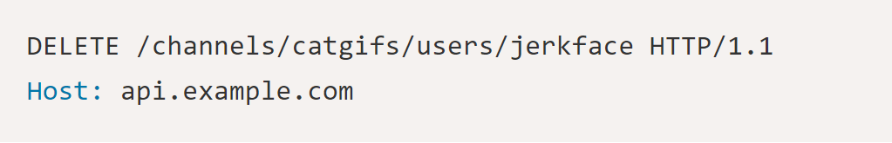
RPC VS REST
Kick user from Slack chat channel.
RPC
REST
Potential issues with REST approach?
Notes:
No kick/ban/exit option for users. Can add collecitons (kick/ban/exit) for each channel that are tied to each resource(user). A lot of extra data.

Slide 10
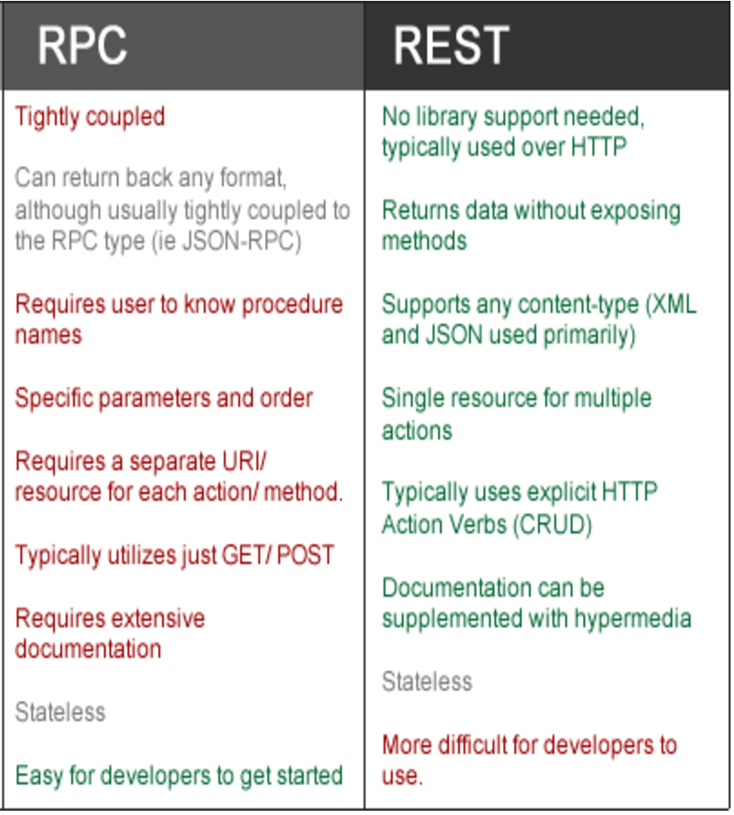
Rule of thumb
If an API is mostly actions, maybe it should be RPC.
If an API is mostly CRUD (create, read, update, delete) and is manipulating related data, maybe it should be REST
If both, it is possible to use both to get the best of both worlds.

Slide 11
How?
Key questions to ask when designing an API:
Who is our target user for this API
Which of our products/ services do we want them to be working with?
What are their use cases for integrating with our API?
What technologies will they be using to integrate with our API?
What other services will they want our API to interact with?

Slide 12
API DESIGN
-Think long-term
API needs to be flexible to meet new technological advances.
Clarity
Proper name conventions for methods to help end-users and software developers that wish to integrate with the API.
Documentation
Provide proper documentation for each method, with the requests and responses that it needs.

Slide 13
API DESIGN TOOL
www.apiary.com
Integrated with GIT repository
Includes documentation, editor, and testing of the API

