Slide 1

Practice Experiences for School Reintegration (PrESR)
Prototype Demonstration

Slide 2

Introduction to the PrESR
Mixed-Reality Supplement to hospital treatment (CBT)
Designed to enhance inpatient treatment
Aims to support transfer of skill learning to schools and improve school re-entry following hospitalization for suicide-related crises
Click to "virtual reality" by Alberto Cinco Jr. is licensed with CC BY-NC-ND 4.0.

Slide 3
Sequence
PrESR Intended to Facilitate Learning of CBT Skills:
Affect Regulation
Problem Solving
Cognitive Restructuring
At conclusion of sessions, adolescent and clinician build a school safety plan with input from relevant school professionals

Slide 5
Affect Regulation | Problem Solving | Cognitive Restructuring
Affect regulation involves reducing physiological arousal by teaching self-talk and relaxation strategies, such as progressive muscle relaxation, breathing exercises, meditation, and imagery. | Problem-solving involves teaching adolescents to identify problems and develop solutions, by, for example, identifying a problem and generating a list of triggers for suicidal thoughts and behaviors and then rating each solution. | Cognitive restructuring involves techniques to address negative or faulty thinking including identifying and challenging schemas, automatic thoughts, and cognitive distortions in order to change thoughts and emotions.
CBT Skills

Slide 6
Scenario | Description | Skills
Crowded Hallway | Transitioning between classes throughout the day has been described as a difficult experience by returning adolescents. This 5-minute experience involves having the patient practice walking through or standing in the hallway in between classes when the hallways are filled with students. This scene may include peers walking quickly through the hall, peers standing and talking near lockers, peers staring at adolescent, and peers whispering and giggling. | Affect regulation Problem-solving
Confrontation with Peer | Adolescents report answering questions about where they have been or why they were gone to be a difficult experiences upon re-entry. This scenario may involve a virtual interaction with a peer or teacher in which the adolescent is queried about their absence and allow the adolescent to practice answering the question. | Affect regulation Problem-solving
Confrontation with Teacher
Bullying | Adolescents with bullying experiences prior to hospitalization may face ongoing relational issues upon return, with bullying a commonly identified difficulty faced upon return.⁶ In particular, adolescents report concerns about mental health stigma. Therefore, this scenario may depict a small group of adolescents verbally harassing the adolescent about their hospitalization. For example, the scenario may occur in the cafeteria, with the participant sitting at a lunch table. Three students walk by the participant with one student commenting to the others “don’t sit next to that kid, I heard they had to be locked up.” | Affect regulation Problem-solving Cognitive Restructuring

Slide 7
Scenario | Description | Skills
Meeting with Teacher/Counselor | A common concern among adolescents returning to school from psychiatric hospitalization relates to academic pressure, make-up work, and missed classes. In this scenario, the patient may meet with a teacher who will ask the adolescent about completing missed assignments. The adolescent will answer questions about addressing missed work and practice asking questions related to a timeline for completing work. | Affect regulation Problem-solving Cognitive Restructuring
Help-Seeking from a Counselor | Parents and adolescents describe frequent encounters with school counselors during their return to school. This scenario would allow the adolescent to practice seeking-help from a counselor and also discuss academic/scheduling needs. | Affect regulation Problem-solving
Re-Entry Meeting | Students returning to school following hospitalization describe their re-entry meeting as uncomfortable; this scenario may involve an adolescent sitting at a table with multiple school professionals explaining how their return to school will work. | Affect regulation Problem-solving
Text/Social Media | Social media interactions and text exchanges following hospitalization may be important to practice. This session would allow adolescents practice in receiving difficult messages from peers and friends. | Affect regulation Problem-solving Cognitive Restructuring

Slide 8
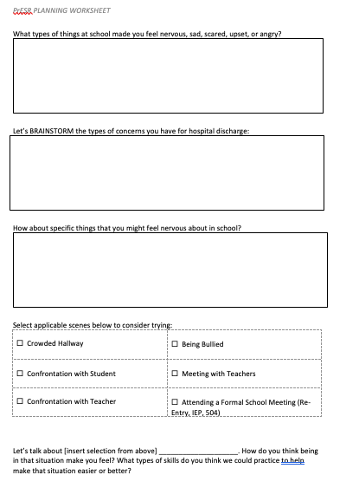

Slide 9

Welcome to PrESR
Practice session
Select session
back
help
exit
This Photo by Unknown Author is licensed under CC BY-SA

Slide 10
Choose skill
Affect Regulation
Problem Solving
Cognitive Restructuring
back
help
exit
This Photo by Unknown Author is licensed under CC BY-SA

Slide 11
Affect regulation
Crowded Hallway
Bullying
Meeting with Teacher
Re-Entry Meeting
Confrontation with Peer
Confrontation with Teacher
back
help
exit
This Photo by Unknown Author is licensed under CC BY-SA

Slide 12
Affect regulation
Meeting with Teacher
Crowded Hallway
Meeting with Teacher
Low
Medium
High
Re-Entry Meeting
Confrontation with Peer
Confrontation with Teacher
Please select intensity.
back
help
exit
This Photo by Unknown Author is licensed under CC BY-SA

Slide 13
Begin session
Please follow onscreen instructions.
back
help
exit
This Photo by Unknown Author is licensed under CC BY-SA

Slide 14
Session completed.
View session summary
back
help
exit
This Photo by Unknown Author is licensed under CC BY-SA

Slide 15
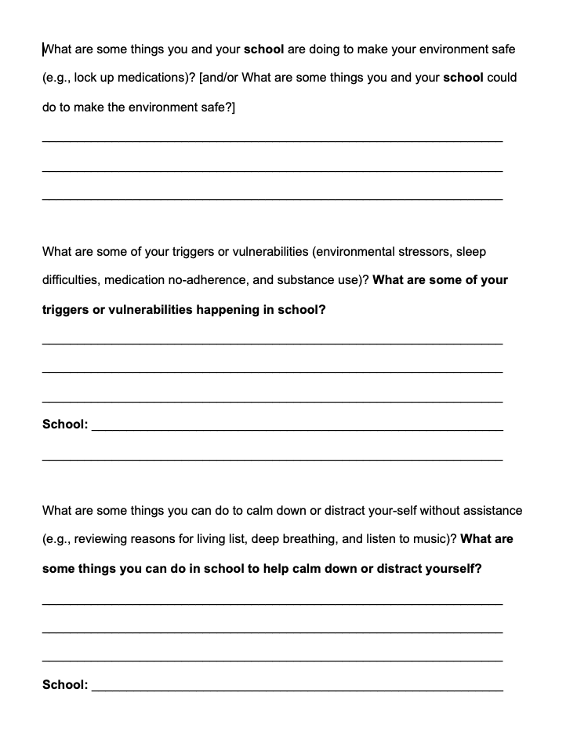
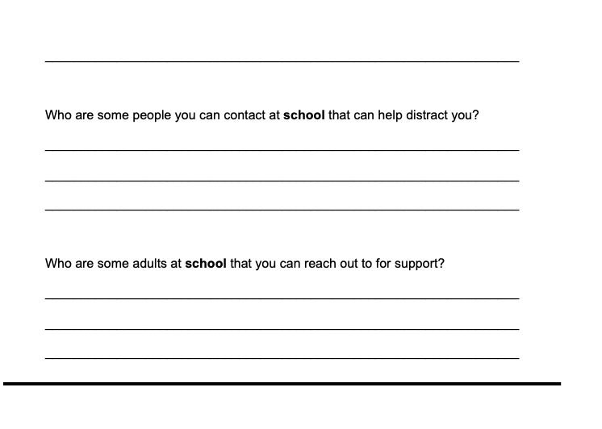
Safety Planning
Notes:
Sample Safety Planning Worksheet (includes questions from VR experiences to create)

Slide 16
Feedback
Improving the PrESR
This Photo by Unknown Author is licensed under CC BY-SA

