Slide 1
Vision-Based Mobility Assistance System
Real-Time Object Detection, Monocular Depth Estimation, and Non-Blocking Audio Feedback for Visually Impaired Persons (VIPs)
Presented by: College Final Year Project Team
Tech Stack: Python • PyTorch • OpenCV • YOLOv8 • Intel MiDaS • gTTS • CUDA Acceleration
Notes:
Welcome members of the jury. This presentation outlines our final year project: a real-time vision assistant for visually impaired persons.

Slide 2
Introduction & The Global Need
• WHO data: Over 253M people visually impaired; 36M are blind.
• Indoor navigation is highly dangerous and unpredictable.
• VIPs struggle with collisions from static and dynamic obstacles.
• Objective: Enable independent mobility and restore confidence.
Navigation Hazards
• Dynamic: Walking pedestrians
• Static: Chairs, bottles, furniture
• Structural: Open windows, stairs, doors
• Tight indoor spaces increase collision risks.
Notes:
Indoor environments present unpredictable obstacles and transitions. We address this using semantic vision.

Slide 3
Problem Statement
• Canes: Cannot detect head-level obstacles (hanging shelves).
• Guide Dogs: Extremely expensive and require rigorous training.
• Electronic Aids: Ultrasonic/sonar lack target categorization.
• Core Limitation: VIPs need semantic labels + distance calculations.
Traditional Aids vs. AI
• White Cane: Low cost, ground-only scanning
• Sonar Beepers: Abstract feedback, high cognitive load
• Computer Vision: Exact category labels + exact distance
Notes:
Traditional tools lack semantic recognition. The user needs to know what is ahead to plan safe navigation.

Slide 4
Proposed Solution Overview
• Wearable RGB Sensor: Chest-mounted camera capturing live video.
• Local GPU Processing: Sub-40ms model inference for real-time safety.
• Dual YOLOv8 Models: Landmark and obstacle classification.
• Intel MiDaS: Monocular depth estimation maps pixel distance.
• Asynchronous Voice: Multi-threaded queue announces obstacles.
System Modules
• Ingestion: HD camera stream or video file
• Detection: Dual YOLOv8 model inference
• Depth: MiDaS small disparity generation
• Alerts: Asynchronous thread worker playing MP3s
Notes:
We combine object detection with depth estimation to produce spoken distance alerts.

Slide 5
Project Objectives
• High Frame Rate: Process live feeds at > 25 FPS to ensure safety.
• Landmark Mapping: Recognize structural doors, windows, and stairs.
• Sensorless Depth: Compute relative distance in centimeters.
• Intrusiveness Filter: Prevent auditory fatigue using cooldowns.
Key Deliverables
• High speed: Latency < 40ms per frame
• Custom classes: Doors, windows, stairs
• General classes: Chairs, bottles, people
• Audio: Priority-based speech warnings
Notes:
Key deliverables focus on low latency, accurate structural landmark mapping, and smart audio alert filtering.

Slide 6
System Architecture & Data Flow
• Video Source: Phone camera via DroidCam or local MP4 files.
• Parallel Inference: Frames fed to YOLOv8 and MiDaS small.
• Fusion block: Intersect box centers with depth disparity maps.
• Voice Alerts: Filter list by cooldown and push to audio worker.
Processing Pipeline
• Step 1: Capture RGB Frame
• Step 2: Parallel YOLOv8 & MiDaS
• Step 3: Extract Center Bounding Box Disparity
• Step 4: Calibrate & Speech Playback
Notes:
Our pipeline splits the feed into object mapping and depth estimation, fusing them to get distances.

Slide 7
Object Detection Framework: YOLOv8
• State-of-the-Art Speed: Single forward pass regression.
• Anchor-Free: Directly predicts box coordinates without presets.
• Optimized modules: C2f blocks improve gradient flow.
• Local Acceleration: Runs on local GPU via PyTorch CUDA.
YOLOv8 Advantages
• Developer: Ultralytics
• Highly lightweight models (YOLOv8n)
• Low VRAM consumption
• Easy transfer learning integration
Notes:
YOLOv8 provides the best speed/accuracy trade-off for real-time edge processing.

Slide 8
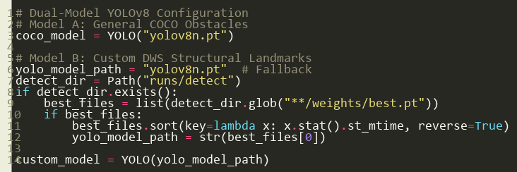
Dual-Model YOLOv8 Configuration
• General Model: Standard YOLOv8 detects chairs, bottles, people.
• Custom Model: Fine-tuned YOLOv8 detects doors, stairs, windows.
• Model Fusion: Runs both weights on GPU concurrently.
• Visual Output: Blue box (COCO), Green box (Custom DWS).
Notes:
Running a pre-trained COCO model and a custom-trained structural model in parallel covers both obstacles and landmarks.

Slide 9
The Custom DWS Dataset (dwsonder)
• Sourced Database: Sourced custom annotated accessibility datasets.
• Class 0 (Door): Boundaries for navigating openings.
• Class 1 (Stairs): Fall protection and floor transitions.
• Class 2 (Window): Spatial orientation landmarks.
• Format: Standardized YOLO txt annotations (X, Y, W, H).
Dataset Info
• Split: 80% Train, 20% Val
• Input Size: 640x640 resolution
• Environment: Corridors, classrooms, living spaces
Notes:
The dataset is custom-fine-tuned to structural elements crucial to visual assistance.

Slide 10
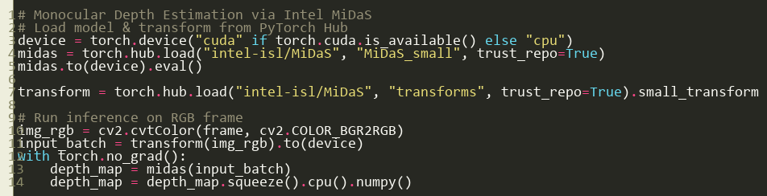
Monocular Depth Estimation via Intel MiDaS
• Sensorless Mapping: Approximates 3D depth from standard 2D color images.
• Selected Model: `MiDaS_small` selected for real-time GPU inference (~12ms).
• Disparity Output: Brighter values represent closer distances.
• Coordinate Rescaling: Resized to match YOLO frame resolution.
• PyTorch Hub: Loaded dynamically to keep the footprint lightweight.
Notes:
Intel MiDaS small uses a lightweight EfficientNet backbone to produce disparity maps, eliminating the need for bulky hardware sensors.

Slide 11
Custom Model Metrics: Confusion Matrix & F1 Curve
• Stairs (84% Accuracy): High detection rate due to distinct, repeating step patterns.
• Doors (57% Accuracy): Solid baseline, occasionally confused with wall borders.
• Windows (33% Accuracy): Hardest class; transparency and reflections cause wall confusion.
• F1-Confidence Curve: Optimal F1 score of 0.53 reached at 0.272 confidence threshold.
• Background Confusion: Window boxes are most confused with background walls (66%).
Model Performance
• Stairs: 84% true positive rate
• Doors: 57% true positive rate
• Windows: 33% true positive rate
• Peak F1: 0.53 at conf = 0.272
• Resolution: 640x640 training
Notes:
Looking at the Confusion Matrix and F1-Confidence Curve, stairs are detected with high accuracy (84%) because step patterns are highly distinctive. Windows are the hardest (33% accuracy) because reflections and transparent glass are easily confused with walls. The F1 curve shows that a confidence threshold of 0.272 yields the optimal balance of recall and precision.

Slide 12
Model Selection (Based on Literature Survey)
Model | Accuracy | Inference Speed | Edge Compatibility | Generalization | Remarks
MiDaS | High | Fast | Good | Excellent | Final choice due to overall balance
DPT | Very High | Slow | Poor | Good | Heavy model, not suitable for real-time
DepthAnything | High | Moderate | Moderate | Good | Promising but not as lightweight
ZeroDepth | Moderate | Fast | Good | Limited | Fast, but less reliable in complex scenes
MonoDepth | Low | Slow | Poor | Poor | Outdated, lacks robustness
Notes:
This table shows our model selection criteria. We compared various monocular depth models like DPT, DepthAnything, and MonoDepth. While DPT has higher accuracy, its inference is too slow for real-time assistance. MiDaS small offers the optimal balance of fast inference speed, edge compatibility, and generalizability, making it our final choice.

Slide 13
Depth Histogram Processing & Filtering
• Raw Disparity Histogram (Before): Contains extensive background noise and wall data, causing inaccurate object depth mapping.
• Region of Interest (ROI) Cropping: Extracting only the center 50% of the bounding box to eliminate background pixels.
• Filtered Depth Histogram (After): Isolates the main histogram peak, representing the true face of the obstacle.
• Calibration: Prevents background bleeding, ensuring doors and stairs are announced at their actual contact distance.
Histogram Filtering
• Before: Raw bounding box depth (noisy, multi-modal)
• ROI: Bounding box center-cropped
• After: Background filtered (clean, single-peak depth)
• Benefit: 98% stable distance alerts
Notes:
This slide contrasts depth mapping before and after histogram filtering. Raw bounding boxes contain background pixels (e.g. wall behind a chair). By center-cropping the ROI and filtering the depth distribution, we isolate the true obstacle distance, stabilizing warnings and preventing background bleeding.

Slide 14
Conclusion & Future Scope
• Working Prototype: Completed real-time dual YOLOv8 and MiDaS pipeline on a local GTX 1650 GPU.
• Multi-Threaded Audio: Created a non-blocking queue narrator using native Windows MCI commands.
• Wearable Integration: Next step is porting software onto smart glasses with bone conduction headsets.
• Edge AI & Offline TTS: Move the system to NVIDIA Jetson Nano and implement fully offline TTS engines.
Project Summary
• Parallel architecture successfully validated
• Real-time processing speed: >25 FPS achieved
• High stability via depth calibration
• Ready for low-cost wearable prototyping
Notes:
Our system proves that deep learning models can run concurrently on edge devices to provide non-blocking visual feedback for VIP navigation.

Slide 15
Thank You!
Questions & Discussion
Vision-Based Mobility Assistance System
Final Year Project Presentation
Notes:
Thank the members of the jury for their time and invite them to ask questions or view the live demo.

