Slide 1


M.Tech Program
Advanced Industry Integrated Programs
Jointly offered by University and LTIMindTree
AI-Powered Healthcare System for Diabetes Risk Prediction
and Lifestyle Management
Calibri body -36
Team Member
NIVYASREE.C
Knowledge partner | Implementation partner

Slide 2
Project Title - Calibri body 18
Introduction…. Calibri body -36
Problem: The global rise in diabetes cases presents a significant healthcare challenge. Early diagnosis and proactive management are crucial to prevent severe complications.
Our Mission: To create a comprehensive, AI-powered system that not only predicts diabetes risk but also empowers users with personalized lifestyle management tools.
Impact: Shifting from reactive treatment to a proactive, predictive healthcare model.

Slide 3
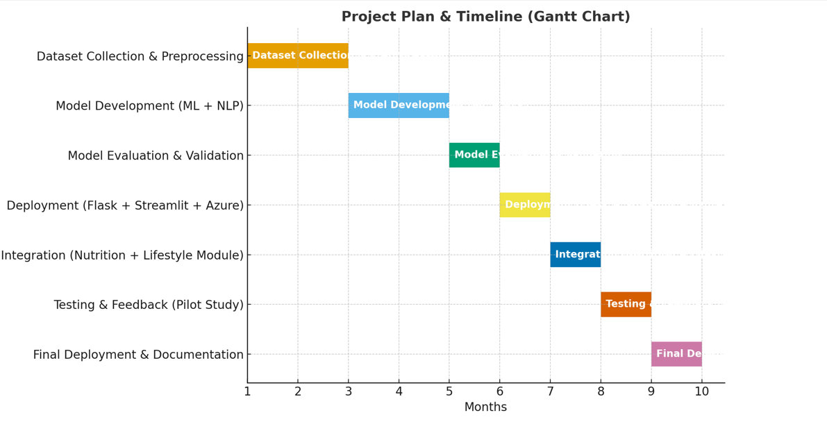
Project Title - Calibri body 18
Objective…. Calibri body -36

Slide 4
Project Title - Calibri body 18
Literature Review…. Calibri body -36
TITLE | Methodology | Inference
Web-Based Diabetes Prediction System Using Machine Learning Year: 2022 (IEEE Conference publication) | Dataset: Pima Indians Diabetes Dataset (~768 samples, 8 features). Preprocessing: Data cleaning, removal of zero values, correlation analysis. Models used: SVM, Decision Tree, Random Forest, Naive Bayes. Data split: 75% training, 25% testing. Evaluation: Confusion matrix and accuracy score. Deployment: Flask web app for user interaction ------ ML Models: Random Forest, SVM, Naive Bayes, Decision Tree on the Pima dataset. - Web Framework: Flask for a simple web application. - Focus: Pure classification (Diabetic/Non-Diabetic). | Random Forest gave the best accuracy (96.6%) for diabetes prediction. System predicts binary outcome (diabetic vs. non-diabetic). Demonstrates feasibility of ML in diabetes prediction but limited by small dataset and lack of lifestyle factors --- Achieves high prediction accuracy (Random Forest: 96.6%). Proves the effectiveness of ML for medical diagnosis. Strengths: Simplicity, strong benchmark results. Limitations: Limited dataset, no real-time data, basic frontend, no personalized feedback.

Slide 5
Project Title - Calibri body 18
Literature Review…. Calibri body -36
TITLE | Methodology | Inference
Web-Based Diabetes Prediction System Using Machine Learning |  | Random Forest gave the best accuracy (96.6%) for diabetes prediction. System predicts binary outcome (diabetic vs. non-diabetic). Demonstrates feasibility of ML in diabetes prediction but limited by small dataset and lack of lifestyle factors

Slide 6
Project Title - Calibri body 18
Literature Review…. Calibri body -36
TITLE | Methodology | Inference
An Ensemble Learning and Machine Learning Approach for Predicting Diabetic Disease Year:2025 | Dataset: BRFSS Diabetes Health Indicators (253,680 records, 11 attributes). Preprocessing: Missing value imputation, outlier removal, encoding, normalization. Models: Logistic Regression, Random Forest, Adaptive Boosting, XGBoost (hyperparameter-tuned). Ensemble learning with AdaBoost + XGBoost as best perform | XGBoost achieved 87% accuracy, F1-score = 0.95. Robust for large, imbalanced datasets. Focused on algorithmic improvement, not deployment or recommendations. Strengths vs. Limitations Strengths : Personalized recommendations, NLP for nutrition, high accuracy, real-world deployment pipeline. Limitations :Small dataset may inflate accuracy, limited generalizability.

Slide 7
Project Title - Calibri body 18
Literature Review…. Calibri body -36
TITLE | Methodology | Inference
An Ensemble Learning and Machine Learning Approach for Predicting Diabetic Disease Published in: 2024 By: Chidambaram M, Narayanan M, Sankar C, Santhosh J | Algorithms: Employs Logistic Regression (LR), Random Forest (RF), Adaptive Boosting (AB), and XGBoost on the BRFSS Diabetes Health Indicators dataset (253,680 records). Preprocessing: Handles missing values, removes outliers, and applies feature encoding and normalization. Ensemble Learning: Uses Adaptive Boosting to combine models and hyperparameter tuning with GridSearchCV for XGBoost optimizatio | XGBoost achieved the highest performance with 87% accuracy and an F1-score of 0.95, outperforming other models (AB: 85.5%, RF: 79.3%). The study demonstrates that advanced ensemble methods like XGBoost are highly effective for diabetes prediction on large, imbalanced datasets. Strengths: High predictive accuracy, robust handling of a large dataset. Limitations: Focused purely on prediction accuracy; lacks a deployed application or user-facing recommendations. Future work will explore incorporating broader health features and other cutting-edge algorithms.

Slide 8
Project Title - Calibri body 18
Literature Review…. Calibri body -36
TITLE | Methodology | Inference
Diabetes Prediction and Classification Using Machine Learning and Deep Learning: A Chatbot-Based Approach Year:2025 | Dataset: Public diabetes dataset with 8 clinical features (glucose, BMI, insulin, BP, age, pregnancies, skin thickness, pedigree function) - Preprocessing: Feature scaling, normalization, missing value handling, outlier detection, correlation analysis - Models: Random Forest, XGBoost, LSTM (deep learning) - Integration: Tkinter-based chatbot GUI with SQLite database for patient history | The paper’s system achieved 99% training accuracy and 97% testing accuracy with LSTM (outperforming RF at 94% and XGBoost at 96%). It classifies into Type 1, Type 2, or Non-Diabetic, provides chatbot-based lifestyle/medication recommendations, and tracks patient history. However, it is limited to desktop use (Tkinter + SQLite) and not cloud-deployable, reducing scalability compared to our project

Slide 9
Project Title - Calibri body 18
Literature Review…. Calibri body -36
TITLE | Methodology | Inference
Diabetes Prediction and Classification Using Machine Learning and Deep Learning: A Chatbot-Based Approach Year:2025

Slide 10
Project Title - Calibri body 18
Literature Review…. Calibri body -36
TITLE | Methodology | Inference
Diabetes Predicting mHealth Application Using Machine Learning Year: (2017 IEEE WIECON-ECE) | Dataset: Survey data (191 participants, Bangladesh), features: age, BMI, gender, family diabetic history Preprocessing: Survey analysis, Pearson correlation, Chi-square test Model: Naive Bayes classifier Deployment: Android mHealth app (“Diabetes Predictor”), developed in Java & Android Studio | he mHealth app classified users into Diabetic, Prediabetic, or Nondiabetic categories. Accuracy reached only 64% due to small dataset and limited features. Useful for basic self-assessment and awareness, but lacks medical depth, personalization, and large-scale validation.

Slide 11
Project Title - Calibri body 18
Literature Review…. Calibri body -36
TITLE | Methodology | Inference
Personalized Diabetes Suggestion Using ML Algorithms and Cloud Technology Year: 2024 By: Vura Venkata Naga Sai Bhargav Rohith, Sathwik kumar Rudroju, Satya Chetan Kamisetty, P Balamurugan | Algorithms: Employs SVM, ANN, Decision Tree, and an Ensemble classifier on the PIMA Indian Diabetes dataset. Cloud Integration: Uses a cloud server for data storage, model training, and real-time predictions. Architecture: A three-tier system for data sensing, sharing, and personalized diagnostics. Data is preprocessed to handle missing values and inconsistencies before model training. | chieves a moderate accuracy of 52.86% using the Ensemble method, which outperformed the individual models (SVM: 50.4%, ANN: 49.9%, Decision Tree: 49.7%). The system provides personalized nutrition recommendations based on the predicted diabetes risk. Strengths: Integrates ML with cloud tech for scalable, personalized healthcare. Limitations: The overall model accuracy is relatively low, indicating significant room for improvement in the predictive model. Future work could focus on hyperparameter tuning, using larger/more diverse datasets, and integrating real-time data from IoT devices.

Slide 12
Project Title - Calibri body 18
Summary of Literature…. Calibri body -36
1. An Ensemble Learning and Machine Learning Approach for Predicting Diabetic Disease (2024, IEEE ICIICS)
Research Gap: Focused on algorithm benchmarking only, no deployment, no lifestyle/nutrition personalization.
2. Diabetes Prediction and Classification Using Machine Learning and Deep Learning: A Chatbot-Based Approach (2025, ICICI)
Research Gap: Desktop-only, local database (SQLite), no cloud scalability, no nutrition integration, no real-world deploymen
3.Diabetes Predicting mHealth Web-Based Applications (2024)
Research Gap: Most lacked personalization, nutrition/lifestyle integration, explainability, and secure cloud deployment.
4. Diabetes Predicting mHealth Application Using Machine Learning (2017, IEEE WIECON-ECE)
Research Gap: Very low accuracy, limited features, no nutrition or advanced ML integration, not scalable

Slide 14
Project Title - Calibri body 18
MODULAR TO COVER
MODULAR | WEEKS | TASK
Module 1 | WEEK1 | Data Acquisition & Preprocessing
Module 2 | WEEK2 | Train Machine Learning Models
Module 3 | WEEK3 | Advanced Models & NLP
Module 4: | WEEK4 | Risk Prediction & Stratification
Module 5 | WEEK5 | Recommendation Engine
Module 6 | WEEK6 | Deployment
Module 7 | WEEK7 | Testing & Validation
Module 8 | WEEK8 | Monitoring & Maintenance

Slide 15
Project Title - Calibri body 18
Additional Information…. Calibri body -36
System Architecture Overview
Input Layer: Clinical parameters (Glucose, BMI, BP, Age, Family history) + Meal logs (text).
Processing Layer:
Data cleaning and preprocessing.
NLP (BERT) for meal text → nutrition values.
ML models (Random Forest, XGBoost) for risk prediction.
Output Layer: Risk classification (Low/Medium/High), lifestyle & dietary recommendations.
Deployment Layer: Streamlit frontend + Azure AD authentication + Dockerized deplo

Slide 16
Project Title - Calibri body 18
Additional Information…. Calibri body -36

Slide 17
Project Title - Calibri body 18
Modules to cover…. Calibri body -36
Module 1 calibri 28

Slide 18
Project Title - Calibri body 18
Module name - Calibri body -36
Subtopic - Calibri body -28
Content Calibri body -28
Calibri body -28

