Slide 1
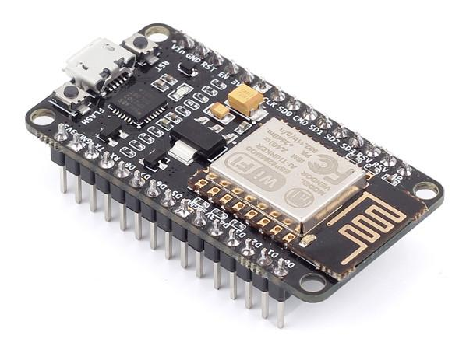
HOME AUTOMATION and INTERNET OF THINGS
NDUBUISI IWUALA
KINGSLEY ASONYE
Room 1088
Easc building
December 5th , 2018

