Slide 1
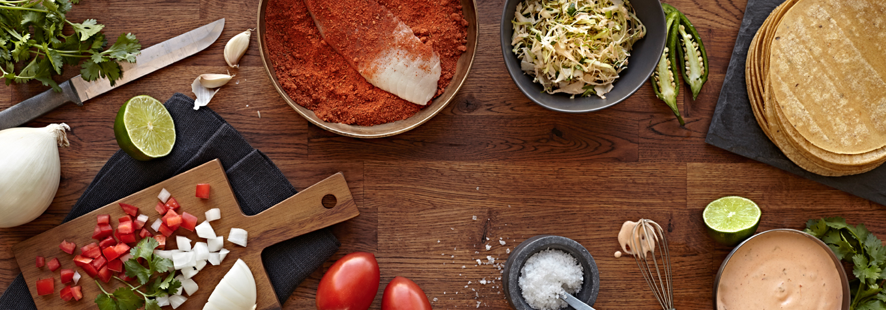
Cook'It

Slide 2



History of Cook'It
October 2015
From idea to concept
April 2016
"Stand up and create your thing" by Carrefour
May 2016
Coddity contest
December 2017
Innovation Hub Barcelona

Slide 3
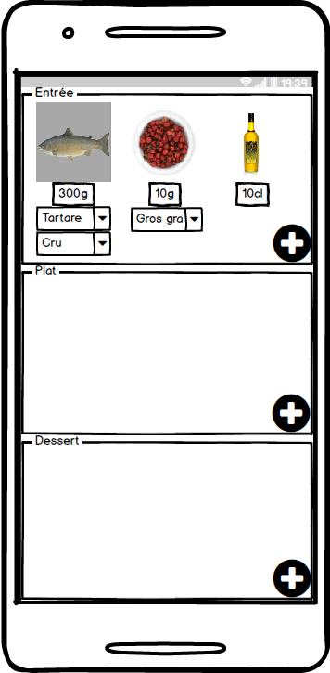
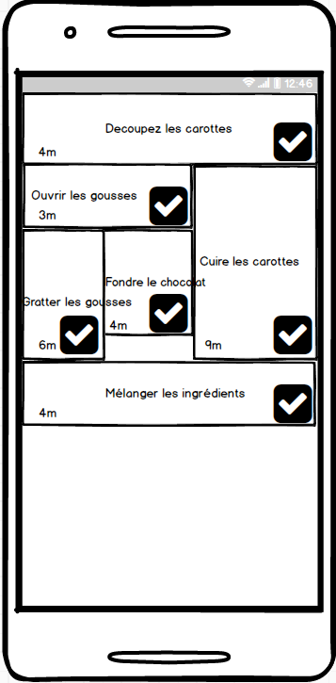
How does it works ?

Slide 4




Why you should use it ?

Slide 5




How is it powered ?

Slide 6
Thanks for your attention

